Slide 1
Chapter 8: Statistical intervals for a single sample
LEARNING OBJECTIVES
1. Introduction
2. Confidence interval for the population mean μ
If σ known.
If σ not known.
3. Confidence interval for the population proportion p.

Slide 2
Introduction
A point estimate is a single number, used to estimate an unknown population parameter
A confidence interval provides additional information about variability
Lower
Confidence
Limit
Upper
Confidence
Limit
Point Estimate
Width of confidence interval

Slide 3
Introduction
Random Sample
I am 95% confident that μ is between 40 & 60.
Population
Mean
x = 50
(mean, μ, is unknown)
Sample

Slide 4
Confidence interval for μ
A confidence interval estimate for μ with 100(1- α)% confidence level is an interval of the form l ≤ μ ≤ u, where l and u are computed from the sample data, such that:
P(l ≤ μ ≤ u) = 1 – α,
where l: lower limit; u: upper limit.
Question: How to find l and u?
Solution: Use Central limit theorem.

Slide 5
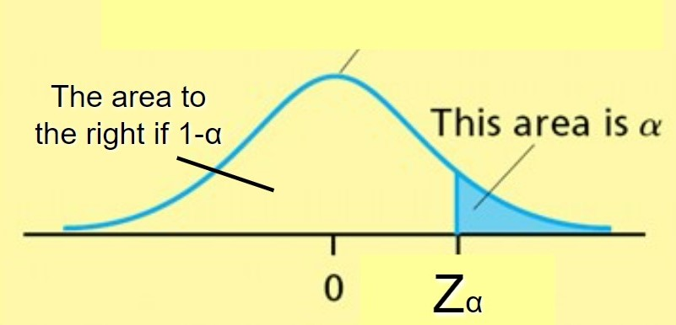
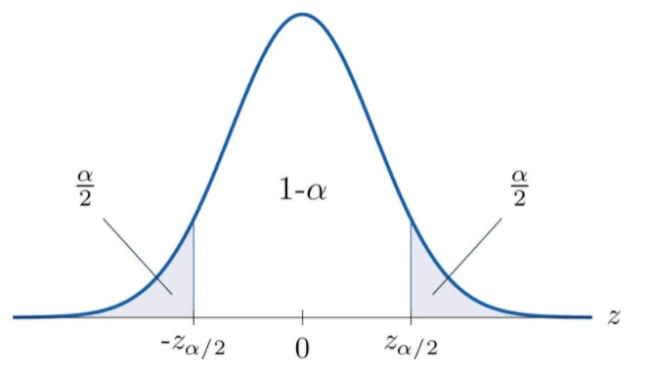
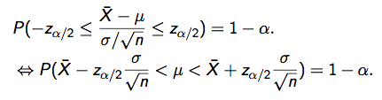

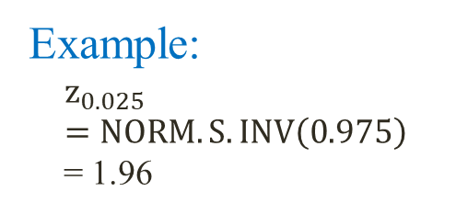

Confidence interval for μ (σ is known)
Critical value $z_{α} (or a percentage point)$is the value such that $P\left(Z>z_{α}\right)=α.$
We have:
$$z_{α}=NORM.S.INV(1−α)$$
Example:
$$z_{0.025}=NORM.S.INV\left(0.975\right)$$
= 1.96
Remark: If σ is known then by CLT, we have:

Slide 6
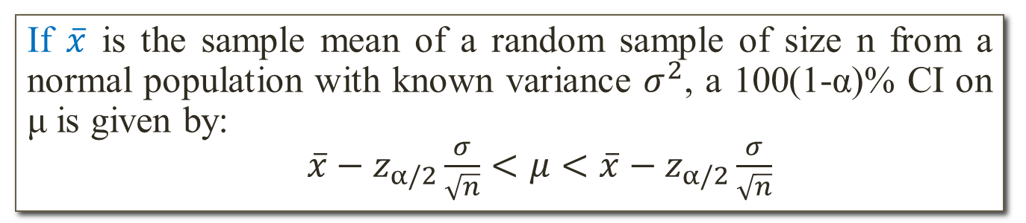
Confidence interval for μ (σ is known)
Theorem (C.I. for μ if σ is known)
If $\overline{x}$ is the sample mean of a random sample of size n from a normal population with known variance $σ^{2}$, a 100(1-α)% CI on μ is given by:
$\overline{x}−z_{α/2}\frac{σ}{\sqrt{n}}<μ<\overline{x}−z_{α/2}\frac{σ}{\sqrt{n}}$
Example: In a sample of 36 randomly selected women, it was found that their mean height was 65.3 inches. From previous studies, it is assumed that the standard deviation of all women heights σ = 2.5 (in). Construct a 90% confidence interval for the mean height of all women.

Slide 7
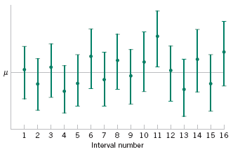
Confidence interval for μ (σ is known)
Figure: Repeated construction of a confidence interval for μ.

Slide 8
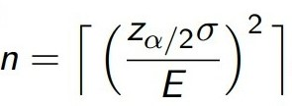
Confidence interval for μ (σ is known)
Remark:
The error of estimation:
To reduce the error, we can increase sample size n.
If we want to be 100(1-α)% confident that the error will not exceed a specified amount E the required sample size should be
Example: A nurse at a local hospital is interested in estimating the birth weight of infants. How large a sample must she select if she desires to be 98% confident that the true mean is within 4 ounces of sample mean? Assume that the standard deviation of the birth weights is known to be 6
ounces.

Slide 9
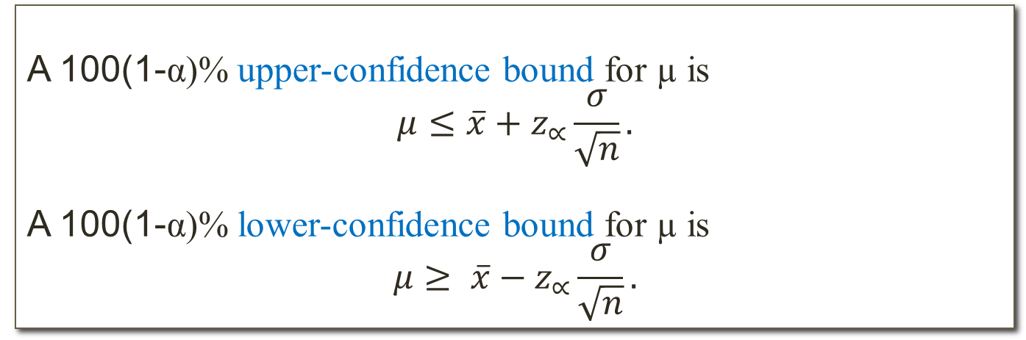
Confidence interval for μ (σ is known)
One-sided Confidence interval for μ if σ known
A 100(1-α)% upper-confidence bound for µ is
$$μ≤\overline{x}+z_{∝}\frac{σ}{\sqrt{n}}.$$
A 100(1-α)% lower-confidence bound for µ is
$$μ≥ \overline{x}−z_{∝}\frac{σ}{\sqrt{n}}.$$
Example: The diameter of holes for a cable harness is known to have a normal distribution with σ = 0.01 inch. A random sample of size 15 yields an average diameter of 1.5 inch. Find a 98% lower-confidence bound for the population mean.

Slide 10
Confidence interval for μ (σ is unknown)
Question: What if we do not know the population standard deviation σ?
We need to replace the population standard deviation σ by a sample standard deviation s.
Use t-distribution instead of normal distribution.
Question: What is t-distribution?

Slide 11
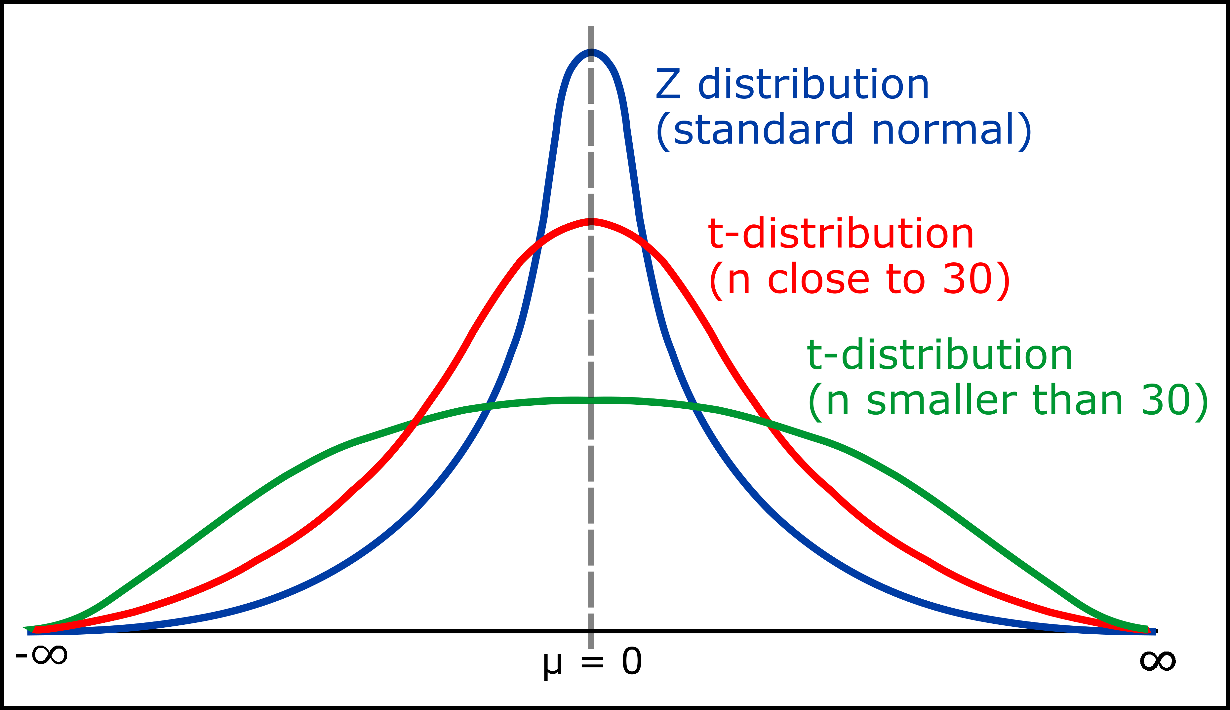
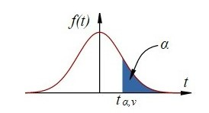
Confidence interval for μ (σ is unknown)
Student t-distribution
The shape is similar to standard normal distribution.
There is a degree of freedom df = an integer
2. Critical value $t_{\text{α};df}=T.INV.2T$(2α,df)
Example: $t_{0.025;9}=T.INV.2T$(0.05;9) = 2.262

Slide 12
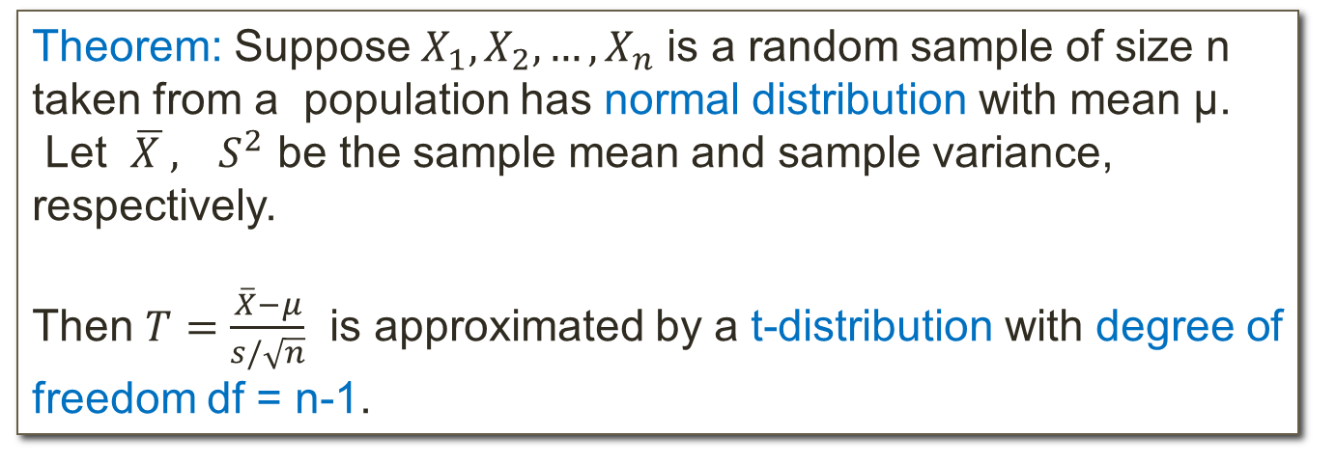
Confidence interval for μ (σ is unknown)
Theorem: Suppose $X_{1},X_{2},…,X_{n}$ is a random sample of size n taken from a population has normal distribution with mean µ.
Let $\overline{X },{ S}^{2}$ be the sample mean and sample variance, respectively.
Then $T=\frac{\overline{X}−μ}{s/\sqrt{n}}$ is approximated by a t-distribution with degree of freedom df = n-1.

Slide 13
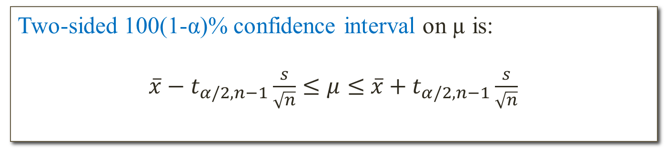
Confidence interval for μ (σ is unknown)
Two-sided 100(1-α)% confidence interval on µ is:
$\overline{x}−t_{α/2,n−1}\frac{s}{\sqrt{n}}≤μ≤$ $\overline{x}+t_{α/2,n−1}\frac{s}{\sqrt{n}}$
Example: The distribution of weights of all products of a company has a normal distribution. A random sample of products has the following weights (in kg):
1.9 2.0 2.0 2.1 1.8 2.2 1.8
Construct a 95% confidence interval for the true average weight of all products.

Slide 14
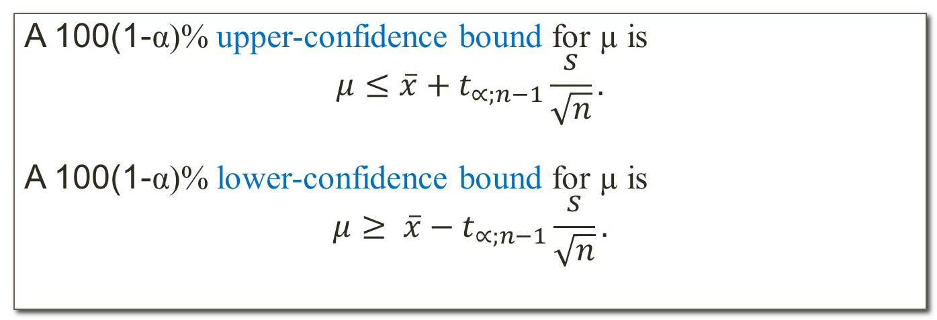
Confidence interval for μ (σ is unknown)
A 100(1-α)% upper-confidence bound for µ is
$$μ≤\overline{x}+t_{∝;n−1}\frac{s}{\sqrt{n}}.$$
A 100(1-α)% lower-confidence bound for µ is
$$μ≥ \overline{x}−t_{∝;n−1}\frac{s}{\sqrt{n}}.$$
Example (continues the previous example):
Construct a 95% lower-confidence bound for the average weight of all products.

Slide 15
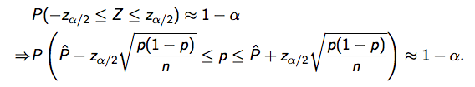
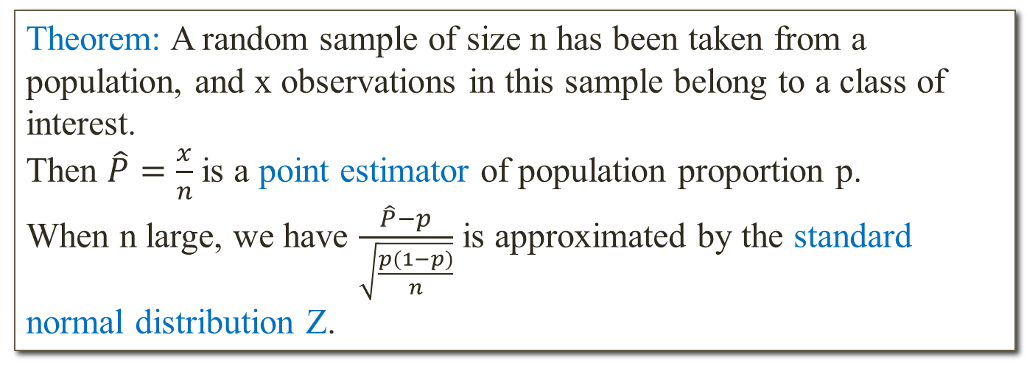
Confidence interval for p
Theorem: A random sample of size n has been taken from a population, and x observations in this sample belong to a class of interest.
Then $\hat{P}=\frac{x}{n}$ is a point estimator of population proportion p.
When n large, we have $\frac{\hat{P}−p}{\sqrt{\frac{p(1−p)}{n}}}$ is approximated by the standard normal distribution Z.
We have:

Slide 16
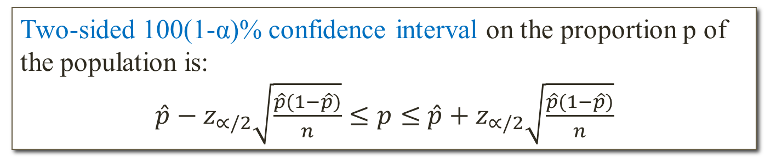
Confidence interval for p
Two-sided 100(1-α)% confidence interval on the proportion p of the population is:
$\hat{p}−z_{∝/2}\sqrt{\frac{\hat{p}(1−\hat{p})}{n}}≤p≤$ $\hat{p}+z_{∝/2}\sqrt{\frac{\hat{p}(1−\hat{p})}{n}}$
Example: Of 1000 randomly selected cases of lung cancer, 750 resulted in death within 10 years.
Calculate a 95% two-sided confidence interval of the death rate from lung cancer.

Slide 17
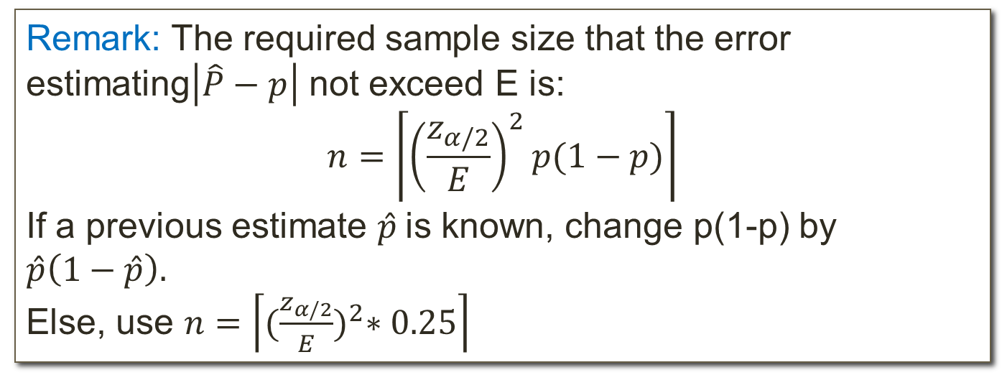
Confidence interval for p
Remark: The required sample size that the error estimating$\left|\hat{P}−p\right|$ not exceed E is:
$$n=\left\lceil {\left(\frac{z_{α/2}}{E}\right)}^{2}p(1−p)\right\rceil$$
If a previous estimate $\hat{p}$is known, change p(1-p) by $\hat{p}\left(1−\hat{p}\right).$
Else, use $n=\left\lceil {(\frac{z_{α/2}}{E})}^{2}∗0.25\right\rceil$
Example: (continues the previous example)
What sample size is needed to be 95% confident that the error in estimating the true value of p is less than 4%?

Slide 18
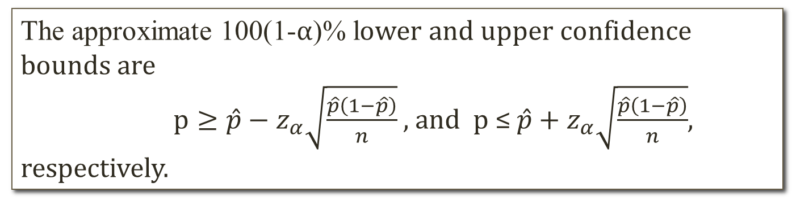
Confidence interval for p
One-sided confidence bound for p
The approximate 100(1-α)% lower and upper confidence bounds are
$p≥\hat{p}−z_{α}\sqrt{\frac{\hat{p}\left(1−\hat{p}\right)}{n}}$, and p ≤ $\hat{p}+z_{α}\sqrt{\frac{\hat{p}\left(1−\hat{p}\right)}{n}}$,
respectively.
Example: A survey of 250 homeless persons showed that 47 were veterans. Construct a 95% upper confidence bound for the proportion of homeless persons who are veterans.

