Slide 1
Chapter 9: Test of hypotheses for a single sample
LEARNING OBJECTIVES
1. Introduction.
2. Test of hypotheses for population mean μ,
If σ is known.
If σ is unknown.
3. Test of hypotheses for population proportion p.

Slide 2
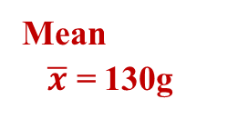
Introduction
Random Sample
Is there sufficient evident to support the claim that the true mean is 150g?
A company claims that the average weight of all product is 150g.
Mean
$\overline{x}$ = 130g
Sample

Slide 3
Introduction
Definition
A statistical hypothesis is a statement about the parameters of one or more populations.
Example:
1. A company claims that the mean weight all product is 150g.
This is a claim about the population mean: μ = 150g.
2. A university claims that the employment rate of its students after graduation is more than 94%.
→This is claim about the population proportion: p > 0.94.
Remark: We will use information from a random sample to make a decision whether the claim is acceptable

Slide 4
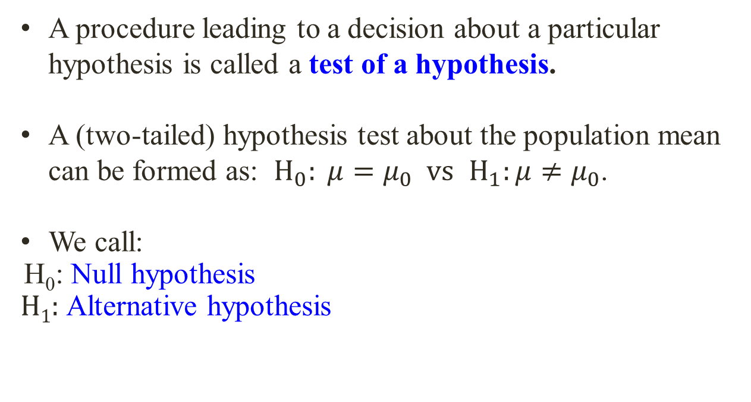
Introduction
A procedure leading to a decision about a particular hypothesis is called a test of a hypothesis.
A (two-tailed) hypothesis test about the population mean can be formed as: $H_{0}: μ=μ_{0} vs$ $H_{1}:μ≠μ_{0}$.
We call:
H₀: Null hypothesis
H₁: Alternative hypothesis

Slide 5
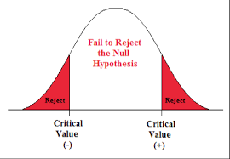
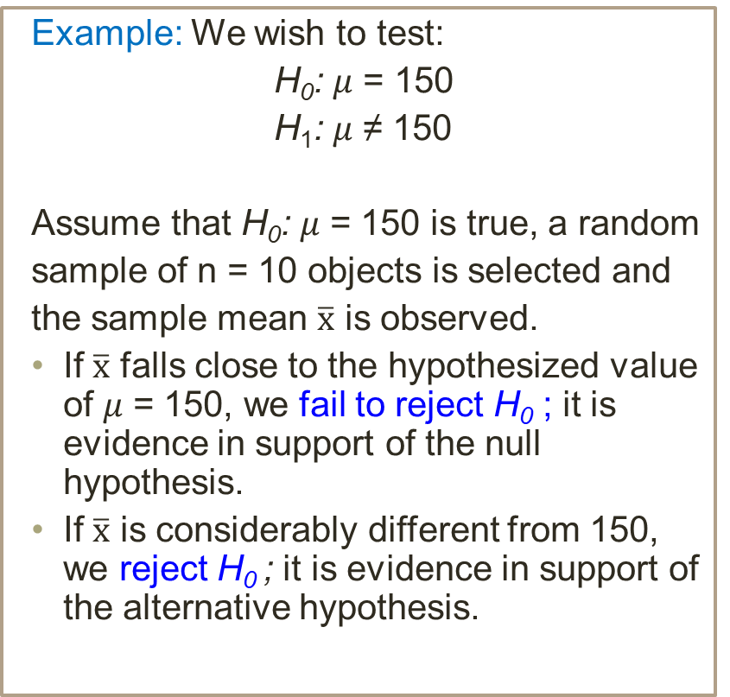
Introduction
Example: We wish to test:
H₀: 𝜇 = 150
H₁: 𝜇 ≠ 150
Assume that H₀: 𝜇 = 150 is true, a random
sample of n = 10 objects is selected and
the sample mean $\overline{x}$ is observed.
If $\overline{x}$ falls close to the hypothesized value of 𝜇 = 150, we fail to reject H₀ ; it is evidence in support of the null hypothesis.
If $\overline{x}$ is considerably different from 150, we reject H₀ ; it is evidence in support of the alternative hypothesis.

Slide 6
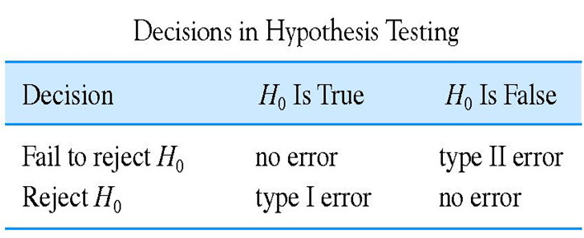
Types of error
α = P(type I error )
= P(reject H₀ when H₀ is true )
β = P(type II error)
= P(fail to reject H₀ when H₀ is false)

Slide 7
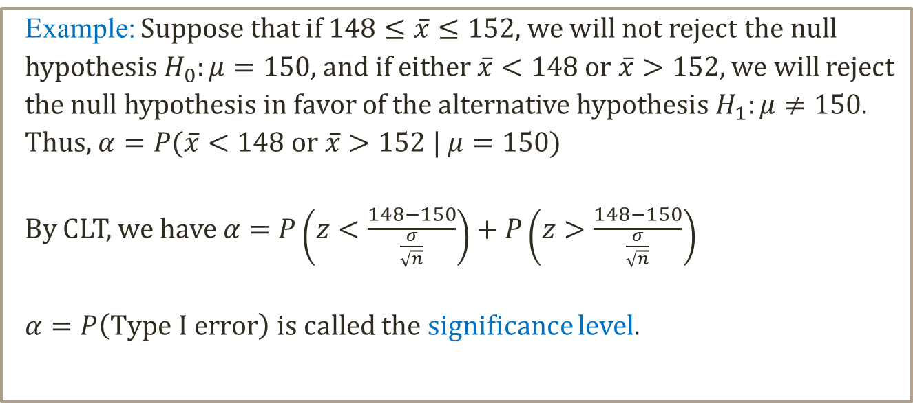

Test of hypotheses for population mean μ (σ is known)
Computing Probability of Type I error:
$$α=P\left(Type I error\right)=P\left(Reject H_{0} | H_{0} true\right)$$
$$=P\left(\overline{X }is in critical region \right| μ=μ_{0})$$
Example: Suppose that if $148≤\overline{x}≤152$, we will not reject the null
hypothesis $H_{0}:μ=150$, and if either $\overline{x}<148$or $\overline{x}>152$, we will reject
the null hypothesis in favor of the alternative hypothesis $H_{1}:μ≠150$.
Thus, $α=P(\overline{x}<148$or $\overline{x}>152$ | $μ=150)$
By CLT, we have $α=P\left(z<\frac{148−150}{\frac{σ}{\sqrt{n}}}\right)+P\left(z>\frac{148−150}{\frac{σ}{\sqrt{n}}}\right)$
$α=P\left(Type I error\right)$ is called the significance level.

Slide 8
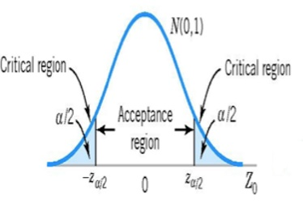
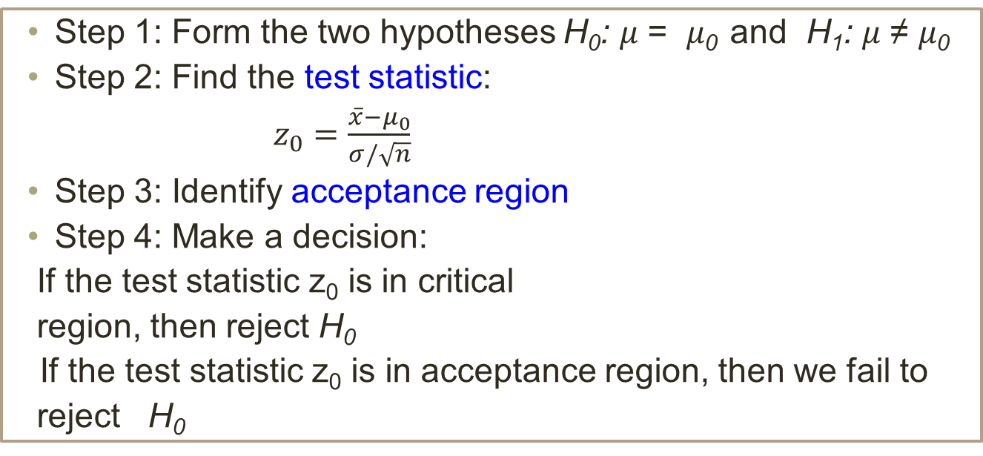
Test of hypotheses for population mean μ (σ is known)
Tradition method (two-tailed test)
Step 1: Form the two hypotheses H₀: 𝜇 = 𝜇₀ and H₁: 𝜇 ≠ 𝜇₀
Step 2: Find the test statistic:
$z_{0}=\frac{\overline{x}−μ_{0}}{σ/\sqrt{n}}$
Step 3: Identify acceptance region
Step 4: Make a decision:
If the test statistic z₀ is in critical
region, then reject H₀
If the test statistic z₀ is in acceptance region, then we fail to
reject H₀
Example: The heights of all adults in a community is known to have standard deviation of 0.03m. A random sample of 43 adults are collected, and their average height is 1.64m. Test the hypothesis that the true average height of all adults in the community is 1.7m, at α = 0.05.

Slide 9
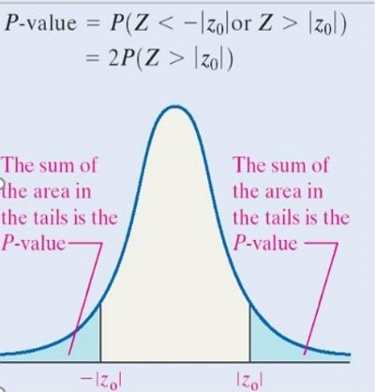
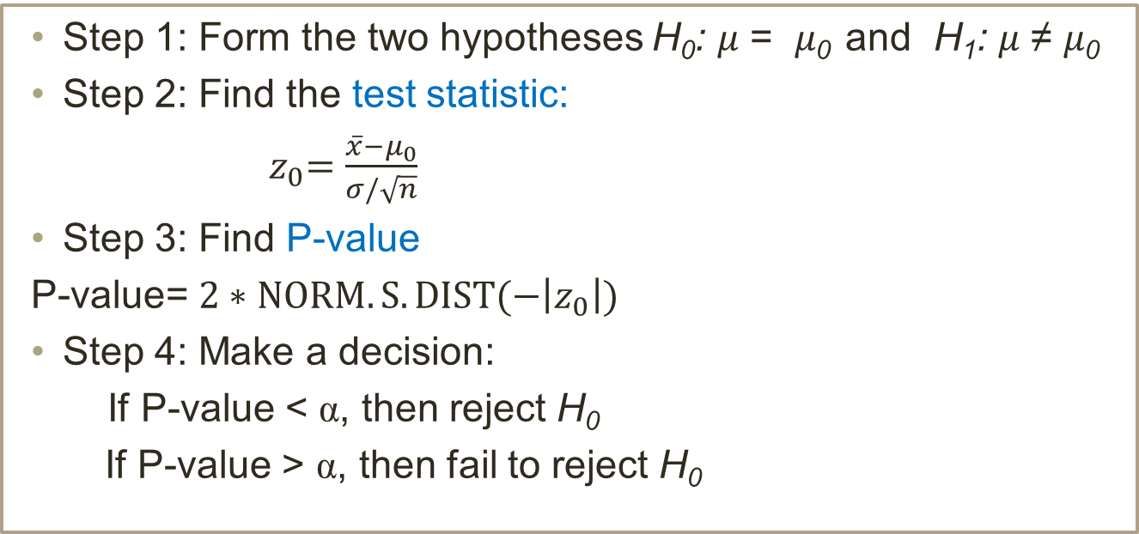
Test of hypotheses for population mean μ (σ is known)
P-value method (two-tailed test)
Step 1: Form the two hypotheses H₀: 𝜇 = 𝜇₀ and H₁: 𝜇 ≠ 𝜇₀
Step 2: Find the test statistic:
${ z}_{0}=\frac{\overline{x}−μ_{0}}{σ/\sqrt{n}}$
Step 3: Find P-value
P-value= $2∗NORM.S.DIST(−\left|z_{0}\right|)$
Step 4: Make a decision:
If P-value < α, then reject H₀
If P-value > α, then fail to reject H₀
Remark: The P-value is the smallest level of significance that would lead to rejection of the null hypothesis H₀ with the given data.

Slide 10

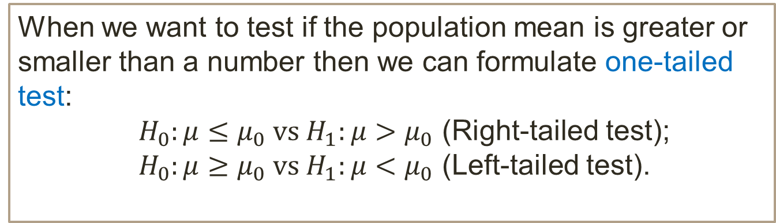
Test of hypotheses for population mean μ (σ is known)
One-tailed test
When we want to test if the population mean is greater or smaller than a number then we can formulate one-tailed test:
${ H}_{0}:μ≤μ_{0} vs H_{1}:μ>μ_{0}$ (Right-tailed test);
${ H}_{0}:μ≥μ_{0} vs H_{1}:μ<μ_{0}$ (Left-tailed test).
Remark:
The null hypothesis in these cases can be written as ${ H}_{0}:μ=μ_{0}$
The test statistic: $z_{0}=\frac{\overline{x}−μ_{0}}{σ/\sqrt{n}}$

Slide 11
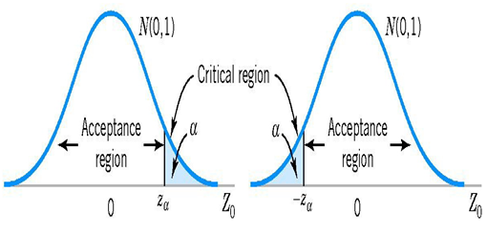
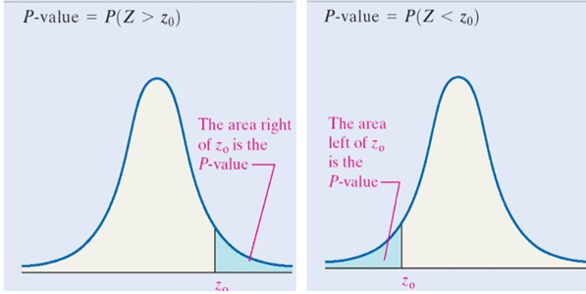


Test of hypotheses for population mean μ (σ is known)
Critical regions and P-values for one-tailed tests
$${ H}_{0}: μ=μ_{0}$$
$H_{1}: μ>μ_{0}$
$${ H}_{0}: μ=μ_{0}$$
$H_{1}: μ<μ_{0}$

Slide 12
Test of hypotheses for population mean μ (σ is known)
Example:
The heights of all adults in a community is known to have standard deviation of 0.03m. A random sample of 43 adults are collected, and the average height of this sample is 1.64m.
Use both tradition and P-value methods, at the significance level of 5%, test the hypothesis that the average height of all adults in the community is greater than 1.6m.

Slide 13

Test of hypotheses for population mean μ (σ is unknown)
Tradition method
Step 1: Form the two hypotheses H₀: 𝜇 = 𝜇₀ and H₁: 𝜇 ≠ 𝜇₀
Step 2: Compute the test statistic:
Step 3: Identify acceptance region, use t-distribution with df = n-1
Step 4: Make a decision:
If the test statistic t₀ is in critical region, then reject H₀
If the test statistic t₀ is in acceptance region, then fail to reject H₀
$$t_{0}=\frac{\overline{x}−μ_{0}}{s/\sqrt{n}}$$

Slide 14
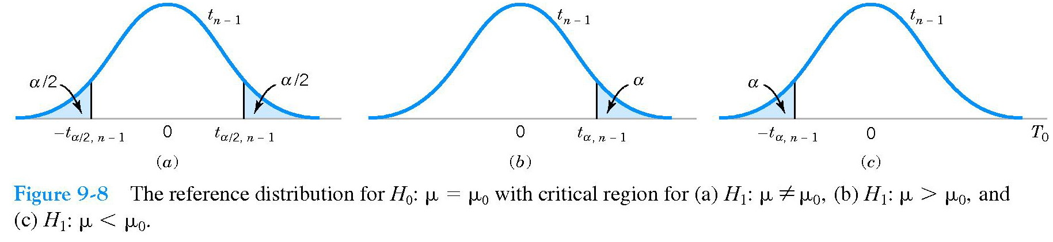
Test of hypotheses for population mean μ (σ is unknown)
Example: The heights of all adults in a community is known to have a normal distribution. A random sample are collected and the heights (in meters) are recorded as follows:
1.55 1.60 1.58 1.62 1.65 1.70 1.68
Test the hypothesis that the average height of all adults in the community is at most 1.60(m), at the significance level of 5%.

Slide 15
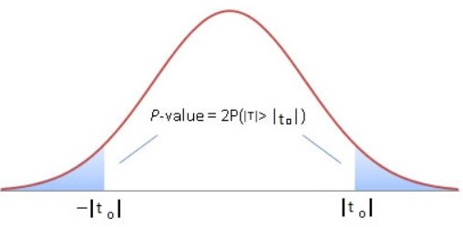
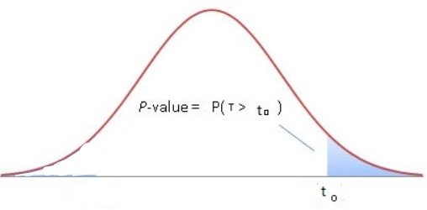
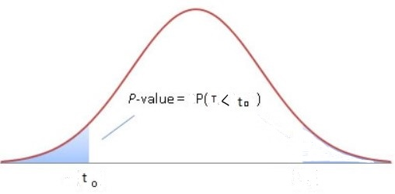
Test of hypotheses for population mean μ (σ is unknown)
P-value:
Two-tailed test
One-tailed test
One-tailed test
Example: Use P-value method to solve the previous
example.

Slide 16
Test of hypotheses for population proportion p
Tradition method
Step 1: Construct the two hypotheses H₀: p = p₀ and H₁ : p ≠ p₀
Step 2: Find the test statistic:
Step 3: Identify acceptance region, use Z = N(0,1).
Step 4: Make a decision:
If the test statistic is in critical region, then reject H₀
If the test statistic is in acceptance region, then fail to reject H₀

Slide 17
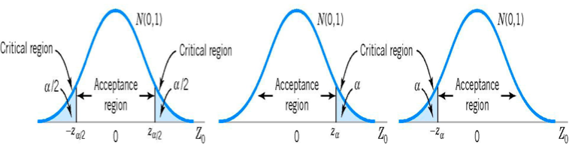
Test of hypotheses for population proportion p
Example: A company claims that the percentage of defective products is kept under control, that is less than 3%. In a random sample of 135 products it is found out that 6 of them are defective. Test the claim of the company at the significance level of 5%.

Slide 18
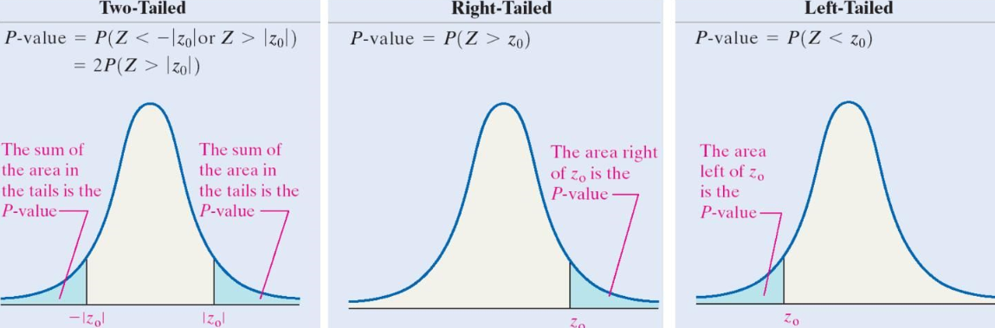
Test of hypotheses for population proportion p
P-value
Example: Use P-value method to solve the previous example.

