Slide 1

Model Inference
Deploying models with docker vLLM.
NCHC LLM
蔡顓澤
2026/05/20

Slide 2
Agenda
Pre-flight Check​
Model Review on Hugging Face​
Inference Framework - vLLM​
Resource Planning
Discussion
Setup with Docker vLLM
Demo​

Slide 3





Pre-flight Check: Before Deployment​
Model Review on HF
Inference Framework
Resource Planning
Key info:
model type
precision …
Choose:
vLLM / Ollama / Sglang
python / docker / k8s
Check:
Model supported
Arguments…
Request and limits:
GPU VRAM
CPU RAM

Slide 4
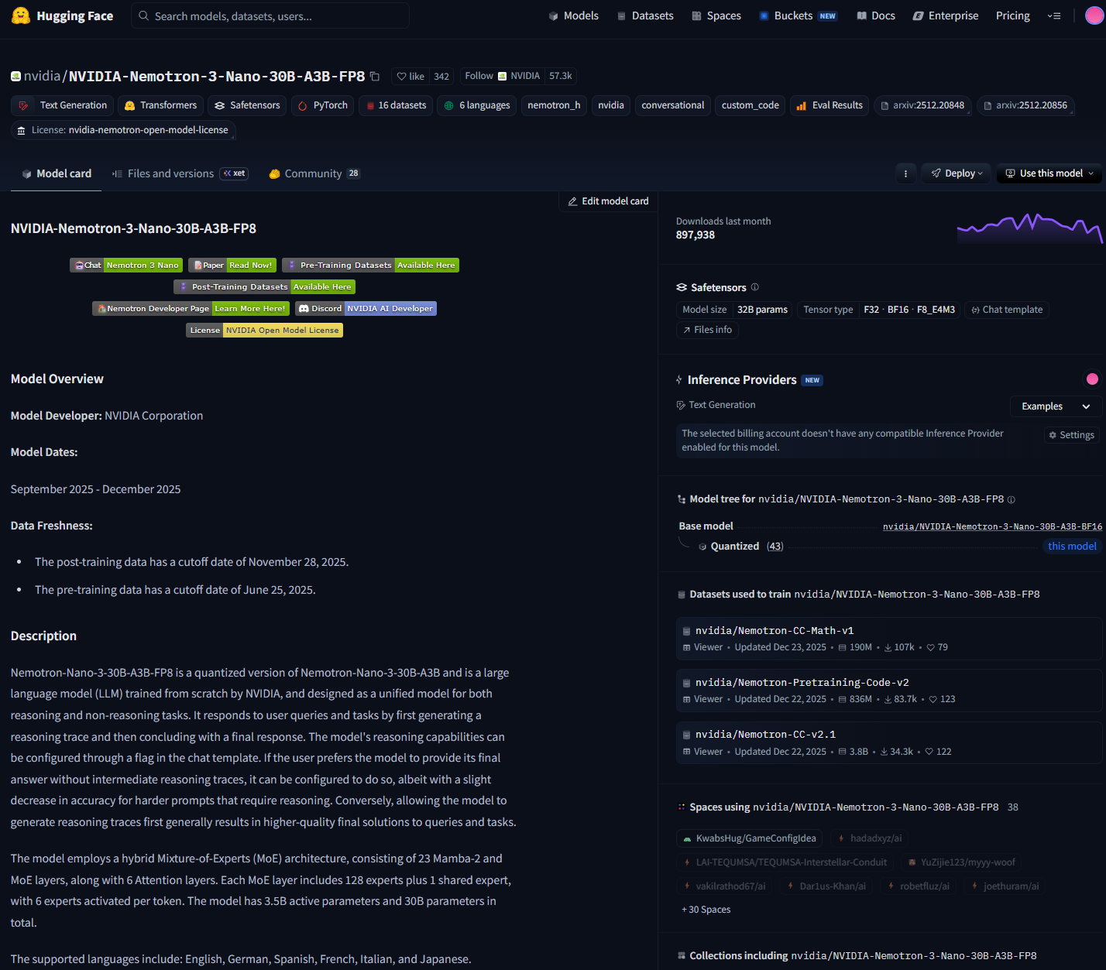
Hugging Face Model Review
Docs walkthrough:
Introduction​
Model card​
Model type​
Precision​
Max token length​
License / access requirements​
(HF token)
Architectures​ (for supported model)
Example: nvidia/NVIDIA-Nemotron-3-Nano-30B-A3B-FP8

Slide 5







vLLM Inference framework
PagedAttention
Continuous Batching
Quantization
vLLM's breakthrough in KV Cache management, reducing fragmentation and boosting batching.
Dynamically adding new requests to the batch without waiting for the entire batch to finish.
Native support for AWQ and FP8 to shrink VRAM footprint while maintaining high throughput.
Notes:
vLLM 的 PagedAttention 技術，更有效地管理 KV Cache ，在相同的 VRAM 下支援更高的併發請求

Slide 6
vLLM Inference framework
Docs walkthrough:
vLLM (check version)
Check supported model
Key serving parameters (Configuration/Engine Arguments)
Deploy popular models: vLLM Recipes

Slide 7

Resource Planning - GPU (VRAM) sizing
How to estimate?
Total VRAM = Memory_Weights + ( Memory_KV * Context_Length ) + Buffer
Memory_Weights = parameters * bytes_per_parms
Memory_KV = 2 * layers * heads * dimension * bytes_per_parms
Notes:
記憶體壓力的兩大來源

Slide 8
Resource Planning - GPU (VRAM) sizing
1.5×
How to estimate?
VRAM BUFFER FACTOR
Total VRAM = Memory_Weights * 1.5
Memory_Weights = parameters * bytes_per_parms
Memory_KV = 2 * layers * heads * dimension * bytes_per_parms
Moe Model -> VRAM BUFFER FACTOR = 1.8
Agentic / Vision / Audio Model -> VRAM BUFFER FACTOR = 2
Notes:
通常用1.5 倍做為預估緩衝

Slide 9
Resource Planning - Precision vs GPU Architecture
Model Precision | Bytes Per Parameter | Volta | Ampere | Ada Lovelace | Hopper | Blackwell
FP32 | 4 Bytes | O | O | O | O | O
FP16 | 2 Bytes | O | O | O | O | O
BF16 | 2 Bytes | X | O | O | O | O
FP8 | 1 Bytes | X | X | O | O | O
MXFP4 | 0.5 Bytes | X | X | X | O | O
NVFP4 | 0.5 Bytes | X | X | X | X | O
Architecture | Core GPU Models | GPU VRAM
Volta | V100 | 32 GB
Ada Lovelace | L40S | 48 GB
Ampere | A100 | 80 GB
Hopper | H100, H200 | 80 GB, 141 GB
Blackwell | B200, GB200 | 192 GB, 384GB

Slide 10
Resource Planning – H200 (VRAM 141GB)
Total VRAM = parameters * bytes_per_parms * 1.5
Model Precision | Bytes Per Parameter | Model parameters | Estimated VRAM
FP32 | 4 Bytes | 23 B | 138GB
FP16 | 2 Bytes | 46 B | 138GB
BF16 | 2 Bytes | 46 B | 138GB
FP8 | 1 Bytes | 94 B | 141GB
MXFP4 | 0.5 Bytes | 188 B | 141GB
NVFP4 | 0.5 Bytes | 188 B | 141GB

Slide 11
Discussion
Q1: FP16 (float16) vs BF16 (bfloat16)?
為了解決 FP16 容易溢位的問題（例如梯度計算約大於65,504 就會變成NaN）
BF16 犧牲了部分精度來換取更大的值域
BF16 的值域相當於 FP32，但精度比 FP16 略低（7-bit vs 10-bit）
在維持 VRAM 效率的同時，有較高的穩定性
Q2: 如果 GPU 太舊(老於 Ampere)無法佈署 BF16 的模型怎麼辦?
解法通常是把 BF16 的模型在佈署時指定 dtype 用 FP32
值域一樣，能確保不會溢位
代價是需要兩倍 VRAM

Slide 12
Discussion
Q3: LLM 推論是 Memory Bound (受限於硬體頻寬和記憶體大小)，目標是盡量放在VRAM
可能的解法 | Trade-off
降低 max-model-len 以縮減 KV Cache 佔用的 VRAM 頻寬與空間 | 喪失處理長文與複雜 Agent 的能力
用精度比較低的模型 | 需監控模型輸出品質與正確率
offload KV cache from GPU VRAM to CPU RAM | 延遲高
offload partial model weight from GPU VRAM to CPU RAM | 延遲高
用更高頻寬的硬體 | 花錢

Slide 13
Setup with Docker vLLM
Prerequisites​
GPU status: nvidia-smi
Install Docker (Install | Docker Docs)​
Install NVIDIA Container Toolkit (Installing the NVIDIA Container Toolkit)​
Prepare Hugging Face token for gated model
​Run Docker Container​
Add arguments and environment variables
Curl to verify ​
Notes:
libsndfile1 與 ffmpeg 是為了處理不同格式音訊（如 mp3/wav）進入 Whisper 的必要套件

Slide 14
Setup with Docker vLLM
Curl to verify
Check API server
curl -sS http://127.0.0.1:8000/health
Check Model name
curl -sS http://127.0.0.1:8000/v1/models
Test chat completion
curl -sS http://127.0.0.1:8000/v1/chat/completions \
-H "Content-Type: application/json" \
-d '{
"model": "nvidia/NVIDIA-Nemotron-3-Nano-30B-A3B-FP8",
"messages": [
{
"role": "user",
"content": "Say hello in one short sentence."
}
],
"max_tokens": 64,
"temperature": 0
}'
​Run Docker Container
docker run -d \
--name vllm \
--gpus all \
--ipc=host \
--network host \
-e VLLM_USE_FLASHINFER_MOE_FP8=1 \
-e VLLM_FLASHINFER_MOE_BACKEND=throughput \
-v /home/ubuntu/nvidia/NVIDIA-Nemotron-3-Nano-30B-A3B-FP8:/model:ro \
vllm/vllm-openai:v0.21.0-ubuntu2404 \
/model \
--served-model-name nvidia/NVIDIA-Nemotron-3-Nano-30B-A3B-FP8 \
--trust-remote-code \
--async-scheduling \
--kv-cache-dtype fp8 \
--tensor-parallel-size 1 \
--enable-auto-tool-choice \
--tool-call-parser qwen3_coder \
--reasoning-parser-plugin /model/nano_v3_reasoning_parser.py \
--reasoning-parser nano_v3

Slide 15
Setup with Docker vLLM
Curl to verify (extra)
curl -s http://127.0.0.1:8000/v1/chat/completions \
-H "Content-Type: application/json" \
-d '{
"model": "nvidia/NVIDIA-Nemotron-3-Nano-30B-A3B-FP8",
"messages": [
{"role": "user", "content": "What is the weather in Taipei? Use tool."}
],
"tools": [{
"type": "function",
"function": {
"name": "get_weather",
"description": "Get weather by city",
"parameters": {
"type": "object",
"properties": {
"location": {"type": "string"},
"unit": {"type": "string", "enum": ["celsius", "fahrenheit"]}
},
"required": ["location"]
}
}
}],
"tool_choice": "auto",
"max_tokens": 128,
"temperature": 0
}'

Slide 16
Questions & Discussion
Model Inference

