Slide 1

Sorting Visualization

Slide 2
Problem
Description:
This project’s objective is to develop an application based on OOP in order to visualize three sorting algorithms on array: selection sort, merge sort and shell sort.
Requirements:
On the main menu: title of the application, three types of sort algorithms for user to choose, help menu, quit
User must select a sort type in order to start the demonstration
Help menu show the basic usage and aim of the program
Quit exits the program. The application ask for confirmation before closing
In the demonstration:
A button for creating the array: user can choose to randomly create an array or input an array for the program
A button for starting the algorithm with the program
A button for starting the algorithm with the created array. The application should show clearly each step of the sorting
A back button for user to return to main menu at any time
A bar Chart for visualizing the created array
First, previous, go, next, last button and process slider bar for user to control the sorting process

Slide 3
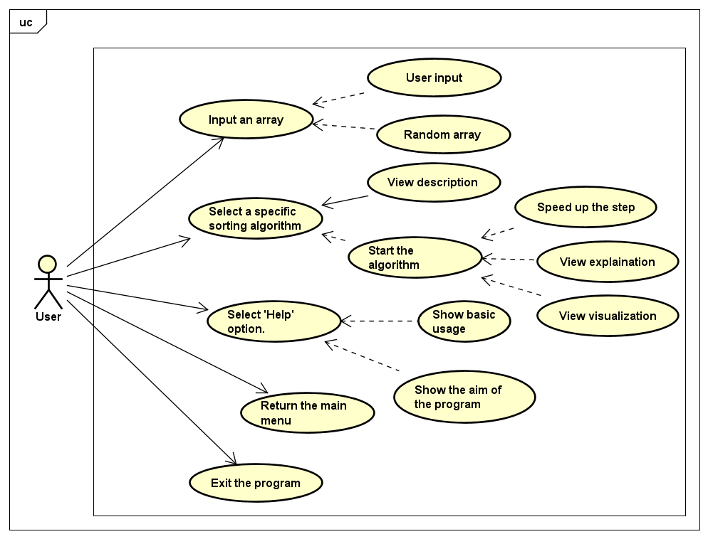
Use Case

Slide 4
General Class Diagram

Slide 5
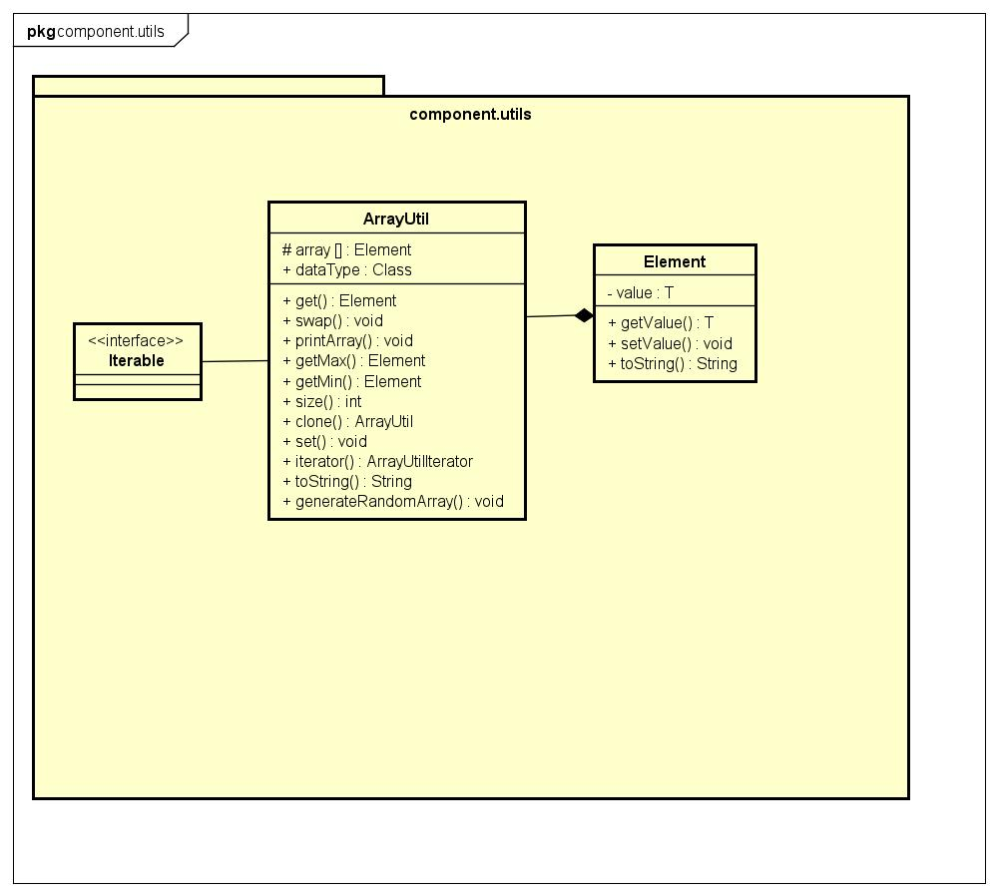
Package component.utils

Slide 6
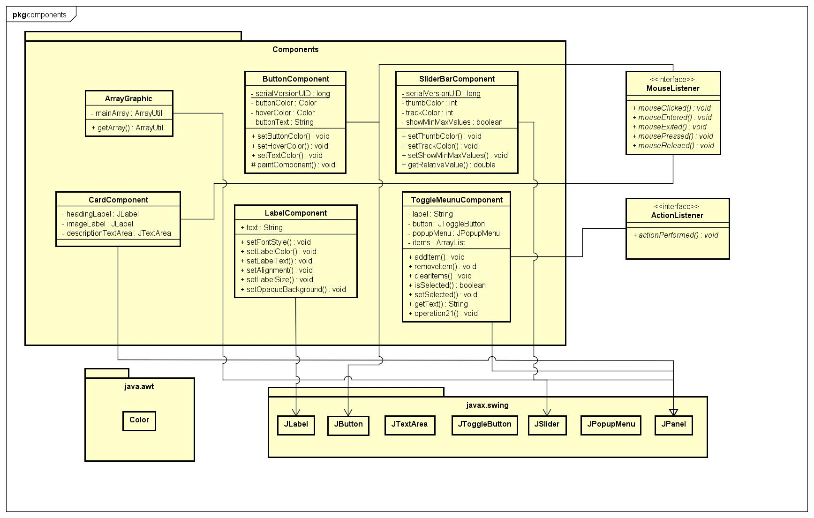
Package component

Slide 7
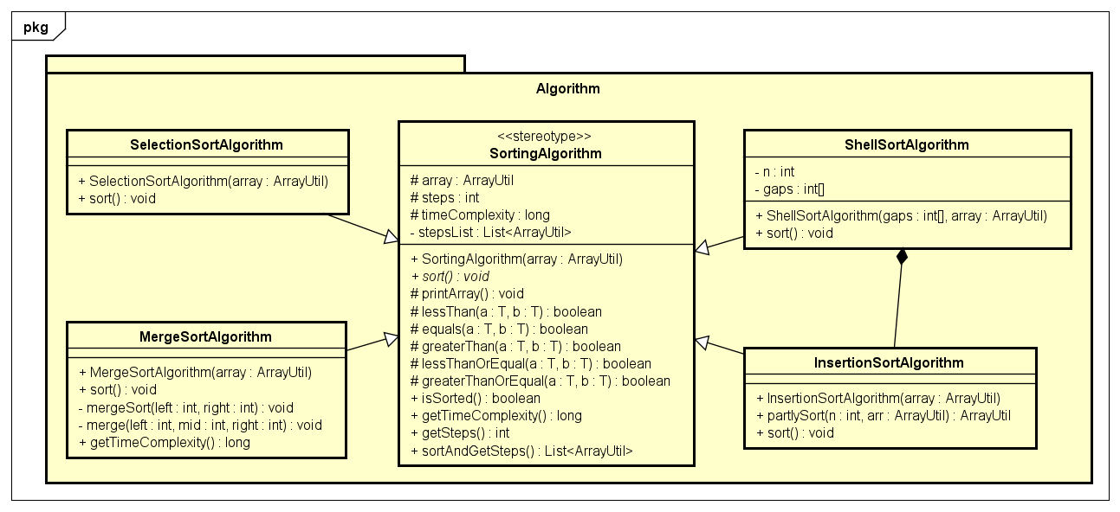
Package algorithm

Slide 8
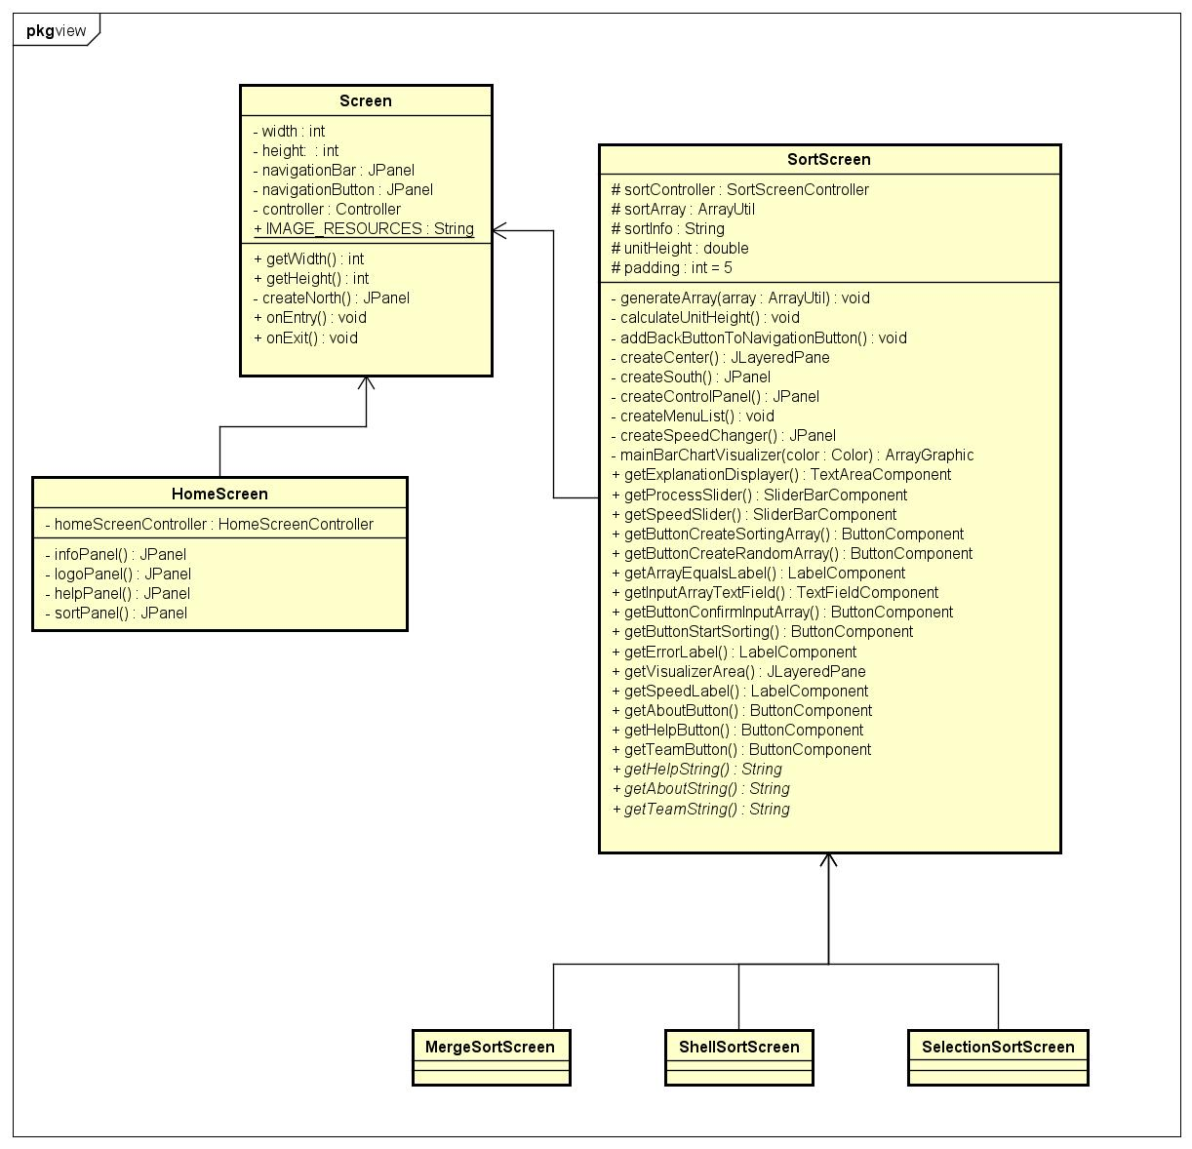
Package view

Slide 9
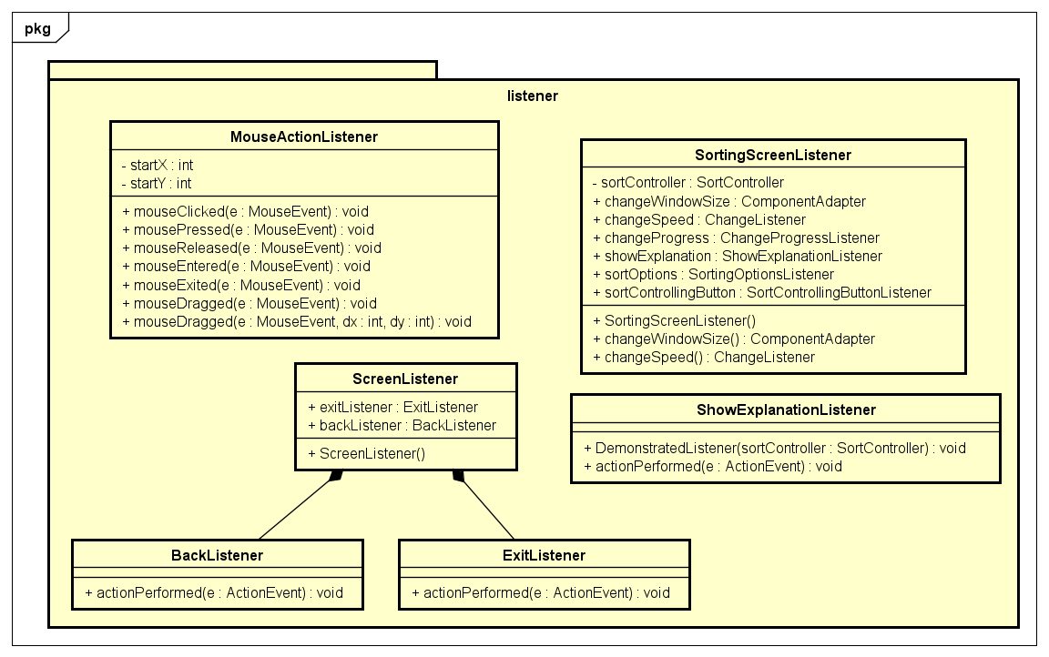
Package Listener

Slide 10
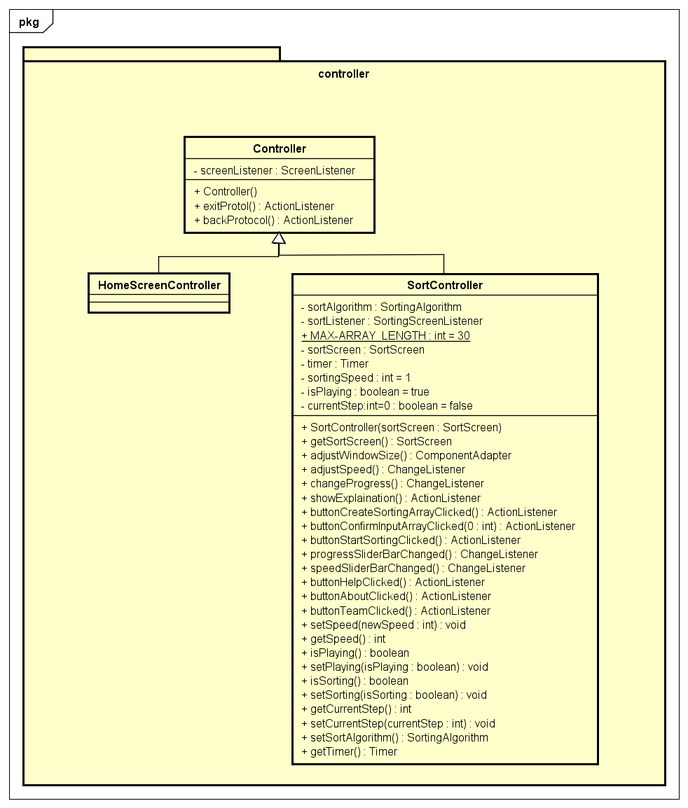
Package Controller

Slide 11
OOP Techniques
Inheritance:
In package algorithm, three type of sort algorithms inherit from the SortingAlgorithm class.
In package controller, HomeScreenController and SortScreenController classes inherit from the Controller class.
Abstraction:
We use abstract class SortingAlgorithm to manage MergeSortAlgorithm, SelectionSortAlgorithm, InsertionSortAlgorithm and ShellSortAlgorithm classes.

Slide 12
Demo Video

Slide 13
THANK YOU !

