Slide 1
Fjord
Company research with inspectable evidence
Sanjay P
Chennai Institute of Technology
AZINHACK 2026
Notes:
Solo software prototype by Sanjay P, Chennai Institute of Technology, AI & ML, graduation 2029. Existing MIT Fjord foundation developed for Signalpost is reused and extended with a new functional TinyFish discovery and evidence-review workflow. AI assistance was used for research, development, design, tests and presentation. No unaided authorship or contest result is claimed.

Slide 2
The company behind a plausible website
Supplier researchers need exact legal attribution before trusting a profile.
A website name can refer to a brand, a parent company or a different business. Missing registry fields increase the checking work.
The local sample contains 100 companies. These are field-availability counts, not accuracy or market statistics.
Notes:
Source: reports/smoke-100.json, the actual 16 October 2026 random local smoke sample. Legal name 100/100, available revenue in at least one observed period 76/100, registered employee value 17/100, registry website candidate 11/100. A candidate website is not proof of exact-company ownership. Missing registry employee values do not mean zero employees. This sample is not representative market research. Official source documentation: https://data.brreg.no/enhetsregisteret/api/dokumentasjon/en/index.html .

Slide 3
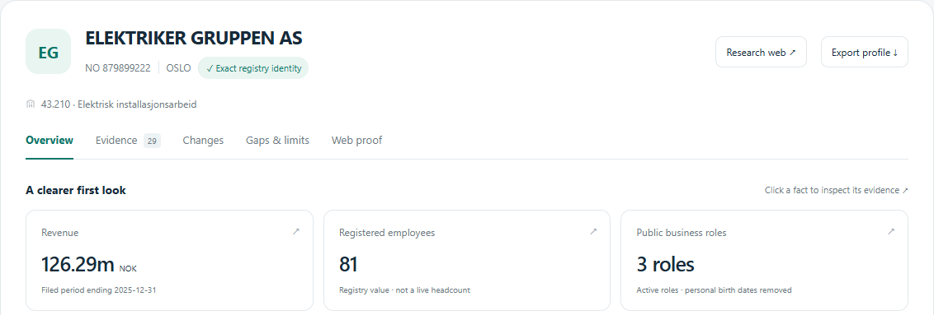
A working company research desk
Exact legal number
Filed periods stay separate. Group accounts are excluded.
Every claim opens its source, timestamp and extraction path.
Notes:
Actual Fjord application screenshot. The example is ELEKTRIKER GRUPPEN AS, organisation number 879899222, from the real recorded 100-company run. The interface is a fixed-snapshot viewer unless served by the local research service. The screenshot is product evidence, not an independent verification of all upstream facts. Source files: dist/app.js, dist/sample.json.

Slide 4
TinyFish integration
Search finds candidate URLs
Fetch exposes evidence
Two searches combine the exact legal identity with licensed-source discovery. Search snippets stay transient.
Public URL and robots checks run before Fetch. An explicit source-rights scope controls what can be inspected and published.
Real example: 2 Search requests and 1 Fetch request produced a matching licensed profile and rendered identity excerpt.
Notes:
Sources: https://docs.tinyfish.ai/search-api/reference ; https://docs.tinyfish.ai/fetch-api/reference ; https://www.tinyfish.ai/terms ; https://www.wikidata.org/wiki/Wikidata:Licensing . Actual one-company local browser workflow: reports/tinyfish-live-ui.json, organisation 993101583. Three TinyFish requests total, nine direct source requests, approximately 42.7 seconds, no paid endpoints used. The two sourced external observations are the exact-number Wikidata mapping and the rendered identity excerpt. This is not an accuracy benchmark. Free Search/Fetch pricing was checked on 16 October; no Agent, Browser or Monitor usage, card or top-up is required by the implementation.

Slide 5
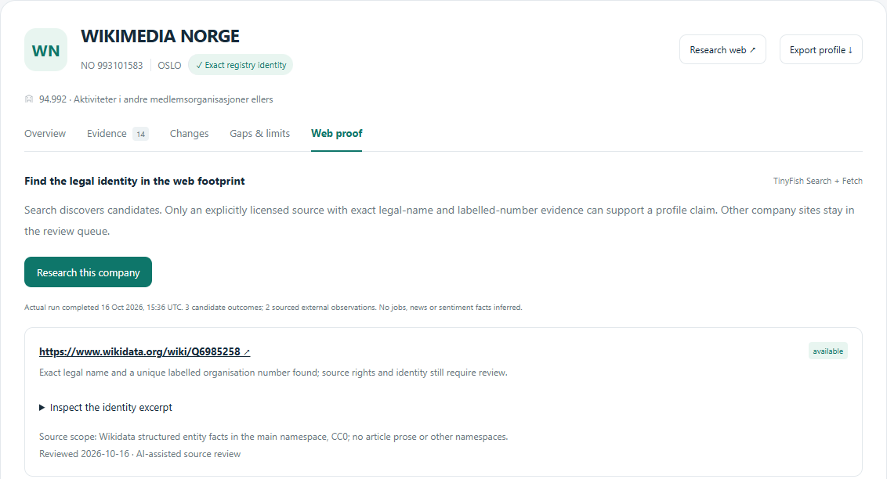
The evidence review queue
1 licensed profile
The exact organisation number maps to a unique Wikidata entity.
2 other pages withheld
Unreviewed source rights keep their company facts unpublished.
Notes:
Actual working UI for WIKIMEDIA NORGE, organisation number 993101583. TinyFish Search initially returned an unrelated name candidate; an exact P2333 identifier query found Q6985258. TinyFish Fetch then supplied the readable matching excerpt. The source-rights policy permits scoped CC0 entity facts. The company website and Norwegian Wikipedia page remain blocked from content publication under the current allowlist. “Blocked” here is the application publication/access policy state, not a claim that the company is illegitimate. Source: reports/tinyfish-live-ui.json and dist/web-sample.json.

Slide 6
AI role and technical approach
AI web infrastructure
Deterministic attribution
TinyFish handles live discovery and readable page extraction. Retrieved text is treated as data, never instructions.
BRREG anchors legal identity. A unique Wikidata P2333 mapping supports a licensed entity profile. Conflicting identities stay ambiguous.
Company facts come from attributed source fields. Identity checks remain deterministic.
Notes:
Implementation: footprint.py, core.py, network.py, agent.py and server.py. TinyFish Search/Fetch are the functional sponsor integration. We do not claim a custom trained ML model, a particular underlying TinyFish model, autonomous browsing actions, independent sentiment, or reasoning accuracy. Wikimedia structured entity data is CC0. Identity matching and financial extraction are deterministic. Public role snapshots discard birth dates and personal identifiers.

Slide 7
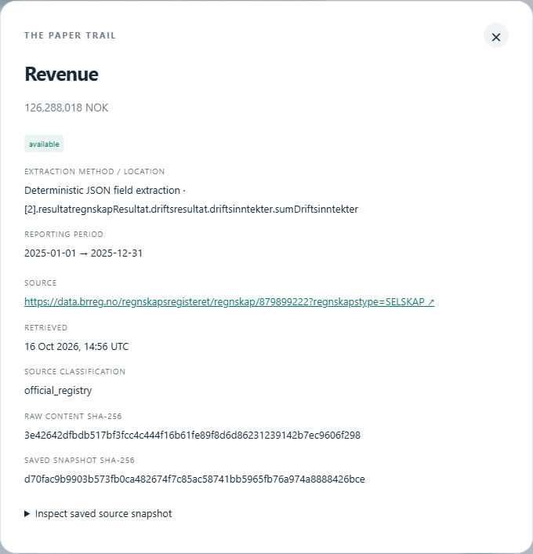
Source inspection and refresh
A paper trail for every available claim
Source URL and retrieval time
Reporting period where relevant
Content and snapshot hashes
Extraction location
Refresh retains previous evidence. Changed values and missing observations are distinct.
Notes:
Actual source inspector from the application. core.py changes() ignores timestamp-only changes, retains previous source IDs, and distinguishes value_changed, availability_changed, new_evidence and not_observed_in_refresh. Provider-derived evidence explicitly distinguishes an evidence-projection hash from the raw-origin HTML; the provider-response hash is recorded separately. The official registry inspector shown here uses received-byte and saved-snapshot hashes. Tests cover a source disappearing during refresh.

Slide 8
Measured execution and current limits
100 / 100
23 tests pass
Terminal results in the official-source smoke test
Wrong-company accounts, missingness, privacy, refresh, URL policy and exact licensed-entity mapping are tested.
401 requests in 151.2 seconds
0 remaining collector errors
USD 0 paid API charges
The sponsor workflow was tested on one company through the live UI. Independent precision, recall and time saved remain unmeasured.
Notes:
Source: reports/smoke-100.json and test_core.py, test_boundaries.py, test_snapshot.py, test_footprint.py. The 100-company run predates the TinyFish extension and frozen-input adapter and is not presented as a 100-company sponsor benchmark. The later live sponsor UI example is separate at reports/tinyfish-live-ui.json. Browser QA checked desktop/mobile, claim inspection, imports/exports, actual sponsor request flow, cross-origin rejection, malformed input rejection and absence of a key in the page. No competition score, qualification, production reliability or independently measured exact-company precision is claimed. Infrastructure/network costs excluded from API-charge figures.

Slide 9
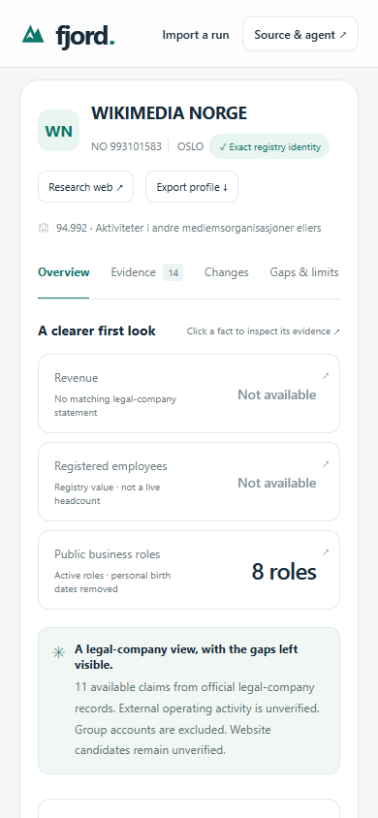
Users, impact and feasibility
For a supplier research team
A researcher can inspect the legal identity, source history and unresolved candidates in one place before making a supplier decision.
Proposed evaluation
Compare manual research with Fjord on unfamiliar companies. Measure checking time, wrong-company publications and valid evidence coverage.
Notes:
Intended user and impact hypothesis, not evidence of adoption, customer interviews, commercial demand or time saved. Current prototype is software only and runs with the Python standard library. The browser snapshot viewer is buildless HTML/CSS/JavaScript. Live research runs through a loopback service with a server-side environment key and a twenty-run session limit. API calls are bounded and use only advertised free Search/Fetch endpoints. Screenshot is the actual responsive application.

Slide 10
Screening prototype and next build
Implemented
Next after screening
Registry research and financial history
Claim inspection and refresh comparison
Functional TinyFish Search and Fetch
Licensed evidence and review queue
Test more ambiguous identities
Review additional source permissions
Measure researcher task performance
Secure hosted research backend
github.com/nqtexd/fjord-signalpost
Sanjay P, solo. Code MIT. Registry data NLOD 2.0. Wikidata structured facts CC0.
Notes:
Submission requirements checked at https://api.unstop.com/hackathons/azinhack-2026-university-school-of-automation-robotics-usar-guru-gobind-singh-indraprastha-university-ggsipu--1763832 . The proposed TinyFish integration is already functional in this screening prototype. The remaining tasks are explicitly future scope. The existing Fjord foundation is reused from the Signalpost entry, with new sponsor integration and source-review workflow developed afterward. Static preview is owner-private; judges should use the public repository and documented local server, supplying their own TinyFish key. No secret is embedded in this deck, app frontend or repository. AI-assisted development, design, research, tests and deck preparation disclosed.

