Slide 1
Glyra
A glucose digital twin with visible uncertainty
Sanjay P · Chennai Institute of Technology
AI & Machine Learning · Graduating 2029 · Solo team: sanjaytenn11
Notes:
Project title: Glyra. A software-only research prototype for the Digital Twin Challenge and open innovation. Codex assisted research, development, design and documentation. Source and reproducible benchmark accompany the deck. All patient records and results are synthetic.

Slide 2
A glucose value needs context
The review problem
A focused use case
A current reading shows a moment. A clinician also needs the recent trajectory, patient context and an honest view of uncertainty.
Explore 30–120 minute glucose forecasts for a simulated person with type 2 diabetes. Review a potential excursion before the next reading arrives.
Research basis: A1C averages can conceal short glucose excursions. Long-horizon prediction remains difficult.
GLYRA / RESEARCH PROTOTYPE
02
Notes:
Sources: https://diabetesjournals.org/clinical/article/42/3/398/154390/Detection-and-Intervention-Use-of-Continuous ; https://pmc.ncbi.nlm.nih.gov/articles/PMC6806292/ . The published forecasting work concerns type 1 diabetes and does not validate this type 2 synthetic prototype. No clinical outcome improvement is claimed.

Slide 3
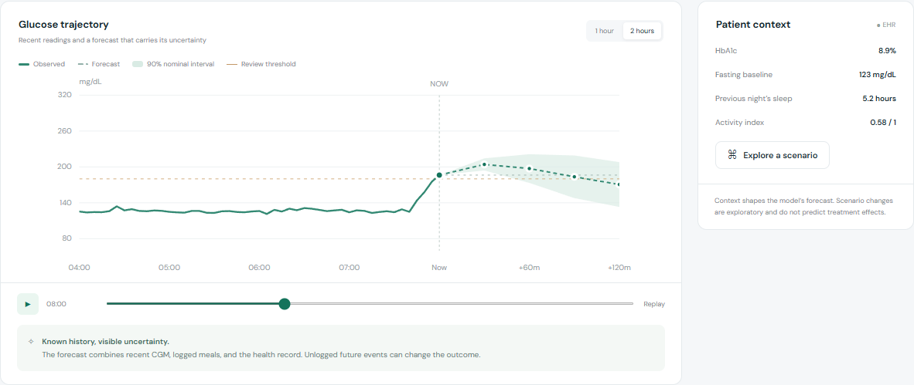
A working review dashboard
Synchronized history, learned forecasts, calibrated intervals and patient context
GLYRA / RESEARCH PROTOTYPE
03
Notes:
Actual product screenshot captured from the local app. Overview includes patient selection, recent events, replay, source provenance, threshold crossings and review export. The 180 mg/dL review threshold is illustrative and configurable.

Slide 4
System architecture
Synthetic EHR
Ridge forecasts
Fasting baseline, HbA1c, age, sleep, activity
30, 60, 90, 120 minutes
Data-quality gate
Fresh, ordered, complete, supported
CGM & logged meals
Calibrated intervals
Five-minute history; no future events
Separate synthetic calibration group
Browser dashboard and JSON review export
Bundled model + fixtures · browser-local inference · no API keys or sensor hardware
GLYRA / RESEARCH PROTOTYPE
04
Notes:
Architecture reflects dist/engine.js, app.js and train.py. Synthetic data only. Data-quality failures withhold model output. The offline training pipeline exports coefficients, residual quantiles and held-out metrics; runtime loads these static artifacts.

Slide 5
Reproducible data and model
150 synthetic people
Four regression heads
100 train · 25 calibration · 25 test
Four simulated days per person
27,600 total forecast windows
Sixteen temporal and record features
Training-only standardization
Ridge penalty 8; unpenalized intercept
Generator includes variable meals, sleep, activity, sensor noise and future meals unknown to the model.
A fixed seed and separate people make the benchmark reproducible. The generator simplifies physiology.
GLYRA / RESEARCH PROTOTYPE
05
Notes:
Source: train.py and dist/data/benchmark.json. Correct total windows: 18,400 train + 4,600 calibration + 4,600 test = 27,600. Each group contains different synthetic people. Seed is 4100 + person id. Ridge uses fixed penalty chosen as a simple baseline, not tuned against test people.

Slide 6
Synthetic benchmark against persistence
19.64
mg/dL MAE at 120 min
29.79 persistence baseline
89.8% empirical coverage
90% nominal pointwise interval
25 unseen simulated people · 4,600 windows · synthetic-only performance
GLYRA / RESEARCH PROTOTYPE
06
Notes:
Source: dist/data/benchmark.json generated by train.py. MAE / RMSE at 30 min 6.48 / 12.56; 60 min 13.53 / 21.14; 90 min 18.03 / 24.66; 120 min 19.64 / 25.38 mg/dL. Persistence MAE 10.35,18.48,25.09,29.79. Empirical pointwise interval coverage 90.0,89.9,89.9,89.8%. Windows within a person are dependent. These synthetic results do not establish clinical validity.

Slide 7
Explicit provenance for both streams
Static health record
Dynamic sensor history
Fasting baseline, HbA1c and age accompany previous sleep and an activity index. Every patient record is labelled synthetic.
Five-minute glucose series and meals logged before the replay time. Future readings are excluded from features.
CSV import runs locally, validates the series and pairs it with the current demo record. No patient data leave the browser.
GLYRA / RESEARCH PROTOTYPE
07
Notes:
Actual data contract: CSV header minute,glucose; 13 or more rows; exact increasing five-minute intervals; glucose 40–400; at most 5,000 rows and 500 KB. Imported values paired with synthetic context are unsupported for real physiology. No medication fields or real health records are collected.

Slide 8
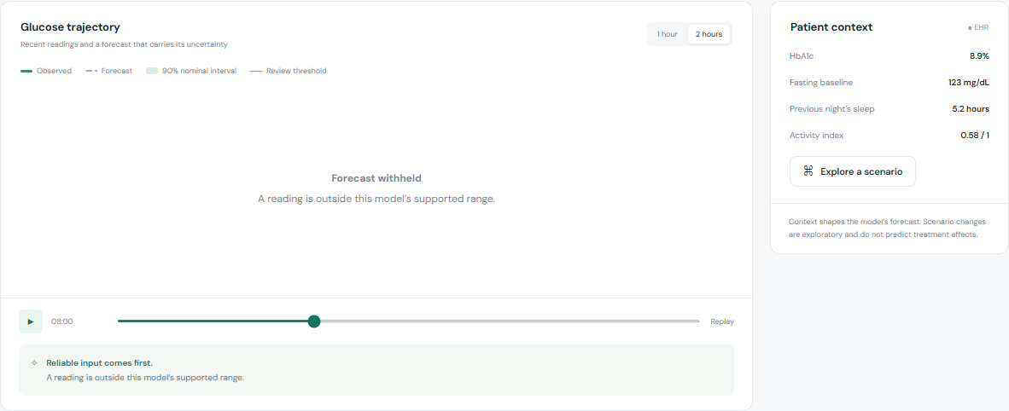
A missing window withholds the forecast
The input gate checks freshness, spacing, completeness and supported ranges before inference.
GLYRA / RESEARCH PROTOTYPE
08
Notes:
Actual screenshot of the missing-reading demonstration. The same engine gate handles invalid numeric values, out-of-order timestamps, stale readings and out-of-range EHR context. This is an input-compatibility gate, not a clinical safety certification.

Slide 9
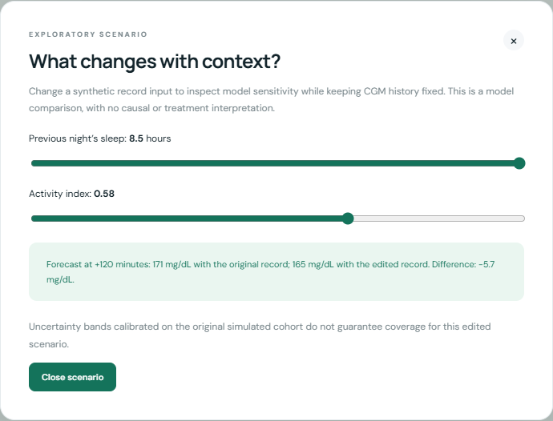
Scenario comparison exposes model sensitivity
A reviewer can adjust synthetic sleep or activity while holding the glucose history fixed.
The resulting difference describes the model. It does not establish what an intervention would do for a patient.
GLYRA / RESEARCH PROTOTYPE
09
Notes:
Actual scenario dialog screenshot. A scenario is an exploratory record edit, not a causal effect estimate. Original calibrated intervals do not guarantee coverage for scenario edits. Sliders stay inside the generator support.

Slide 10
Limitations and failure cases
Unknown future events
Synthetic evidence only
An unlogged meal can change glucose after the forecast. A wide interval cannot make an unseen event predictable.
The generator simplifies physiology. No real patient evaluation, external validation, diagnosis or dosing capability is claimed.
Next evidence: independent retrospective testing and clinician usability review, with appropriately governed data.
GLYRA / RESEARCH PROTOTYPE
10
Notes:
Patient-level test MAE at 120 minutes ranges from 12.21 to 26.43 mg/dL across synthetic test people. Nominal intervals are marginal and pointwise, not simultaneous trajectory guarantees. Correlated windows and distribution shift limit interpretation. Research: https://pmc.ncbi.nlm.nih.gov/articles/PMC13119999/ ; https://pmc.ncbi.nlm.nih.gov/articles/PMC6806292/ .

Slide 11
Impact, adoption and implementation roadmap
Intended practical value
Feasible next steps
A review workflow could reduce the effort of reconstructing context across separate records. This remains a usability hypothesis.
Clinician interviews and task testing
Independent retrospective benchmark
A supervised research pilot
Business hypothesis: clinic subscription after validation. Pricing, demand, clinical outcomes and adoption are untested.
The current software works without hardware purchases, cloud inference or API credentials.
GLYRA / RESEARCH PROTOTYPE
11
Notes:
No interviews, hospital customers, clinical pilot, commercial revenue or economic savings have been demonstrated. Proposed research roadmap is conditional on data governance, partners and validation. The present deliverable is a transparent prototype, not a deployed clinical product.

Slide 12
Source, team and reproducibility
Sanjay P
Chennai Institute of Technology · AI & ML · Graduating 2029
Solo team: sanjaytenn11
Browser: HTML, CSS, JavaScript
Model training: Python + NumPy
Runtime: bundled coefficients, no inference service
License: MIT
github.com/nqtexd/glyra-digital-twin
GLYRA / RESEARCH PROTOTYPE
12
Notes:
AI disclosure: Codex assisted research, implementation, visual design, tests, deck and demonstration preparation. The submission does not claim unaided authorship. See RESEARCH.md, README.md, train.py, dist/engine.js, dist/data/benchmark.json and tests/engine.test.mjs. Research references appear in notes on the relevant slides.

