Slide 1
Virtualization and the Cloud
Chapter 7
Tanenbaum & Bos, Modern Operating Systems: 4th ed., Global Edition (c) 2015 Pearson Education Limited. All rights reserved.

Slide 2
Requirements for Virtualization
Hypervisors should score well in three dimensions:
Safety: hypervisor should have full control of virtualized resources.
Fidelity: behavior of a program on a virtual machine should be identical to same program running on bare hardware.
Efficiency: much of code in virtual machine should run without intervention by hypervisor.
Tanenbaum & Bos, Modern Operating Systems: 4th ed., Global Edition (c) 2015 Pearson Education Limited. All rights reserved.

Slide 3
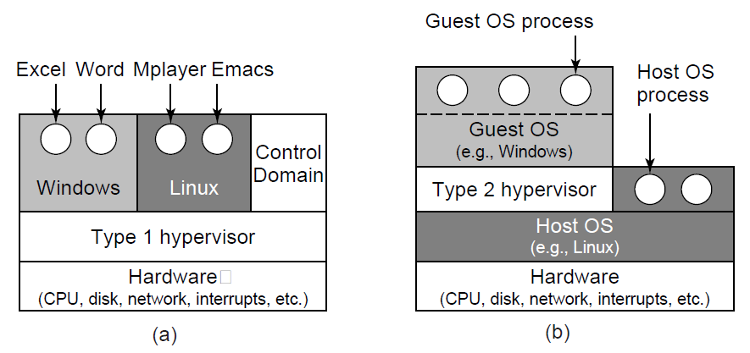
Type 1 and Type 2 Hypervisors (1)
Figure 7-1. Location of type 1 and type 2 hypervisors.
Tanenbaum & Bos, Modern Operating Systems: 4th ed., Global Edition (c) 2015 Pearson Education Limited. All rights reserved.

Slide 4
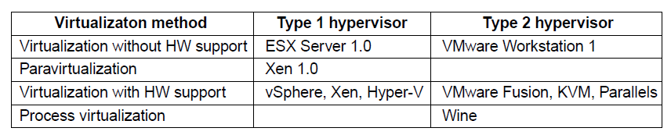
Type 1 and Type 2 Hypervisors (2)
Figure 7-2. Examples of the various combinations of virtualization type and hypervisor. Type 1 hypervisors always run on the bare metal whereas type 2 hypervisors use the services of an existing host operating system.
Tanenbaum & Bos, Modern Operating Systems: 4th ed., Global Edition (c) 2015 Pearson Education Limited. All rights reserved.

Slide 5
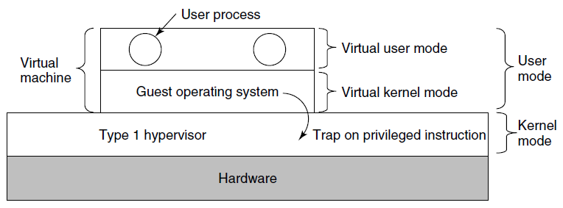
Techniques for Efficient Virtualization
Figure 7-3. When the operating system in a virtual machine executes a kernel only instruction, it traps to the hypervisor if virtualization technology is present.
Tanenbaum & Bos, Modern Operating Systems: 4th ed., Global Edition (c) 2015 Pearson Education Limited. All rights reserved.

Slide 6
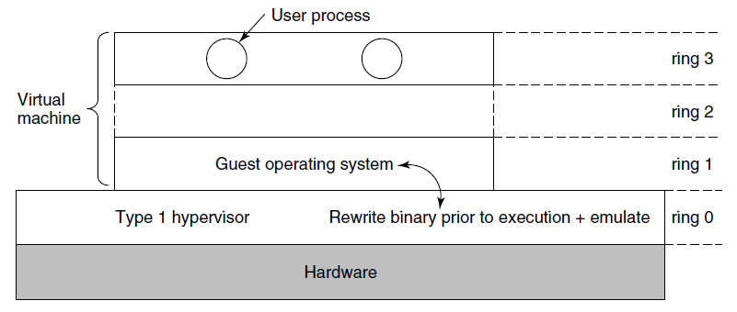
Virtualizing the Unvirtualizable
Figure 7-4. The binary translates rewrites the guest operating system running in ring 1, while the hypervisor runs in ring 0
Tanenbaum & Bos, Modern Operating Systems: 4th ed., Global Edition (c) 2015 Pearson Education Limited. All rights reserved.

Slide 7
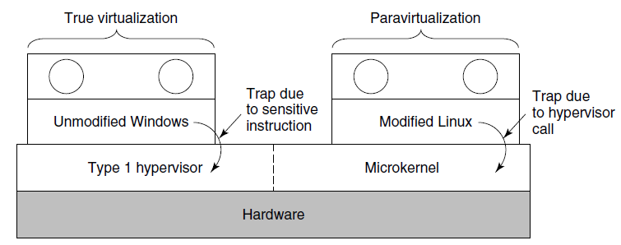
Are Hypervisors Microkernels
Done Right? (1)
Figure 7-5. True virtualization and paravirtualization
Tanenbaum & Bos, Modern Operating Systems: 4th ed., Global Edition (c) 2015 Pearson Education Limited. All rights reserved.

Slide 8
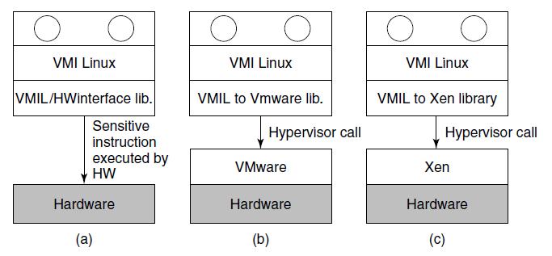
Are Hypervisors Microkernels
Done Right?
Figure 7-6. VMI Linux running on (a) the bare hardware
(b) VMware (c) Xen.
Tanenbaum & Bos, Modern Operating Systems: 4th ed., Global Edition (c) 2015 Pearson Education Limited. All rights reserved.

Slide 9
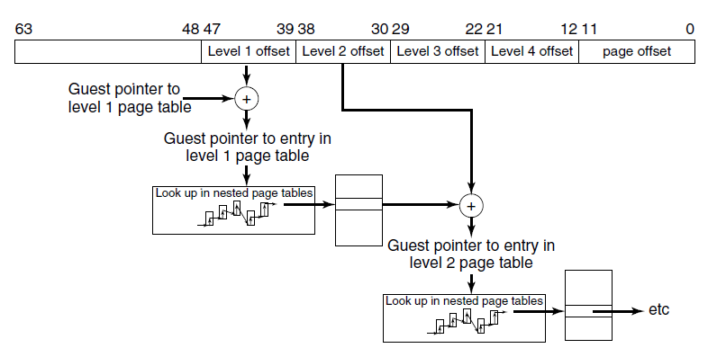
Hardware Support For
Nested Page Tables
Figure 7-7. Extended/nested page tables are walked every time a guest physical address is accessed—including the accesses for each level of the guest’s page tables.
Tanenbaum & Bos, Modern Operating Systems: 4th ed., Global Edition (c) 2015 Pearson Education Limited. All rights reserved.

Slide 10
Clouds
National Institute of Standards and Technology defines characteristics of “cloud”
On-demand self-service
Broad network access
Resource pooling
Rapid elasticity
Measured service
Tanenbaum & Bos, Modern Operating Systems: 4th ed., Global Edition (c) 2015 Pearson Education Limited. All rights reserved.

Slide 11
Challenges in Bringing Virtualization to the x86 (1)
Core attributes of a virtual machine to
x86-based target platform:
Compatibility
Performance
Isolation
Tanenbaum & Bos, Modern Operating Systems: 4th ed., Global Edition (c) 2015 Pearson Education Limited. All rights reserved.

Slide 12
Challenges in Bringing Virtualization to the x86 (2)
Major Challenges:
The x86 architecture was not virtualizable
The x86 architecture was of daunting complexity
x86 machines had diverse peripherals
Need for a simple user experience
Tanenbaum & Bos, Modern Operating Systems: 4th ed., Global Edition (c) 2015 Pearson Education Limited. All rights reserved.

Slide 13
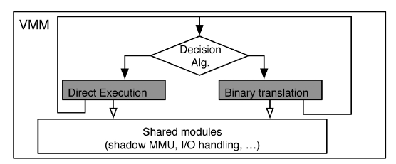
Virtualizing the x86 Architecture (1)
Figure 7-8. High-level components of the VMware virtual machine monitor (in the absence of hardware support).
Tanenbaum & Bos, Modern Operating Systems: 4th ed., Global Edition (c) 2015 Pearson Education Limited. All rights reserved.

Slide 14
Virtualizing the x86 Architecture (2)
Binary translation must be used if any of the following is true:
Virtual machine is currently running in kernel mode
Virtual machine can disable interrupts and issue I/O instruction
Virtual machine is currently running in real mode
Tanenbaum & Bos, Modern Operating Systems: 4th ed., Global Edition (c) 2015 Pearson Education Limited. All rights reserved.

Slide 15
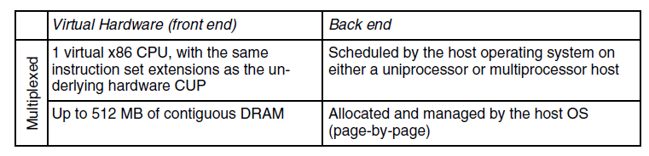
Virtual Hardware Platform (1)
Figure 7-9 Virtual hardware configuration options
of the early VMware Workstation, ca. 2000.
Tanenbaum & Bos, Modern Operating Systems: 4th ed., Global Edition (c) 2015 Pearson Education Limited. All rights reserved.

Slide 16
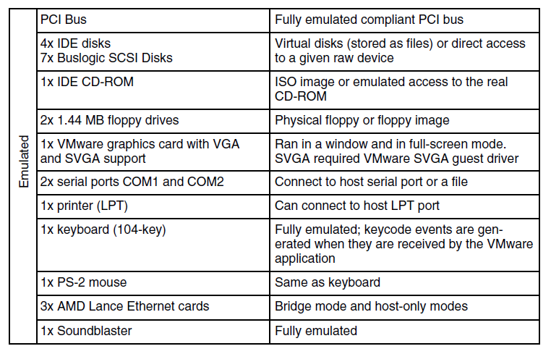
Virtual Hardware Platform (2)
Figure 7-9 Virtual hardware configuration options
of the early VMware Workstation, ca. 2000.
Tanenbaum & Bos, Modern Operating Systems: 4th ed., Global Edition (c) 2015 Pearson Education Limited. All rights reserved.

Slide 17
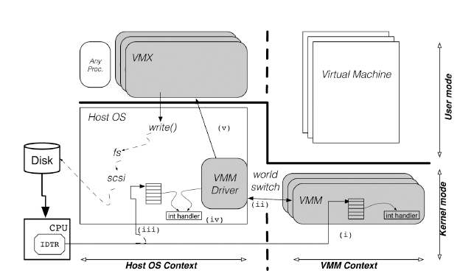
Role of the Host Operating System (1)
Figure 7-10. The VMware Hosted Architecture and its three components: VMX, VMM driver and VMM.
Tanenbaum & Bos, Modern Operating Systems: 4th ed., Global Edition (c) 2015 Pearson Education Limited. All rights reserved.

Slide 18
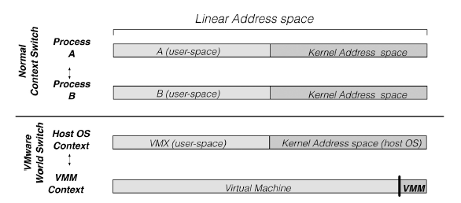
Role of the Host Operating System (2)
Figure 7-11. Difference between a normal context
switch and a world switch.
Tanenbaum & Bos, Modern Operating Systems: 4th ed., Global Edition (c) 2015 Pearson Education Limited. All rights reserved.

Slide 19
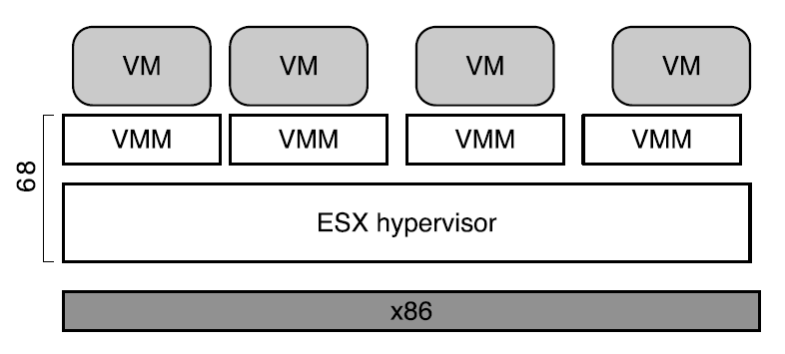
ESX Server: VMware’s type-1 Hypervisor (1)
Figure 7-11. ESX Server: VMware’s type-1 Hypervisor
Tanenbaum & Bos, Modern Operating Systems: 4th ed., Global Edition (c) 2015 Pearson Education Limited. All rights reserved.

Slide 20
ESX Server: VMware’s type-1 Hypervisor (2)
ESX Server architecture provides substantial benefits
CPU scheduler ensures that each virtual machine gets a fair share of the CPU
Memory manager is optimized for scalability
I/O subsystem is optimized for performance
Back ends also typically relied on abstractions provided by host operating system.
ESX Server made it easy to introduce new capabilities
Tanenbaum & Bos, Modern Operating Systems: 4th ed., Global Edition (c) 2015 Pearson Education Limited. All rights reserved.

Slide 21
End
Chapter 7
Tanenbaum & Bos, Modern Operating Systems: 4th ed., Global Edition (c) 2015 Pearson Education Limited. All rights reserved.

