Slide 1
Multiple Processor Systems
Chapter 8
Tanenbaum & Bos, Modern Operating Systems: 4th ed., Global Edition (c) 2015 Pearson Education Limited. All rights reserved.

Slide 2
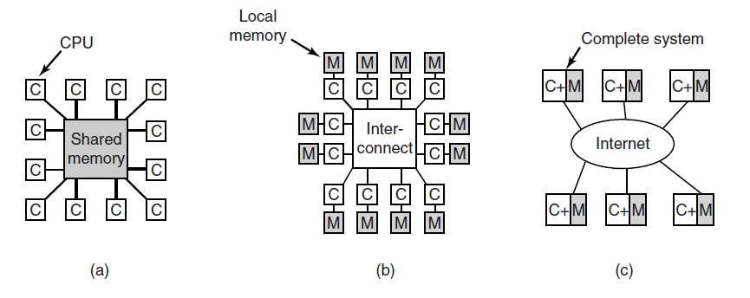
Multiple Processor Systems
Figure 8-1. (a) A shared-memory multiprocessor. (b) A message-passing multicomputer. (c) A wide area distributed system
Tanenbaum & Bos, Modern Operating Systems: 4th ed., Global Edition (c) 2015 Pearson Education Limited. All rights reserved.

Slide 3
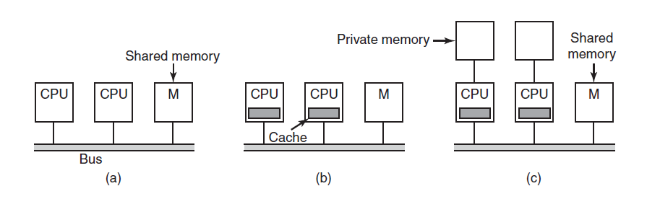
Multiprocessor Hardware
Figure 8-2. Three bus-based multiprocessors. (a) Without caching. (b) With caching. (c) With caching and private memories.
Tanenbaum & Bos, Modern Operating Systems: 4th ed., Global Edition (c) 2015 Pearson Education Limited. All rights reserved.

Slide 4
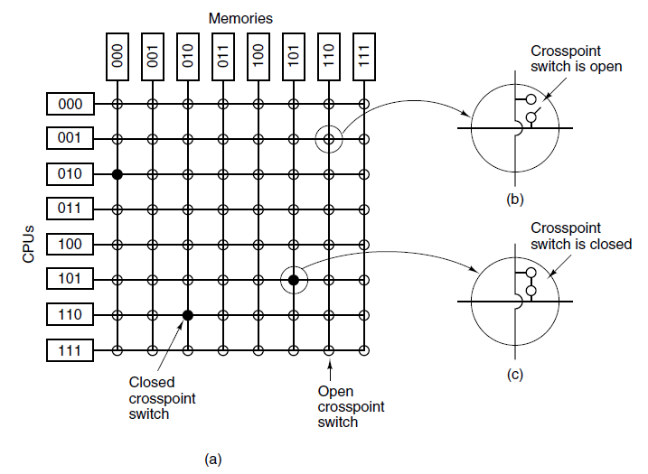
UMA Multiprocessors Using Crossbar Switches
Figure 8-3. (a) An 8 × 8 crossbar switch. (b) An open crosspoint. (c) A closed crosspoint.
Tanenbaum & Bos, Modern Operating Systems: 4th ed., Global Edition (c) 2015 Pearson Education Limited. All rights reserved.

Slide 5
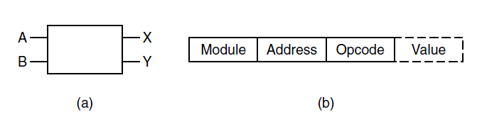
UMA Multiprocessors Using Multistage Switching Networks (1)
Figure 8-4. (a) A 2 × 2 switch with two input lines, A and B, and two output lines, X and Y. (b) A message format.
Tanenbaum & Bos, Modern Operating Systems: 4th ed., Global Edition (c) 2015 Pearson Education Limited. All rights reserved.

Slide 6
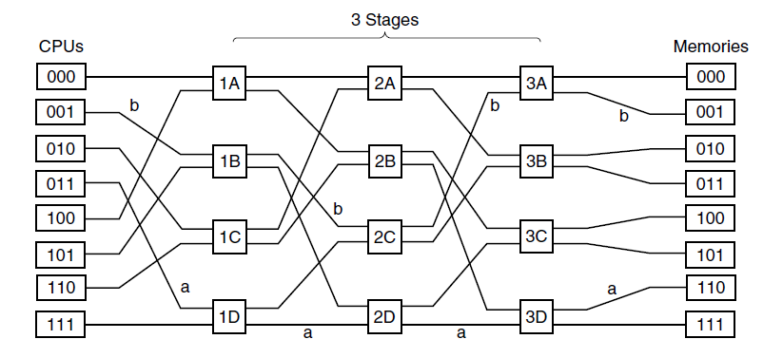
UMA Multiprocessors Using Multistage Switching Networks (2)
Figure 8-5. An omega switching network.
Tanenbaum & Bos, Modern Operating Systems: 4th ed., Global Edition (c) 2015 Pearson Education Limited. All rights reserved.

Slide 7
NUMA Multiprocessors (1)
Characteristics of NUMA machines which distinguish them from other multiprocessors:
There is a single address space visible to all CPUs.
Access to remote memory is via LOAD and STORE instructions.
Access to remote memory is slower than access to local memory.
Tanenbaum & Bos, Modern Operating Systems: 4th ed., Global Edition (c) 2015 Pearson Education Limited. All rights reserved.

Slide 8
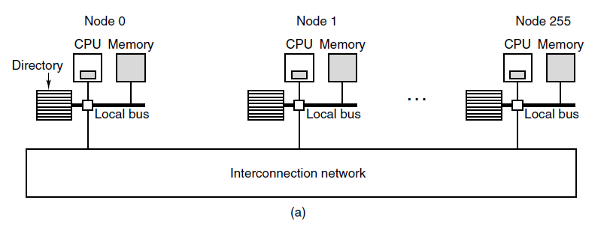
NUMA Multiprocessors (2)
Figure 8-6. (a) A 256-node directory-based multiprocessor
Tanenbaum & Bos, Modern Operating Systems: 4th ed., Global Edition (c) 2015 Pearson Education Limited. All rights reserved.

Slide 9
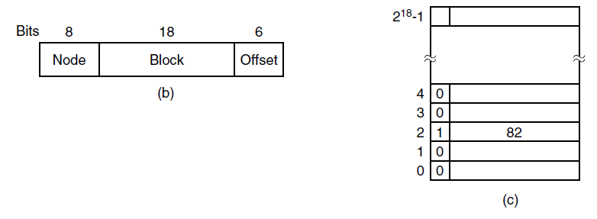
NUMA Multiprocessors (3)
Figure 8-6. (b) Division of a 32-bit memory address into fields. (c) The directory at node 36.
Tanenbaum & Bos, Modern Operating Systems: 4th ed., Global Edition (c) 2015 Pearson Education Limited. All rights reserved.

Slide 10
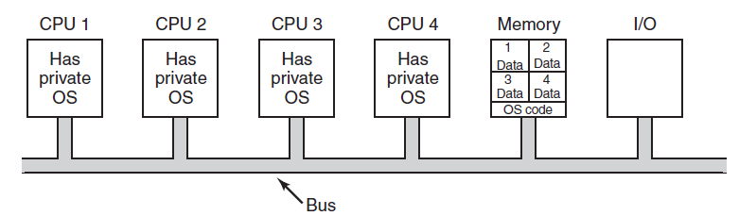
Multiprocessor Operating System Types
Each CPU Has Its Own Operating System
Figure 8-7. Partitioning multiprocessor memory among four CPUs, but sharing a single copy of the operating system code. The boxes marked Data are the operating system’s private data for each CPU.
Tanenbaum & Bos, Modern Operating Systems: 4th ed., Global Edition (c) 2015 Pearson Education Limited. All rights reserved.

Slide 11
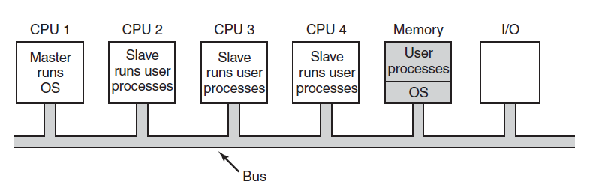
Master-Slave Multiprocessors
Figure 8-8. A master-slave multiprocessor model.
Tanenbaum & Bos, Modern Operating Systems: 4th ed., Global Edition (c) 2015 Pearson Education Limited. All rights reserved.

Slide 12
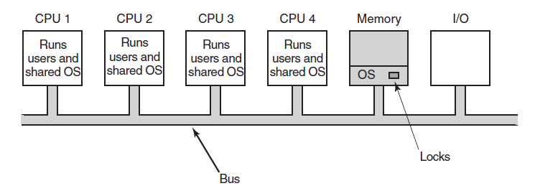
Symmetric Multiprocessors
Figure 8-9. The SMP multiprocessor model.
Tanenbaum & Bos, Modern Operating Systems: 4th ed., Global Edition (c) 2015 Pearson Education Limited. All rights reserved.

Slide 13
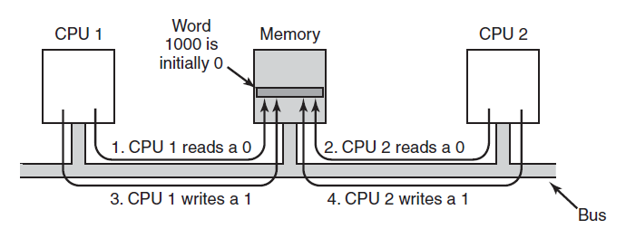
Multiprocessor Synchronization (1)
Figure 8-10. The TSL instruction can fail if the bus cannot be locked. These four steps show a sequence of events where the failure is demonstrated.
Tanenbaum & Bos, Modern Operating Systems: 4th ed., Global Edition (c) 2015 Pearson Education Limited. All rights reserved.

Slide 14
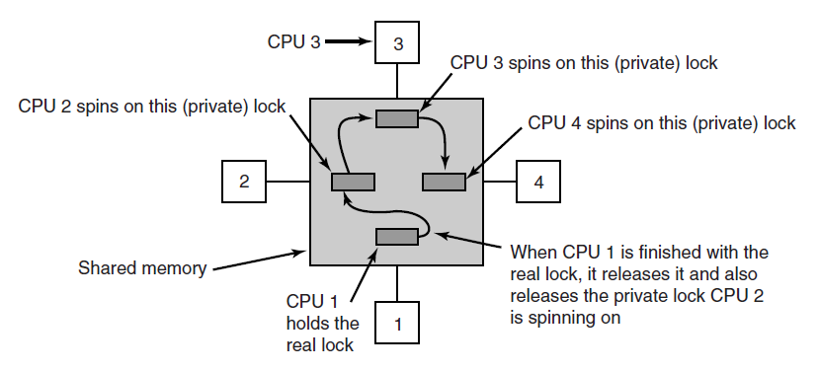
Multiprocessor Synchronization (2)
Figure 8-11. Use of multiple locks to avoid cache thrashing.
Tanenbaum & Bos, Modern Operating Systems: 4th ed., Global Edition (c) 2015 Pearson Education Limited. All rights reserved.

Slide 15
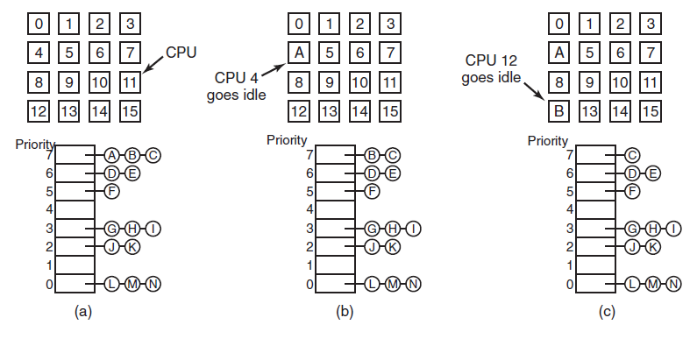
Time Sharing
Figure 8-12. Using a single data structure for scheduling a multiprocessor.
Tanenbaum & Bos, Modern Operating Systems: 4th ed., Global Edition (c) 2015 Pearson Education Limited. All rights reserved.

Slide 16
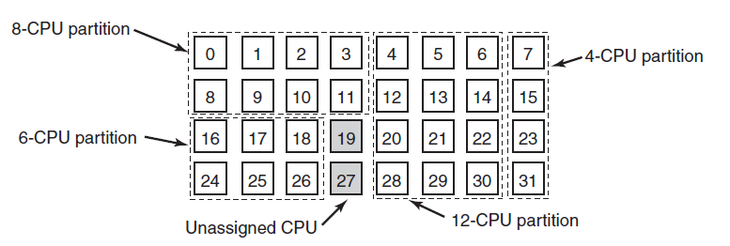
Space Sharing
Figure 8-13. A set of 32 CPUs split into four partitions,
with two CPUs available.
Tanenbaum & Bos, Modern Operating Systems: 4th ed., Global Edition (c) 2015 Pearson Education Limited. All rights reserved.

Slide 17
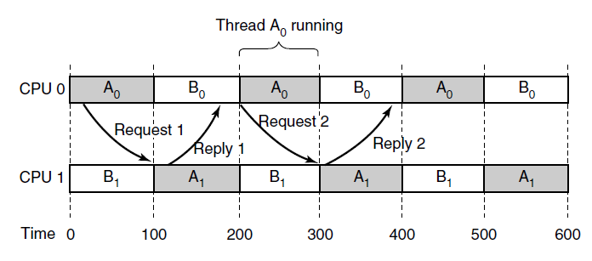
Gang Scheduling (1)
Figure 8-14. Communication between two threads belonging to thread A that are running out of phase.
Tanenbaum & Bos, Modern Operating Systems: 4th ed., Global Edition (c) 2015 Pearson Education Limited. All rights reserved.

Slide 18
Gang Scheduling (2)
Gang scheduling has three parts:
Groups of related threads are scheduled as a unit, a gang.
All members of a gang run at once on different timeshared CPUs.
All gang members start and end their time slices together.
Tanenbaum & Bos, Modern Operating Systems: 4th ed., Global Edition (c) 2015 Pearson Education Limited. All rights reserved.

Slide 19
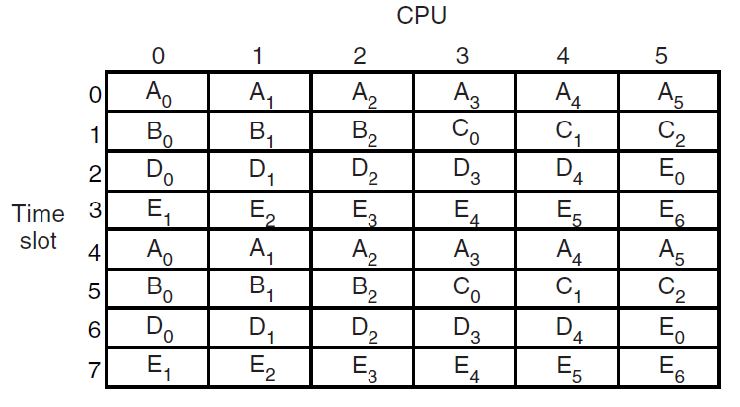
Gang Scheduling (3)
Figure 8-15. Gang scheduling.
Tanenbaum & Bos, Modern Operating Systems: 4th ed., Global Edition (c) 2015 Pearson Education Limited. All rights reserved.

Slide 20
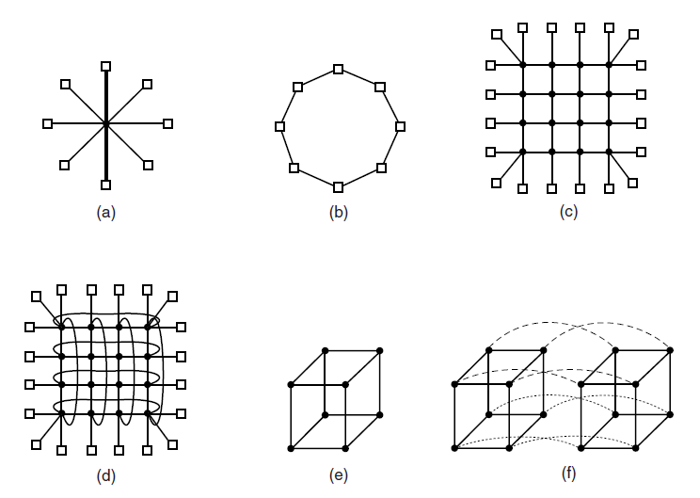
Interconnection Technology (1)
Figure 8-16. Various interconnect topologies. (a) A single switch. (b) A ring. (c) A grid. (d) A double torus. (e) A cube. (f) A 4D hypercube.
Tanenbaum & Bos, Modern Operating Systems: 4th ed., Global Edition (c) 2015 Pearson Education Limited. All rights reserved.

Slide 21
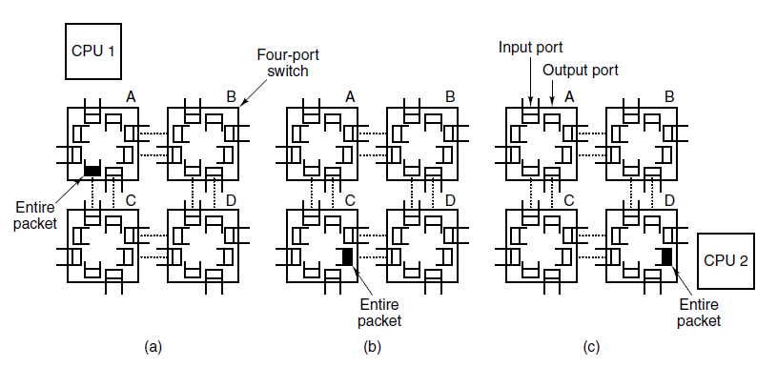
Interconnection Technology (2)
Figure 8-17. Store-and-forward packet switching.
Tanenbaum & Bos, Modern Operating Systems: 4th ed., Global Edition (c) 2015 Pearson Education Limited. All rights reserved.

Slide 22
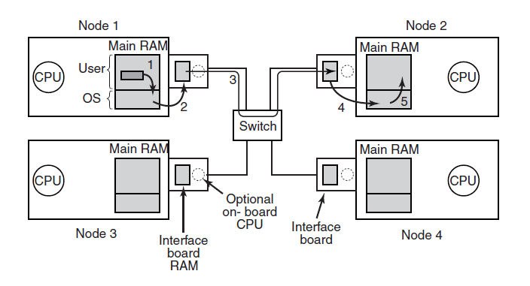
Network Interfaces
Figure 8-18. Position of the network interface boards
in a multicomputer.
Tanenbaum & Bos, Modern Operating Systems: 4th ed., Global Edition (c) 2015 Pearson Education Limited. All rights reserved.

Slide 23
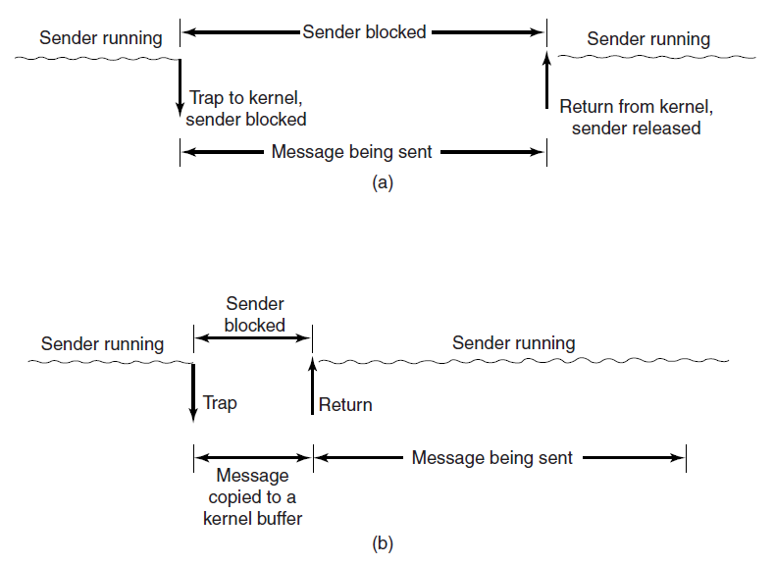
Blocking versus Nonblocking Calls (1)
Figure 8-19. (a) A blocking send call.
(b) A nonblocking send call.
Tanenbaum & Bos, Modern Operating Systems: 4th ed., Global Edition (c) 2015 Pearson Education Limited. All rights reserved.

Slide 24
Blocking versus Nonblocking Calls (2)
Choices on the sending side:
Blocking send (CPU idle during transmission).
Nonblocking send with copy (CPU time wasted for the extra copy).
Nonblocking send with interrupt (makes programming difficult).
Copy on write (extra copy probably needed eventually).
Tanenbaum & Bos, Modern Operating Systems: 4th ed., Global Edition (c) 2015 Pearson Education Limited. All rights reserved.

Slide 25
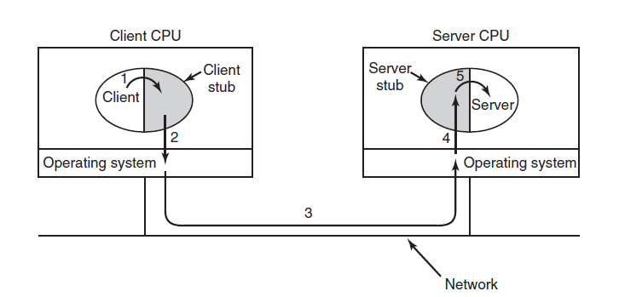
Remote Procedure Call
Figure 8-20. Steps in making a remote procedure call.
The stubs are shaded gray.
Tanenbaum & Bos, Modern Operating Systems: 4th ed., Global Edition (c) 2015 Pearson Education Limited. All rights reserved.

Slide 26
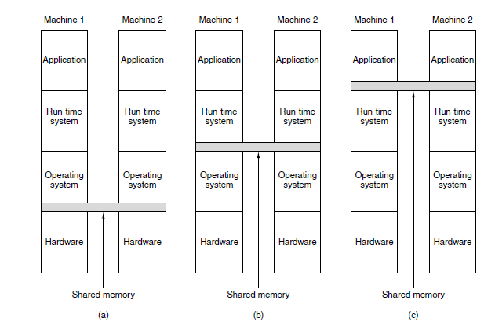
Distributed Shared Memory (1)
Figure 8-21. Various layers where shared memory can be implemented. (a) The hardware. (b) The operating system. (c) User-level software.
Tanenbaum & Bos, Modern Operating Systems: 4th ed., Global Edition (c) 2015 Pearson Education Limited. All rights reserved.

Slide 27
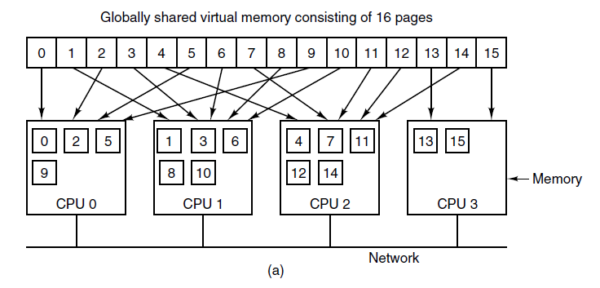
Distributed Shared Memory (2)
Figure 8-22. (a) Pages of the address space distributed among four machines.
Tanenbaum & Bos, Modern Operating Systems: 4th ed., Global Edition (c) 2015 Pearson Education Limited. All rights reserved.

Slide 28
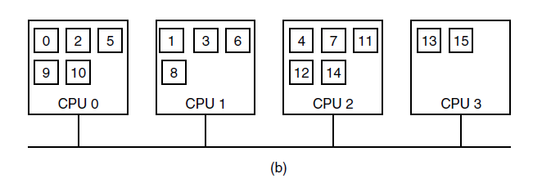
Distributed Shared Memory (3)
Figure 8-22. (b) Situation after CPU 1 references page 10 and the page is moved there.
Tanenbaum & Bos, Modern Operating Systems: 4th ed., Global Edition (c) 2015 Pearson Education Limited. All rights reserved.

Slide 29
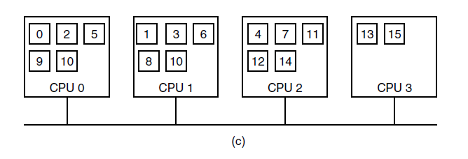
Distributed Shared Memory (4)
Figure 8-22. (c) Situation if page 10 is read only and replication is used.
Tanenbaum & Bos, Modern Operating Systems: 4th ed., Global Edition (c) 2015 Pearson Education Limited. All rights reserved.

Slide 30
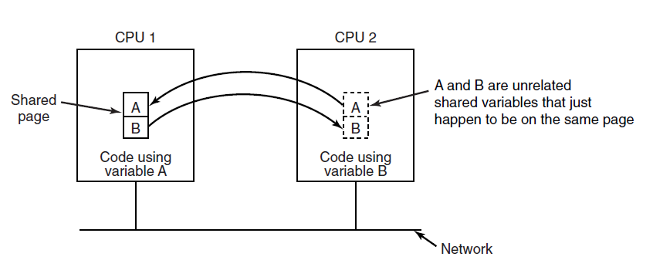
False Sharing
Figure 8-23. False sharing of a page containing
two unrelated variables.
Tanenbaum & Bos, Modern Operating Systems: 4th ed., Global Edition (c) 2015 Pearson Education Limited. All rights reserved.

Slide 31
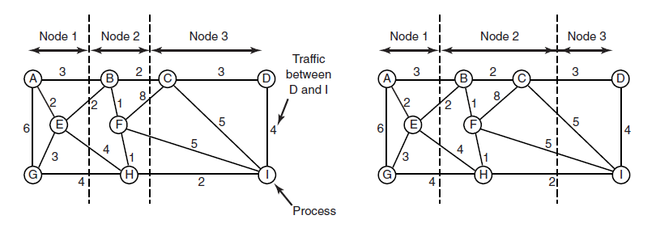
Graph-Theoretic Deterministic Algorithm
Figure 8-24. Two ways of allocating nine
processes to three nodes.
Tanenbaum & Bos, Modern Operating Systems: 4th ed., Global Edition (c) 2015 Pearson Education Limited. All rights reserved.

Slide 32
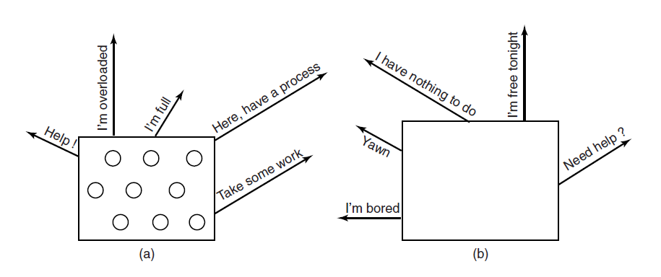
Sender-Initiated Distributed Heuristic Algorithm
Figure 8-25. (a) An overloaded node looking for a lightly loaded node to hand off processes to. (b) An empty node looking for work to do.
Tanenbaum & Bos, Modern Operating Systems: 4th ed., Global Edition (c) 2015 Pearson Education Limited. All rights reserved.

Slide 33
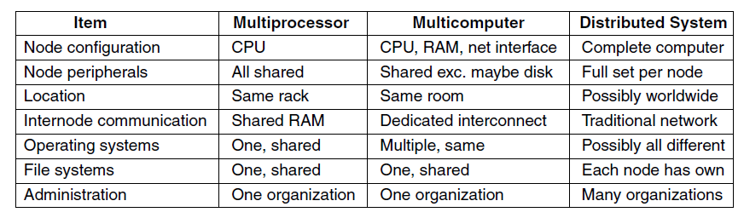
Distributed Systems (1)
Figure 8-26. Comparison of three kinds of multiple CPU systems.
Tanenbaum & Bos, Modern Operating Systems: 4th ed., Global Edition (c) 2015 Pearson Education Limited. All rights reserved.

Slide 34
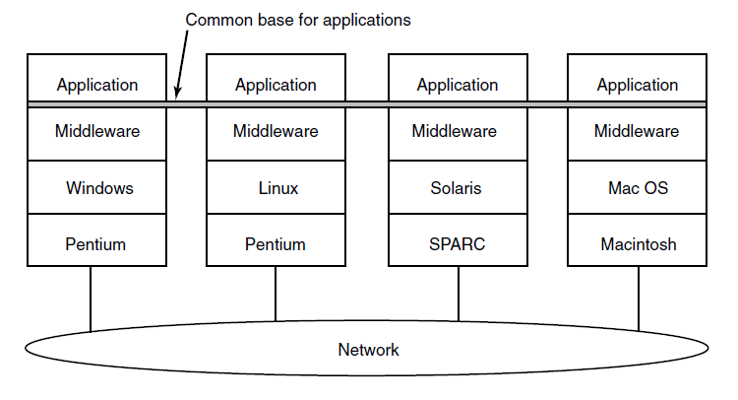
Distributed Systems (2)
Figure 8-27. Positioning of middleware in a distributed system.
Tanenbaum & Bos, Modern Operating Systems: 4th ed., Global Edition (c) 2015 Pearson Education Limited. All rights reserved.

Slide 35
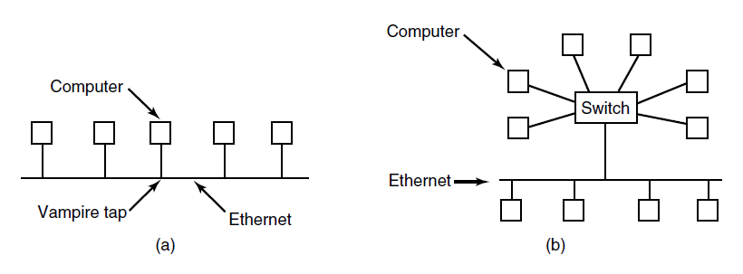
Network Hardware
Ethernet
Figure 8-28. (a) Classic Ethernet. (b) Switched Ethernet.
Tanenbaum & Bos, Modern Operating Systems: 4th ed., Global Edition (c) 2015 Pearson Education Limited. All rights reserved.

Slide 36
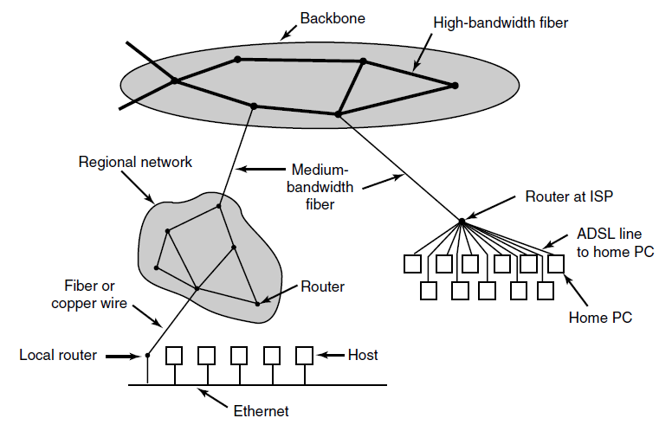
The Internet
Figure 8-29. A portion of the Internet.
Tanenbaum & Bos, Modern Operating Systems: 4th ed., Global Edition (c) 2015 Pearson Education Limited. All rights reserved.

Slide 37
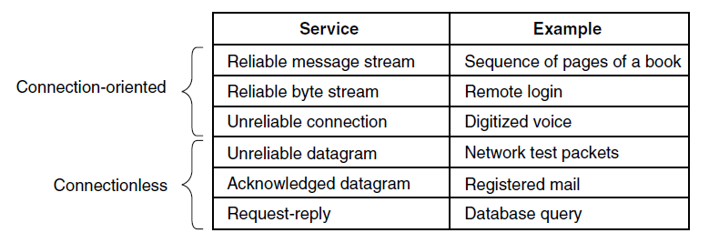
Network Services
Figure 8-30. Six different types of network service.
Tanenbaum & Bos, Modern Operating Systems: 4th ed., Global Edition (c) 2015 Pearson Education Limited. All rights reserved.

Slide 38
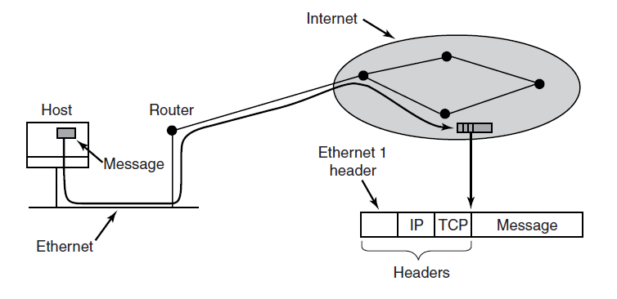
Network Protocols
Figure 8-31. Accumulation of packet headers.
Tanenbaum & Bos, Modern Operating Systems: 4th ed., Global Edition (c) 2015 Pearson Education Limited. All rights reserved.

Slide 39
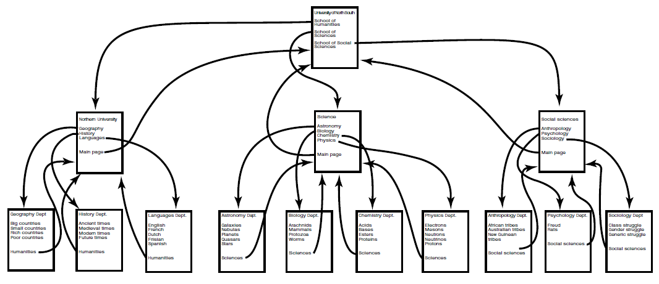
Document-Based Middleware (1)
Figure 8-32. The Web is a big directed graph of documents.
Tanenbaum & Bos, Modern Operating Systems: 4th ed., Global Edition (c) 2015 Pearson Education Limited. All rights reserved.

Slide 40
Document-Based Middleware (2)
For the browser to get the page
http://www.minix3.org/getting-started/index.html
Browser asks DNS for IP address of www.minix3.org
DNS replies with 66.147.238.215
Browser makes a TCP connection to port 80 on 66.147.238.215
Browser sends a request asking for the file
getting-started/index.html
Tanenbaum & Bos, Modern Operating Systems: 4th ed., Global Edition (c) 2015 Pearson Education Limited. All rights reserved.

Slide 41
Document-Based Middleware (3)
The www.minix3.org server sends the file
getting-started/index.html
Browser displays all the text in
getting-started/index.html.
Browser also fetches and displays all images on the page
The TCP connection is released
Tanenbaum & Bos, Modern Operating Systems: 4th ed., Global Edition (c) 2015 Pearson Education Limited. All rights reserved.

Slide 42
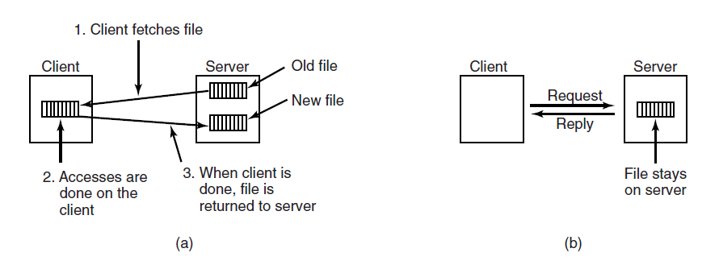
File-System-Based Middleware
Transfer Model
Figure 8-33. (a) The upload/download model.
(b) The remote access model.
Tanenbaum & Bos, Modern Operating Systems: 4th ed., Global Edition (c) 2015 Pearson Education Limited. All rights reserved.

Slide 43
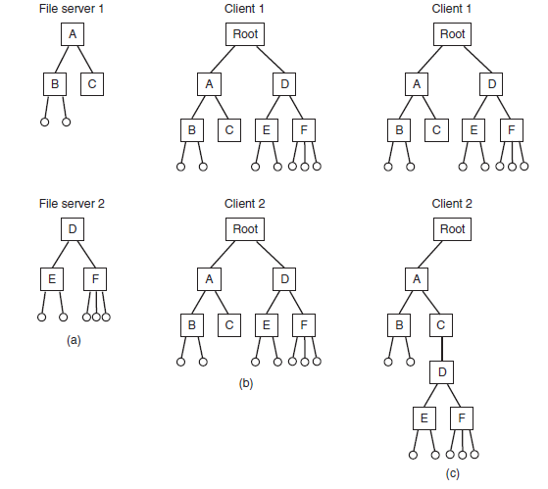
The Directory Hierarchy
Figure 8-34. (a) Two file servers. The squares are directories and the circles are files. (b) A system in which all clients have the same view of the file system. (c) A system in which different clients may have different views of the file system.
Tanenbaum & Bos, Modern Operating Systems: 4th ed., Global Edition (c) 2015 Pearson Education Limited. All rights reserved.

Slide 44
Naming Transparency
Common approaches to file and directory naming in a distributed system:
Machine + path naming, such as /machine/path or machine:path.
Mounting remote file systems onto the local file hierarchy.
A single name space that looks the same on all machines.
Tanenbaum & Bos, Modern Operating Systems: 4th ed., Global Edition (c) 2015 Pearson Education Limited. All rights reserved.

Slide 45
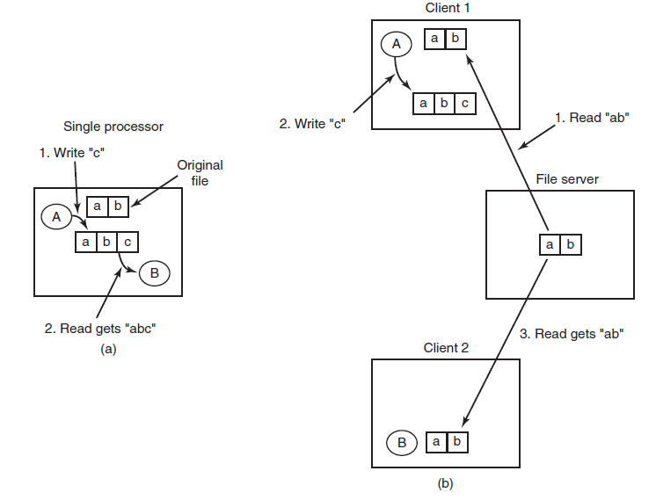
Semantics of File Sharing
Figure 8-35. (a) Sequential consistency. (b) In a distributed system with caching, reading a file may return an obsolete value.
Tanenbaum & Bos, Modern Operating Systems: 4th ed., Global Edition (c) 2015 Pearson Education Limited. All rights reserved.

Slide 46
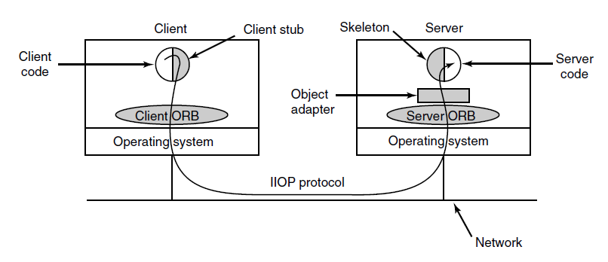
Object-Based Middleware
Figure 8-36. The main elements of a distributed system based on CORBA. The CORBA parts are shown in gray.
Tanenbaum & Bos, Modern Operating Systems: 4th ed., Global Edition (c) 2015 Pearson Education Limited. All rights reserved.

Slide 47
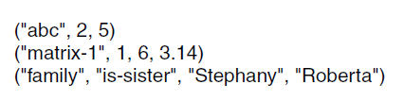
Coordination-Based Middleware (1)
Figure 8-37. Three Linda tuples
Tanenbaum & Bos, Modern Operating Systems: 4th ed., Global Edition (c) 2015 Pearson Education Limited. All rights reserved.

Slide 48
Coordination-Based Middleware (2)
A match occurs if the following three conditions
are all met:
Template and tuple have the same number of fields.
Types of corresponding fields are equal.
Each constant or variable in the template matches its tuple field.
Tanenbaum & Bos, Modern Operating Systems: 4th ed., Global Edition (c) 2015 Pearson Education Limited. All rights reserved.

Slide 49
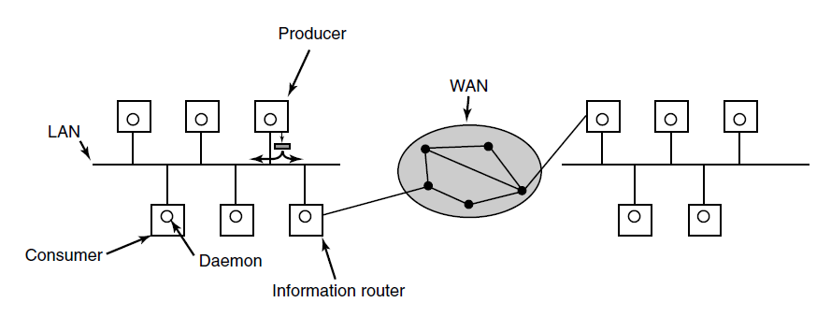
Publish/Subscribe
Figure 8-38. The publish/subscribe architecture.
Tanenbaum & Bos, Modern Operating Systems: 4th ed., Global Edition (c) 2015 Pearson Education Limited. All rights reserved.

Slide 50
End
Chapter 8
Tanenbaum & Bos, Modern Operating Systems: 4th ed., Global Edition (c) 2015 Pearson Education Limited. All rights reserved.

