Slide 1
CASE STUDY 1:
UNIX, Linux, and Android
Chapter 10
Tanenbaum & Bos, Modern Operating Systems: 4th ed., Global Edition (c) 2015 Pearson Education Limited. All rights reserved.

Slide 2
History of UNIX and Linux
UNICS
PDP-11 UNIX
Portable UNIX
Berkeley UNIX
Standard UNIX
MINIX
Linux
Tanenbaum & Bos, Modern Operating Systems: 4th ed., Global Edition (c) 2015 Pearson Education Limited. All rights reserved.

Slide 3
Linux Goals
Simplicity, elegance, consistency
Power and flexibility
Lack of useless redundancy
Tanenbaum & Bos, Modern Operating Systems: 4th ed., Global Edition (c) 2015 Pearson Education Limited. All rights reserved.

Slide 4
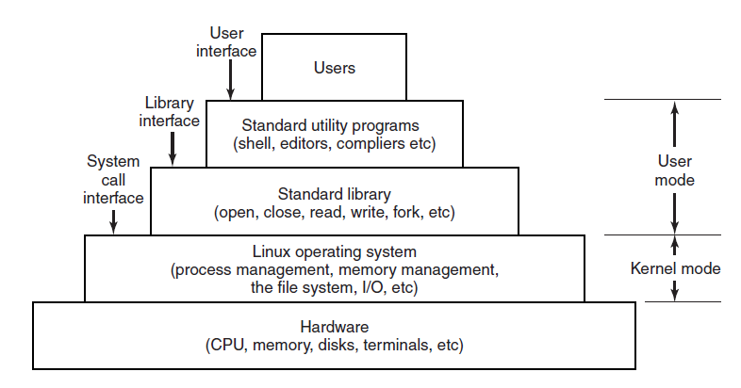
Interfaces to Linux
Figure 10-1. The layers in a Linux system.
Tanenbaum & Bos, Modern Operating Systems: 4th ed., Global Edition (c) 2015 Pearson Education Limited. All rights reserved.

Slide 5
The Shell
Command line interface
  Faster
  More powerful
  Easily extensible
First word entered will be a program name
  Commands take arguments
  Wild card characters used
  Filters, pipes used
Shell scripts
Tanenbaum & Bos, Modern Operating Systems: 4th ed., Global Edition (c) 2015 Pearson Education Limited. All rights reserved.

Slide 6
Linux Utility Programs (1)
File and directory manipulation commands.
Filters.
Program development tools, such as editors and compilers.
Text processing.
System administration.
Miscellaneous.
Tanenbaum & Bos, Modern Operating Systems: 4th ed., Global Edition (c) 2015 Pearson Education Limited. All rights reserved.

Slide 7
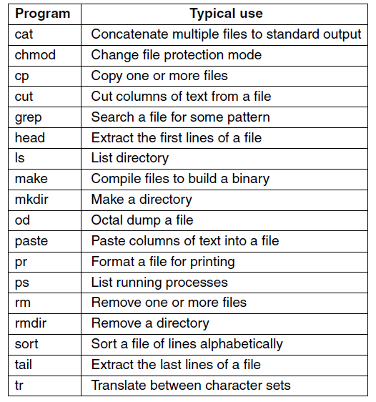
Linux Utility Programs (2)
Figure 10-2. A few of the common Linux utility programs required by POSIX.
Tanenbaum & Bos, Modern Operating Systems: 4th ed., Global Edition (c) 2015 Pearson Education Limited. All rights reserved.

Slide 8
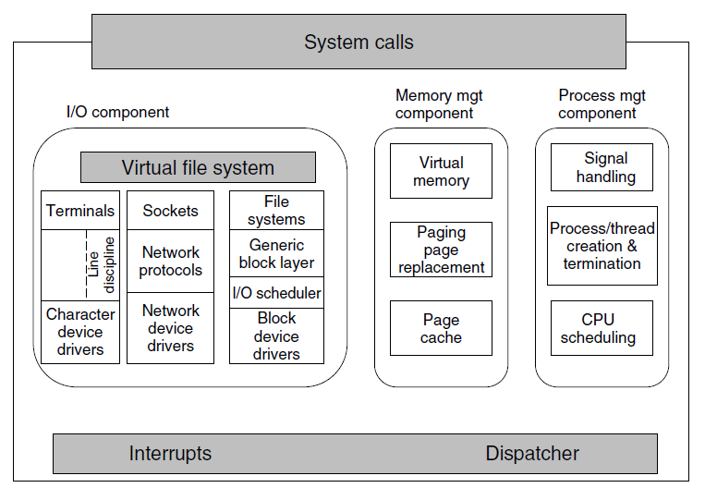
Kernel Structure
Figure 10-3. Structure of the Linux kernel
Tanenbaum & Bos, Modern Operating Systems: 4th ed., Global Edition (c) 2015 Pearson Education Limited. All rights reserved.

Slide 9
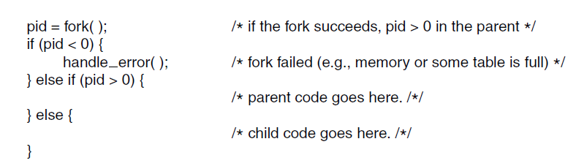
Processes: Fundamental Concepts (1)
Figure 10-4. Process creation in Linux.
Tanenbaum & Bos, Modern Operating Systems: 4th ed., Global Edition (c) 2015 Pearson Education Limited. All rights reserved.

Slide 10
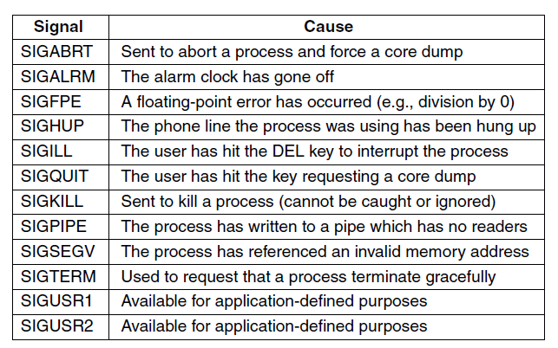
Processes: Fundamental Concepts (2)
Figure 10-5. Some of the signals required by POSIX.
Tanenbaum & Bos, Modern Operating Systems: 4th ed., Global Edition (c) 2015 Pearson Education Limited. All rights reserved.

Slide 11
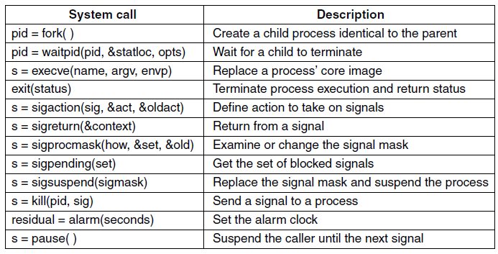
Process Management
System Calls in Linux (1)
Figure 10-6. Some system calls relating to processes. The return code s is −1 if an error has occurred, pid is a process ID, and residual is the remaining time in the previous alarm. The parameters are what the names suggest.
Tanenbaum & Bos, Modern Operating Systems: 4th ed., Global Edition (c) 2015 Pearson Education Limited. All rights reserved.

Slide 12
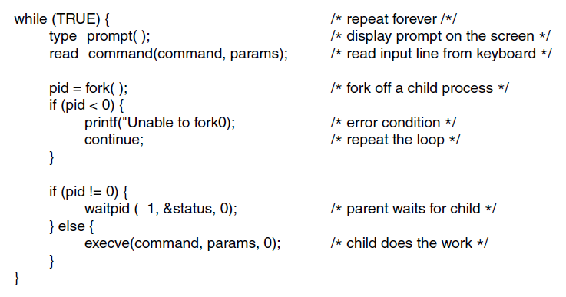
Process Management
System Calls in Linux (2)
Figure 10-7. A highly simplified shell.
Tanenbaum & Bos, Modern Operating Systems: 4th ed., Global Edition (c) 2015 Pearson Education Limited. All rights reserved.

Slide 13
Implementation of Processes and Threads in Linux (1)
Process descriptors
  Scheduling parameters
  Memory image
  Signals
  Machine registers
  System call state
  File descriptor table
  Accounting
  Kernel stack
  Miscellaneous
Tanenbaum & Bos, Modern Operating Systems: 4th ed., Global Edition (c) 2015 Pearson Education Limited. All rights reserved.

Slide 14
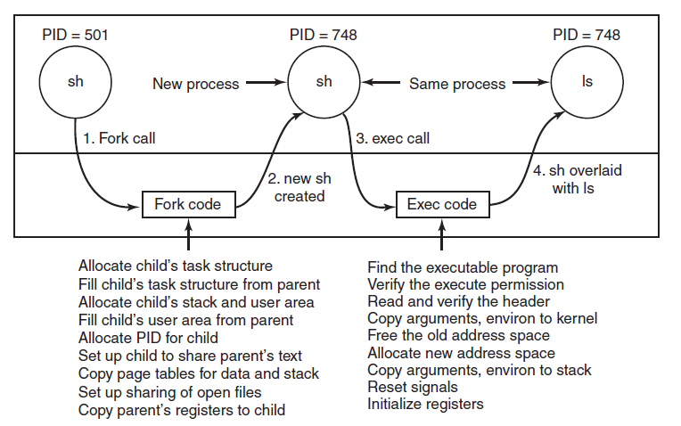
Implementation of Processes and Threads in Linux (2)
Figure 10-8. The steps in executing the
command ls typed to the shell.
Tanenbaum & Bos, Modern Operating Systems: 4th ed., Global Edition (c) 2015 Pearson Education Limited. All rights reserved.

Slide 15
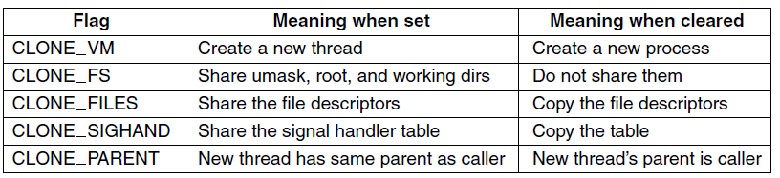
Threads in Linux
Figure 10-9. Bits in the sharing flags bitmap.
Tanenbaum & Bos, Modern Operating Systems: 4th ed., Global Edition (c) 2015 Pearson Education Limited. All rights reserved.

Slide 16
Scheduling in Linux (1)
Three classes of threads for scheduling purposes:
Real-time FIFO.
Real-time round robin.
Timesharing.
Tanenbaum & Bos, Modern Operating Systems: 4th ed., Global Edition (c) 2015 Pearson Education Limited. All rights reserved.

Slide 17
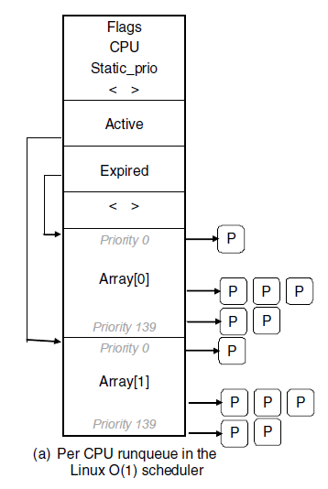
Scheduling in Linux (2)
Figure 10-10. Illustration of Linux run queue data structures for (a) the Linux O(1) scheduler
Tanenbaum & Bos, Modern Operating Systems: 4th ed., Global Edition (c) 2015 Pearson Education Limited. All rights reserved.

Slide 18
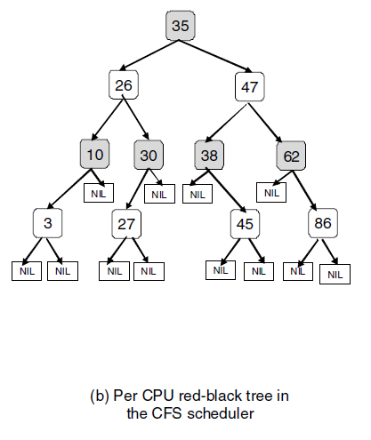
Scheduling in Linux (3)
Figure 10-10. Illustration of Linux run queue data structures for (b) the Completely Fair Scheduler
Tanenbaum & Bos, Modern Operating Systems: 4th ed., Global Edition (c) 2015 Pearson Education Limited. All rights reserved.

Slide 19
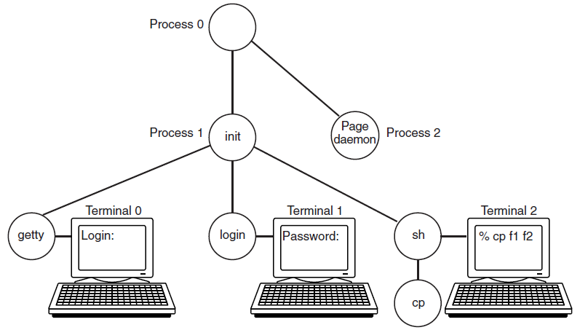
Booting Linux
Figure 10-11. The sequence of processes used
to boot some Linux systems.
Tanenbaum & Bos, Modern Operating Systems: 4th ed., Global Edition (c) 2015 Pearson Education Limited. All rights reserved.

Slide 20
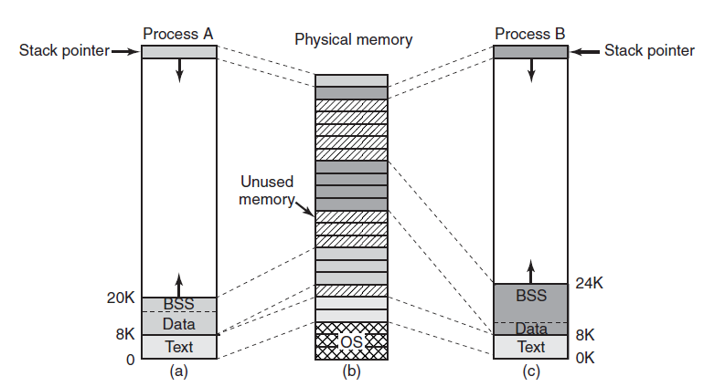
Memory Management
Fundamental Concepts (1)
Figure 10-12. (a) Process A’s virtual address space.
(b) Physical memory. (c) Process B’s virtual address space.
Tanenbaum & Bos, Modern Operating Systems: 4th ed., Global Edition (c) 2015 Pearson Education Limited. All rights reserved.

Slide 21
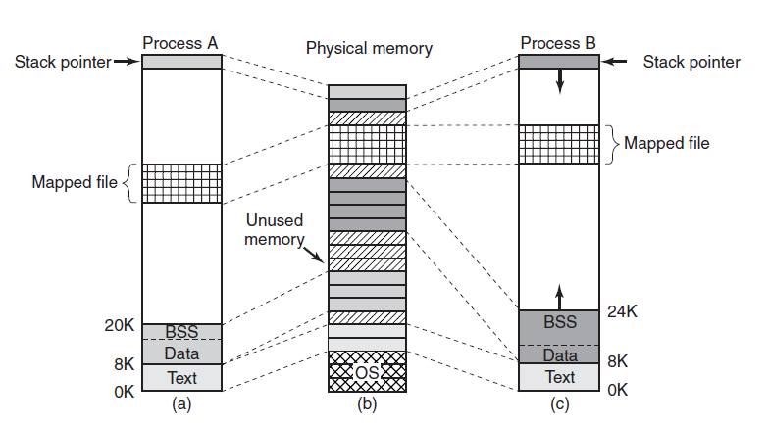
Memory Management
Fundamental Concepts (2)
Figure 10-13. Two processes can share a mapped file.
Tanenbaum & Bos, Modern Operating Systems: 4th ed., Global Edition (c) 2015 Pearson Education Limited. All rights reserved.

Slide 22
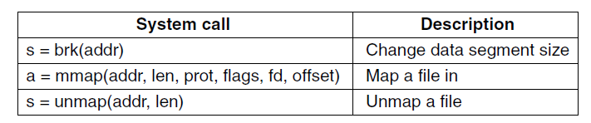
Memory Management
System Calls in Linux
Figure 10-14. Some system calls relating to memory management. The return code s is −1 if an error has occurred; a and addr are memory addresses, len is a length, prot controls protection, flags are miscellaneous bits, fd is a file descriptor, and offset is a file offset.
Tanenbaum & Bos, Modern Operating Systems: 4th ed., Global Edition (c) 2015 Pearson Education Limited. All rights reserved.

Slide 23
Physical Memory Management (1)
Linux Memory Zones:
ZONE_DMA and ZONE_DMA32
ZONE_NORMAL
ZONE_HIGHMEM
Tanenbaum & Bos, Modern Operating Systems: 4th ed., Global Edition (c) 2015 Pearson Education Limited. All rights reserved.

Slide 24
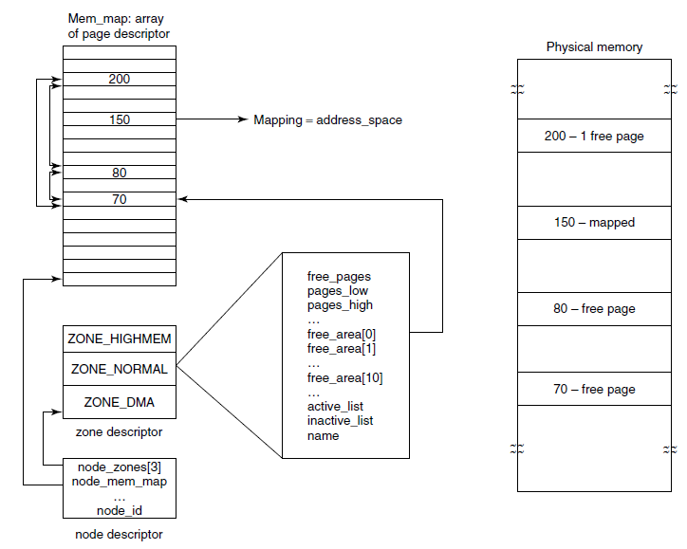
Physical Memory Management (2)
Figure 10-15. Linux main memory representation.
Tanenbaum & Bos, Modern Operating Systems: 4th ed., Global Edition (c) 2015 Pearson Education Limited. All rights reserved.

Slide 25
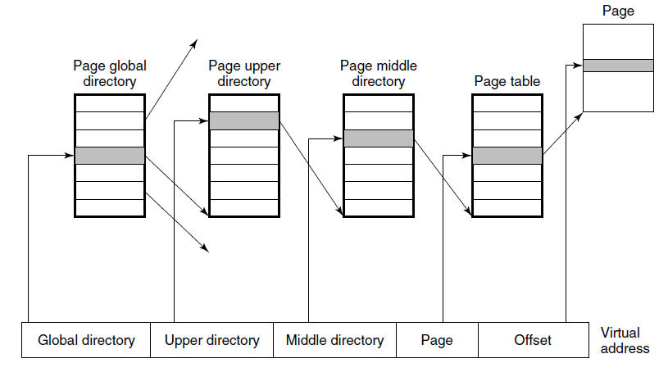
Physical Memory Management (3)
Figure 10-16. Linux uses four-level page tables.
Tanenbaum & Bos, Modern Operating Systems: 4th ed., Global Edition (c) 2015 Pearson Education Limited. All rights reserved.

Slide 26
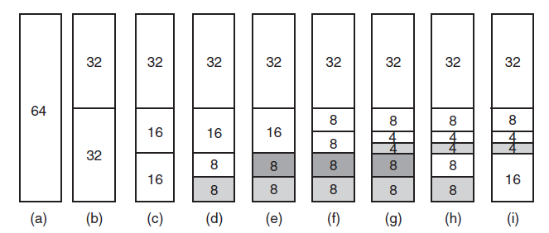
Memory Allocation Mechanisms
Figure 10-17. Operation of the buddy algorithm
Tanenbaum & Bos, Modern Operating Systems: 4th ed., Global Edition (c) 2015 Pearson Education Limited. All rights reserved.

Slide 27
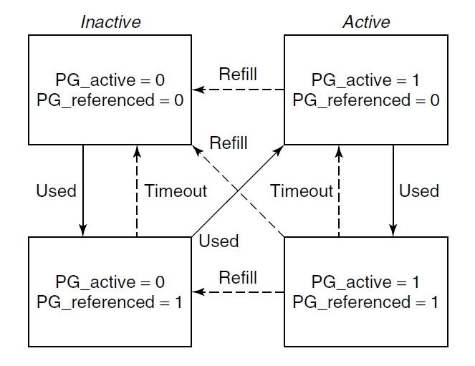
The Page Replacement Algorithm
Figure 10-18. Page states considered in the
page frame replacement algorithm.
Tanenbaum & Bos, Modern Operating Systems: 4th ed., Global Edition (c) 2015 Pearson Education Limited. All rights reserved.

Slide 28
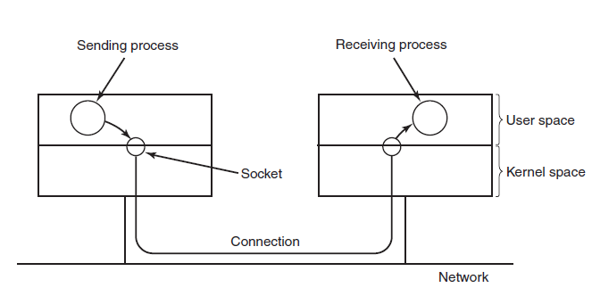
I/O in Linux – Networking (1)
Figure 10-19. The uses of sockets for networking
Tanenbaum & Bos, Modern Operating Systems: 4th ed., Global Edition (c) 2015 Pearson Education Limited. All rights reserved.

Slide 29
I/O in Linux – Networking (2)
Common socket types:
Reliable connection-oriented byte stream.
Reliable connection-oriented packet stream.
Unreliable packet transmission.
Tanenbaum & Bos, Modern Operating Systems: 4th ed., Global Edition (c) 2015 Pearson Education Limited. All rights reserved.

Slide 30
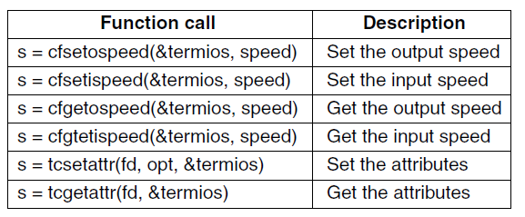
Input/Output System Calls in Linux
Figure 10-20. The main POSIX calls
for managing the terminal.
Tanenbaum & Bos, Modern Operating Systems: 4th ed., Global Edition (c) 2015 Pearson Education Limited. All rights reserved.

Slide 31
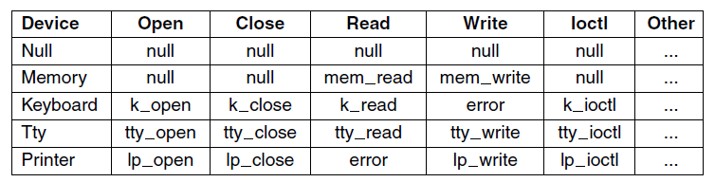
Implementation of I/O in Linux (1)
Figure 10-21. Some of the file operations supported for typical character devices.
Tanenbaum & Bos, Modern Operating Systems: 4th ed., Global Edition (c) 2015 Pearson Education Limited. All rights reserved.

Slide 32
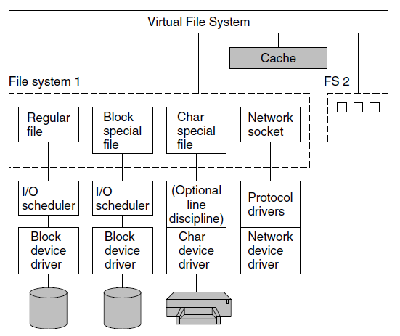
Implementation of I/O in Linux (2)
Figure 10-22. The Linux I/O system showing
one file system in detail.
Tanenbaum & Bos, Modern Operating Systems: 4th ed., Global Edition (c) 2015 Pearson Education Limited. All rights reserved.

Slide 33
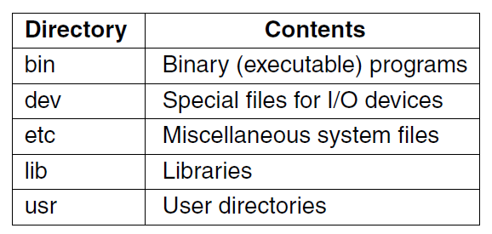
Linux File System:
Fundamental Concepts (1)
Figure 10-23. Some important directories
found in most Linux systems.
Tanenbaum & Bos, Modern Operating Systems: 4th ed., Global Edition (c) 2015 Pearson Education Limited. All rights reserved.

Slide 34
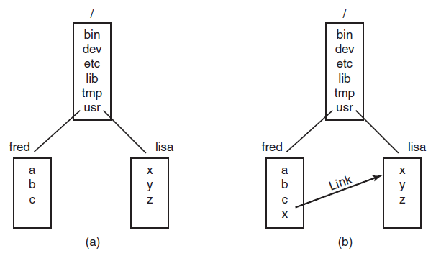
Linux File System:
Fundamental Concepts (2)
Figure 10-24. (a) Before linking. (b) After linking.
Tanenbaum & Bos, Modern Operating Systems: 4th ed., Global Edition (c) 2015 Pearson Education Limited. All rights reserved.

Slide 35
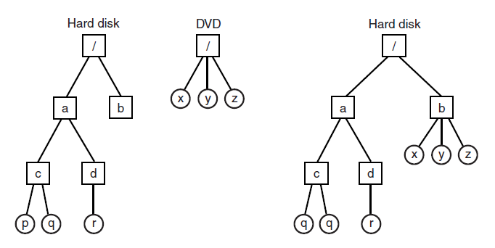
Linux File System:
Fundamental Concepts (3)
Figure 10-25. (a) Separate file systems. (b) After mounting.
Tanenbaum & Bos, Modern Operating Systems: 4th ed., Global Edition (c) 2015 Pearson Education Limited. All rights reserved.

Slide 36
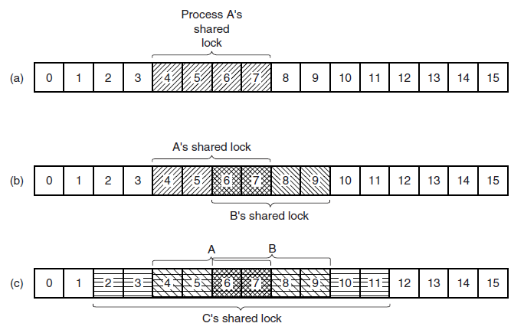
Linux File System:
Fundamental Concepts (4)
Figure 10-26. (a) A file with one lock.
(b) Addition of a second lock. (c) A third lock.
Tanenbaum & Bos, Modern Operating Systems: 4th ed., Global Edition (c) 2015 Pearson Education Limited. All rights reserved.

Slide 37
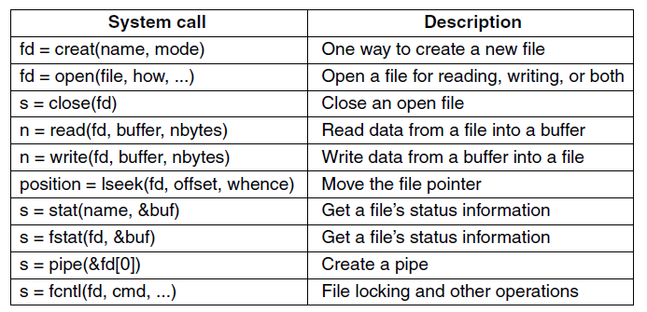
File System Calls in Linux (1)
Figure 10-27. Some system calls relating to files. The return code s is −1 if an error has occurred; fd is a file descriptor, and position is a file offset. The parameters should be self explanatory.
Tanenbaum & Bos, Modern Operating Systems: 4th ed., Global Edition (c) 2015 Pearson Education Limited. All rights reserved.

Slide 38
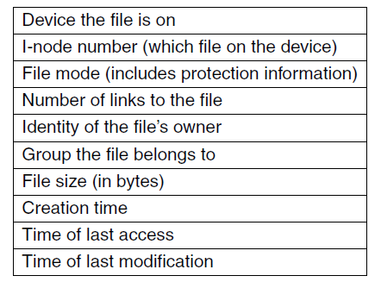
File System Calls in Linux (2)
Figure 10-28. The fields returned by the stat system call.
Tanenbaum & Bos, Modern Operating Systems: 4th ed., Global Edition (c) 2015 Pearson Education Limited. All rights reserved.

Slide 39
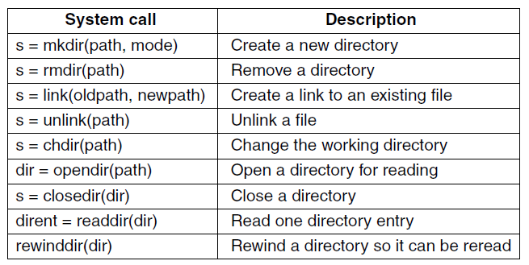
File System Calls in Linux (3)
Figure 10-29. Some system calls relating to directories. The return code s is −1 if an error has occurred; dir identifies a directory stream, and dirent is a directory entry. The parameters should be self explanatory.
Tanenbaum & Bos, Modern Operating Systems: 4th ed., Global Edition (c) 2015 Pearson Education Limited. All rights reserved.

Slide 40
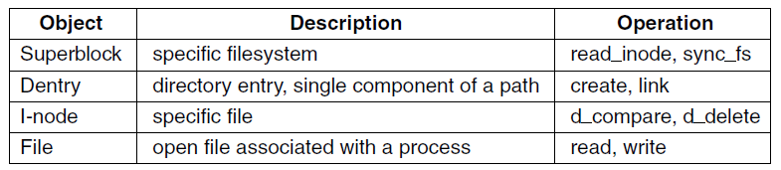
The Linux Virtual File System
Figure 10-30. File system abstractions supported by the VFS.
Tanenbaum & Bos, Modern Operating Systems: 4th ed., Global Edition (c) 2015 Pearson Education Limited. All rights reserved.

Slide 41
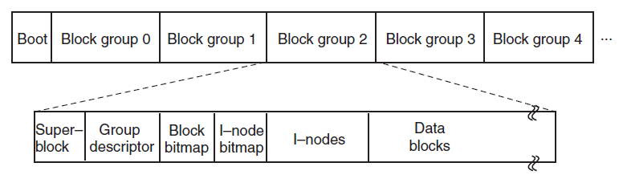
The Linux Ext2 File System (1)
Figure 10-31. Disk layout of the Linux ext2 file system.
Tanenbaum & Bos, Modern Operating Systems: 4th ed., Global Edition (c) 2015 Pearson Education Limited. All rights reserved.

Slide 42
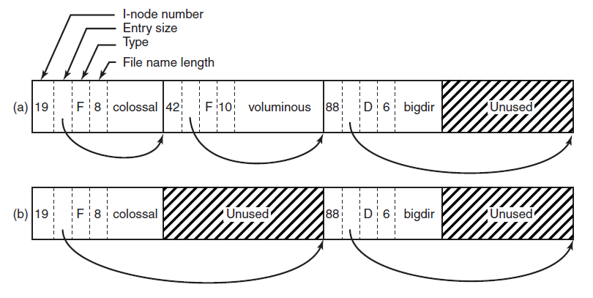
The Linux Ext2 File System (2)
Figure 10-32. (a) A Linux directory with three files. (b) The same directory after the file voluminous has been removed.
Tanenbaum & Bos, Modern Operating Systems: 4th ed., Global Edition (c) 2015 Pearson Education Limited. All rights reserved.

Slide 43
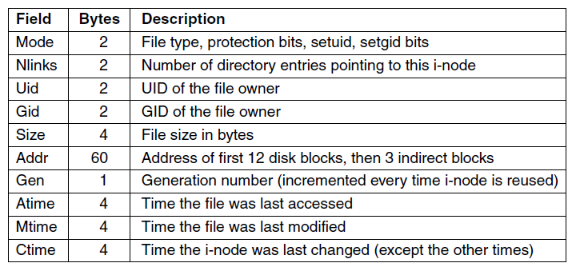
The Linux Ext2 File System (3)
10-33. Some fields in the i-node structure in Linux
Tanenbaum & Bos, Modern Operating Systems: 4th ed., Global Edition (c) 2015 Pearson Education Limited. All rights reserved.

Slide 44
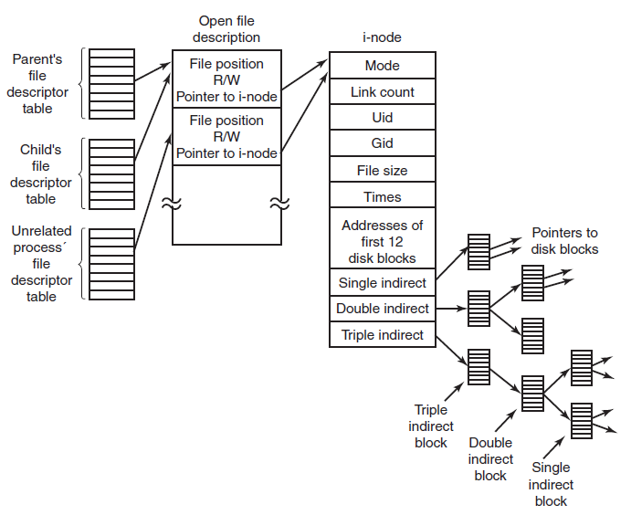
The Linux Ext2 File System (4)
Figure 10-34. The relation between the file descriptor table, the open file description table, and the i-node table.
Tanenbaum & Bos, Modern Operating Systems: 4th ed., Global Edition (c) 2015 Pearson Education Limited. All rights reserved.

Slide 45
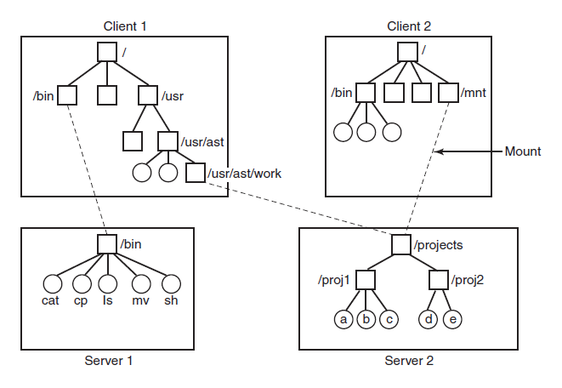
NFS Architecture
Figure 10-35. Examples of remote mounted file systems. Directories are shown as squares and files are shown as circles.
Tanenbaum & Bos, Modern Operating Systems: 4th ed., Global Edition (c) 2015 Pearson Education Limited. All rights reserved.

Slide 46
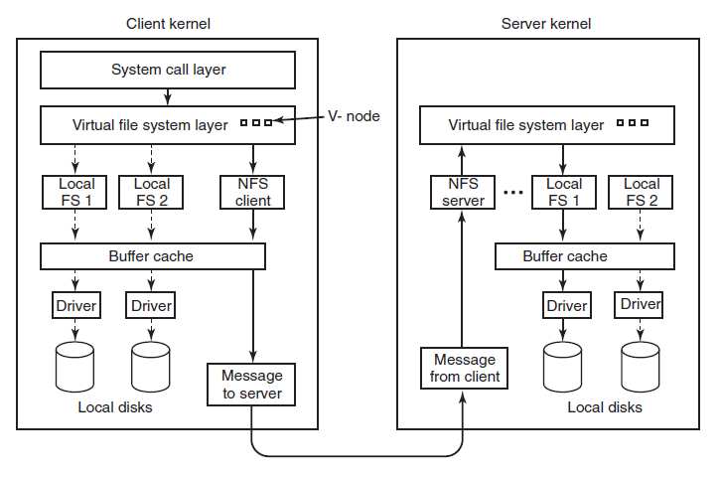
NFS Implementation
Figure 10-36. The NFS layer structure
Tanenbaum & Bos, Modern Operating Systems: 4th ed., Global Edition (c) 2015 Pearson Education Limited. All rights reserved.

Slide 47
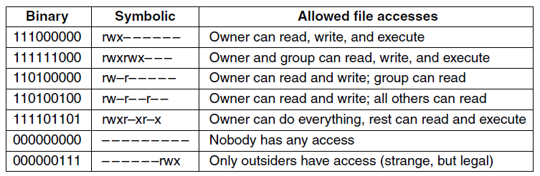
Linux Security
Fundamental Concepts
Figure 10-37. Some example file protection modes.
Tanenbaum & Bos, Modern Operating Systems: 4th ed., Global Edition (c) 2015 Pearson Education Limited. All rights reserved.

Slide 48
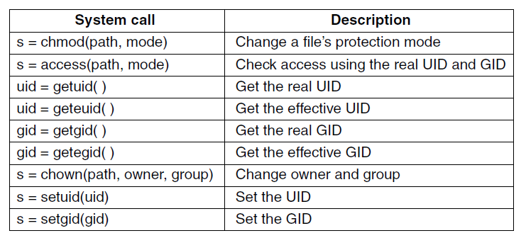
Security System Calls in Linux
Figure 10-38. Some system calls relating to security. The return code s is −1 if an error has occurred; uid and gid are the UID and GID, respectively. The parameters should be self explanatory.
Tanenbaum & Bos, Modern Operating Systems: 4th ed., Global Edition (c) 2015 Pearson Education Limited. All rights reserved.

Slide 49
Android – Design Goals
Open-source platform for mobile devices
Support 3rd party apps with robust, stable API
3rd party apps compete on level playing field
Users need not deeply trust 3rd party apps
Support mobile user interaction
Manage app processes for users
Encourage apps to interoperate, collaborate
Full general-purpose OS
Tanenbaum & Bos, Modern Operating Systems: 4th ed., Global Edition (c) 2015 Pearson Education Limited. All rights reserved.

Slide 50
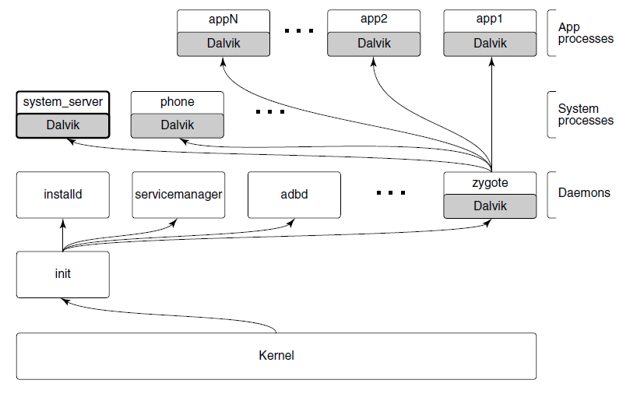
Android Architecture (1)
Figure 10-39. Android process hierarchy.
Tanenbaum & Bos, Modern Operating Systems: 4th ed., Global Edition (c) 2015 Pearson Education Limited. All rights reserved.

Slide 51
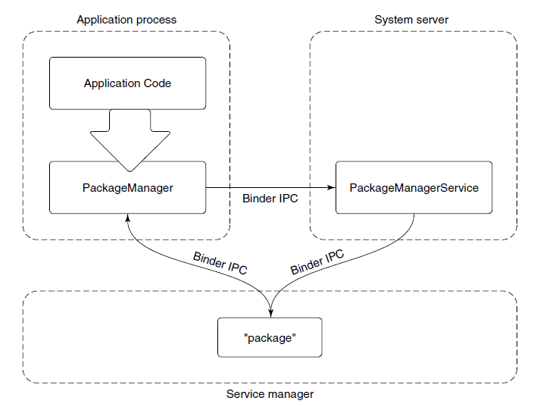
Android Architecture (2)
Figure 10-40. Publishing and interacting with system services.
Tanenbaum & Bos, Modern Operating Systems: 4th ed., Global Edition (c) 2015 Pearson Education Limited. All rights reserved.

Slide 52
Wake Locks
Contrast idle CPU, true sleep
Idle state may use more power than true sleep
Idle CPU can wake up at any moment if work becomes available
Idle CUP does not tell you that you can turn off other hardware not needed in true sleep
Tanenbaum & Bos, Modern Operating Systems: 4th ed., Global Edition (c) 2015 Pearson Education Limited. All rights reserved.

Slide 53
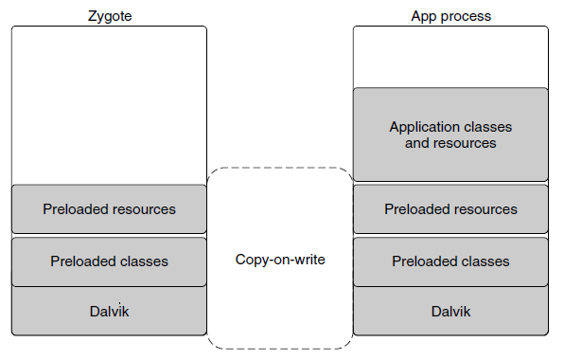
Dalvik
Figure 10-41. Creating a new Dalvik process from zygote.
Tanenbaum & Bos, Modern Operating Systems: 4th ed., Global Edition (c) 2015 Pearson Education Limited. All rights reserved.

Slide 54
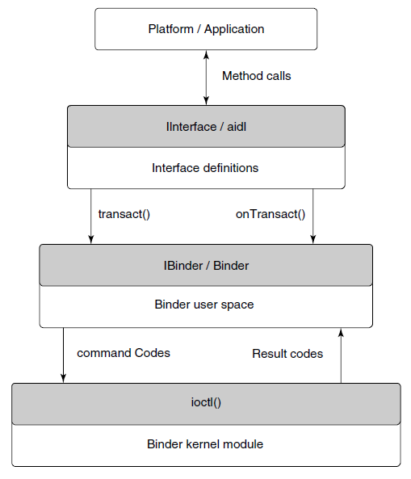
Binder IPC
Figure 10-42. Binder IPC architecture.
Tanenbaum & Bos, Modern Operating Systems: 4th ed., Global Edition (c) 2015 Pearson Education Limited. All rights reserved.

Slide 55
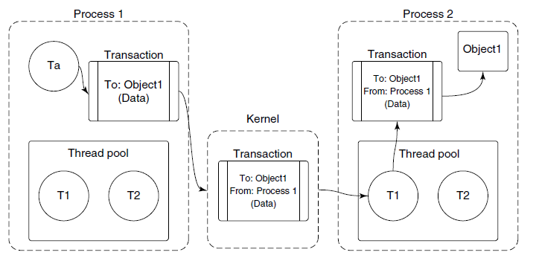
Binder Kernel Module (1)
Figure 10-43. Basic Binder IPC transaction
Tanenbaum & Bos, Modern Operating Systems: 4th ed., Global Edition (c) 2015 Pearson Education Limited. All rights reserved.

Slide 56
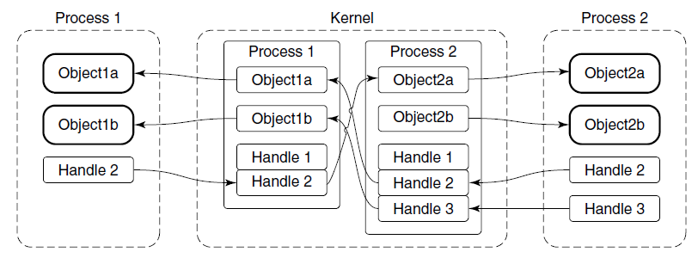
Binder Kernel Module (2)
Figure 10-44. Binder cross-process object mapping.
Tanenbaum & Bos, Modern Operating Systems: 4th ed., Global Edition (c) 2015 Pearson Education Limited. All rights reserved.

Slide 57
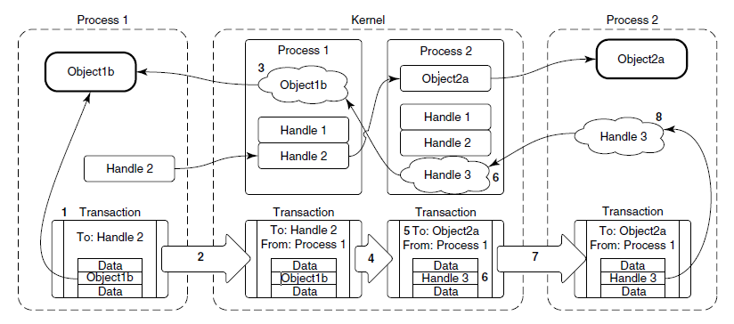
Binder Kernel Module (3)
Figure 10-45. Transferring Binder objects between processes.
Tanenbaum & Bos, Modern Operating Systems: 4th ed., Global Edition (c) 2015 Pearson Education Limited. All rights reserved.

Slide 58
Binder User-Space API (1)
User-space object-oriented library
IBinder is an abstract interface for a Binder object
Binder is a concrete Binder object
Parcel is a container for reading and writing data that is in a Binder transaction.
Tanenbaum & Bos, Modern Operating Systems: 4th ed., Global Edition (c) 2015 Pearson Education Limited. All rights reserved.

Slide 59
Binder User-Space API (2)
Three classes now make it fairly easy to write IPC code:
Subclass from Binder.
Implement onTransact to decode and execute incoming calls.
Implement corresponding code to create a Parcel that can be passed to that object’s transact method.
Tanenbaum & Bos, Modern Operating Systems: 4th ed., Global Edition (c) 2015 Pearson Education Limited. All rights reserved.

Slide 60
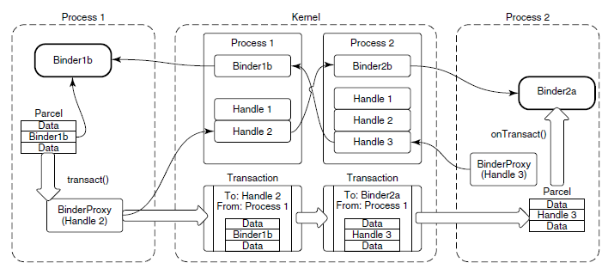
Binder User-Space API (3)
Figure 10-46. Binder user-space API.
Tanenbaum & Bos, Modern Operating Systems: 4th ed., Global Edition (c) 2015 Pearson Education Limited. All rights reserved.

Slide 61
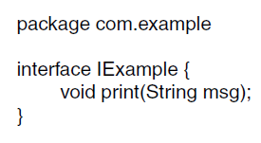
Binder Interfaces and AIDL (1)
Figure 10-47. Simple interface described in AIDL.
Tanenbaum & Bos, Modern Operating Systems: 4th ed., Global Edition (c) 2015 Pearson Education Limited. All rights reserved.

Slide 62
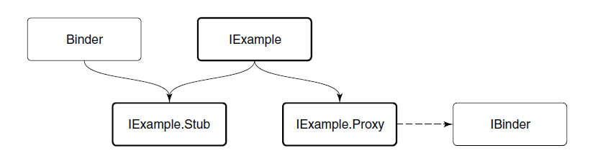
Binder Interfaces and AIDL (2)
Figure 10-48. Binder interface inheritance hierarchy.
Tanenbaum & Bos, Modern Operating Systems: 4th ed., Global Edition (c) 2015 Pearson Education Limited. All rights reserved.

Slide 63
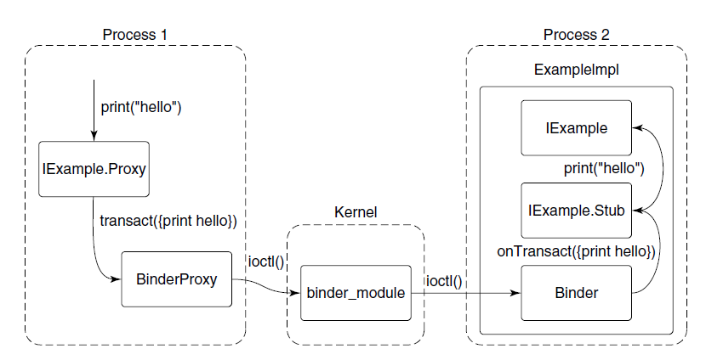
Binder Interfaces and AIDL (3)
Figure 10-49. Full path of an AIDL-based Binder IPC.
Tanenbaum & Bos, Modern Operating Systems: 4th ed., Global Edition (c) 2015 Pearson Education Limited. All rights reserved.

Slide 64

Android Applications (1)
Figure 10-50. Basic service manager AIDL interface.
Tanenbaum & Bos, Modern Operating Systems: 4th ed., Global Edition (c) 2015 Pearson Education Limited. All rights reserved.

Slide 65
Android Applications (2)
Contents of an apk
A manifest describing what the application is, what it does, and how to run it
Resources needed by the application
The code itself
Signing information, securely identifying the author
Tanenbaum & Bos, Modern Operating Systems: 4th ed., Global Edition (c) 2015 Pearson Education Limited. All rights reserved.

Slide 66

Android Applications (3)
Figure 10-51. Basic structure of AndroidManifest.xml.
Tanenbaum & Bos, Modern Operating Systems: 4th ed., Global Edition (c) 2015 Pearson Education Limited. All rights reserved.

Slide 67

Android Applications (4)
Figure 10-51. Basic structure of AndroidManifest.xml.
Tanenbaum & Bos, Modern Operating Systems: 4th ed., Global Edition (c) 2015 Pearson Education Limited. All rights reserved.

Slide 68

Activities (1)
Figure 10-52. Starting an email application’s main activity.
Tanenbaum & Bos, Modern Operating Systems: 4th ed., Global Edition (c) 2015 Pearson Education Limited. All rights reserved.

Slide 69

Activities (2)
Figure 10-53. Starting the camera application after email.
Tanenbaum & Bos, Modern Operating Systems: 4th ed., Global Edition (c) 2015 Pearson Education Limited. All rights reserved.

Slide 70

Activities (3)
Figure 10-54. Removing the email process to
reclaim RAM for the camera.
Tanenbaum & Bos, Modern Operating Systems: 4th ed., Global Edition (c) 2015 Pearson Education Limited. All rights reserved.

Slide 71

Activities (4)
Figure 10-55. Sharing a camera picture
through the email application.
Tanenbaum & Bos, Modern Operating Systems: 4th ed., Global Edition (c) 2015 Pearson Education Limited. All rights reserved.

Slide 72

Activities (5)
Figure 10-56. Returning to the email application.
Tanenbaum & Bos, Modern Operating Systems: 4th ed., Global Edition (c) 2015 Pearson Education Limited. All rights reserved.

Slide 73
Services (1)
A service has two distinct identities:
It can be a self-contained long-running background operation.
It can serve as a connection point for other applications or the system to perform rich interaction with the application
Tanenbaum & Bos, Modern Operating Systems: 4th ed., Global Edition (c) 2015 Pearson Education Limited. All rights reserved.

Slide 74

Services (2)
Figure 10-57. Starting an application service.
Tanenbaum & Bos, Modern Operating Systems: 4th ed., Global Edition (c) 2015 Pearson Education Limited. All rights reserved.

Slide 75

Services (3)
Figure 10-58. Interface for controlling a sync service’s sync interval.
Tanenbaum & Bos, Modern Operating Systems: 4th ed., Global Edition (c) 2015 Pearson Education Limited. All rights reserved.

Slide 76

Services (4)
Figure 10-59. Binding to an application service.
Tanenbaum & Bos, Modern Operating Systems: 4th ed., Global Edition (c) 2015 Pearson Education Limited. All rights reserved.

Slide 77

Receivers
Figure 10-60. Sending a broadcast to application receivers.
Tanenbaum & Bos, Modern Operating Systems: 4th ed., Global Edition (c) 2015 Pearson Education Limited. All rights reserved.

Slide 78

Content Providers
Figure 10-61. Interacting with a content provider.
Tanenbaum & Bos, Modern Operating Systems: 4th ed., Global Edition (c) 2015 Pearson Education Limited. All rights reserved.

Slide 79

Application Sandboxes
Security (1)
Figure 10-62. Common UID assignments in Android
Tanenbaum & Bos, Modern Operating Systems: 4th ed., Global Edition (c) 2015 Pearson Education Limited. All rights reserved.

Slide 80

Security (2)
Figure 10-63. Requesting and using a permission.
Tanenbaum & Bos, Modern Operating Systems: 4th ed., Global Edition (c) 2015 Pearson Education Limited. All rights reserved.

Slide 81

Security (3)
Figure 10-64. Accessing data without a permission.
Tanenbaum & Bos, Modern Operating Systems: 4th ed., Global Edition (c) 2015 Pearson Education Limited. All rights reserved.

Slide 82

Security (4)
Figure 10-65. Sharing a picture using a content provider.
Tanenbaum & Bos, Modern Operating Systems: 4th ed., Global Edition (c) 2015 Pearson Education Limited. All rights reserved.

Slide 83

Security (5)
Figure 10-66. Adding a picture attachment
using a content provider.
Tanenbaum & Bos, Modern Operating Systems: 4th ed., Global Edition (c) 2015 Pearson Education Limited. All rights reserved.

Slide 84

Starting Processes
Figure 10-67. Steps in launching a new application process.
Tanenbaum & Bos, Modern Operating Systems: 4th ed., Global Edition (c) 2015 Pearson Education Limited. All rights reserved.

Slide 85

Process Lifecycle
Figure 10-68. Process importance categories.
Tanenbaum & Bos, Modern Operating Systems: 4th ed., Global Edition (c) 2015 Pearson Education Limited. All rights reserved.

Slide 86

Process Dependencies (1)
Figure 10-69. Typical state of process importance
Tanenbaum & Bos, Modern Operating Systems: 4th ed., Global Edition (c) 2015 Pearson Education Limited. All rights reserved.

Slide 87

Process Dependencies (2)
Figure 10-70. Process state after email stops using camera
Tanenbaum & Bos, Modern Operating Systems: 4th ed., Global Edition (c) 2015 Pearson Education Limited. All rights reserved.

Slide 88
End
Chapter 10
Tanenbaum & Bos, Modern Operating Systems: 4th ed., Global Edition (c) 2015 Pearson Education Limited. All rights reserved.

