Slide 1
Security Strategies in Linux Platforms and Applications
Lesson 1
Security Threats to Linux

Slide 2
Learning Objective
Identify threats to the Linux operating system and other open source applications.

Slide 3
Key Concepts
Open source software security considerations
Impact of laws and regulations on a security policy
Threats to the seven domains of an information technology (IT) infrastructure
Standard methodologies for testing vulnerabilities on Linux and open source applications
Linux in the emerging virtual machine (VM) market

Slide 4
DISCOVER: CONCEPTS

Slide 5
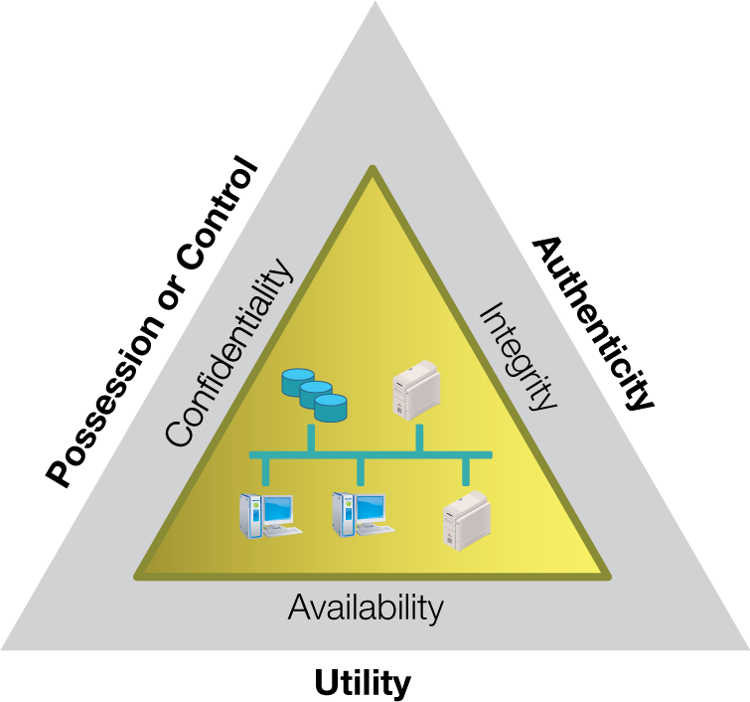
C-I-A Triad the Parkerian Hexad

Slide 6
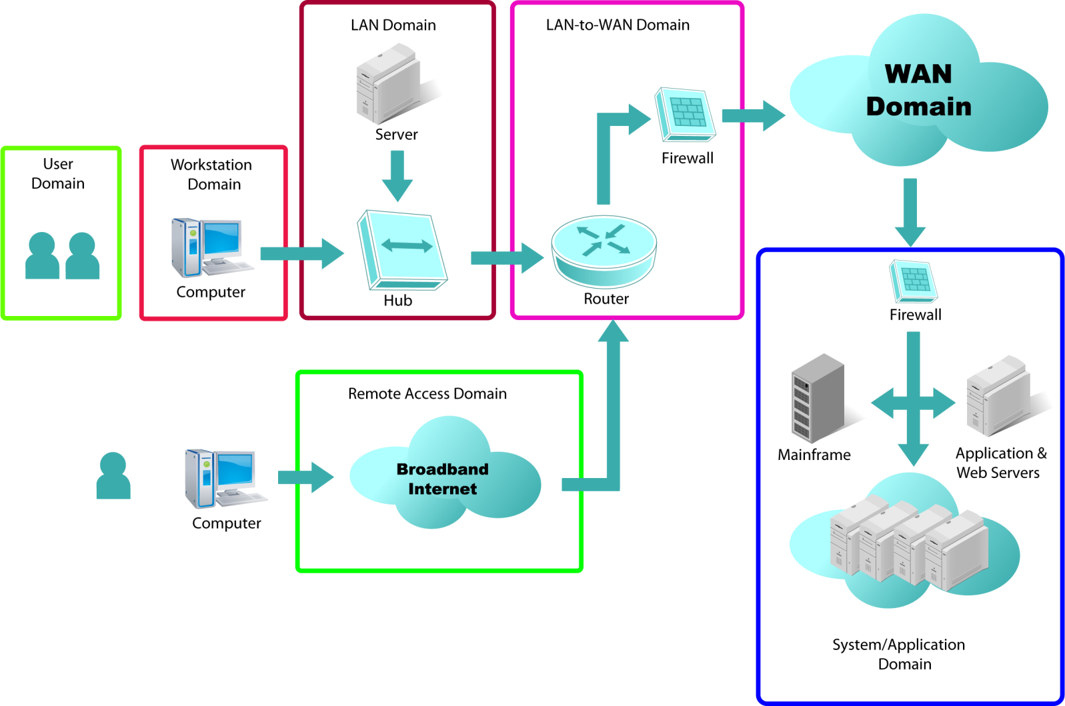
Seven Domains of a Typical IT Infrastructure

Slide 7
Linux in the Seven Domains
User Domain
Workstation Domain
LAN Domain
WAN Domain

Slide 8
Linux in the Seven Domains (Continued)
LAN-to-WAN Domain
Remote Access Domain
System Domain

Slide 9
Open Source Productivity Applications
Firefox Web browser
OpenOffice.org suite
Thunderbird e-mail client
Scribus desktop
Kino video editor

Slide 10
DISCOVER: PROCESS

Slide 11
Defining the Security Framework
Frameworks to Choose From
Key Questions to Consider
National Institute of Standards and Technology (NIST)
Certified Information Systems Security Professional (CISSP) 10 Domains
International Organization for Standardization (ISO) 17799 and ISO 27001
Open Source Security Testing Methodology Manual (OSSTMM)
What are the critical assets and threat agents?
Who would a system compromise impact?
Where are the critical assets located?
When have past security breaches in the industry occurred?
How does legislation and regulations mandate policy?
Framework
Selection
Notes:
Framework selection

Slide 12
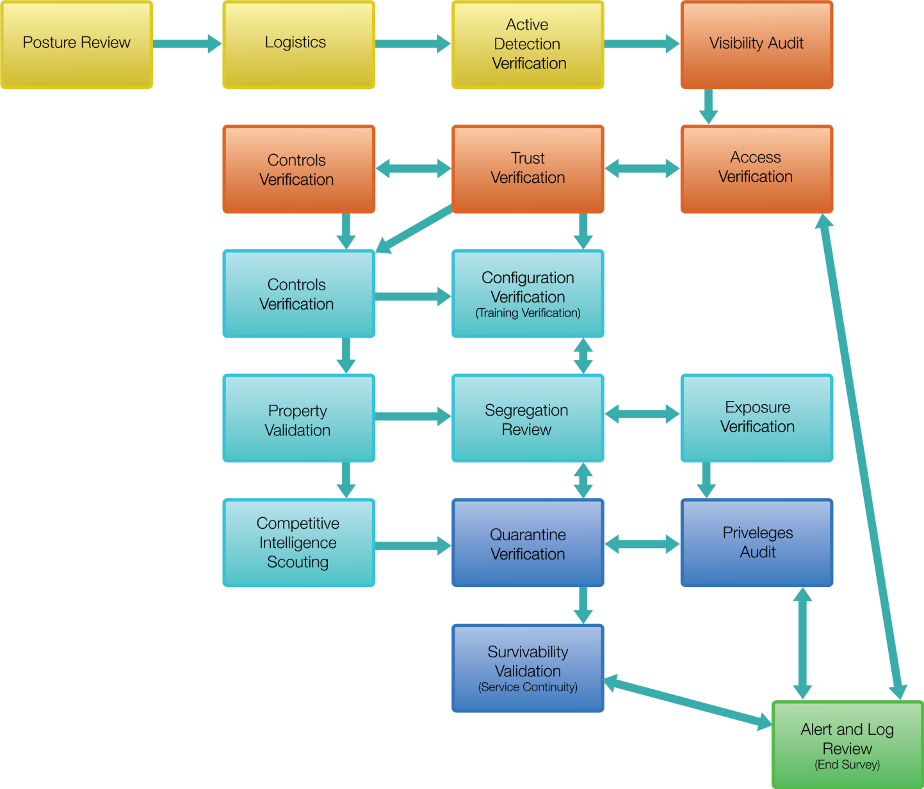
OSSTMM Test Methodologies
Notes:
From OSSTMM 3.0 Lite, 2008.

Slide 13
DISCOVER: ROLES

Slide 14
Responsibilities of a Linux System Administrator
System availability and performance
User access and denial
Maintenance of the integrity of operating system, application, storage files, resources, and data transmission

Slide 15
Tasks of a Linux System Administrator
Tuning performance and making upgrades
Configuring and restoring system
Managing user and group accounts
Deploying, logging, and monitoring
Documenting configurations and processes

Slide 16
DISCOVER: CONTEXTS

Slide 17
Linux in the Market: Quick Facts
Over 90% of the world’s super computers run on Linux.
The servers of New York Stock Exchange and Google run on Linux.
Red Hat and Novell are the top commercial Linux vendors for enterprises.
Linux is predicted to have a 33% smartphone share by 2015.
Notes:
Over 90% of the world’s super computers run on Linux.
Source: http://www.top500.org/lists/2010/06 (accessed July 22, 2010)
A quick check at the Web site http://news.netcraft.com/ shows many organizations’ Web servers run Linux.
Linux is predicted to have a 33% smartphone share by 2015.
Source: http://www.linuxfordevices.com/c/a/News/ABI-Research-Mobile-Linux-in-Smartphones/ (accessed July 22, 2010)

Slide 18
DISCOVER: RATIONALE

Slide 19
Virtual Machine (VM)
A VM can be a:
Hardware VM or Hypervisor
Type1—runs on native machines
Type2—runs on host operating systems as guest
Application VM
Java VM and Dalvik VM
Adobe Flash Player

Slide 20
Advantages of a Hypervisor
Saves money on hardware and power
Well-positioned for bastion hosts
Makes better use of hardware resources
Easier to manage

Slide 21
Linux in the VM Market
Linux provides a scalable, robust solution to scale many servers in a VM environment without the additional licensing costs.
The relative small size of Linux allows for many instances of VMs to run.
The Linux kernel 2.6.20 has virtualization capabilities built-in with Kernel-based VM (KVM).

Slide 22
Popular VM Software Used with Linux
VM | Licensing | Vendor
VirtualBox | Dual open source and commercial | Sun/Oracle
VMware server | Commercial | VMware
Xen | Open source and commercial | Citrix

Slide 23
Summary
Linux in the seven domains and various open source productivity applications
Facts about the use of Linux in the market
Responsibilities and tasks of a Linux system administrator
Process to define a security framework
Linux in the VM market and various VM software used with Linux

Slide 24
Virtual Lab
Installing a Core Linux Operating System on a Server
Notes:
If your educational institution included the Jones & Bartlett labs as part of the course curriculum, use this script to introduce the lab:
"In this lesson, you were introduced to the Linux environment. You learned that compared to other operating systems, fewer viruses, worms, and other malware are written for Linux, but because most Linux software is released with open source code which makes it easier for someone with malintent to break into a system. You discovered that in this environment, the kernel is customizable and the administrator can configure the security controls in the manner that works best for the organization.
In this lab, you will learn how to install the Linux CentOS operating system in a secure manner. You will create a new virtual machine, partition the hard drive, and install the Linux operating system. You also will create a non-root user account and verify that key services are (or are not) running.”

