Slide 1
Security Strategies in Linux Platforms and Applications
Lesson 4
User Privileges and Permissions

Slide 2
Learning Objective
Explain user account management and the principle of least privilege to protect and secure the system and its data.

Slide 3
Key Concepts
Policies for user accounts
Boundaries for the user, system, and root accounts
Group accounts for managing the security process
Pluggable Authentication Modules (PAM)
Special user privileges for accessing files, including the executable files

Slide 4
DISCOVER: CONCEPTS

Slide 5
Defining the User Account Policy
Who needs access and why?
How long does a user need access?
Where will the user access the computer system from?
What are the tasks the user needs to perform?

Slide 6
Best Practices for Account Management
Create a password policy in /etc/login.defs file.
Lock user accounts that will not need access for a long period of time.
Set account expiration for temporary accounts.
Remove user and service accounts that are no longer being used.
Monitor account usage and login attempts.

Slide 7
System, Service, and Regular User Accounts
System Account | Service Account | Regular Account
Created when the operating system is installed | Created automatically when installing a service using a package management program | Created by root or an account with privileged access
Users and groups < 100 | Users and groups < 500 | Users and groups > 500
Login directory typically set to /sbin/nologin or a system command, such as /sbin/shutdown | Login directory mostly set to /sbin/nologin but may also be set to a typical login shell, such as /bin/bash | Login directory set to /bin/bash

Slide 8
DISCOVER: PROCESS

Slide 9
Establishing a User Account Policy
1. Open the /etc/login.defs file.
2. Set the Password Change directive.
3. Set the Warn directive.
4. Set the password minimum length.
5. Enable login failure logging.
8. Save and exit.
6. Enable successful login logging.
7. Enable the su command.
Notes:
Here are the commands used for this process:
Open the /etc/login.defs file.
Su –c ‘vi /etc/login.defs
Set the Password Change directive.
PASS_MAX_DAYS 60
Set the Warn directive.
PASS_WARN_AGE 14
Set the password minimum length.
PASS_MIN_LEN 8
Enable login failure logging.
FAILLOG_ENAB
Enable successful login logging.
LOG_OK_LOGINS
Enable the su command.
SYSLOG_SU_ENAB
Save and exit.

Slide 10
Managing Password Change and Expiration Dates
The following change commands are used to enforce password change and expire accounts:
The command to enable user “jdoe” to change password at next login: [root@is418 ~]# chage -d 0 jdoe
The command to expire the user account “jane” on May 31, 2011: [root@is418 ~]# chage -E “05/31/2011” jane

Slide 11
Using sudo Command
1
As a root user, issue the following command: [root@is418 ~]# visudo
2
Enable ALL privileges to user “jdoe” by using the following command: jdoe ALL=(ALL) ALL
3
Login as “jdoe” and use the following sudo command: [jdoe@is418 ~]# sudo useradd maryj

Slide 12
DISCOVER: ROLES

Slide 13
Linux System Administrator
Creates user accounts
Enforces user account and password policy
Establishes user account policy

Slide 14
Files with Access Control List (ACL) Permissions
ACL grants special permissions that are not part of the regular file permissions.
These files are used to provide a user or group special access to a file or executable without changing the file permissions.
Permissions can be granted to a user (u), a group (g), and others (o).
Permissions are typically read, write, and execute.
Notes:
Types of permissions example:
A file may have the following permissions:
-rw-rw---- root.root /etc/secret_file.txt
The first ‘-’ means this is a file not a directory.
The next three characters ‘rw-’ means the owner has read and write permissions but cannot execute these permissions as denoted by the ‘-’ symbol.
The next set ‘rw-’ represents the group owner has read and write permissions.
The next set ‘---’ means others have no permissions at all to the file.
The next set ‘root.root” is the user owner and the group owner, user_owner.group_owner, which is root for the user owner and root for the group owner in this file.
If we have a user who needs permissions to read the secret_file.txt file but does not need to change the file permissions, an ACL can be set to grant permission to a specific user or group to read the file.
Scenario example:
The user Jane needs special access to read the mail logs. By default, only the root account can do this. Jane doesn’t need any other privileges, so we can assign an ACL privilege for her to read the /var/log/maillog file by using the following command:
Su –c ‘setfacl -m u:jane:r /var/log/maillog’
setfacl is the command to configure ACL permission
The –m switch is to ‘modify’
‘u:jane’ specifies user Jane. If this was a group, we would use g:group_name.
:r specifies ‘read’ permissions’
/var/log/maillog is the file path we are granting permissions for Jane
To, verify the permissions are granted to user Jane, use the following command:
getfacl /var/log/maillog

Slide 15
DISCOVER: CONTEXTS

Slide 16
Group Account
Groups provide a way to better manage accounts in the following ways:
Permissions can be given to a group rather than individuals.
Employees can be added or deleted from predefined groups.
Groups improve the maintainability of user accounts.
Notes:
For example, 500 plus users in a finance department needing special privileges to accounting files can be managed in groups.

Slide 17
DISCOVER: RATIONALE

Slide 18
Using PAM
An application can use its own authentication file in the /etc/pam.d directory.
PAM can be used to:
Allow access to specific application only during certain times of the day
Deny user logins based on files and restrict the user of the su command to only certain groups or users
Disconnect a user after ‘x’ number of login attempts

Slide 19
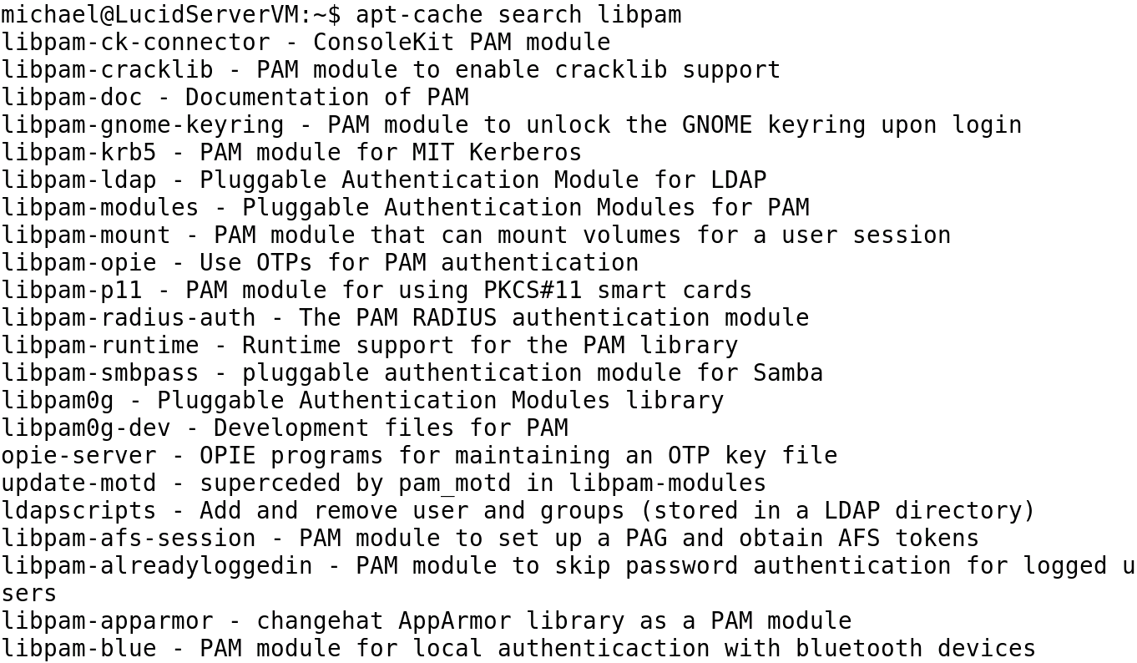
PAM-related Packages on Ubuntu

Slide 20
Summary
System, service, and regular user accounts, group accounts, and user account policy
Best practices for account management
Process of establishing a user account policy, managing password change, and using sudo command
Files with ACL permissions and the roles and responsibilities of a Linux system administrator
Use of PAM

Slide 21
Virtual Lab
Hardening Security with User Account Management and Security Controls
Notes:
If your educational institution included the Jones & Bartlett labs as part of the course curriculum, use this script to introduce the lab:
"In this lesson, you reviewed how user and group security is handled in the Linux environment. You learned that every user and group has a unique ID number and that each user account is configurable with a variety of advanced privileges. You discovered that Linux has a hierarchy of administrative privileges and that the su command allows a user with the root password to temporarily take on an administrators privileges. You also were introduced to PAM for restricting user logins.
In this lab, you will harden user accounts on a Linux system with a secure password policy definition. This definition will include the use of user groups to better manage large numbers of users. You also will create temporary user accounts and apply automatic account and password deletion after 90 days."

Slide 22
OPTIONAL SLIDES

Slide 23
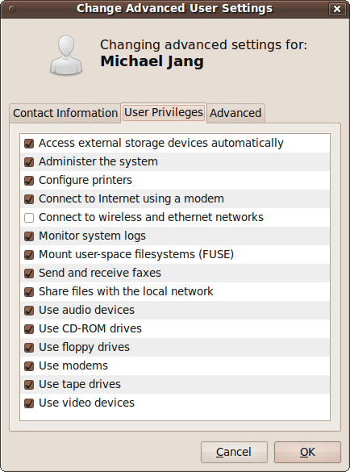
User Privileges as a Member of Special Groups

Slide 24
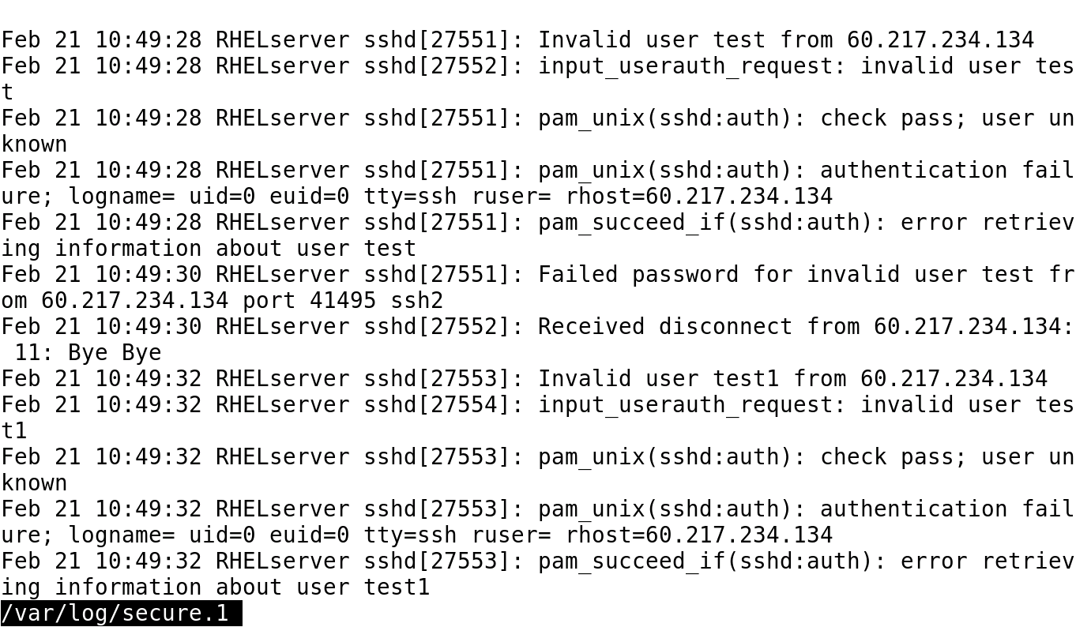
Failed Remote Login Attempts

Slide 25
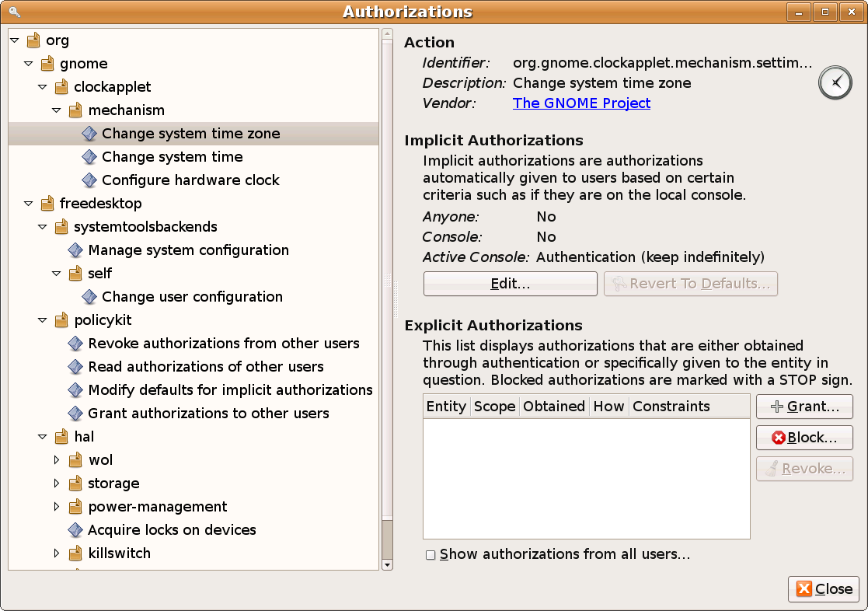
PolicyKit Authorizations Tool

