Slide 1
Security Strategies in Linux Platforms and Applications
Lesson 5
Filesystems, Volumes, and Encryption

Slide 2
Learning Objective
Examine the flexibility of various options with file permissions and filesystem settings and how granular control isolates data access.

Slide 3
Key Concepts
Linux filesystem hierarchy standard (FHS)
Filesystem mounting options
Remote filesystems
Filesystem encryption
Filesystem quotas

Slide 4
DISCOVER: CONCEPTS

Slide 5
The Filesystem Hierarchy Standard
What is it?
What is the purpose?
Notes:
What is it?
A filesystem standard designed to be used by various distributions such as Fedora, Ubuntu, and Debian. It is also used by distributions that package software for installing to UNIX-like systems, such as Apache.
What is the purpose?
To have a uniform standard for all users. If each distribution followed a different standard then it would be difficult to work efficiently across various Linux distributions and to locate files that are necessary to run an application.

Slide 6
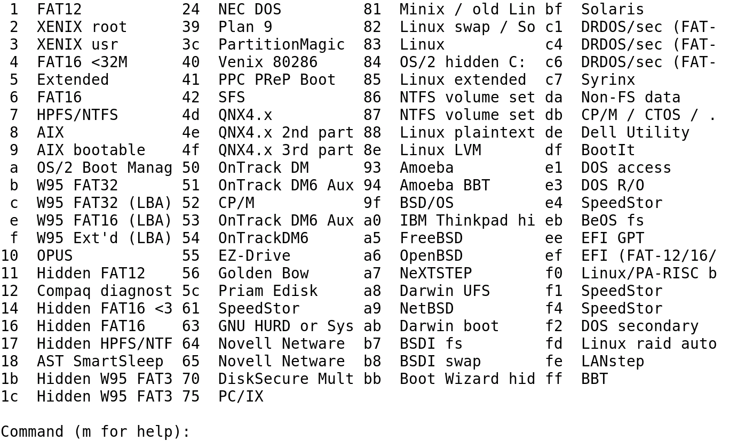
Linux Partition Type Identifiers

Slide 7
Filesystem Encryption
Encryption adds another layer of security for data that is considered confidential.
Documents such as customer personal information, social security numbers, credit card information, and business plans can be encrypted.
There are many regulations and laws for protecting consumer's personal data.

Slide 8
Filesystem Encryption Techniques
Kernel Space
Disk encryption subsystem (dm_Crypt)
Linux unified key setup (LUKS)
Loop-Advanced Encryption Standard (AES)
TrueCrypt
Enterprise cryptographic filesystem (eCryptfs)

Slide 9
Filesystem Encryption Techniques (Continued)
User Space
LUKS
Encrypted File System (EncFS)

Slide 10
Pros and Cons of Filesystem Encryption
Pros
Simple to implement
Cons
All data in filesystem is encrypted, including data you don’t want encrypted
Transparent to the user
Difficult to hack
Resizing the filesystem later is difficult

Slide 11
DISCOVER: PROCESS

Slide 12
Securing a Filesystem Using FHS
Format with an appropriate filesystem type.
Confine to read-only if there is no need for users to write or edit data.
Restrict executing files in the /tmp/ directory.
Encrypt directories that contain sensitive data.
Consider using quotas.

Slide 13
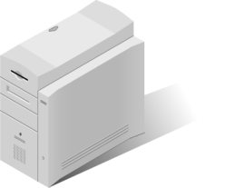
Configuring Remote Mounting
Data server with an Network File System (NFS) share
/etc/exports file on data.is418.local
/share *.is418.local.(ro,all_squash)
data.is418.local
Entry on each client server's /etc/fstab file
Web servers mount the share at boot
data.is418.local:/share /data nfs defaults 0 0

Slide 14
Enabling Quotas
Step 1
Configure filesystem to allow quotas in /etc/fstab using the command :
/home ext4 defaults,usrquota 1 2
Step 2
Remount the home filesystem using the command :
mount -o remount /home
Step 3
Initialize the quota database using the command :
quotacheck –cm /home
Step 4
Turn quotas on using the command:
quotaon /home

Slide 15
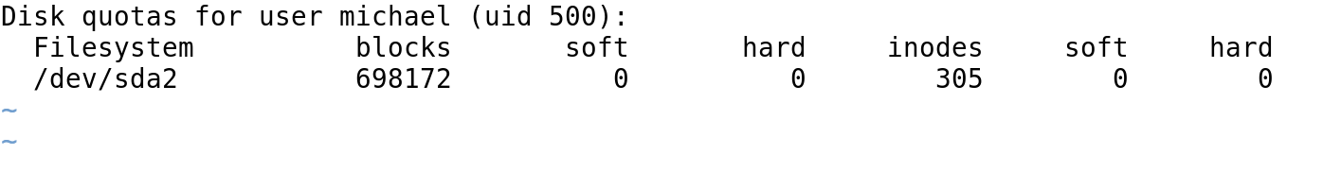
Editing a User Quota

Slide 16
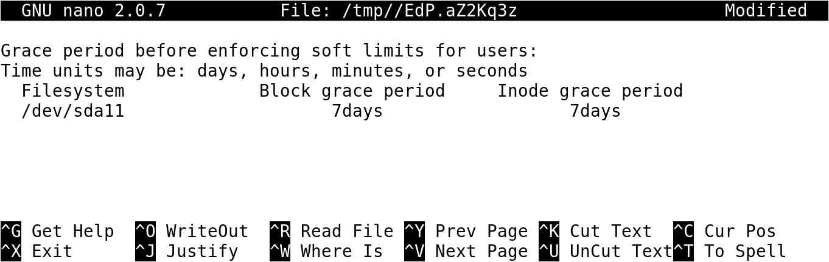
Quota Grace Periods

Slide 17
DISCOVER: ROLES

Slide 18
Securing the Linux Filesystem
Linux system administrator should:
Use binaries placed in /sbin/ directory.
Group files or create separate partitions for directories such as /var/, /home/, and /tmp/.
Isolate root account home directory from other users that are typically located in /home/<user>.

Slide 19
DISCOVER: CONTEXTS

Slide 20
NFS
Use the root_squash option to ensure requests to filesystem are not given root privileges.
Use the all_squash option for read-only shares.
Use the showmount command to verify that the correct shares are exported or not exported to various clients.

Slide 21
Samba
Is very flexible with its security settings
Can restrict access based on network or host address
Can restrict access and permissions to share for a particular group or list of users
Can be used for workstation and mixed environments with Windows operating system

Slide 22
DISCOVER: RATIONALE

Slide 23
Linux FHS
It helps users to locate data and files.
Fedora, Ubuntu, and other Linux distributions abide by the FHS.
It would be difficult to work efficiently across various Linux distributions if each distribution followed a completely different standard.
It helps administrators to systematically create and mount various partitions with desired options.

Slide 24
Filesystem Encryption
Stolen or compromised customer data is typically not encrypted.
If any organization's confidential data is compromised, it can have the following repercussions:
The organization’s image is damaged
The organization would be fined
The organization would incur extra cost for fixing the problem later

Slide 25
Setting Quotas
Once a directory or a partition becomes 100% full due to downloads, installs, archived data, and even personal music and movies, many processes stop working and can cause an operating system to be unavailable.
Enabling quotas for each user or group, or singling out a single user can prevent many problems.

Slide 26
Summary
Importance of FHS
Advantages and disadvantages of filesystem encryption
Process to use for securing a filesystem, configuring remote mounting, and enabling quotas
Use of NFS and Samba in Linux

Slide 27
Virtual Lab
Applying Hardened Linux File System Security Controls
Notes:
If your educational institution included the Jones & Bartlett labs as part of the course curriculum, use this script to introduce the lab:
"In this lesson, you learned how to use file and folder permissions to secure the information stored in those locations. You reviewed the common filesystem hierarchy standard directory configuration, discussed how to control access with file and folder ownership and permissions, and were introduced to Linux encryption tools for files, directories, and filesystems.
This lab incorporates security hardening for file systems and user access to mounted file systems. In this lab, you will mount a file system that does not have execute permissions on the CentOS Linux Server. You also will mount a remote file system and set quotas for users of mounted file systems."

