Slide 1
Security Strategies in Linux Platforms and Applications
Lesson 6
Every Service Is a Potential Risk

Slide 2
Learning Objective
Describe vulnerabilities in Linux services and the appropriate steps to mitigate the risks.

Slide 3
Key Concepts
Commonly installed Linux services
Bastion hosts
Bastion host hardening
Disabling unneeded services and removing unneeded packages
chroot jails

Slide 4
DISCOVER: CONCEPTS

Slide 5
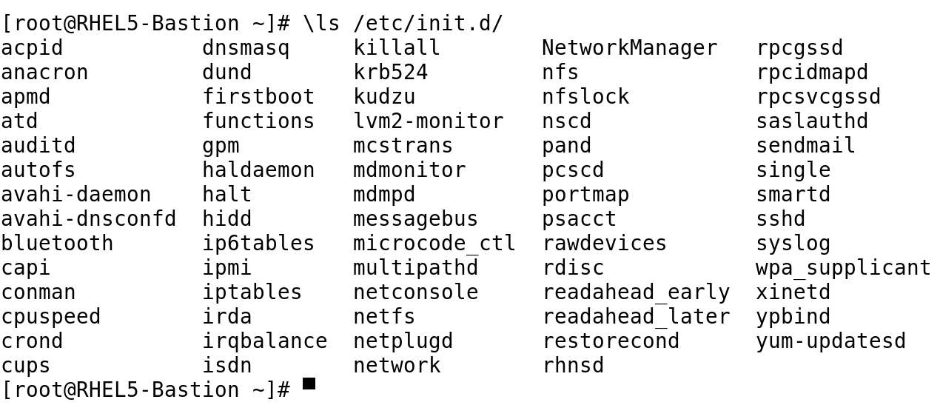
Service Scripts in /etc/init.d/

Slide 6
Vulnerabilities in Linux Services
Denial of Service (DoS)
Buffer overflows and misconfigured servers
Unpatched servers and rootkits
Web applications
Default settings and weak passwords

Slide 7
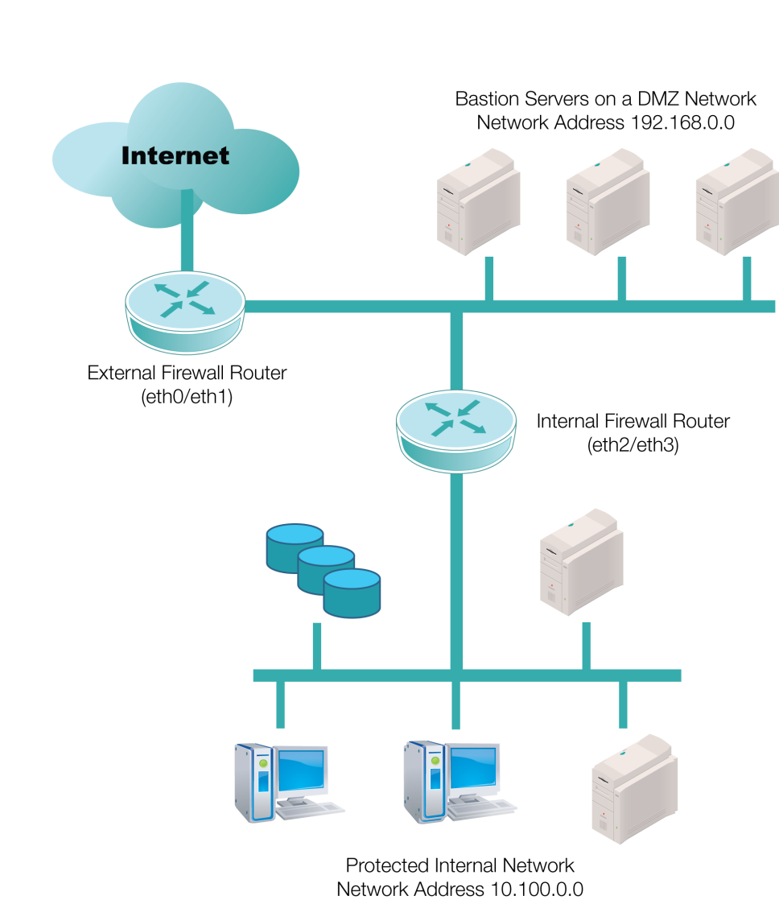
Bastion Servers in the DMZ

Slide 8


Bastion Hosts
Only has access to the one server and service
Web Server
H
Black-hat hacker exploits a bug in the Simple Mail Transfer Protocol (SMTP) Server
Database Server
Now has access to all the server services
Bastion Hosts
SMTP Server
Multipurpose Server

Slide 9
DISCOVER: PROCESS

Slide 10
Configuring a Bastion Host
Install an administrative service like SSH
Start with minimal Linux installation
Set up at least basic IPv4 networking
Remove unnecessary services
Remove unnecessary packages
Notes:
A Graphical User Interface (GUI) requires the X Window System to run, which is an added security risk. Other users in the network cannot login to the GUI remotely when XDMCP is turned off.

Slide 11
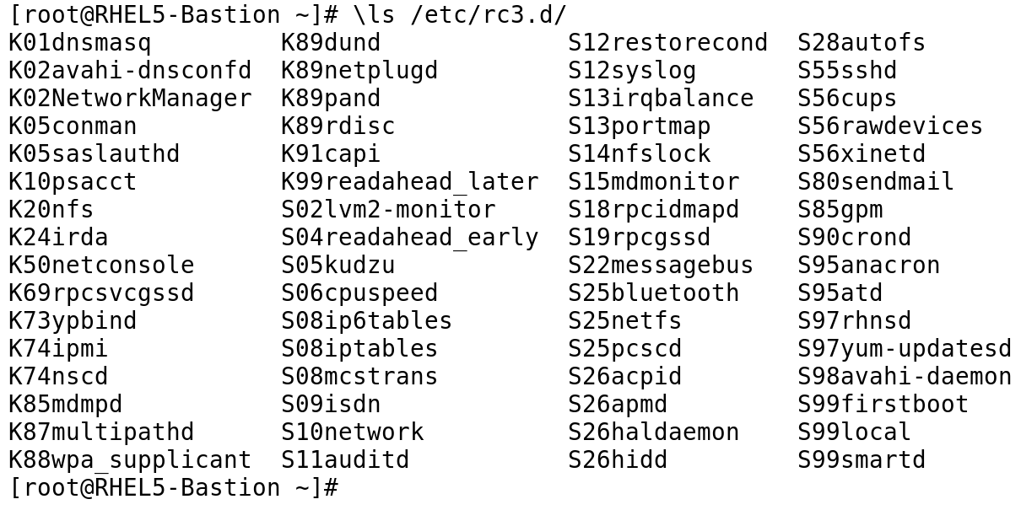
Active Services in Runlevel 3 Start with “S”
Notes:
The standard for most Linux distributions is to activate services in runlevels 2, 3, 4, and 5.
Linux distributions should be set to deactivate most services in runlevels 0, 1, and 6.

Slide 12
Getting Rid of Unneeded Services
Uninstall
Use yum or apt-get
Deactivate
Stop a service
Kill a PID
Watch for dependencies
Change service defaults
Notes:
A Graphical User Interface (GUI) requires the X Window System to run, which is an added security risk. Other users in the network cannot login to the GUI remotely when XDMCP is turned off.

Slide 13
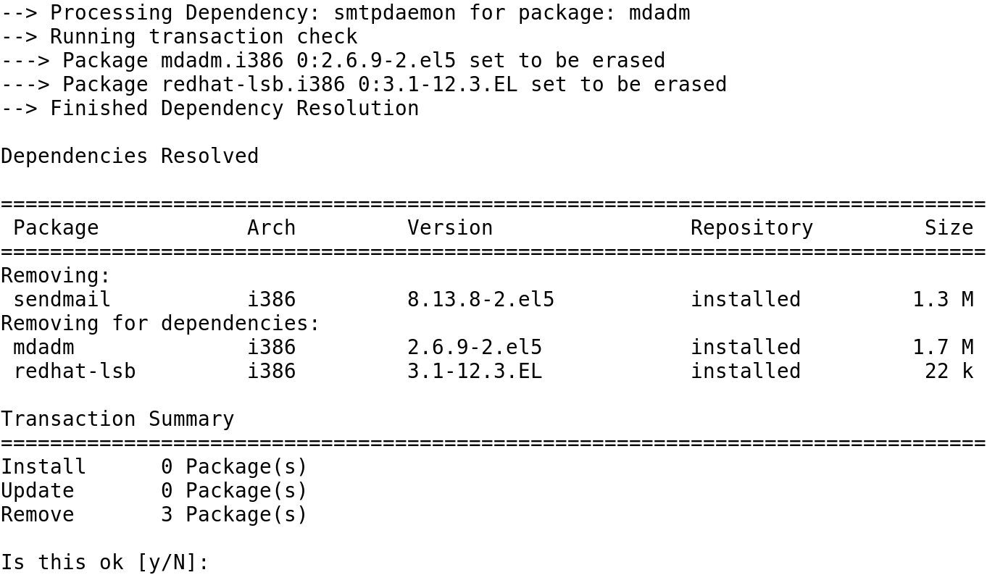
Dependency Processing
Notes:
Do you really want to uninstall packages for software RAID and the Linux Standards Base?

Slide 14
Mitigating Other Service Risks
Turn off the X Display Manager Control Protocol (XDMCP).
Keep only those productivity tools that are necessary.
Don't run any network services that are not needed.
Run the logwatch tool to monitor any attempted access to the Linux system.
Notes:
A Graphical User Interface (GUI) requires the X Window System to run, which is an added security risk. Other users in the network cannot login to the GUI remotely when XDMCP is turned off.

Slide 15
DISCOVER: ROLES

Slide 16
Linux System Administrator
Turns off or uninstalls unused services.
Ensures services do not run as root.
Runs services in chroot jail when appropriate.
Restricts access to services only to necessary users and applications.
Uses bastion hosts for server services and keeps services updated with latest security fixes.

Slide 17
DISCOVER: CONTEXTS

Slide 18
chroot Jail
Use chroot jail:
To enable an application access its own set of libraries and directory structure
To restrict access to users on a system
To run software such as Berkeley Internet Name Domain (BIND)
Notes:
Chroot is not a replacement for bastion hosts and/or virtual servers.

Slide 19
DISCOVER: RATIONALE

Slide 20
Benefits of Disabling or Uninstalling Unneeded Services
To eliminate the possibility of a black-hat hacker exploiting a vulnerability to a service when the service is not running
To improve system performance by running only the required services
To save hard drive space by uninstalling
To eliminate the need to update or patch a service when security vulnerabilities are discovered

Slide 21
Summary
Commonly installed Linux services
Bastion hosts
Bastion host hardening
Disabling unneeded services and removing unneeded packages
chroot jails

Slide 22
Virtual Lab
Hardening Security for Linux Services and Applications
Notes:
If your educational institution included the Jones & Bartlett labs as part of the course curriculum, use this script to introduce the lab:
"In this lesson, you examined the security-related features of a number of services. The more complex they are, the more important it is to keep the installed and enabled features to a minimum. You discussed vulnerabilities in Linux services and their mitigations.
In this lab, you will configure security and hardened services and applications to ensure the confidentiality, integrity, and availability of those services. You will configure and secure an Apache Web server and MySQL database and the components necessary to harden the security implementation of both. You also will configure the Sendmail application for secure local messaging and will enable secure, encrypted remote access using Secure Shell (SSH). "

Slide 23
OPTIONAL SLIDES

Slide 24
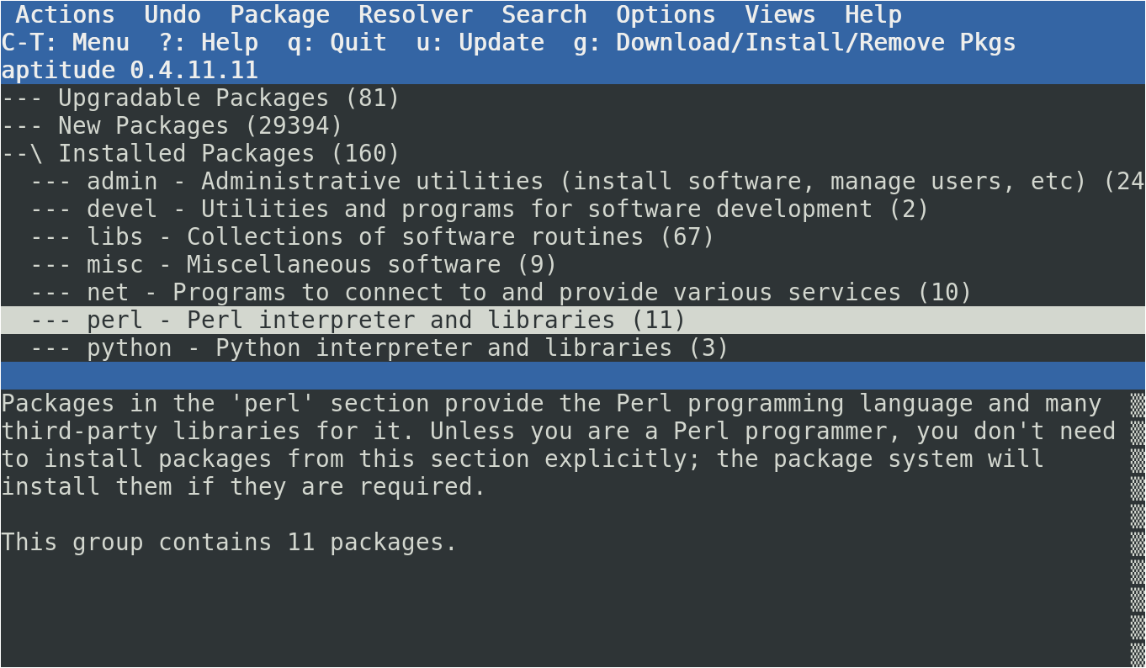
Aptitude as a Package Browser

Slide 25
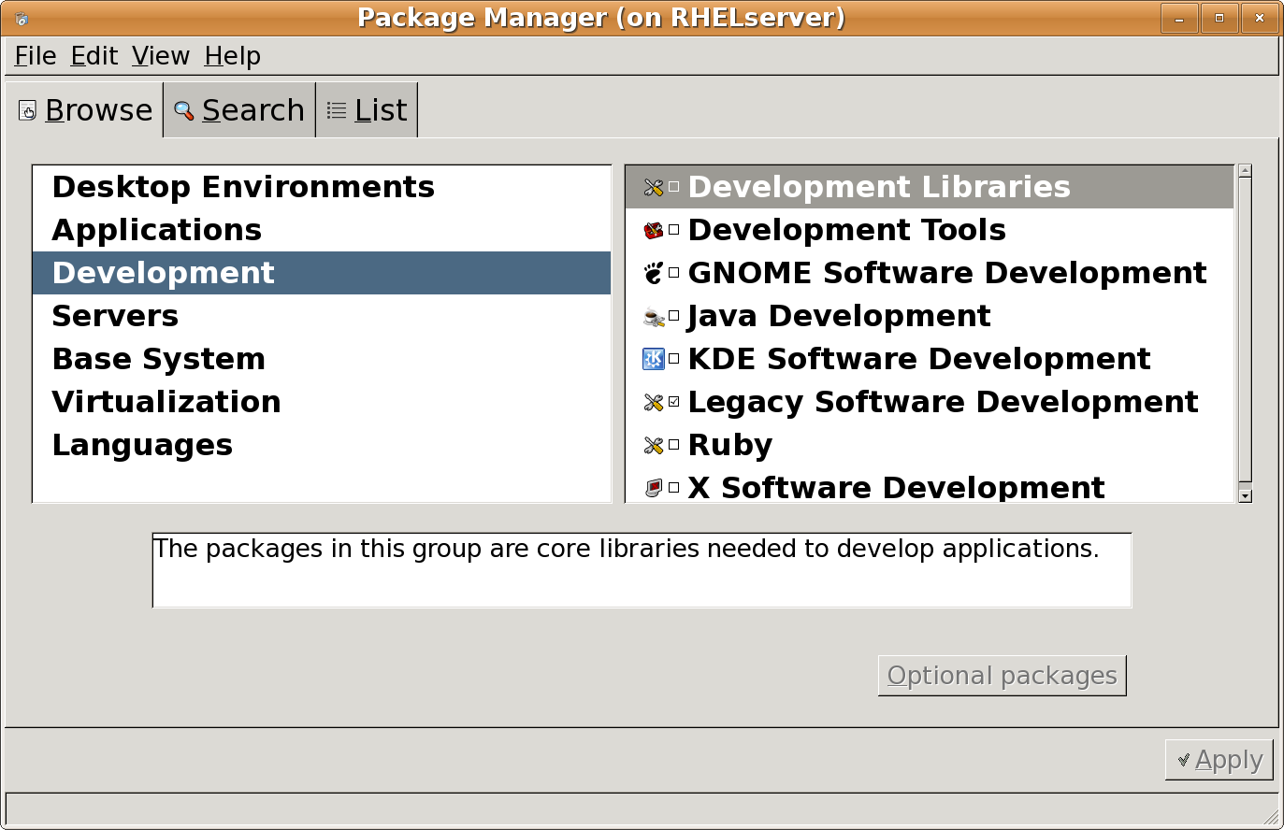
Categories of Red Hat Development Tools

Slide 26
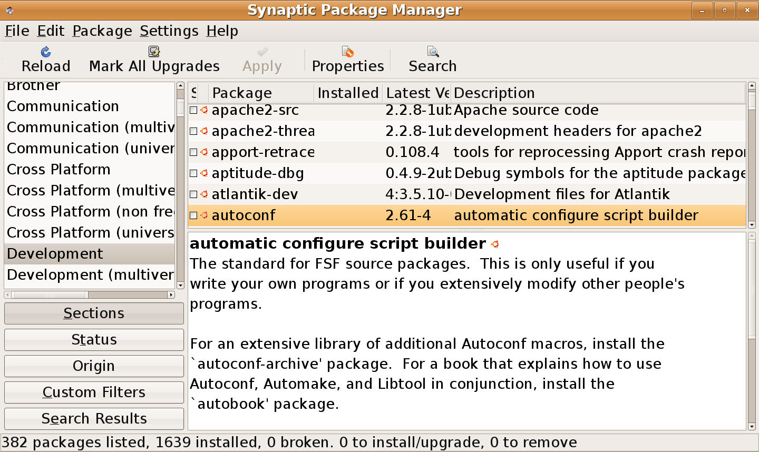
Categories of Ubuntu Development Tools

Slide 27
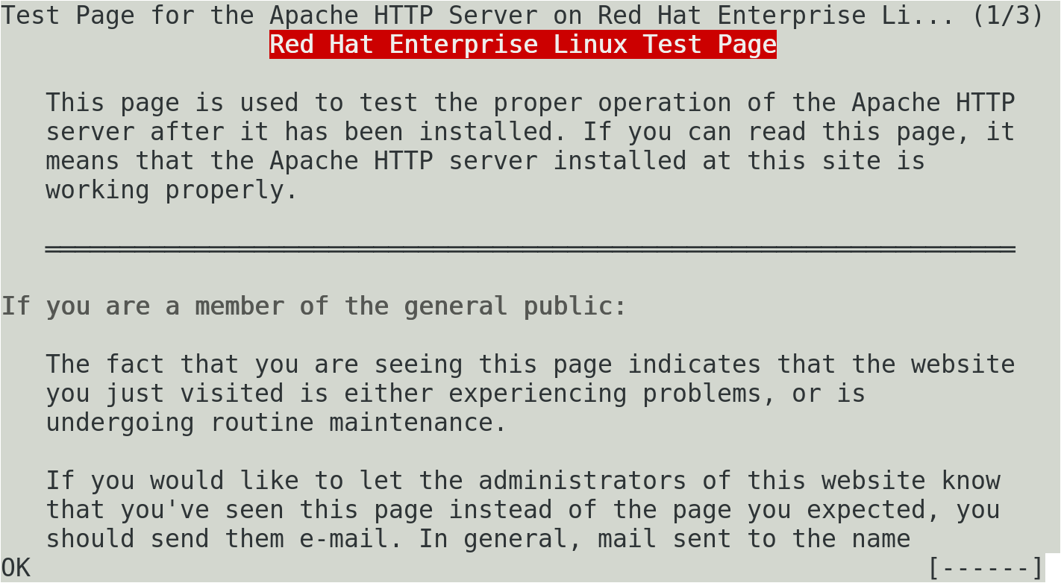
The elinks Web Browser
Notes:
Many excellent text- and console-based tools are available for Linux. These tools can be used to check data from a number of different “graphical” services. For example, elinks is a console browser that you can use to review data from Web servers.
On a Red Hat system with a running Apache Web server, the elinks 127.0.0.1 command returns the page shown above.

