Slide 1
Security Strategies in Linux Platforms and Applications
Lesson 7
Networks, Firewalls, and More

Slide 2
Learning Objective
Assess how firewall, Transmission Control Protocol (TCP) Wrappers, and Security Enhanced Linux (SELinux) complement one another to secure network applications.

Slide 3
Key Concepts
Basic layered security concepts of a Linux infrastructure
Firewall with iptables
Application layer security with TCP Wrappers
Benefits of mandatory access control (MAC) with SELinux

Slide 4
DISCOVER: CONCEPTS

Slide 5
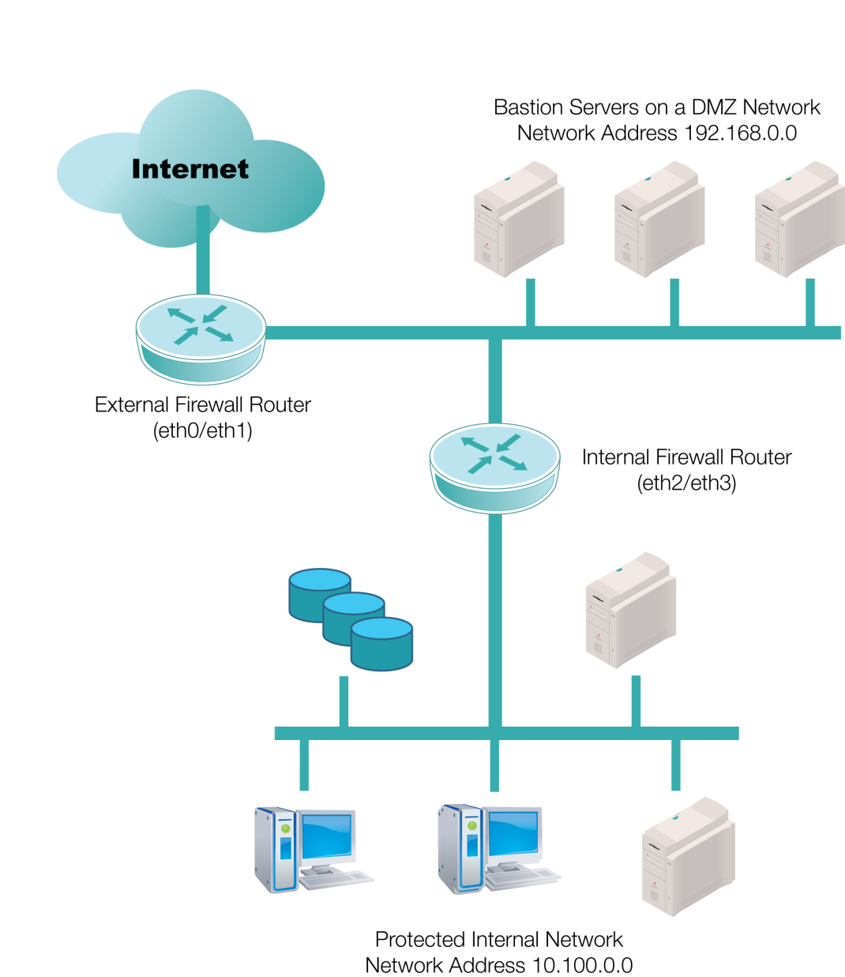
Bastion Servers in DMZ

Slide 6



Linux Firewall on a Bastion Host
Bastion host firewall allows
access only to Ports
80, 443, and 22
Port 80
Hypertext Transfer Protocol (HTTP)
Port 21
File Transfer Protocol (FTP)
Port 21
access is denied here
Perimeter firewall allows access
to Ports 80, 443, 22, and 21

Slide 7
Modes of SELinux
Disabled
Permissive
Enforcing
Notes:
To temporarily turn off SELinux for troubleshooting, issue the “setenforce 0” command.
To turn on SELinux, issue the “setenforce 1” command.

Slide 8
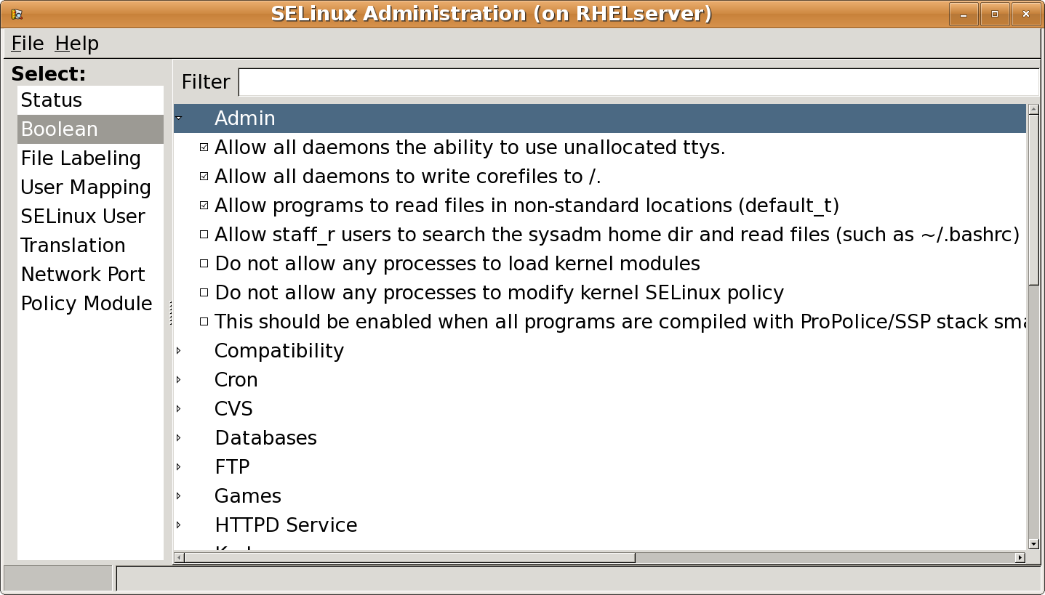
SELinux Administration Tool
Notes:
To temporarily turn off SELinux for troubleshooting, issue the “setenforce 0” command.
To turn on SELinux, issue the “setenforce 1” command.

Slide 9
Common SELinux Commands
chcon: For changing the security context of a file or files
Id -Z: To show the current user context
ls -Z: To show the context of a file or files
Refer to Table 7-2 on pages 203–204 of the textbook for other SELinux commands.

Slide 10
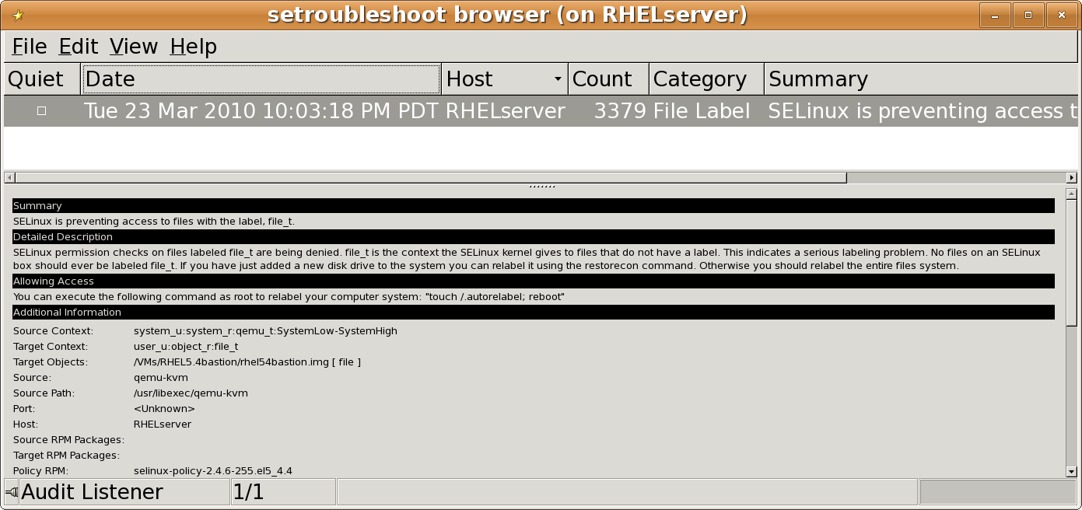
SELinux Troubleshooter

Slide 11
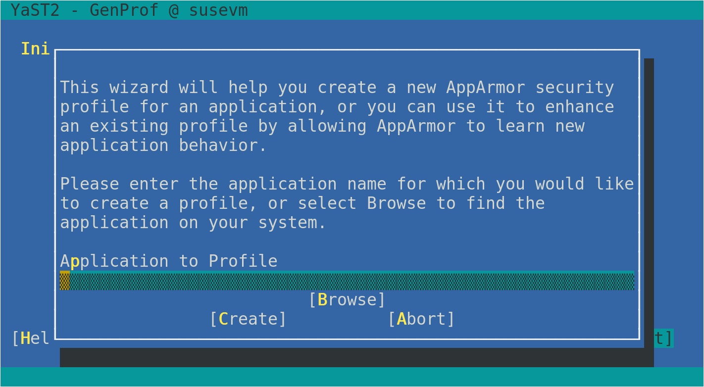
An AppArmor Configuration Tool

Slide 12
DISCOVER: PROCESS

Slide 13
Designing a Firewall
Are rules that should be cleared in place?
Turn on firewall.
Yes
Flush the current rules using the iptables –F command.
List current rules using the iptables –L command.
No
Write firewall rules for INPUT, OUPUT, and FORWARD chains.
Save the new rules using the iptables-save command.

Slide 14
Creating TCP Wrapper Rules
The TCP Wrapper rules on the next two slides are created to allow Secure Shell (SSH) access to the fictitious site is418.com. These rules are also used to log all access with a message and date while denying access to all other users.

Slide 15
Creating TCP Wrapper Rules (Continued)
Step 1
Open the /etc/hosts.allow file using a text editor.
Type the following rule to allow and log access from the is418.com domain:
ssh:.is418.com:spawn /bin/echo `/bin/date` ssh access granted >> /var/log/sshd.log
Step 2
Step 3
Save and exit.

Slide 16
Creating TCP Wrapper Rules (Continued)
Step 4
Open the /etc/hosts.deny file using a text editor.
Step 5
Type the following rule to deny everyone else:
sshd:ALL
Step 6
Save and exit.

Slide 17
DISCOVER: ROLES

Slide 18
Firewalls
Add, remove, and edit rules to a packet filter ruleset
List and flush the rules to a packet filter ruleset
List counters of matched packets to rules
iptables
Provides iptables packet filter in the kernel
Performs stateless and stateful packet filtering
Provides network address translation
Netfilter

Slide 19
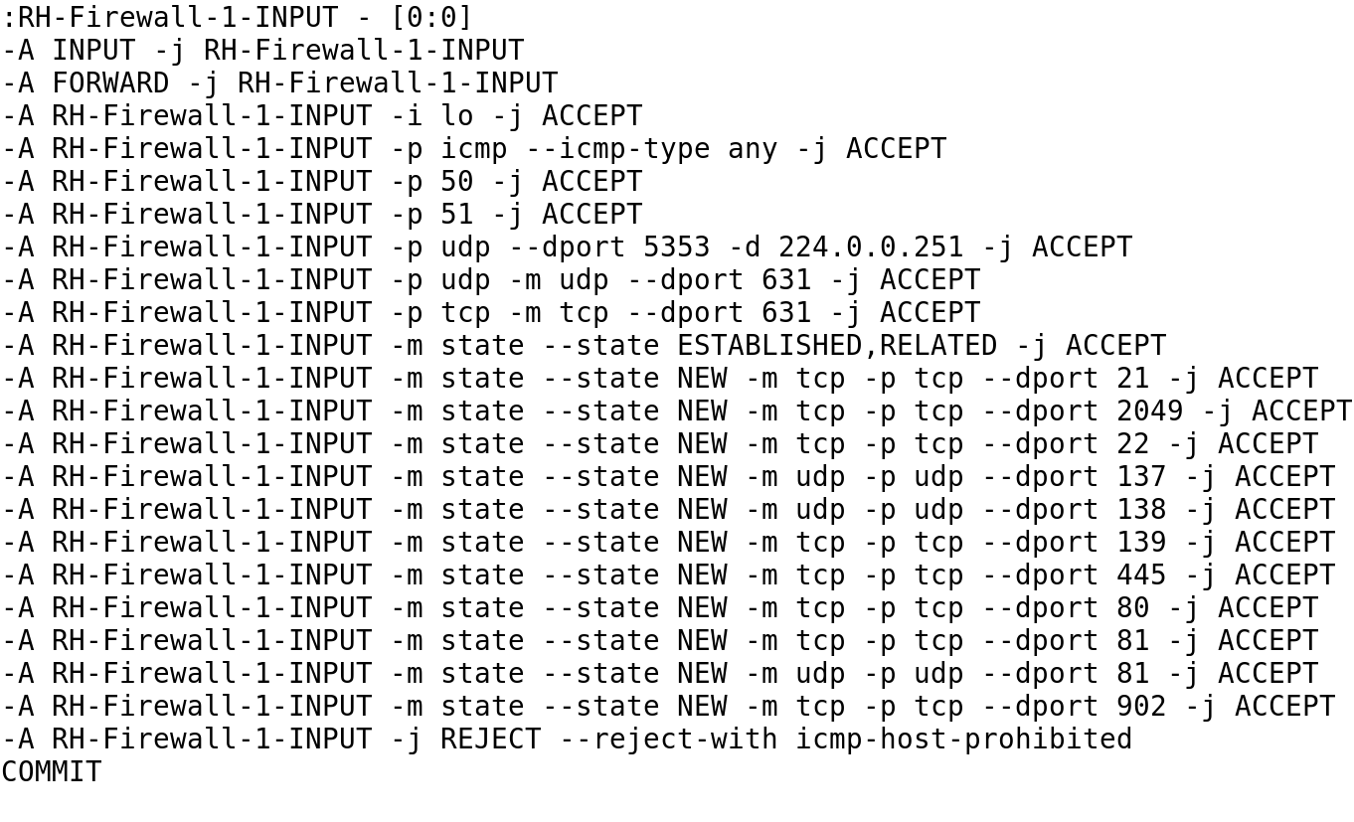
Firewall Rules from /etc/sysconfig/iptables

Slide 20
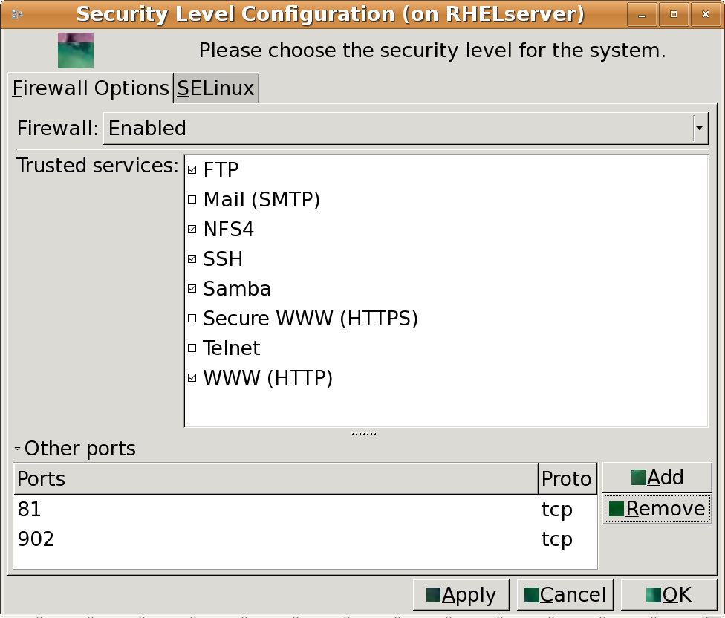
GUI Security Level Configuration Tool

Slide 21
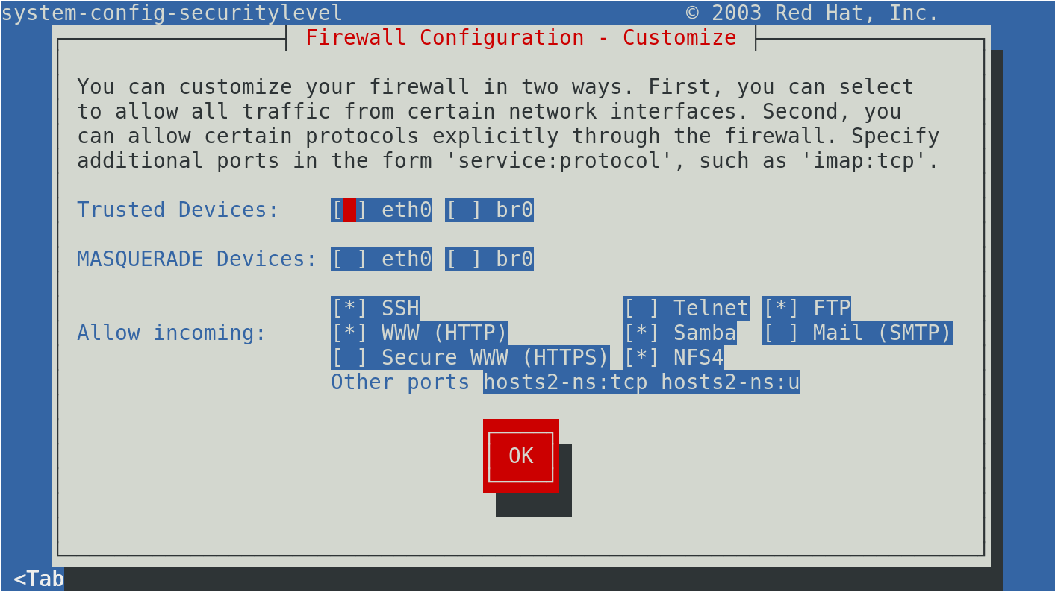
Console-based Security Level Configuration Tool

Slide 22
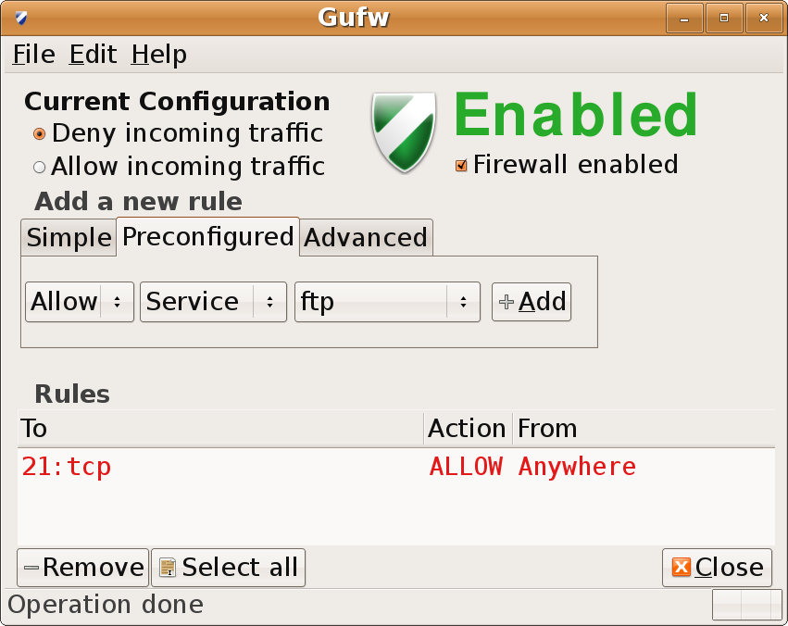
GNOME Uncomplicated Firewall (Gufw) Tool

Slide 23
TCP Wrappers
Allow or deny access to an application based on an Internet Protocol (IP) Address or hostname
Allow or deny access to an application based on time
TCP Wrappers

Slide 24
DISCOVER: CONTEXTS

Slide 25
Layered Security for FTP Access
Firewall | TCP Wrapper | SELinux
Protects against unauthorized traffic | Performs specific actions based on a network service running under the xinetd super server | Protects the network service from unauthorized access based on the subject, such as users, applications, or files
Allows access to FTP from local traffic only | Sends an e-mail to the administrator when access is granted during non-business hours | Denies access to home directories to logged-in users

Slide 26
DISCOVER: RATIONALE

Slide 27
Importance of Firewalls
Can be enabled on bastion hosts in addition to existing network firewalls
Provide a layer of security at the network layer to restrict unauthorized traffic
Can protect bastion hosts from malicious local network traffic

Slide 28
Importance of TCP Wrappers
Adds a layer of security in addition to firewalls
Can allow and restrict access to an application based on domain name and time of the day
Can spawn processes such as e-mail and logging

Slide 29
Summary
SELinux and its commands
Firewall and TCP Wrappers and their importance
Process of designing a firewall by using iptables and creating TCP Wrapper rules
Layered security for FTP access

Slide 30
Virtual Lab
Hardening Security by Controlling Access
Notes:
If your educational institution included the Jones & Bartlett labs as part of the course curriculum, use this script to introduce the lab:
"In this lesson, you discovered the power of the firewall to protect the Linux servers. The readings included a discussion on the best practices for securing the network with a firewall. You also learned that Security Enhanced Linux (SELinux) is an access control system that adds a layer of protection to Red Hat systems when configured properly.
In this lab, you will first review current host-based IP firewall services, flush the current firewall configuration, and then re-configure it with stringent permit/deny rule sets. You also will configure TCP Wrappers for unauthorized access controls and logging. Finally, you will configure SELinux for an additional layer of security. This lab has four parts which should be completed in the order specified."

