Slide 1
Security Strategies in Linux Platforms and Applications
Lesson 8
Networked Filesystems and Remote Access

Slide 2
Learning Objective
Describe Linux file-sharing and remote access solutions.

Slide 3
Key Concepts
File-sharing with Network File System (NFS) and Samba
Secure remote access tools
Encryption with Secure Shell (SSH) and the Internet Protocol Security (IPsec) protocol

Slide 4
DISCOVER: CONCEPTS

Slide 5
Common Network Services Software
File Sharing
Samba | Network File System (NFS)
Has built-in interoperability with Windows clients | Generally faster than Samba when transferring large files
Can be set up as a member server in Windows environment | Easy to set up
Has username/password authentication | Authentication is Internet Protocol (IP)-based; however, it can support Kerberos
 | Can configure to squash root

Slide 6
Common Network Services Software (Continued)
Web server
Database
Authentication and directory services
E-mail and printing
File Transfer Protocol (FTP)

Slide 7
Remote Access Tools
Open Berkeley Software Distribution (BSD) Secure Shell (OpenSSH)
SSH client commands
Port 22
Authentication
X11 forwarding
Port forwarding
Notes:
SSH client commands: ssh, scp, and sftp

Slide 8
Remote Access Tools (Continued)
Internet Protocol Security (IPsec)
Authentication Header (AH) and Encapsulated Security Payload (ESP) protocols
Internet Key Exchange (IKE) protocol
Racoon
Free Secure Wide-Area Networking (FreeS/WAN)
StrongSwan and Openswan
Notes:
IPsec: Compatible with most virtual private network (VPN) hardware solutions, such as Cisco

Slide 9
Remote Access Tools (Continued)
Secure Sockets Layer (SSL)
An SSL virtual private network (VPN) connection uses the traditional SSL over Hypertext Transfer Protocol (HTTP) certificates.
SSL VPN is easier to configure and setup than IPsec.
OpenVPN is the most popular Linux-based SSL VPN solution.

Slide 10
DISCOVER: PROCESS

Slide 11
Configuring Samba
Install Samba service
Create Samba user accounts
Edit main Samba configuration file: smb.conf

Slide 12
Configuring Samba (Continued)
Network-related options
Logging options
Standalone server options
Domain members and domain controller options
Browser control, name resolution, printing options

Slide 13
DISCOVER: ROLES

Slide 14
Authentication
Username/password
Passphrase with public/private keys
One-time passwords
Kerberos
Notes:
SSH client commands: ssh, scp, and sftp
Authentication:
Username/password
Passphrase with public/private keys
One-time passwords
Kerberos

Slide 15
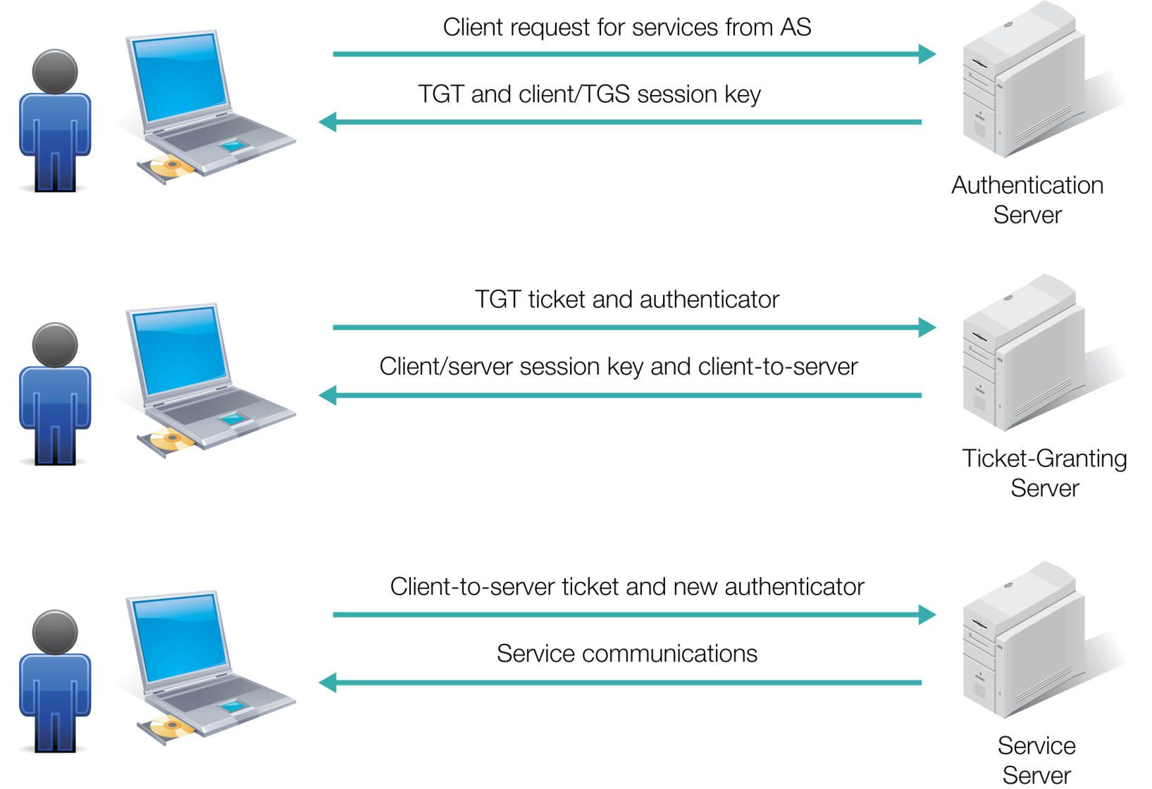
Kerberos
Notes:
SSH client commands: ssh, scp, and sftp
Authentication:
Username/password
Passphrase with public/private keys
One-time passwords
Kerberos

Slide 16
DISCOVER: RATIONALE

Slide 17
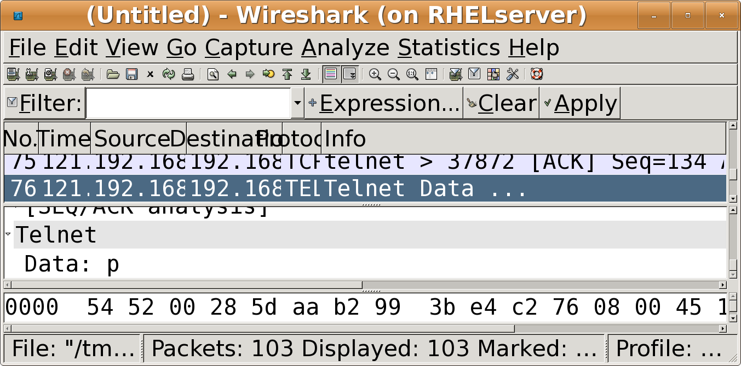
The Problem with Clear Text
Notes:
SSH client commands: ssh, scp, and sftp
Authentication:
Username/password
Passphrase with public/private keys
One-time passwords
Kerberos

Slide 18
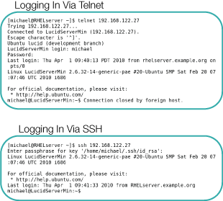
Telnet vs. SSH
Notes:
SSH client commands: ssh, scp, and sftp
Authentication:
Username/password
Passphrase with public/private keys
One-time passwords
Kerberos

Slide 19
Summary
File-sharing with Network File System (NFS) and Samba
Secure remote access tools
Encryption with Secure Shell (SSH) and the Internet Protocol Security (IPsec) protocol

Slide 20
OPTIONAL SLIDES

Slide 21
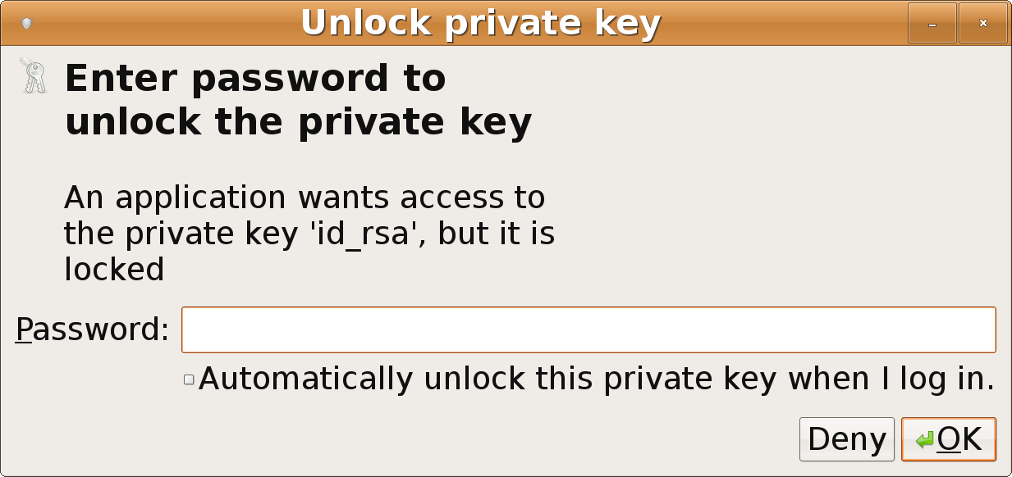
A Request for a Passphrase
Notes:
SSH client commands: ssh, scp, and sftp
Authentication:
Username/password
Passphrase with public/private keys
One-time passwords
Kerberos

Slide 22
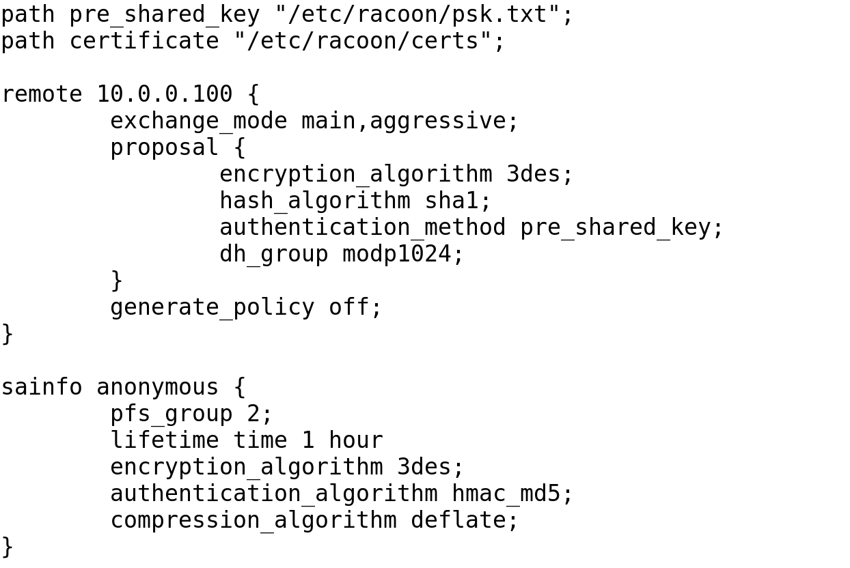
An /etc/racoon/racoon.conf File
Notes:
An /etc/racoon/racoon.conf File for Host-to-Host IPsec Connections

