Slide 1
Security Strategies in Linux Platforms and Applications
Lesson 9
Networked Application Security

Slide 2
Learning Objective
Describe how to secure Web services, applications, and access.

Slide 3
Key Concepts
Common Web applications and services, such as Apache Web Server, Squid, DNS BIND, and mail agents
Configuring secure Web servers and Web sites
Digital certificates and certificate authorities (CAs)

Slide 4
DISCOVER: CONCEPTS

Slide 5
Web Services and Applications
Apache
Squid
DNS BIND
Mail agents
MySQL

Slide 6
The LAMP Stack
Linux
Apache
MySQL
P
Notes:
P = Perl, Python, or PHP: Hypertext Preprocessor (PHP)

Slide 7
Asterisk
Open source VoIP software
Uses Session Initiation Protocol (SIP) and the Real-time Transport Protocol (RTP)
Centered around the dialplan

Slide 8
DISCOVER: PROCESS

Slide 9
Configure a Secure Apache Web Server
Method 1
Limit Web site accessibility to a certain IP address network:
Order deny,allow
Deny from all
Allow from 192.168.0.0/255.255.255.0
Notes:
Web site accessibility can be limited to a certain IP address network with the following directives, which deny access from all systems except those that send requests from addresses with the noted IP network address and network mask:
Order deny,allow
Deny from all
Allow from 192.168.0.0/255.255.255.0

Slide 10
Configure a Secure Apache Web Server
Method 2
Restrict access to a specific Web site or directory:
AuthName “Authorized users only”
AuthType Digest
AuthUsersFile /etc/httpd/conf.d/apacheusers
Require valid-user
Notes:
Based on users created with the htpasswd or htdigest commands
Requires /etc/httpd/conf.d/apacheusers file (users and passwords)

Slide 11
Configure Protection on a Web Site
Customize the ssl.conf file for the desired secure Web site
Configure a certificate authority (CA)
For a self-signed certificate, use the openssl command
Notes:
Customize the ssl.conf file for the desired secure Web site
Configure a certificate authority (CA)
- For a self-signed certificate, use the openssl command

Slide 12



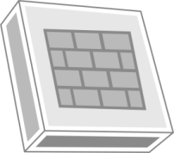
Port Forwarding with SSH
MySQL database management
Graphical user interface (GUI) tool
OpenSSH
Server (Port 22)
Firewall blocks
all traffic to Port
3306
MySQL Database
Server (Port 3306)
Port 22
Port 3306
Notes:
The administrator can use SSH to access the OpenSSH server and use port forwarding to access the database server with a GUI tool.

Slide 13
DISCOVER: ROLES

Slide 14
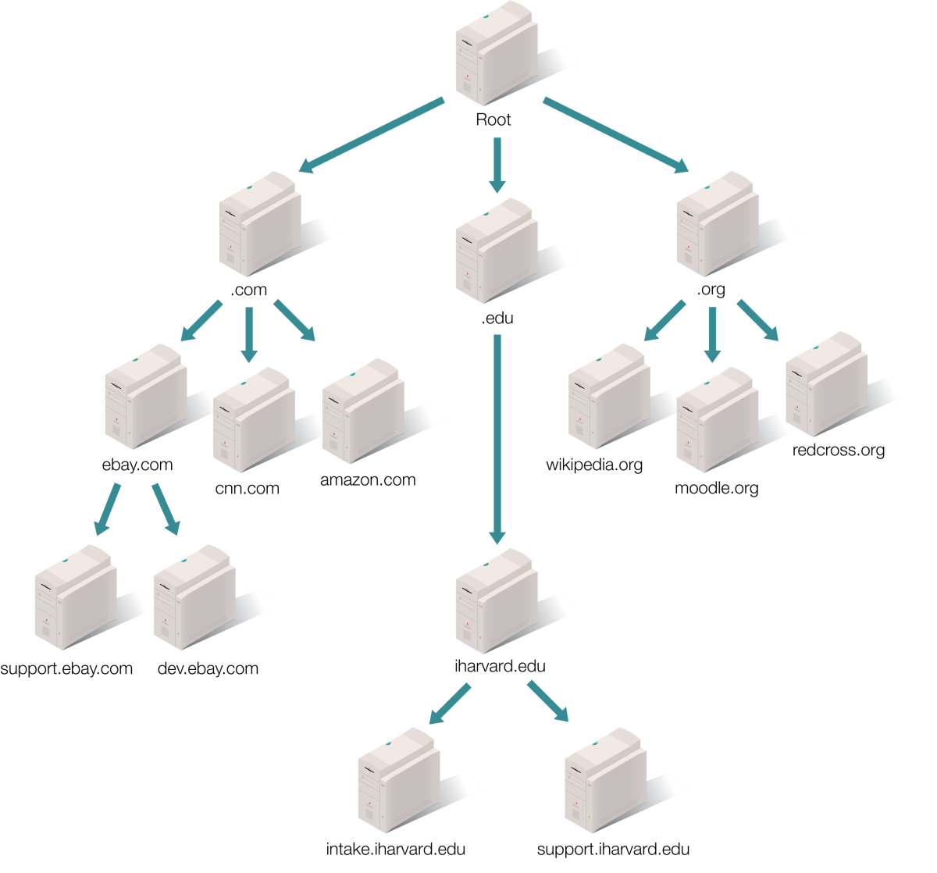
DNS Organization of the Internet

Slide 15
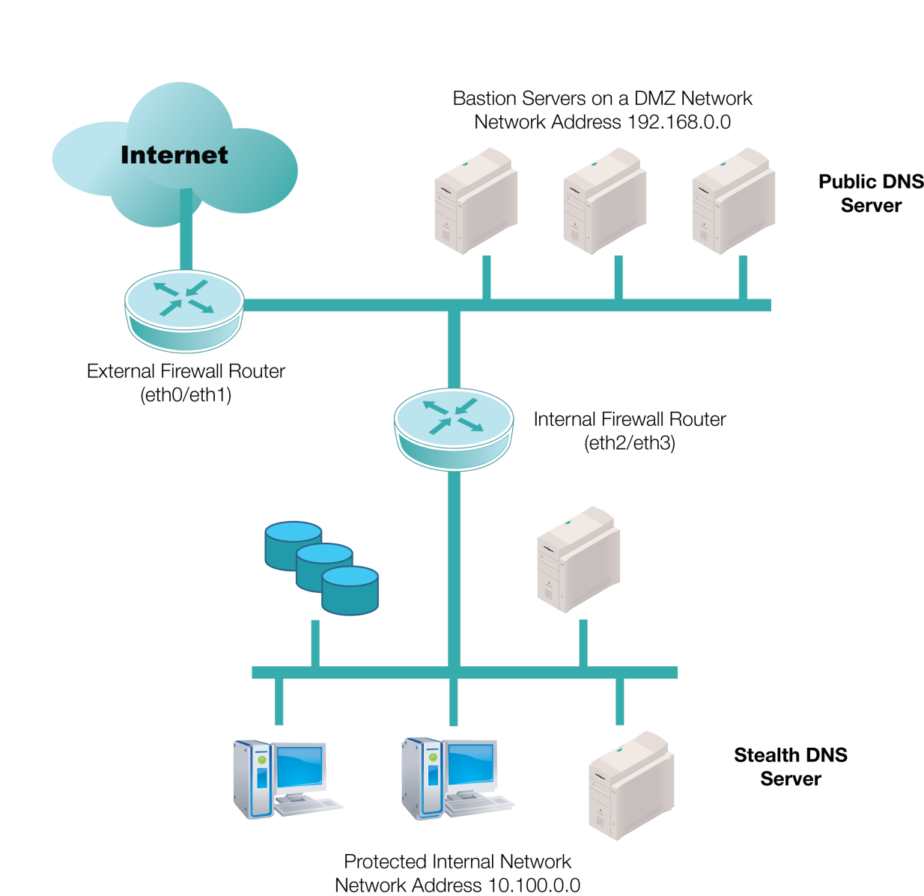
An Internal Network, a DMZ, and the Internet
Notes:
The best place to protect the master authoritative DNS server for a domain is on an internal network, protected by multiple firewalls.
DNS server functionality for the domain is split between a public DNS server (possibly within a demilitarized zone [DMZ]) and a stealth DNS behind a firewall.

Slide 16
DISCOVER: RATIONALE

Slide 17
Why Limit Network Printers?
Monitor usage
Must be able to track who prints what for management and budgetary reasons
Contain costs
Color printing is still much more expensive than b&w; limit who can print to networked color printers
Prevent a security breach
An attacker can hijack a networked printer and take control of the entire network

Slide 18
Summary
Common Web applications and services, such as Apache Web Server, Squid, DNS BIND, and mail agents
Configuring secure Web servers and Web sites
Digital certificates and certificate authorities (CAs)

