Slide 1
Security Strategies in Linux Platforms and Applications
Lesson 10
Kernel Security Risk Mitigation

Slide 2
Learning Objective and Key Concepts
Learning Objective
Assess the architecture of the Linux kernel and techniques used to enact a more secure kernel.
Key Concepts
Linux kernel architecture
Tuning, installing, and upgrading the Linux kernel
Options to consider in a stock versus custom kernel scenario
Steps to compile a custom kernel

Slide 3
DISCOVER: CONCEPTS

Slide 4
Linux Kernel Architecture
Monolithic
Loadable kernel module (LKM)

Slide 5
Linux Kernel Architecture (Continued)
Subsystems
Process scheduler
Memory management
Virtual filesystem (VFS)
Network interface
Inter-process communication (IPC)

Slide 6
Linux Kernel Architecture (Continued)
Process Scheduler
Controls access to the central processing unit (CPU)
Interacts with the CPU
Determines which process will have access to the CPU
Interacts with the memory manager

Slide 7
Linux Kernel Architecture (Continued)
Memory Management
Consists of a virtual memory interface to the hardware memory
Controls access to random access memory (RAM)
Restricts access to user processes
Allows user processes to consume and release storage as well as memory maps for input and output

Slide 8
Linux Kernel Architecture (Continued)
VFS
Loads programs or an executable
Mounts a filesystem on the hardware
Manages all filesystems that are mounted
Provides a common interface for all processes

Slide 9
Linux Kernel Architecture (Continued)
Network Interface
Allows Linux to access other networks
Supports many network cards and protocols
Provides a common interface from the hardware to other subsystems
Allows a network card to interface with software and hardware
Interacts with the VFS and process scheduler subsystems

Slide 10
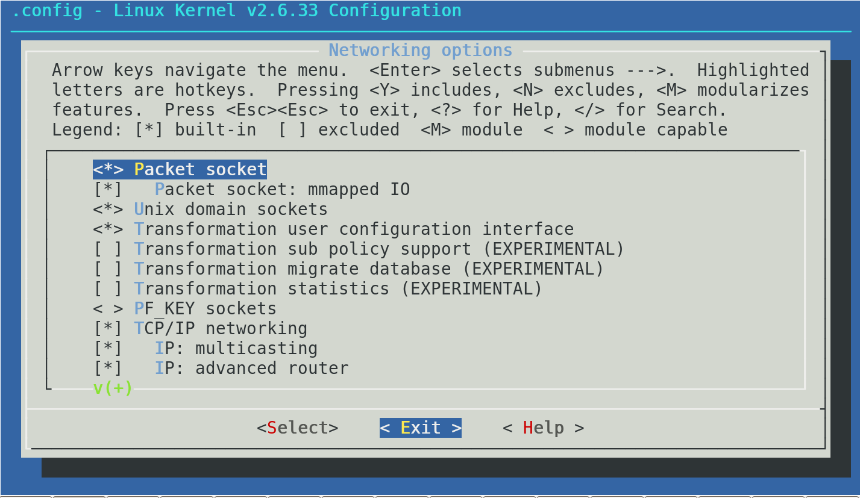
Kernel Networking Options

Slide 11
Linux Kernel Architecture (Continued)
IPC
Sends signals to processes
Sends signals in the following ways:
Message queues
Semaphores
Shared memory

Slide 12
DISCOVER: PROCESS

Slide 13
Patching the Linux Kernel (Version 2.6.35.4 )
Step 1
From the source tree (/usr/src/linux), download the patch from the Internet using the following command:
[root@is418 linux]# wget http://www.kernel.org/pub/linux/kernel/v2.6/patch-2.6.35.4.bz2
Step 2
Extract the file in the source tree using the following command:
[root@is418 linux]# bunzip2 patch-2.6.35.4.bz2
Notes:
Applying a patch to a custom kernel requires compiling the kernel again but this time with the new patch. The patch should be placed where the Linux source tree is located, which is usually in the /usr/src/linux directory.
Applying a kernel patch to a binary kernel that is part of a distribution: The package management software usually takes care of this process. Once the software applies and updates the patch, a new kernel version is placed in the /boot directory and an option to boot from it is added in the GRUB menu. The older kernel version is purposely left intact and should NOT be removed until the new patch starts working as expected, which could take several weeks or months.

Slide 14
Patching the Linux Kernel (Version 2.6.35.4 ) (Continued)
Step 3
Apply the patch using the following command:
root@is418 linux]#patch -p1 < patch-2.6.35.4
Step 4
Proceed to build the kernel as described in the textbook.

Slide 15
Persisting a Kernel Parameter Change
Step 1
Open the /etc/sysctl.conf file in a text editor.
Step 2
Find the directive net.ipv4.tcp_syncookies by using the directive net.ipv4.tcp_syncookies = 0

Slide 16
Persisting a Kernel Parameter Change (Continued)
Step 3
Change the directive's value by using the directive net.ipv4.tcp_syncookies = 1
Step 4
Save and exit.

Slide 17
Process to Compile a Kernel
Login as root and change directory to /usr/src.
Download the latest stable kernel from www.kernel.org.
Extract the compressed source tree into the /usr/src directory and create a symbolic link from the extracted directory to /usr/src/linux.
Configure what needs to be compiled into the kernel and then change into the /usr/src/linux directory by typing cd /usr/src/linux.
Type make menuconfig.
Notes:
If any errors occur when issuing the make menuconfig command, it probably means that the ncurses libraries are not installed on the computer system.

Slide 18
Process to Compile a Kernel (Continued)
Save the options selected when exiting out of the menu interface.
Type make.
Type make modules.
Type make modules_install.
Type make install.

Slide 19
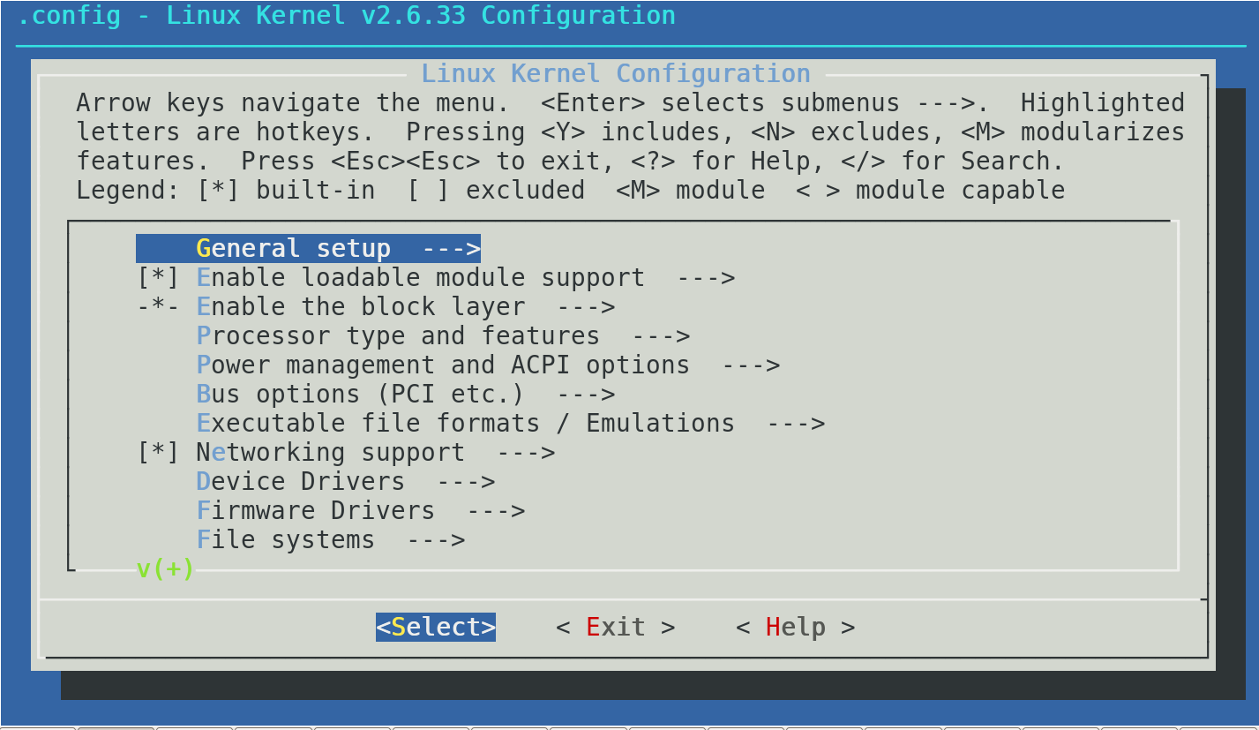
Customizing a Kernel with make menuconfig

Slide 20
DISCOVER: ROLES

Slide 21
Linux System Administrator
Configures kernel parameters for optimal security
Ensures all LKMs are necessary and tested
Manages kernel updates
Monitors the operating system for any kernel changes

Slide 22
DISCOVER: CONTEXTS

Slide 23
Use of LKM in Securing Linux System
Advantages
Allows Linux to be a monolithic kernel
Loads modules as needed
Removes or unloads unneeded modules
Performs changes in hardware or any new module without recompiling the kernel

Slide 24
Use of LKM in Securing Linux System (Continued)
Disadvantages
Has access to kernel space and a poorly written LKM can impact the performance of the operating system
Is a source of rootkits and other malicious software that could gain access to kernel space

Slide 25
DISCOVER: RATIONALE

Slide 26
Linux Kernel Architecture
Assessing the Linux kernel architecture helps to:
Examine how memory and swap space are managed
Examine how modules interact with the kernel
Analyze the risks involved when adding new modules
Explore how networks interact with the kernel and the drivers and protocols that are available for use
Understand how filesystems are mounted and managed

Slide 27
Vendor-Supplied and Custom Kernel
Vendor-Supplied Kernel
Pros
Easier to apply patches and updates, easier to maintain, and has a system to address security issues
Cons
Has generic builds that are not optimized for the specific hardware that will run the kernel
Often times contains more features and modules than are needed

Slide 28
Vendor-Supplied and Custom Kernel (Continued)
Custom Kernel
Pros
Optimized for specific hardware
More secure because only the needed features and modules are compiled into the kernel
Cons
Need to recompile when patches are available
Requires a Linux system administrator to manage kernel updates

Slide 29
Benefits of Installing a New Kernel
Installing is less riskier than upgrading because a computer system can become unstable or even unbootable after an upgrade.
If the new kernel causes the computer system to become unbootable or unstable, the older kernel will still be available to run the system until the issue is resolved.

Slide 30
Summary
Vendor-supplied and custom Linux kernel
Process to patch and compile a Linux kernel
Role of a Linux system administrator in securing the Linux kernel
Use of LKM to secure the Linux kernel
Benefits of installing a new kernel

Slide 31
Virtual Lab
Hardening Security for the Linux Kernel
Notes:
If your educational institution included the Jones & Bartlett labs as part of the course curriculum, use this script to introduce the lab:
"In this lesson, you delved deeper into the Linux kernel. You learned that the kernel is highly configurable and black-hat hackers are quick to take advantages of mistakes made by less skilled network administrators. You explored configuration options for the stock kernel and even considered the option for building a custom kernel.
In this lab, you will view and tune all kernel parameters and discover information regarding the current Loadable Kernel Modules (LKMs) and information about the kernel itself. You will explore the sysctl.conf file and make modifications to system settings. Finally, you also will enable and interpret the results of the lsmod command."

Slide 32
OPTIONAL SLIDES

Slide 33
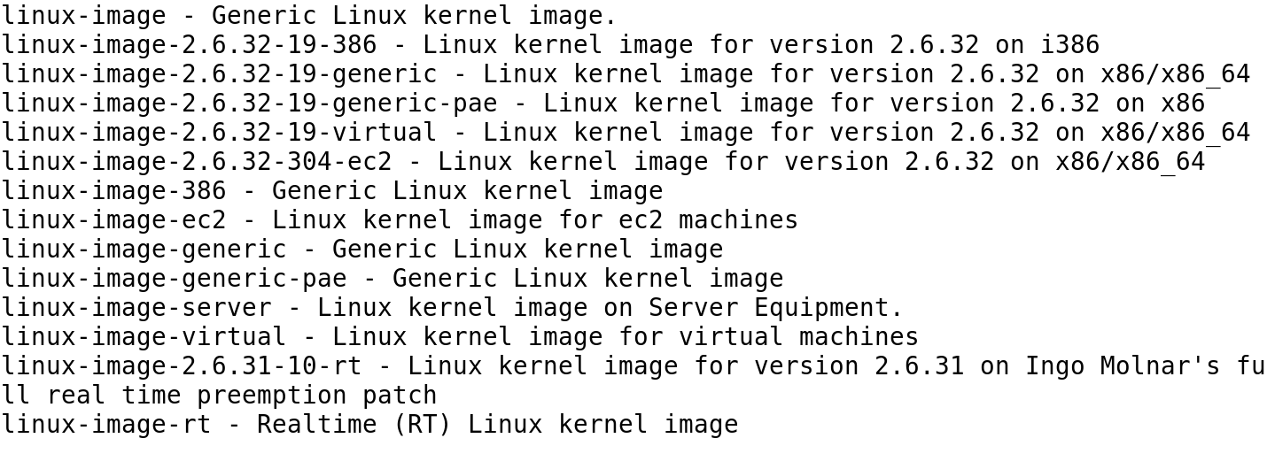
Ubuntu Kernel Package Options

Slide 34
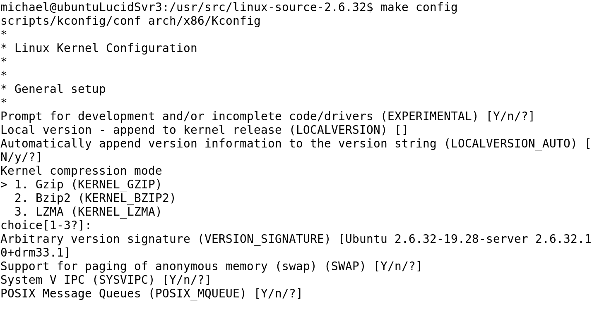
Customizing a Kernel with make config

