Slide 1
Security Strategies in Linux Platforms and Applications
Lesson 11
Managing Security Alerts and Updates

Slide 2
Learning Objective and Key Concepts
Learning Objective
Evaluate the importance of maintaining a software management plan.
Key Concepts
Software management tools
Techniques to manage the update process
Importance of anti-virus software in Linux security
Open source software vulnerabilities and security updates

Slide 3
DISCOVER: CONCEPTS

Slide 4
Common Package Managers
Yellowdog Updater, Modified (YUM)
Advanced Package Tool (APT)
Portage and emerge
Zypper
Conary
Notes:
Common Packaging Methods:
RPM Package Manager (Formerly Red Hat Package Manager)
Debian package
Gentoo Linux is a popular distribution that downloads and compiles from source code. It does not use packaged software.

Slide 5
Graphical Package Managers
PackageKit
Synaptic
Porthole
YaST (Yet another Setup Tool)

Slide 6
Best Practices for Compiling Software
You must know about the software you are downloading. Make sure that it is from a reputable organization.
Verify the source code.
Do not compile the software as root if it can be compiled as a regular user.
Always read the README file.
Follow recommendations of the Linux Filesystem Hierarchy Standard (FHS).

Slide 7


Red Hat Satellite Server
Updates are controlled internally and not by Red Hat's
platform
Red Hat's platform
Transmits all software packages and updates
Red Hat Satellite Server
Corporate demilitarized zone
(DMZ) firewall
Computer Systems

Slide 8
DISCOVER: PROCESS

Slide 9

Process to Apply Security Updates Manually
Security patch becomes available
Apply and test in development
Apply and test in staging
Apply to production
Check if it is high priority?
Enter task or patch in queue for next scheduled maintenance of systems

Slide 10

Process to Apply Security Updates Automatically
Security patch becomes available
Linux distribution repositories: Community or commercial
Development updated
Production updated
Staging updated

Slide 11


Red Hat Network (RHN) Update
Step 1: Security patch becomes available for
Apache Web server
Step 4: RHN transmits update to the Web server
Step 2: RHN flags that www1.is418.com
Is in need of the patch
Step 3: RHN sends an e-mail notification, places an alert in the control panel, and sends alert to impacted Linux systems
rhn.redhat.com
www1.is418.com
installs update
Notes:
This slide uses the example of a fictitious company, is418.com, to explain the RHN update process.

Slide 12
DISCOVER: ROLES

Slide 13
Commercial Linux Vendor
Monitors specific software vulnerabilities
Provides patches to the software
Packages the software
Tests the patches
Notifies customers and provides updates

Slide 14
Linux System Administrator
Monitors mailing lists, forums, and security-related Web sites
Communicates with Linux vendor about updates
Applies patches to development and staging servers
Rolls out security updates to production systems

Slide 15
DISCOVER: CONTEXTS

Slide 16
Software Management Plans
Vendor Supported
Used for mission-critical Linux servers
Popular with businesses without in-house Linux system administration expertise

Slide 17
Software Management Plans (Continued)
Community Supported
Used for less critical servers
Popular with Web hosting companies with experienced Linux system administrators
Popular choice with business entities on a budget

Slide 18
DISCOVER: RATIONALE

Slide 19
Software Management Plans
Update all software on the Linux system
Send notifications directly to the impacted systems
Verify and maintain a history of all installed software
Keep all installed software in a database for easy querying

Slide 20
Anti-Virus Software
These software protect operating systems from viruses that are contained in documents and e-mails.
Anti-virus software needs to be installed on critical servers for compliance with regulations, such as the Payment Card Industry (PCI) Data Security Standard (DSS).

Slide 21
Summary
Common and graphical package managers
Red Hat Satellite Server
Processes to apply security updates
Importance of anti-virus software in Linux security
Software management plans

Slide 22
Virtual Lab
Applying Best Practices for Secure Software Management
Notes:
If your educational institution included the Jones & Bartlett labs as part of the course curriculum, use this script to introduce the lab:
"In this lesson, you found that the best practices for handling security updates include first verify the source of the update before installing it to your system. A company may choose automated update tools, in the case of a trusted developer, or create a local update repository which allows you time to test updates before they get installed. Regardless of the update option used by the organization, it is always best practice to limit the number of applications installed on the system.
In this lab, you will work with a CentOS machine and use RPM to query and verify package files, verify a source tarball used for application integrity verification when downloading and installing new applications, and learn how to create a repository to properly secure the RPN databases. You will also use the md5sum for hashing and integrity verification against downloaded program files. Finally, you will learn to use GPG (GnuPG) tool to view a GPG license key to ensure downloaded software is valid.”

Slide 23
OPTIONAL SLIDES

Slide 24
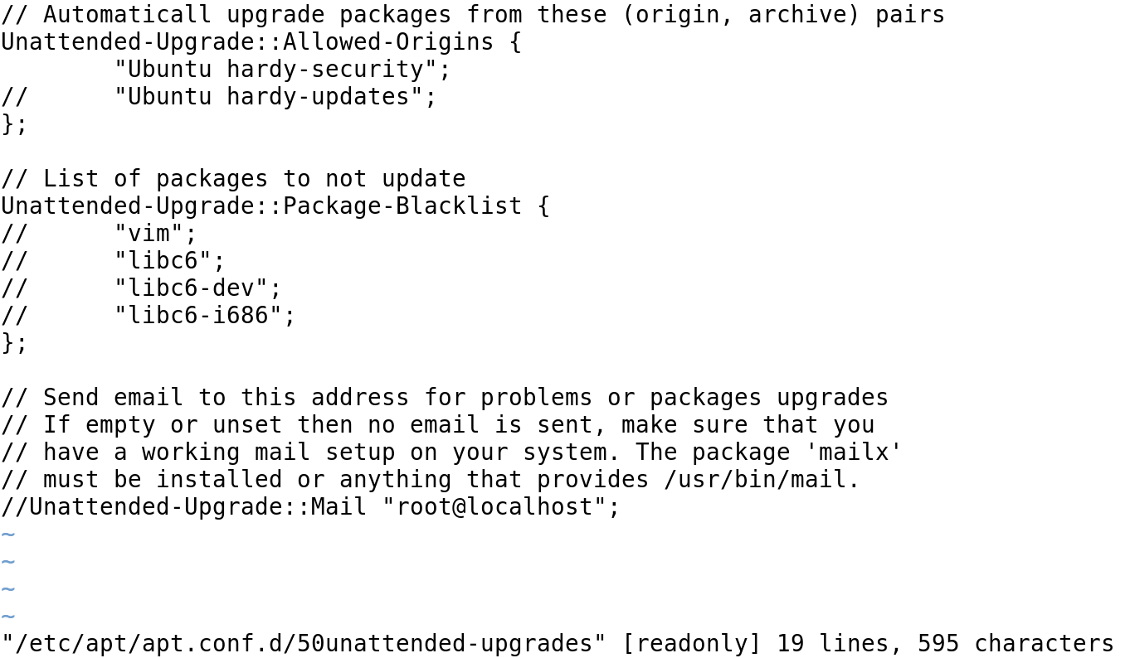
Ubuntu 50unattended-upgrades Configuration File

Slide 25
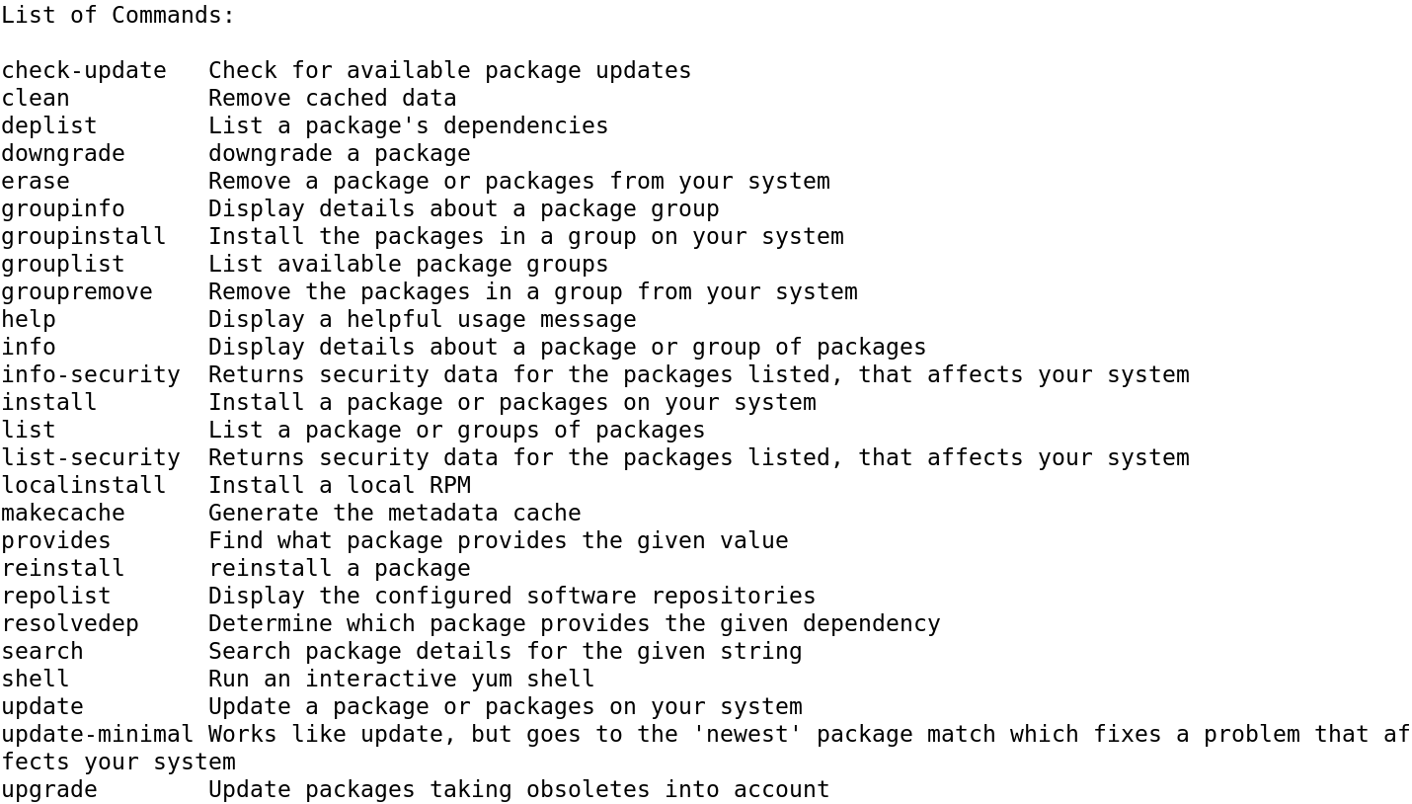
X

