Slide 1
Security Strategies in Linux Platforms and Applications
Lesson 12
Building and Maintaining a Security Baseline

Slide 2
Learning Objective
Establish a system baseline to detect anomalies.

Slide 3
Key Concepts
A secure baseline Linux system
Read-only versus live bootable operating systems
Local and remote log configuration
File and data integrity checkers

Slide 4
DISCOVER: CONCEPTS

Slide 5
Server Baseline
A default system configuration
Baseline system is secure
Helps in maintaining installed software
Performance of a baseline system can be monitored by using log files
Sources for ensuring the confidentiality, integrity, and availability of any server
Notes:
Tripwire
Stores a security policy containing rules for all files to be checked. When a file changes, Tripwire compares it against the checksum and fires an alert.
Advanced Intrusion Detection Environment (AIDE)
Developed as a replacement for Tripwire
Works within the same concept as Tripwire
Chkrootkit
Checks system binaries for modifications
Checks other files as well for rootkits and worms known to Linux
Rkhunter
Checks for rootkits and other vulnerabilities

Slide 6
Importance of a Baseline
Helps you identify anomalies
Ensures computer system availability with regards to:
Increased network traffic
Hard drive usage
Potential hardware problems

Slide 7
DISCOVER: PROCESS

Slide 8
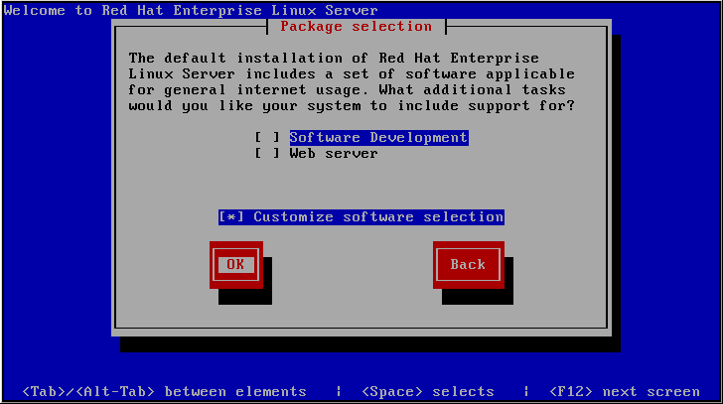
Customizing an RHEL 5 installation

Slide 9
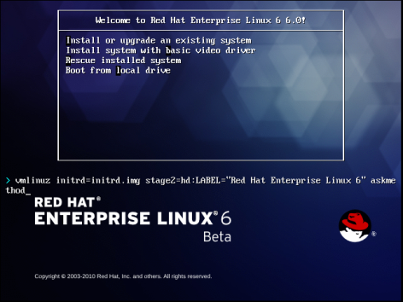
Starting an RHEL 6 Text-mode Installation

Slide 10
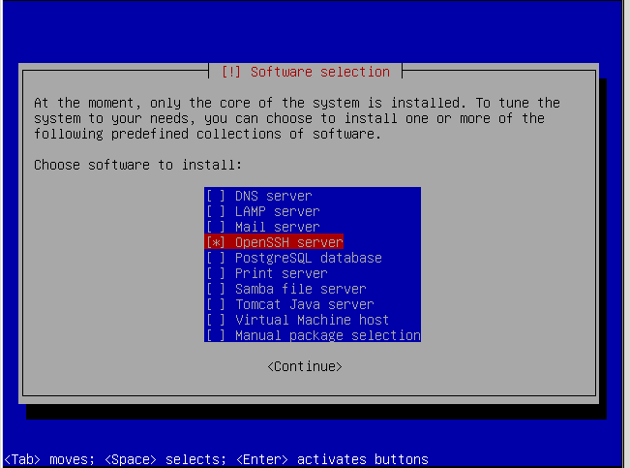
Ubuntu Software Selection Options

Slide 11
Identify System State Baseline
Collect list of packages
Compare files, Permissions, and ownership
Define baseline network configuration
Collect runtime information

Slide 12

Remote Logging
Step 1: Open the /etc/rsyslog.conf file in a text editor.
Step 2: Add the line *.* @10.10.10.4:514.
Step 3: Save and exit.
Step 4: Open the /etc/rsyslog.conf file in a text editor.
Step 5: Add the line $ModLoad imudp.so.
Step 6: Add the line $UDPServerRun 514.
Step 7: Save and exit.
Web Server
Internet Protocol
(IP) 10.10.10.9
All logs on 10.10.10.9 will be sent to 10.10.10.4 over User Database Protocol (UDP) Port 514
Remote logging Server
IP 10.10.10.4

Slide 13
DISCOVER: ROLES

Slide 14
Read-only Mode Filesystem
Mounting a filesystem in read-only mode prevents a black-hat hacker from writing to the filesystem

Slide 15
Live Bootable Operating System
Linux live CD/DVD is a fully functional version of a Linux distribution
When booted, loads a fully functional version of Linux into RAM
Is independent of local hard-drive media
Useful for diagnosing problems with other connected physical media

Slide 16
DISCOVER: CONTEXTS

Slide 17



Remote Monitoring and Logging
Used to consolidate monitoring and logging of all servers for easier and more effective monitoring of computer systems in a network
Linux system administrator
monitors from a central location
Logging and
monitoring server
Linux system logs
Firewall logs

Slide 18
Logwatch
It is a program written in Perl scripting language that consolidates information from various log files and creates a report.
In Fedora, it is installed by default and runs daily.
Its main configuration file is /etc/logwatch/conf/logwatch.conf.
Its configuration allows to set range of dates from the log files. By default, it reads logs from the previous day.
The reporting level of activity can be set as low, medium, or high.

Slide 19
Logcheck
It is used mostly on Debian-based systems, such as Ubuntu.
By default, it runs every hour and upon a reboot.
Its main configuration file is /etc/logcheck/logcheck.conf.
The log files to monitor are set in the /etc/logcheck/logcheck.logfiles file.
It supports paranoid, server, and workstation levels of output.

Slide 20
DISCOVER: RATIONALE

Slide 21
Host-Based Intrusion Detectors
Provide a solution to the “needle in the haystack” problem
Provide a layer of security
Help establish a baseline for files, processes, and ports

Slide 22
File Integrity Checkers
Tripwire
Advanced Intrusion Detection Environment (AIDE)
Chkrootkit
Rootkit Hunter (rkhunter)
Notes:
Tripwire
Stores a security policy containing rules for all files to be checked. When a file changes, Tripwire compares it against the checksum and fires an alert.
Advanced Intrusion Detection Environment (AIDE)
Developed as a replacement for Tripwire
Works within the same concept as Tripwire
Chkrootkit
Checks system binaries for modifications
Checks other files as well for rootkits and worms known to Linux
Rkhunter
Checks for rootkits and other vulnerabilities

Slide 23
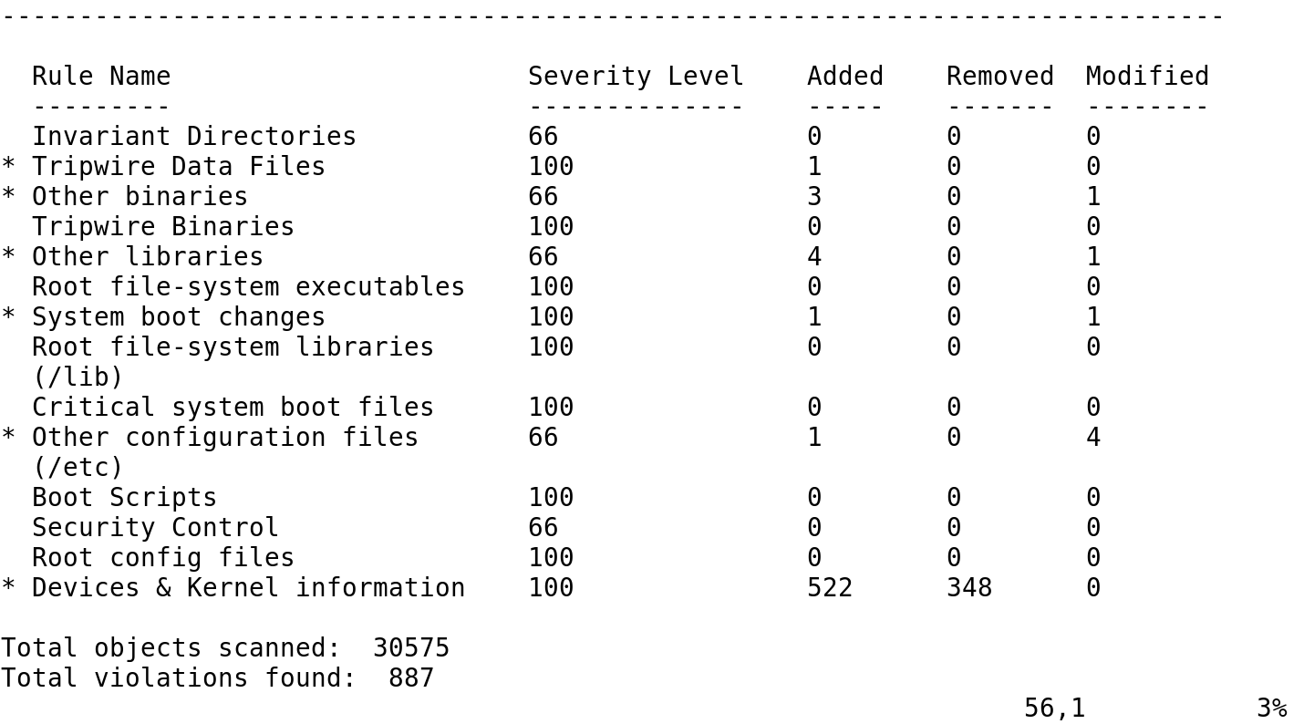
A Tripwire Check

Slide 24
Summary
A secure baseline Linux system
Read-only versus live bootable operating systems
Local and remote log configuration
File and data integrity checkers

Slide 25
Virtual Labs
Applying Best Practices for Security Logging and Monitoring
Notes:
If your educational institution included the Jones & Bartlett labs as part of the course curriculum, use this script to introduce the lab:
"In this lesson, you learned the importance of a good baseline that keeps installed software to a minimum and controls against unauthorized access. The quality of the baseline can be monitored with logs and with IDS tools such as Tripwire, a third-party software tool that helps monitor the Linux server for changes.
In this lab, you will configure remote logging in the CentOS Linux Server and send syslogs to a remote host for secure secondary logging. You will use Tripwire, a third-party file integrity tool, to identify modifications to important system files. You will configure Rootkit Hunter, (rkhunter), to search for rootkits and other anomalies on a set schedule. You also will search the log files for specific criteria."

