Slide 1
Security Strategies in Linux Platforms and Applications
Lesson 13
Testing and Reporting

Slide 2
Learning Objective
Test and gather security reports.

Slide 3
Key Concepts
Security testing tools
Tools to monitor open ports
Security management on physical and virtual systems
Reporting features in common tools

Slide 4
DISCOVER: CONCEPTS

Slide 5
What to Test
Firewalls
Services
Passwords
Access Control

Slide 6
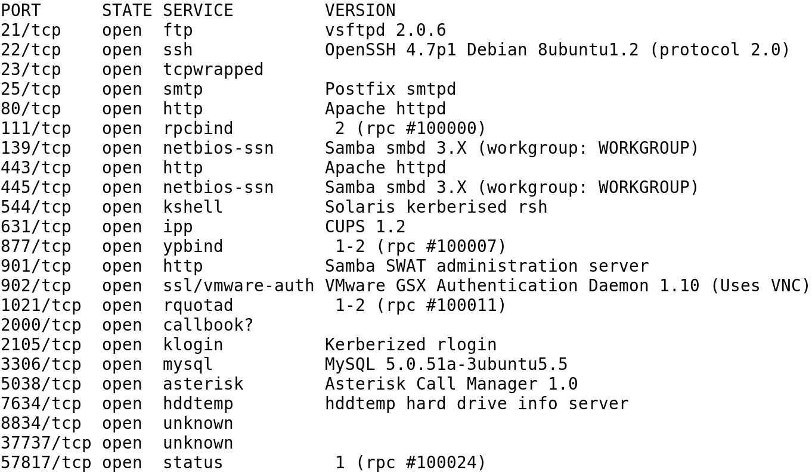
A List of Open Services with Version Information

Slide 7
Open Source Testing Tools
Wireshark
Snort
Netcat
Metasploit
Hping2
Notes:
Wireshark—Supports analysis of network packets
Snort—An intrusion detection system (IDS) with modes for packet analysis, logging, and interaction with iptables firewall rules; associated rules are updated on a regular basis
Netcat—A utility that can read both TCP and UDP packets
Metasploit Framework—A platform for testing for code designed to take advantage of known vulnerabilities
Hping2—A command-line packet analyzer that sends TCP and UDP packets based on the features of the ping command

Slide 8
Commercial Testing Tools
Nessus
SAINT

Slide 9
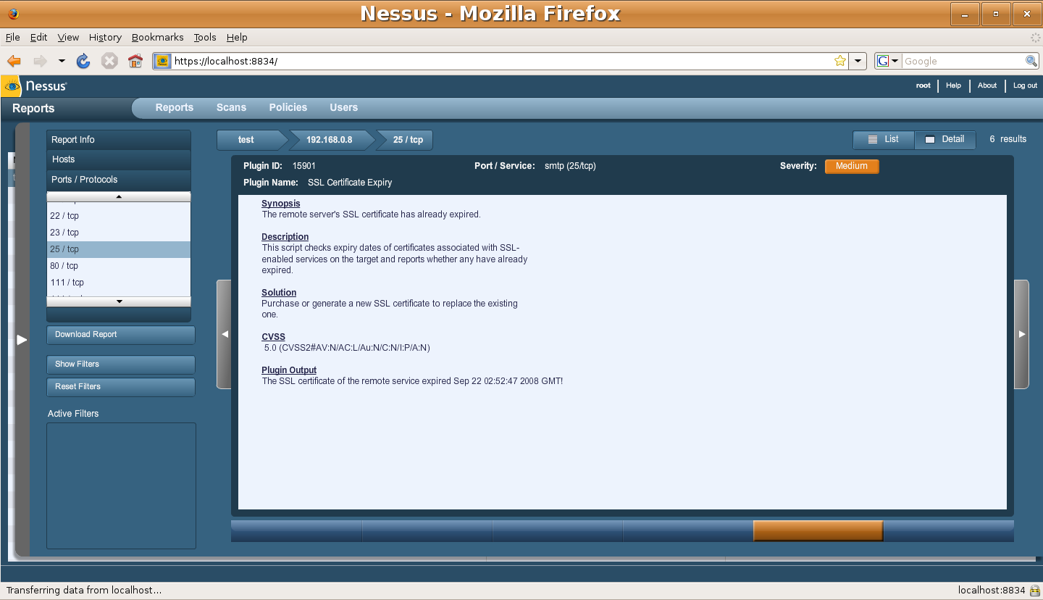
An Excerpt from a Nessus Report

Slide 10
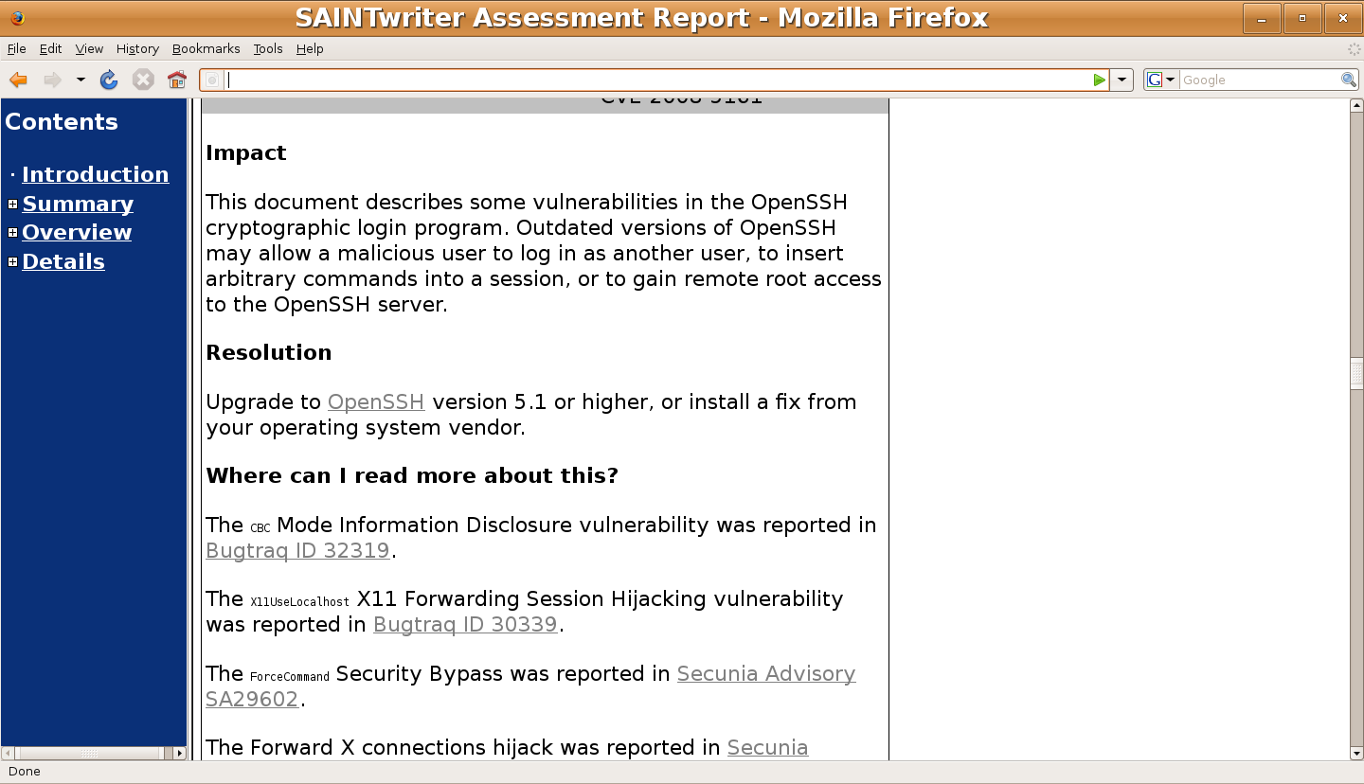
An Excerpt from a SAINT Report

Slide 11
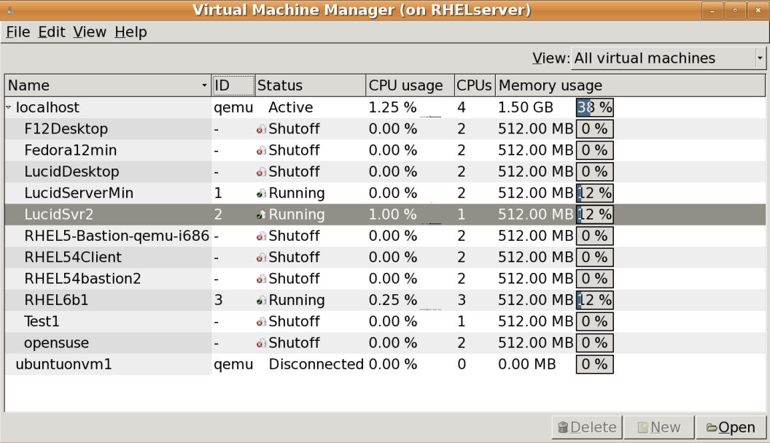
Virtual Machine Manager

Slide 12
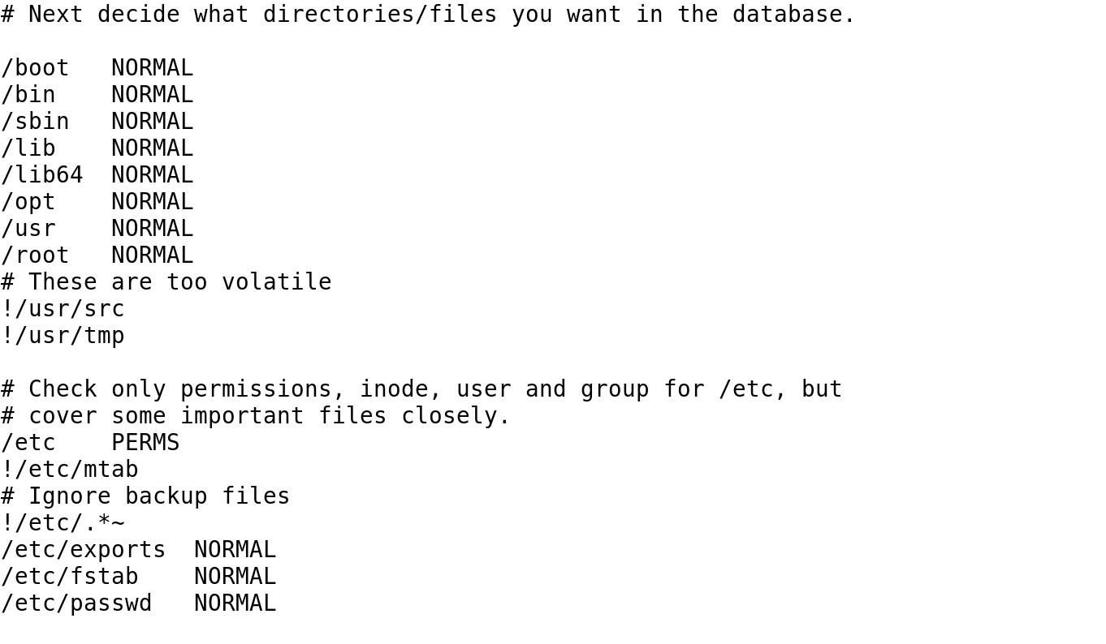
Excerpt from the Default Red Hat Version of aide.conf

Slide 13
Audit Service
Install the service with the yum install audit command.
Configure the service to run on boot with chkconfig auditd on.
Use auditctl command to create audit rules.
Use ausearch command to search for activity in the audit rules.

Slide 14
DISCOVER: PROCESS

Slide 15
Checking for Open Ports
telnet
netstat
lsof
nmap

Slide 16
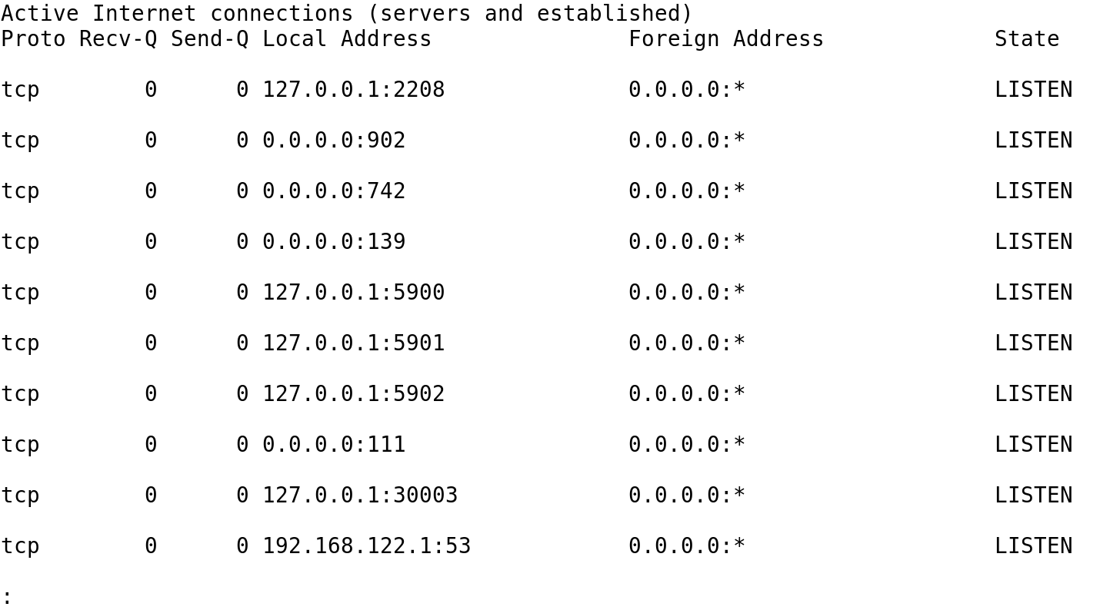
Identify What Your System Listens to with netstat -atun

Slide 17
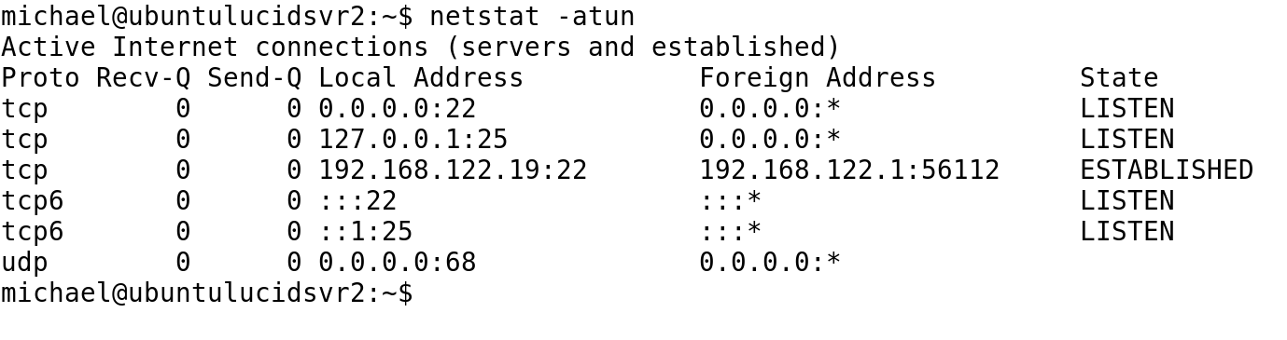
The netstat –atun Command on a Bastion Server

Slide 18
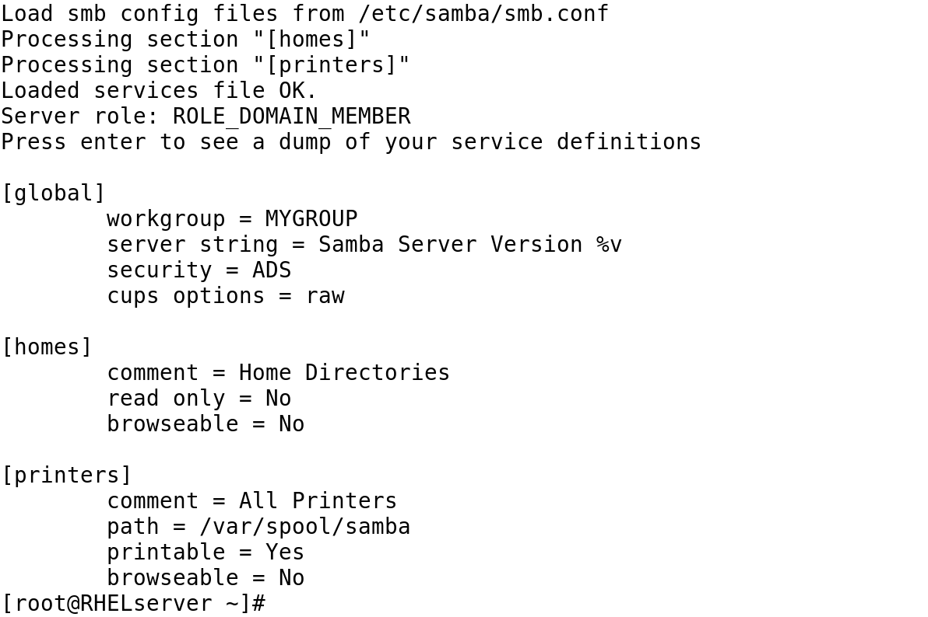
Testing Samba Syntax with testparm

Slide 19
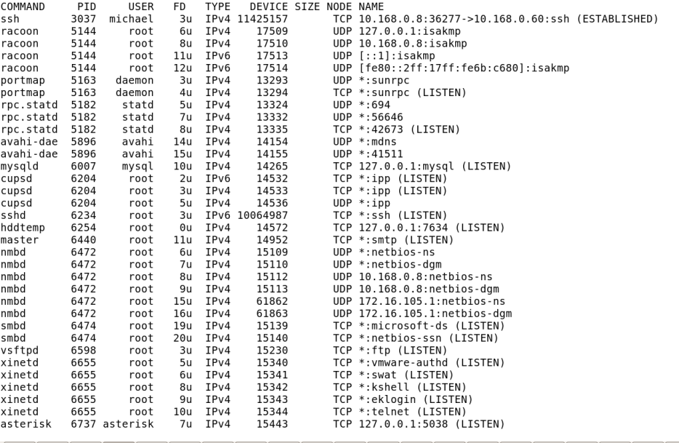
The lsof -ni Command on a Multipurpose System

Slide 20
DISCOVER: ROLES

Slide 21
Port Monitoring and Log Configuration
Port monitoring:
Indexes and monitors ports
Investigates unauthorized ports
Log configuration:
Configures logs on local and remote logging servers and runs log scanners, such as logwatch

Slide 22
DISCOVER: CONTEXTS

Slide 23
The Right Place for Security Tools
On a secure system
Run from a live CD/DVD
Live tools:
BackTrack
Knoppix Security Tools Distribution (STD)
Network Security Toolkit (NST)

Slide 24
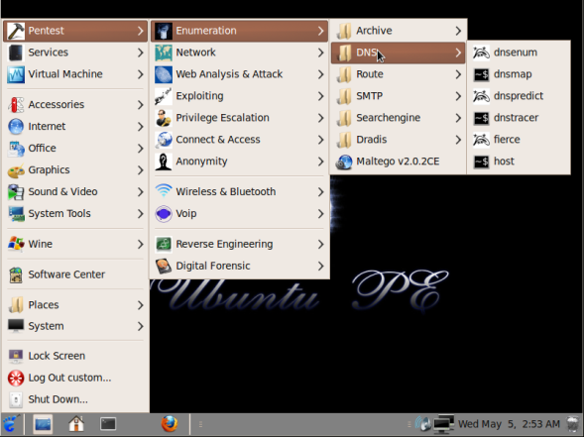
Ubuntu Pentest Edition

Slide 25
Summary
Security testing tools
Tools to monitor open ports
Security management on physical and virtual systems
Reporting features in common tools

