Slide 1
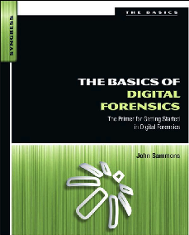
2. Key Technical Concepts

Slide 2
Topics
Basic Computer Operation
Bits & Bytes
File Extensions & File Signatures
How Computers Store Data
RAM: Random Access Memory
Volatility of Data

Slide 3
Topics
The Difference Between Computer Environments
Active, Latent, and Archival Data
Allocated and Unallocated Space
Computer File Systems

Slide 4
Bits & Bytes

Slide 5
Bits & Bytes
A Bit is 0 or 1
8 bits is a byte
00000000 to 11111111
256 possible bytes
Can be written as a number 0 to 255
In Hexadecimal, 00 to FF
Binary Games

Slide 6
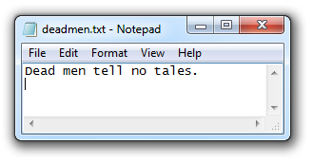
ASCII Text
One byte per character
7 bits encode character, one parity bit
94 printable characters
Originally used for English
Adapted to other languages

Slide 7
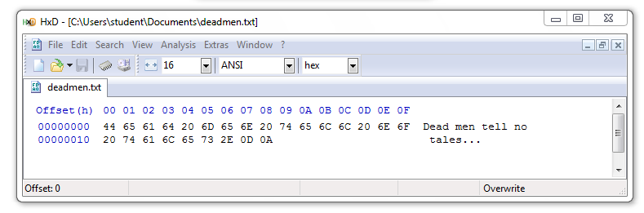
ASCII file in Hexadecimal
20 hex = 32 decimal = SPACE
0D 0A = 13 10 = CR LF

Slide 8
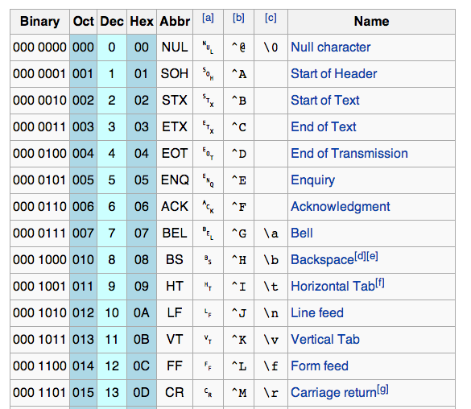
ASCII
Link Ch 2a & Wikipedia

Slide 9
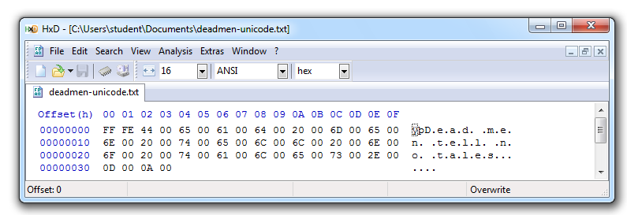
Unicode
Encodes all "commercially significant" languages
Two bytes per character
FF FE at the start is a Byte Order Mark
Link Ch 2c

Slide 10
File Headers & File Carving

Slide 11
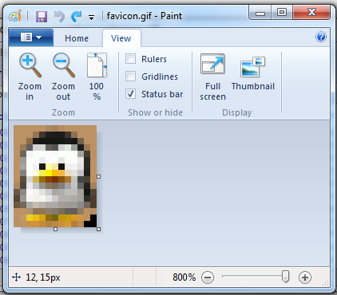
GIF Image (13x16 pixels)

Slide 12
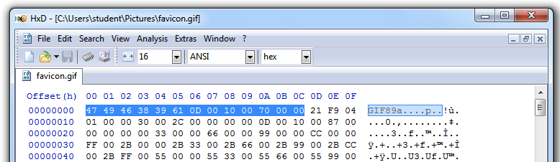
GIF File Header
GIF89a – Version of GIF
0D 00 0A 00 – 13 pixels x 16 pixels

Slide 13
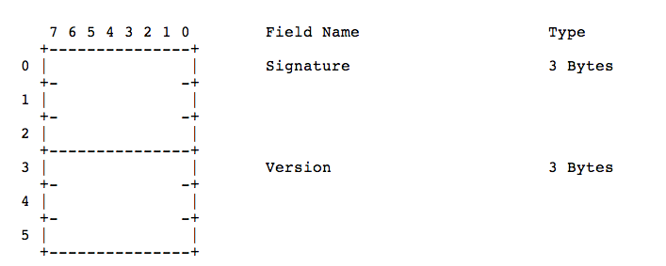
GIF Specification
Link Ch 2d

Slide 14
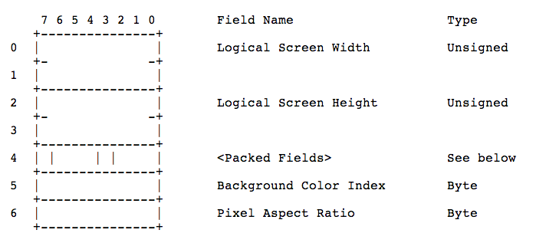
GIF Specification
Link Ch 2d

Slide 15
File Carving
Rebuilding files by assembling blobs of data found on a disk
Relies on file headers and footers
Done automatically by all-purpose forensic suites like FTK and EnCase
Many other tools exist to carve files

Slide 16
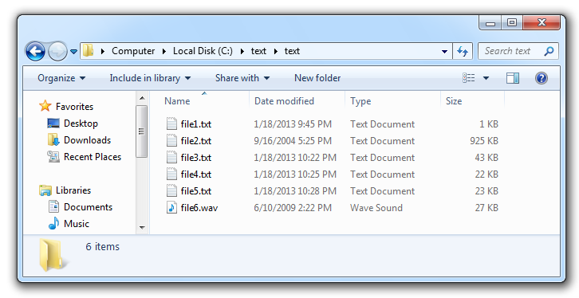
Lab-Project 3: Identifying File Types

Slide 17
File Extensions & File Signature

Slide 18
File Extensions
Usually three letters long
Appear at the end of a file name, after a dot
Hidden in Windows by default
Used to specify the file type, icon, and default application

Slide 19
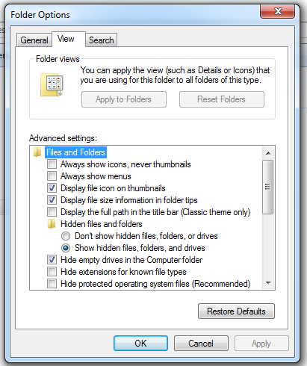
Hide File Extensions

Slide 20
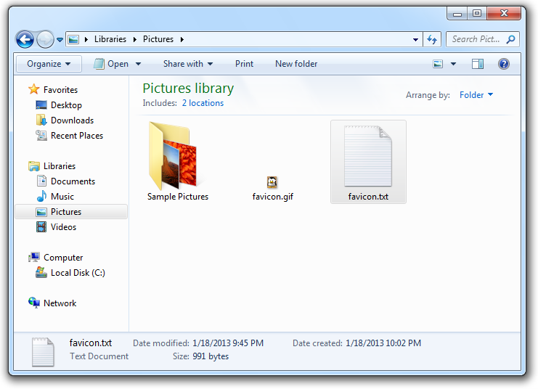
Incorrect File Extension

Slide 21
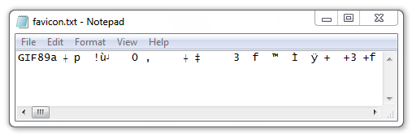
Wrong Default Application
Any stream of bytes can be interpreted as ASCII

Slide 22
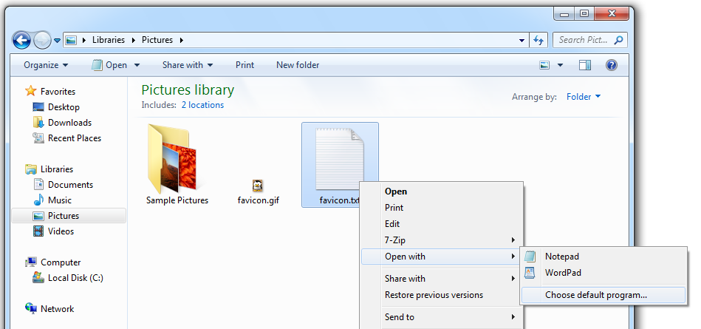
Open With…

Slide 23
How Computers Store Data

Slide 24
Storage Methods
Electromagnetism
Hard disks and floppy disks
Microscopic Electrical Transistors
SSDs, USB flash drives, SD cards, etc.
Reflecting Light
CDs, DVDs, Blu-ray
They are all nonvolatile – they retain data without power

Slide 25
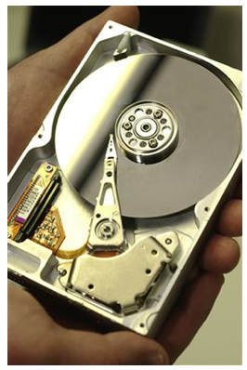
Magnetic Disks
Platter spins at 7,000 rpm to 15,000 rpm
Spindle is the axis
Read/write head is an electromagnet mounted to an actuator arm
Image from textbook

Slide 26
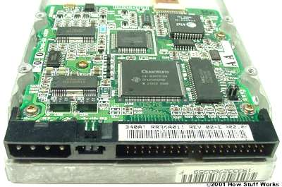
Disk Controller Card
Stores and retrieves data from the platters
Controlled by firmware stored in the Host Protected Area
Image from http://static.ddmcdn.com/gif/ide-controller2.jpg

Slide 27
Flash Memory
Made of transistors
Solid State Devices (SSDs)
Faster than hard disks
Use less power
More expensive

Slide 28
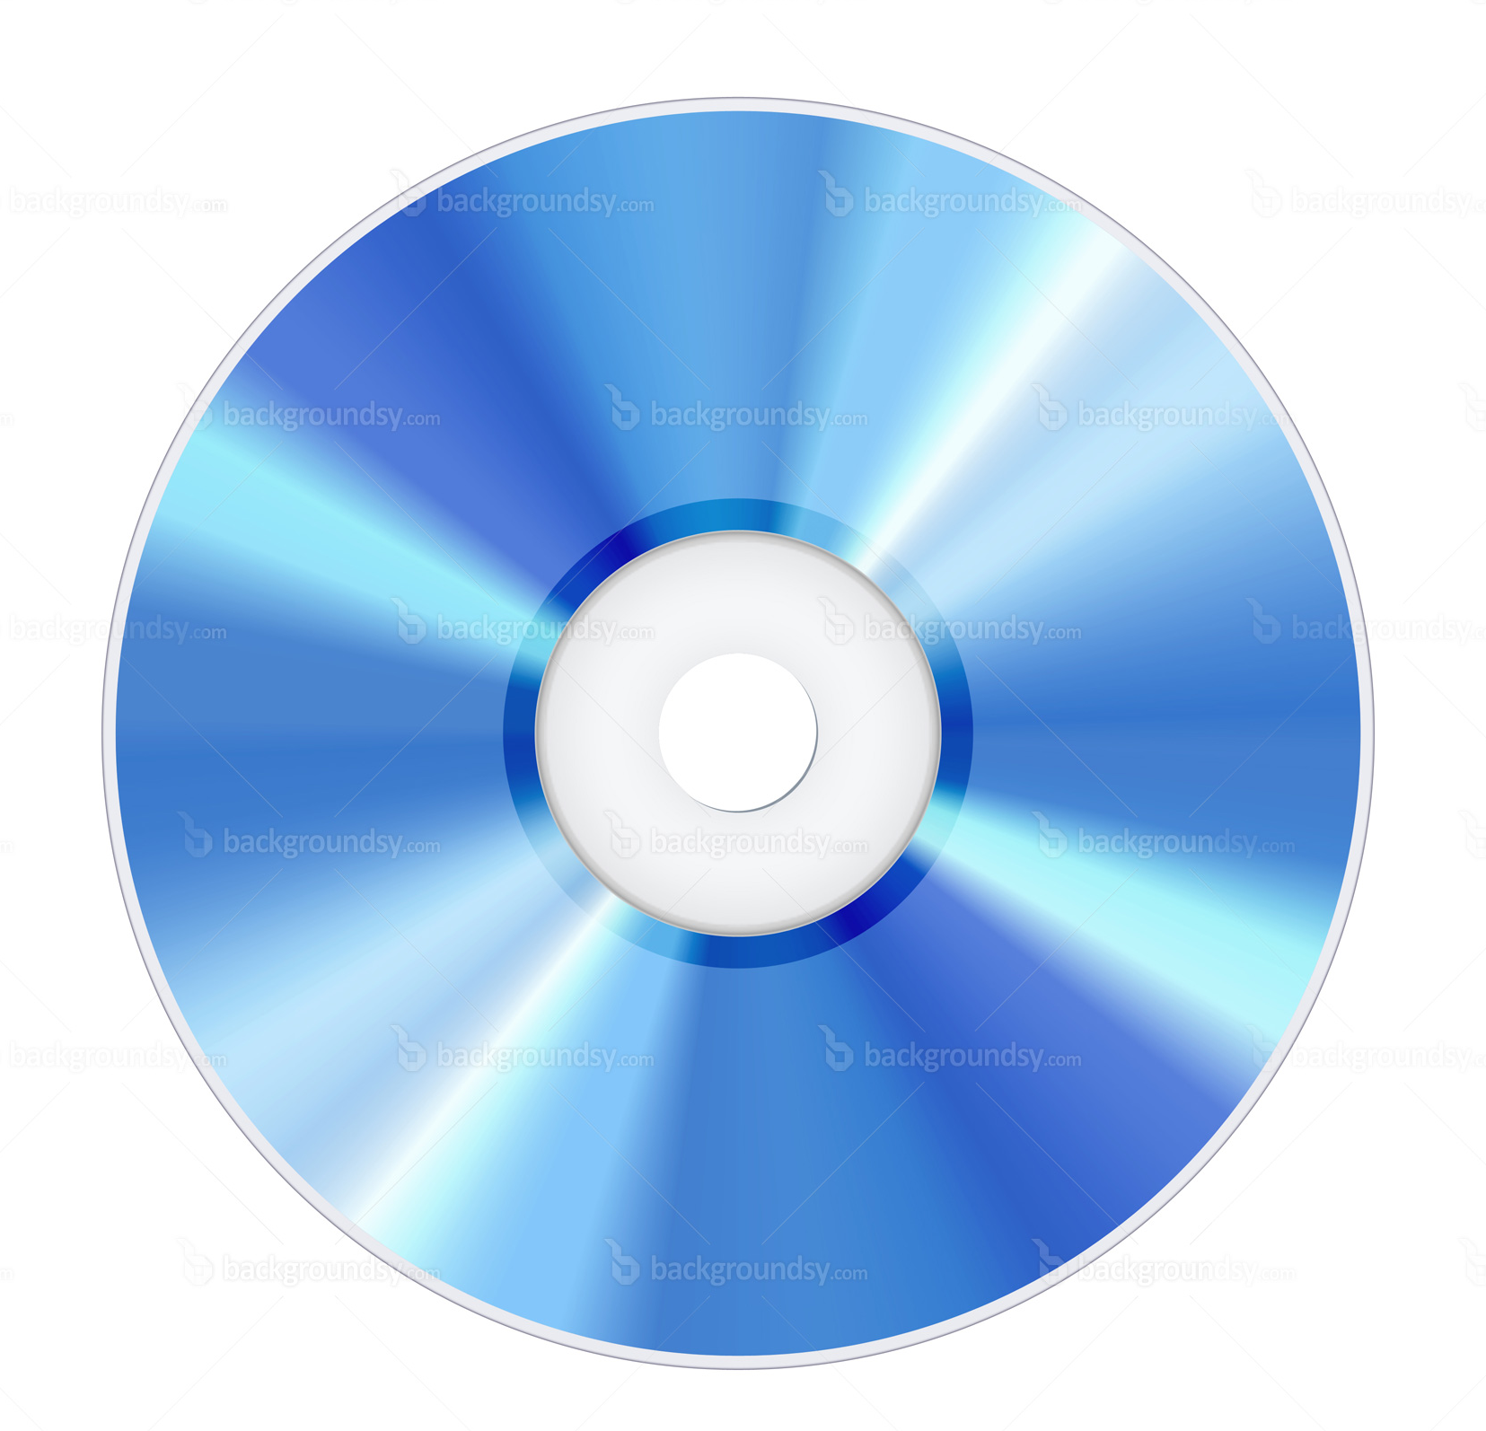
Optical Storage
Microscopic pits encode bits
Area between pits are called lands
There is one long spiral track for the whole disk
Data is read with laser light
Link Ch 2e
Image from http://www.backgroundsy.com/file/large/blu-ray-disc-isolated.jpg

Slide 29
Volatile v. Nonvolatile Memory
Memory is short-term storage
Storage devices (hard disks, SSDs, and optical disks) are nonvolatile - data is retained without power
RAM is main system memory
RAM is volatile - data is lost when power goes off

Slide 30
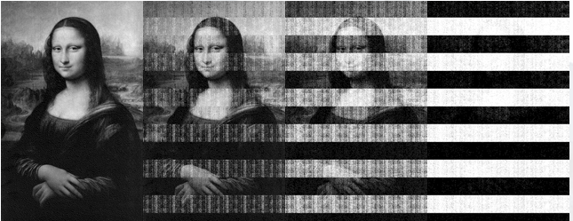
Volatility of RAM
5 sec
30 sec
60 sec
5 min
From Princeton (Link Ch 2f)

Slide 31
RAM Forensics
RAM contains important evidence that is not normally written to the hard disk
Instant messages
Network connections
Running processes
BUT there are no time-stamps on RAM contents
It can be misleading

Slide 32
Computing Environments

Slide 33
Four Categories
Stand-alone
Networked
Mainframe
Cloud

Slide 34
Stand-Alone
A computer not connected to any other computer
Such as a laptop not connected to Wi-Fi or cellular data
BUT networks are everywhere now, even in BART or on airplanes

Slide 35
Networked
A computer connected to at least one other computer
Evidence might be on servers and network devices as well as the local computer
Almost every computer is networked now

Slide 36
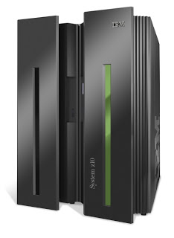
Mainframe
A powerful computer used at a business, or shared by many users
Located in a data center or colocation center
Image from http://danialsharifudin.blogspot.com/2012/08/classification-of-computer.html

Slide 37
Cloud Computing

Slide 38
Examples of Cloud Computing
Gmail
Facebook
Twitter
Amazon Web Services
CloudFlare

Slide 39
Cloud Services
Infrastructure as a Service (IaaS)
Platform as a Service (PaaS)
Software as a Service (SaaS)

Slide 40
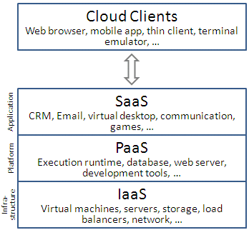
From Wikipedia (Link Ch 2m)

Slide 41
IaaS
The most basic cloud service
Outsources hardware needs
Servers, storage, routers, switches…
Examples
Amazon EC2
Windows Azure Virtual Machines
Google Compute Engine
Rackspace Cloud
Link Ch 2m

Slide 42
PaaS
Provides a computing platform
OS, programming language execution, database, and Web server
Examples
AWS Elastic Beanstalk
Heroku
Google App Engine
Windows Azure Compute
Link Ch 2m

Slide 43
SaaS
Providers install and operate application software in the cloud
Users access the software from cloud clients
Examples
Google Apps
Microsoft Office 365
Link Ch 2m

Slide 44
IaaS
Outsource hardware needs
Servers, storage, routers, switches…
Examples
Amazon EC2
Windows Azure
Google Compute Engine
Link Ch 2m

Slide 45
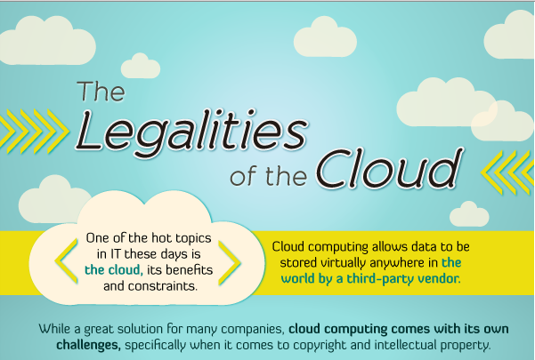
From link Ch 2g

Slide 46
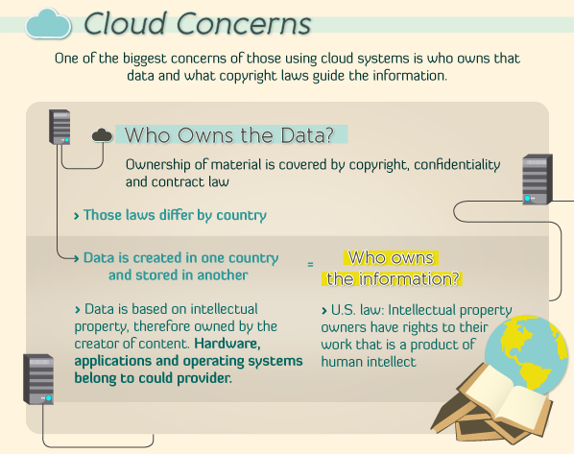
From link Ch 2g

Slide 47
Instagram
Online photo-sharing site
In Dec. 2012, Instagram changed its terms of service
Perpetual rights to all photos
Right to sell photos to advertisers without payment or notice to the user
Instagram lost half its daily users in a month
Links Ch 2h, Ch 2i

Slide 48
AWS Outage
Dec. 24, 2012
Netflix was down, because they rely on AWS (Link Ch 2j)
Amazon has had several other major outages (Link Ch 2k)

Slide 49
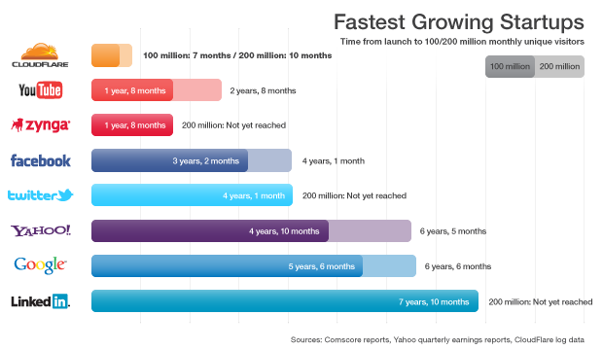
From 2011 (Link Ch 2l)

Slide 50
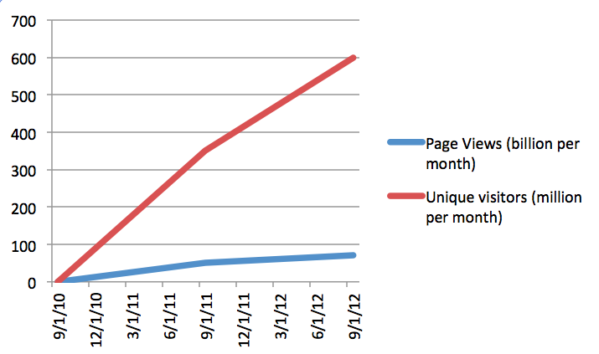
Cloudflare Growth

