Slide 1
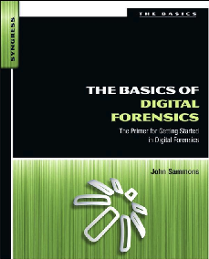
3. Key Technical Concepts Part 2

Slide 2
Active, Latent and Archival Data

Slide 3
Active Data
Data the operating system can "see" and use
Files and folders that appear in Windows Explorer
Reside in allocated space
Can be acquired by copying files

Slide 4
Latent Data
Data that has been deleted or partially overwritten
Invisible to OS
Does not appear in Windows Explorer
A bitstream or forensic image is required to acquire this data

Slide 5
Archival Data
Also called Backups
Commonly stored on
External hard drives
DVDs
Magnetic tapes
Cloud backup services like Iron Mountain or Symform

Slide 6
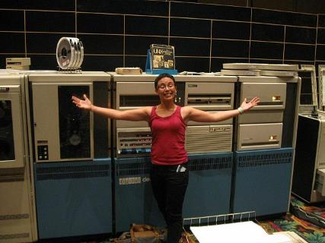
Legacy Archival Data
Made with software or hardware that is no longer in production
To acquire the data, you need to get old devices
User's groups
eBay
Image: PDP-11 at Defcon 17
Link Ch 2n

Slide 7
Computer File System

Slide 8
File System
Keeps track of used and free sectors
Location of each file
Filename
Last modified date
Permissions

Slide 9
FAT (File Allocation Table)
Oldest and simplest file system
FAT12 (for floppy disks)
FAT16 (2 GB max. partition size)
4 GB on Win 2000 (link Ch 2p)
FAT32 (Common on USB drives)
Not used on Windows XP or later
FATX for the X-Box
exFAT used for Windows CE
Link Ch 2o

Slide 10
NTFS (New Technology File System)
Used by Win XP, 7, and Server
Advantages
Journaling (recovers from errors)
Encryption
Permissions
Uses B-Trees for fast searches

Slide 11
HFS+ (Hierarchical File System)
Used by Apple products
Also uses B-Trees
Related versions
HFS
HFSX

Slide 12
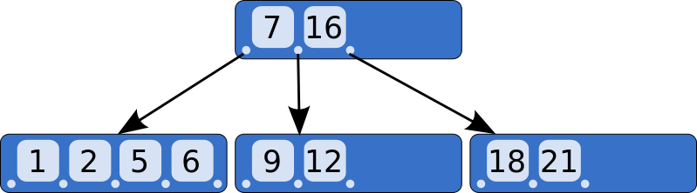
B-Tree
An way of storing objects so they can be searched quickly
Image From Wikipedia

Slide 13
Allocated and Unallocated Space

Slide 14
Space on a Hard Drive
Allocated
Active data
In use
Can be seen by OS
Unallocated
No longer in use
Slack space (Drive slack)
Invisible to OS

Slide 15
Space on a Hard Drive
Host Protected Area and Device Configuration Overlays
Hidden area on a hard drive
Difficult to detect
Not used by OS
Stores device firmware and data
Accessed by firmware update routines, which can be reverse engineered

Slide 16
Data Persistence
Old Data is Left in Slack Space
Unallocated clusters
Remains on drive until overwritten
Can be years
Even an Overwrite may not get it all
If the new file doesn't use all the sectors

Slide 17
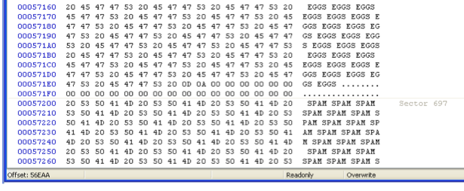
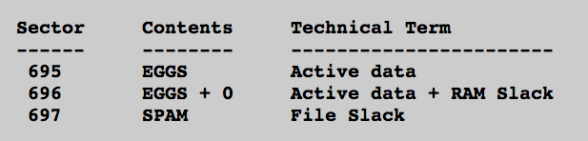
Lab-Project 4

Slide 18
Magnetic Drive Storage
Sector = 512 bytes
All data is read and written a sector at a time
Cluster
Varies, often 4096 bytes = 8 sectors
OS can only use space a cluster at a time

Slide 19
Example
BIG file: 4000 bytes
Written onto disk
Nearly fills 8 sectors = 1 cluster
Delete BIG file
Save SMALL file on same cluster
SMALL file: 1000 bytes
Only uses 2 clusters

Slide 20
Drive Slack
Sector Before After
------ ------ ------
200 BIG SMALL
201 BIG SMALL
202 BIG BIG
203 BIG BIG
204 BIG BIG
205 BIG BIG
206 BIG BIG
207 BIG BIG

Slide 21
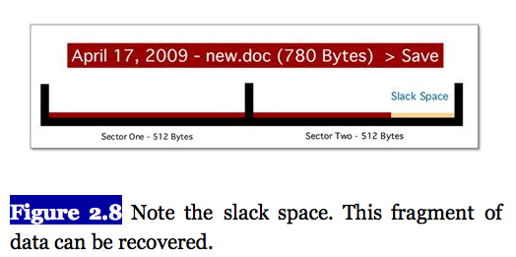
Error in Textbook, 1st Edition
Discussion from Fig. 2.5 through 2.8 is wrong
Book says a 780 byte file only overwrites 780 bytes on disk, i.e. the leftover data between the 780-byte mark and the 1024-byte end of sector can be recovered, when it actually overwrites 1024 bytes

Slide 22
Explanation
Every write operation always writes 512 bytes
So the area marked "slack space" in the figure is overwritten by zeroes in modern operating systems
In very old operating systems, that space was overwritten with data from RAM - technically known as "RAM Slack“
In both cases, that data is overwritten and cannot be recovered
In Lab-Proj 4: students saved a group of 10,002-byte files containing "SPAM" to a disk, deleted the files, and then re-filled the disk with 1002-byte files containing "EGGS“
The leftover space at the end of the sector contains zeroes, not leftover "SPAM" data: The latent "SPAM" appears only in later sectors, not in the sector to which the "EGGS" data were written (cf. slide 17)

Slide 23
Page File (Swap Space)
Used for virtual memory
Temporary storage when your computer runs out of available RAM
Windows puts data here even when RAM is not full
It also loads old data from swap back into RAM
I once found something years old in my RAM

Slide 24
Potential Page File Contents
Passwords
Fragments of images or documents
Anything else from RAM
BUT there is no timestamp, so it will be hard to connect to a specific user or event

Slide 25
Hiberfil.sys
Contains entire RAM contents
Filled when a computer hibernates

Slide 26
Whole Disk Encryption
Because of the Page file and the Hiberfil
You can never be sure where your data is
Whole Disk Encryption
The only way to be sure all your data is protected
Microsoft BitLocker
Apple FileVault
TrueCrypt (Open Source)

Slide 27
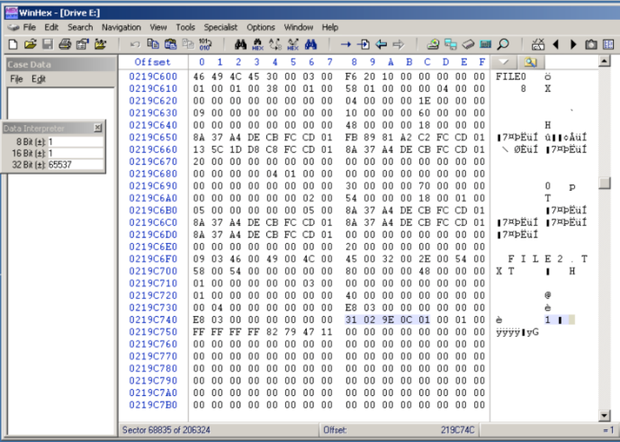
Lab-Project: NTFS Data Runs
Notes:
For more details see Lect.11 of IAR401

