Slide 1
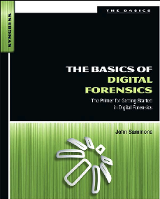
4. Labs and Tools

Slide 2
Topics
Forensic Laboratories
Policies and Procedures
Quality Assurance
Hardware and Software
Accreditation v. Certification

Slide 3
Forensic Laboratories

Slide 4
Forensic Labs
Most are run by law enforcement agencies
FBI's crime lab in Quantico, VA is largest in the world
Regional Computer Forensic Laboratory (RCFL)
FBI Program
16 facilities throughout US
They process smartphones, hard drives, GPS units, and flash drives

Slide 5
Virtual Labs
Evidence repository separate from the examiner
This is how the FBI does it
Saves money, increases access to resources
Role-based access
Examiners and management get full access
Investigators, prosecutors, and attorneys get restricted access
Drive images on server
Examiner
connects remotely

Slide 6
Concerns with Virtual Labs
Security
Must retain integrity or evidence will be inadmissible in court
Performance
High-speed connectivity required
Cost

Slide 7
Lab Security
Physical security
Keep unauthorized people out of critical areas
Examination stations
Evidence storage
Keys, swipe cards, access codes
Digital access control is better than keys
Keeps an audit trail to support chain of custody
Protection from fire, flood. etc.

Slide 8
Chain of Custody
Evidence must be signed in and out of storage
Evidence log must be complete

Slide 9
Work in Isolation
Forensic examination computer should not be connected to the Internet
This avoids arguments over contamination by malware
Evidence drives may contain malware
Scan them with antivirus software

Slide 10
Evidence Storage
Data safe
Protects evidence from tampering
Fireproof and waterproof
Evidence log
Must record who entered, when, and what they removed or returned
Data storage lockers must be kept locked

Slide 11
Policies and Procedures

Slide 12
Standard Operating Procedures (SOPs)
Documents that detail evidence collection, examinations, etc.
These ensure consistency and reliability
Very important to handle questions in court
Unusual situations will often require special handling

Slide 13
Best Practices for Evidence Collection
For proper evidence preservation, follow these procedures in order (Do not use the computer or search for evidence)
Photograph the computer and scene
If the computer is off do not turn it on
If the computer is on photograph the screen
Collect live data - start with RAM image (Live Response locally or remotely via F-Response) and then collect other live data "as required" such as network connection state, logged on users, currently executing processes etc.
If hard disk encryption detected (using a tool like Zero-View) such as full disk encryption i.e. PGP Disk — collect "logical image" of hard disk using dd.exe, Helix - locally or remotely via F-Response
Unplug the power cord from the back of the tower - If the computer is a laptop and does not shut down when the cord is removed then remove the battery

Slide 14
Best Practices for Evidence Collection
Diagram and label all cords
Document all device model numbers and serial numbers
Disconnect all cords and devices
Check for HPA then image hard drives using a write blocker, Helix or a hardware imager
Package all components (using anti-static evidence bags)
Seize all additional storage media (create respective images and place original devices in anti-static evidence bags)
Keep all media away from magnets, radio transmitters and other potentially damaging elements
Collect instruction manuals, documentation and notes
Document all steps used in the seizure
From link Ch 3a

Slide 15
Quality Assurance

Slide 16
Quality Assurance
A well-documented system of protocols used to assure accuracy and reliability
Peer reviews of reports
Evidence handling
Case documentation
Training of lab personnel

Slide 17
Reviews
Technical review
Focuses on results and conclusions
Are the results reported supported by the evidence?
Administrative review
Ensures all paperwork is present and completed correctly

Slide 18
Proficiency Testing
Examiner's competency must be confirmed and documented
Open test
Examiner is aware they are being tested
Blind test
Examiner is not aware they are being tested
Internal test
Conducted by agency itself
External test
Conducted by independent agency
Results must be documented

Slide 19
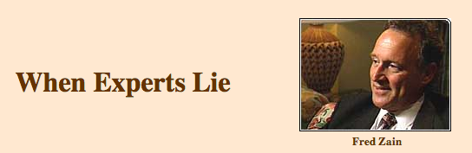
West Virginia State Police forensics expert who testified in hundreds of criminal cases
Very persuasive in court
…became something of a forensics "star," sought after by prosecutors who wanted to win convictions in difficult cases

Slide 20
Lies
Falsified his own credentials
Fabricated and altered evidence
Convicted an innocent man of sex crimes in 1997
He was freed when DNA evidence proved he was innocent
Sued State of West VA
That exposed Fred Zain
Real rapist was caught 24 years later
Link Ch 3b

Slide 21
Tool Validation
Each tool, software or hardware, must be tested before use on an actual case
Paper records are necessary to prove this

Slide 22
Documentation
Case File
Case submission forms
Requests for assistance
Chain of custody reports
Examiner's notes
Crime scene reports
Examiner's final reports
Copy of search authorization
All collected in a case file
Preprinted forms help maintain uniformity

Slide 23
Examiner Notes
Must be detailed enough to enable another examiner to duplicate the process
Discussions with key players including prosecutors and investigators
Irregularities found and actions taken
OS versions & patches
Passwords
Changes made to the system by lab personnel and law enforcement
It may be years before trial, and you will need to understand your notes

Slide 24
Examiner's Final Report
Formal document delivered to prosecutors. investigators, opposing counsel, etc.
Remember the audience is nontechnical
Avoid jargon, acronyms, and unnecessary details

Slide 25
Examiner's Final Report Contents
Identity of the reporting agency
Case ID #
Identity of the submitting person and case investigator
Dates of receipt and report
Detailed description of the evidence items submitted
Serial numbers, makes, models, etc.
Identity of the examiner
Description of the steps taken during the examination process
Results and conclusions

Slide 26
Examiner's Final Report Sections
Summary
Brief description of the results
Detailed findings
Files pertaining to the request
Files that support the findings
Email, Web cache, chat logs, etc.
Keyword searches
Evidence of ownership of the device
Glossary

Slide 27
Digital Forensic Tools

Slide 28
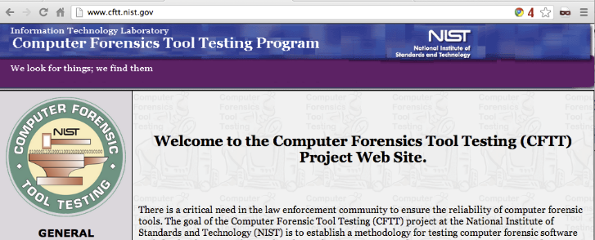
Digital Forensic Tools
NIST's Forensic Tool Testing Project
Link Ch.3c

Slide 29
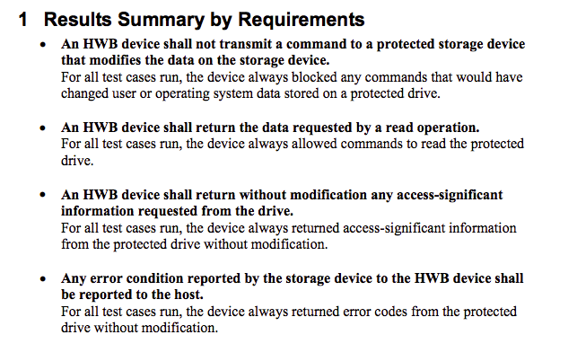
Sample Report

Slide 30
Hardware Tools
Cloning devices
Cell phone acquisition devices
Write blockers
Portable storage devices
Adapters
Cables
Much more

Slide 31
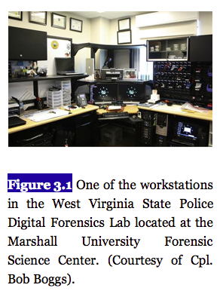
From textbook

Slide 32
Computer Recommendations
Multiple multicore processors
As much RAM as possible
Large, fast hard drives
FTK 4 recommends:
64-bit processor, Quad core
8 GB RAM
A dedicated 150 GB hard disk for the PostgreSQL database; SSD or RAID preferred
1 GB network
Link Ch 3d

Slide 33
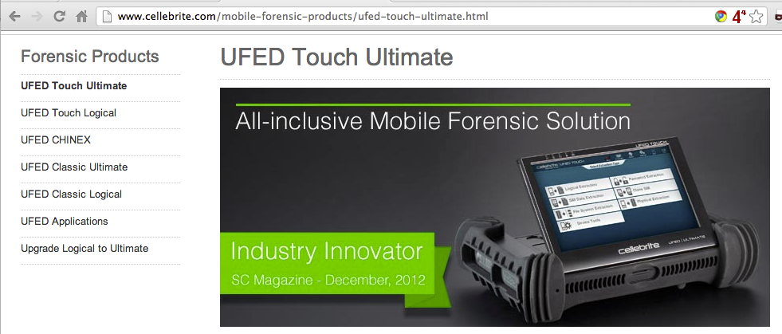
Non-PC Hardware
Cellebrite's UFED
Supports over 3,000 phones (Link Ch 3e)

Slide 34
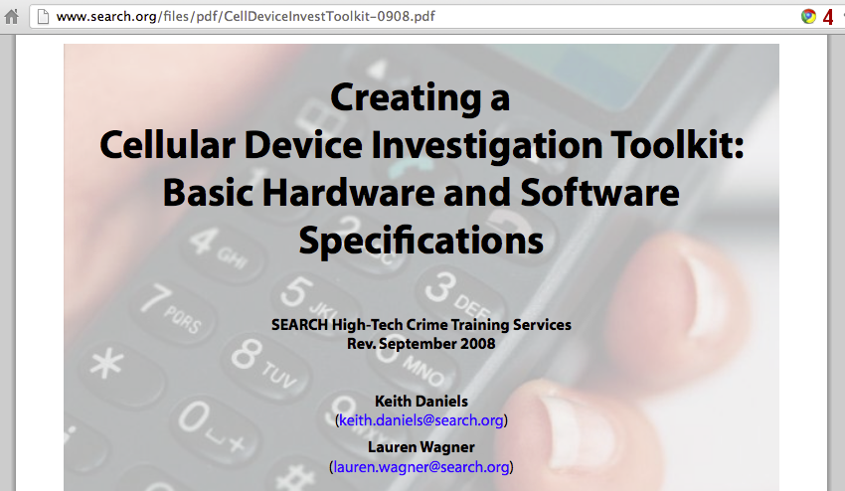
Link Ch 3f

Slide 35
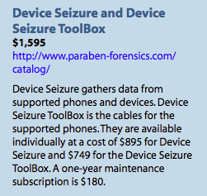
Paraben
Competes with Cellebrite
Supports more than 4,000 phones, PDAs, and GPS units

Slide 36
Cloners and Kits
Hardware Cloners
Faster, can clone multiple drives at once
Provide write protection, hash authentication, drive wiping, audit trail…
Crime scene kits
Preloaded with supplies to collect digital evidence
Pens, digital camera, forensically clean storage media, evidence bags, evidence tape, report forms, markers…

Slide 37
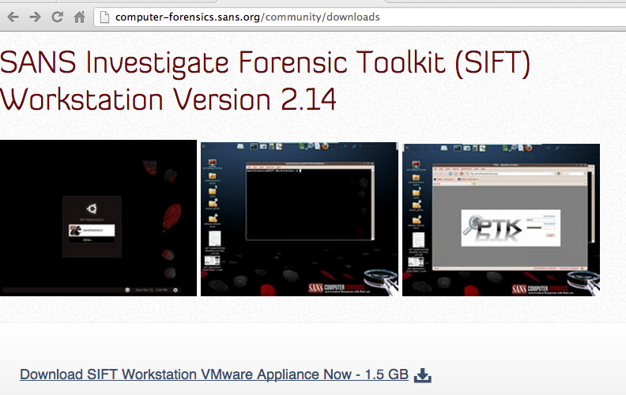
Software: Open-Source
SIFT: SANS Investigative Forensic Toolkit
SIFT Workstation is free, based on Ubuntu
Link Ch 3g

Slide 38
SIFT Capabilities
Windows (MSDOS FAT, VFAT, NTFS)
Mac (HFS)
Solaris (USF)
Linux (ext2/3/4)
File carving
Analyzing file systems
Web history
Recycle bin
Memory
Timeline

Slide 39
SIFT Capabilities
Evidence Image Support
Expert Witness (E01)
RAW (dd)
Advanced Forensic Format (AFF)

Slide 40
SIFT Capabilities
The Sleuth Kit (File system Analysis Tools)
log2timeline (Timeline Generation Tool)
ssdeep & md5deep (Hashing Tools)
Foremost/Scalpel (File Carving)
WireShark (Network Forensics)
Vinetto (thumbs.db examination)
Pasco (IE Web History examination)
Rifiuti (Recycle Bin examination)
Volatility Framework (Memory Analysis)
DFLabs PTK (GUI Front-End for Sleuthkit)
Autopsy (GUI Front-End for Sleuthkit)
PyFLAG (GUI Log/Disk Examination)

Slide 41
Commercial Tools
EnCase & FTK have similar capabilities
Searching
E-mail analysis
Sorting
Reporting
Password cracking

Slide 42
EnCase & FTK
Search tools
E-mail addresses
Names
Phone numbers
Keywords
Web addresses
File types
Date ranges

Slide 43
Don't Trust Tools
Using a tool without understanding what it's doing is a trap
Verify all findings with a second tool, like a simple hex editor
You must figure out how the data got on the system and what it means

Slide 44
Other Multipurpose Tools
Acquisition, verification, searching, reporting, wiping, etc.)
SMART
ProDiscover
X-Ways Forensics
Helix (Linux-based)
Raptor (Linux-based)

Slide 45
Other Tools
Mac Tools
Softblock
Macquisition
Blacklight
BlackBag
Mac Marshall

Slide 46
Other Tools
Dossier from LogiCube
Hardware acquisition
Tableau
Write-blockers
Weibetech
Write-blockers

Slide 47
Accreditation vs. Certification

Slide 48
Accreditation
Endorsement of a crime lab's policies and procedures
ASCLD/LAB does this
Very burdensome to achieve
Not possible for every lab
ASTM also accredits labs

Slide 49
Certification
Applies to examiners, not the lab
SWGDE Core Competencies for Forensic Practitioner Certification
Pre-examination procedures and legal issues
Media assessment and analysis
Data recovery
Specific analysis of recovered data
Documentation and reporting
Presentation of findings
Link Ch 3h

