Slide 1
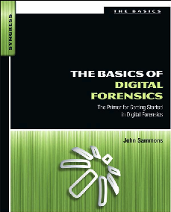
5. Collecting Evidence

Slide 2
Topics
Crime scenes
Documenting
Chain of Custody
Forensic cloning
Live and Dead Systems
Hashing
Final Report

Slide 3
Crime Scenes and Collecting Evidence

Slide 4
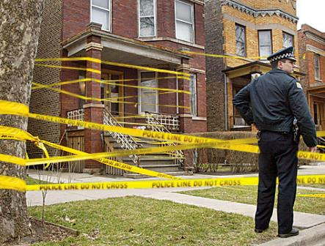
Securing the Scene
Unnecessary people must be kept out
Network connections place data at risk
Once it is assured that volatile data won't be lost, disconnect network cables
Isolate seized phoned from network
Image from crimescenecleanupdetroit.com

Slide 5
Removable Media
Memory cards can be tiny
Hidden in books, wallets, hat bands, etc.
Also DVDs, external hard drives, thumb drives, memory cards
Examine books and manuals to determine the skill level of the target
Are they using encryption?

Slide 6
Cell Phones
Valuable evidence
Text messages, email, call logs, contacts
Interacting with the phone can change data
Apple's "Find My iPhone" app can be used to remotely wipe the phone

Slide 7
Isolating Cell Phones
Turn the phone off
BUT it may require a password when turned back on
Shielded container
Paint can, Faraday bag
Power
Provide external battery pack to keep phone alive
Seize power cables if phone is off, so it can be charged for examination

Slide 8
Questions at the Scene
After scene is secured, ask these questions
What kinds of devices are present?
How many device?
Are the devices running?
What tools are needed?
Do we have the necessary expertise?

Slide 9
Order of Volatility
Gather most volatile evidence first
CPU, cache and registers
Routing table, ARP cache, processes
RAM
Temp files/swap space
Hard disk
Remotely logged data
Archival media

Slide 10
Documenting the Scene
If you don't write it down, it didn't happen

Slide 11
Types of Documentation
Photographs
Written notes
Video
Record precise details
Type, make, model, serial number
Whether a device is on or off
Network connections
Peripheral connections like printers
Document and label cables

Slide 12
Photography
Walk through the scene to find devices and see what will be needed
Then photograph entire scene before anything is disturbed
Broad perspective, then each item of evidence in its original position
Add a ruler in a second photo for perspective
Photos don't replace notes

Slide 13
Notes
No set standard
Chronological is common
Those notes will guide you in court later
Notes can be discoverable and may be seen by other side
Don't draw conclusions or speculate

Slide 14
Chain of Custody

Slide 15
Marking Evidence
Initials, dates, case numbers
Permanent markers
Sealed in evidence anti-static bag
Tamper-resistant evidence tape

Slide 16
Forensic cloning

Slide 17
Cloning
Exact copy of a hard drive, bit for bit
Gathers unallocated space and Master File Table
Time-consuming process
Usually done at the lab, not on the scene
In civil cases, you may lack legal authorization to remove the computer
Must clone it on-scene

Slide 18
Purpose of Cloning
Examine a copy, not the original
Unless there are exigent circumstances, like a missing child
You can recover from mistakes
A properly authenticated forensic clone is as good as the original in court

Slide 19
The Cloning Process
Copy one hard drive to another, larger hard drive
Source drive normally removed from computer
Critical to use a write-blocker
Hardware or software
Forensically clean destination drive first
Proof of that goes in the case file

Slide 20
Forensically Clean Media
Can be proven devoid of data
"Sterile"
Overwrite entire drive with a pattern of data
Such as 00000000

Slide 21
Forensic Image Formats
Proprietary
EnCase (.E01) – Actually "Expert Witness"
AccessData Custom Content Image (.AD1)
Open
Advanced Forensics Format (AFF)
Open format, see link Ch 4a
Raw (.dd or .001)
Direct uncompressed disk image

Slide 22
Risks and Challenges
Biggest Risk: Writing to the evidence drive
Bad sectors
Damaged or malfunctioning drives
Corrupt boot sector
Anti-forensic measures (theoretical, not practical risk)

Slide 23
eDiscovery
Gathering and presenting electronically stored information (ESI) for legal cases
Cloning preserves evidence best
Can be expensive and impractical
du Pont v. Kolon
Kolon lost and was hit with
$920 million judgement
20-year ban from competing with du Pont
Links Ch 4b, 4c

Slide 24
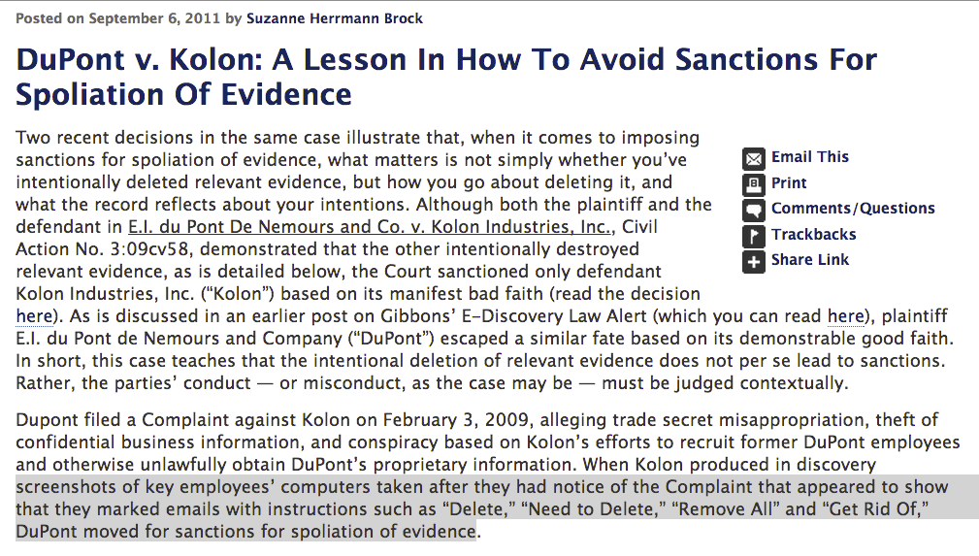
Spoliation

