Slide 1
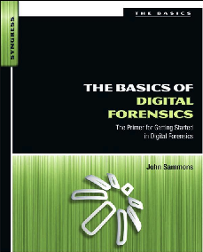
6. Collecting Evidence Part 2

Slide 2
Topics
Live and Dead Systems
Hashing
Final Report

Slide 3
Live and Dead Systems

Slide 4
Old School: Pull the Plug
Loses RAM data
May render encrypted files unavailable
May corrupt data on the disk when power goes off
May lose some evidence that doesn't get properly written to disk

Slide 5
Now: Live Acquisition
Modern tools being marketed to first responders
Non-technical people
Live acquisition is important if RAM is important
Malware -> RAM is important
Possession of child porn -> RAM unimportant
Examiner needs proper skills and tools

Slide 6
Principles of Live Collection
Least invasive procedure possible
RAM may contain
Running processes
Executed console commands
Passwords in cleartext
Unencrypted data
Instant messages
IP Addresses
Trojans

Slide 7
Conducting and Documenting a Live Collection
Work without interruptions
Every interaction with the computer must be noted
I did this…the computer did that
Make desktop visible by moving the mouse
Or press a key (and record which)
Note date and time
Note icons and taskbar buttons of running programs
Open Task Manager & record processes
Capture RAM with a forensic RAM imager
Perform proper shutdown

Slide 8
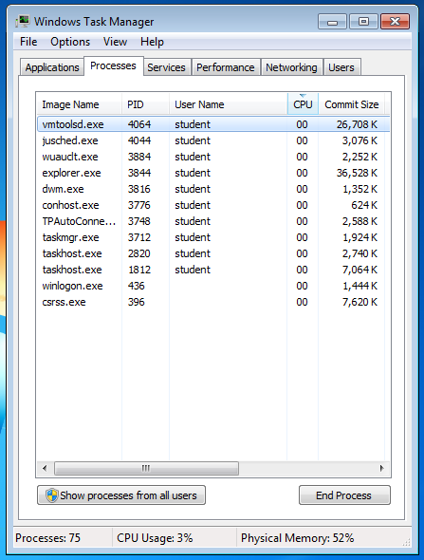
Task Manager
Show processes from all users
Record all processes
Perp will probably claim malware did it later

Slide 9
Hashing Algorithms
Even a single changed bit in the input file completely changes the hash
If the hash of two files match, the files can be regarded as identical
MD5 is most common
SHA-1 is better
In practice, either will do
Hash value must accompany all evidence images
So copies can be verified

Slide 10
Final Report
Consider the audience
Many reports are too technical & confusing
Avoid jargon and code
The report generated by FTK or EnCase should be included, but it's not readable enough alone
Add a detailed narrative of all actions taken by the examiner
Add a summary written in plain English

