Slide 1
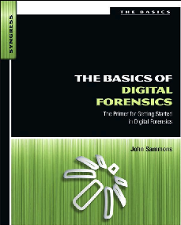
7. Windows System Artifacts Part 1

Slide 2
Topics
Deleted data
Hibernation Files
Registry

Slide 3
Deleted Data

Slide 4
Recovering Deleted Data
File Carving
Allocated space contains active data
Deleted files are in unallocated space
Useful tools
ProDiscover
FTK or EnCase
Foremost
Recuva
Photorec

Slide 5
Hibernation File

Slide 6
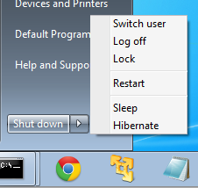
Shutdown Options
Sleep – data kept in RAM
Power still on
Documents lost if power fails
Hibernate – RAM copied to Hiberfil.sys
Power off
Documents never lost
Hybrid Sleep
Default for Windows 7 desktops
Puts open documents and programs on disk
Keeps them in RAM as well for fast wakeup
Documents not lost if power fails

Slide 7
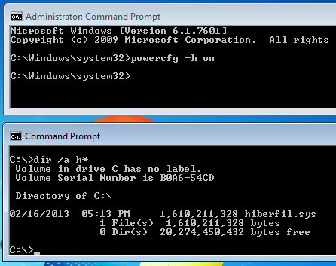
Enabling Hibernation
Link Ch 5i

Slide 8
Registry
Not in book, but may be on quizzes and Final Exam

Slide 9
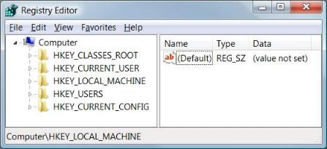
Understanding the Structure of the Registry
The registry consists of five root keys
HKey_Classes_Root
HKey_Current_User
HKey_Local_Machine
HKey_Users
HKey_Current_Config
Or HKCR, HKCU, HKLM, HKU, and HKCC

Slide 10
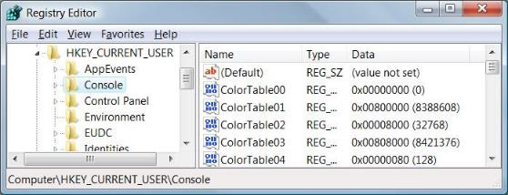
Subkeys
Root keys (sometimes called predefined keys), contain subkeys
Subkeys look like folders in Regedit
HKCU has these top-level subkeys: AppEvents, Console, Control Panel, …
A root key and its subkeys form a path
HKCU\Console

Slide 11

Values
Every Subkey contains at least one value
But it may show (value not set)
The default value (often undefined)
Values have name, data type, and data

Slide 12
Hives
A key with all its subkeys and values is called a hive
The registry is stored on disk as several separate hive files
Hive files are read into memory when the operating system starts (or when a new user logs on)

Slide 13
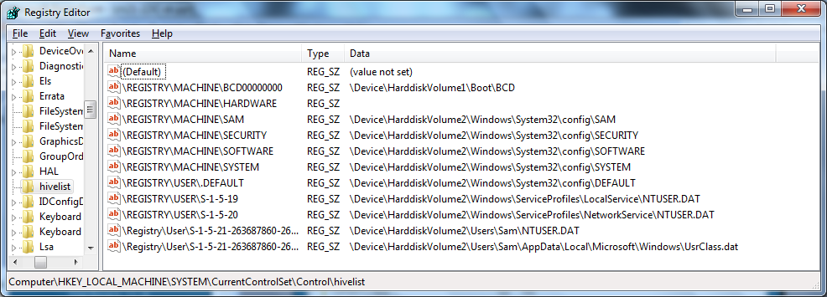
HiveList
HKLM\System\CurrentControlSet\Control\HiveList

Slide 14
Hardware Hive
\Registry\Machine\Hardware has no associated disk file
Windows 7 creates it fresh each time you turn your system on

Slide 15
HKCR and HKCU
These keys are links to items contained in other root keys
HKey_Classes_Root (HKCR)
Merged from keys within HKLM\Software\Classes and HKU\sid_Classes
sid is the security identifier of the currently logged on user
HKey_Current_User (HKCU)
HKU\sid

Slide 16
Purpose of Registry
Database for configuration files
Registry artifacts are very valuable for forensics
Search terms
Programs run or installed
Web addresses
Files recently opened
USB devices connected

Slide 17
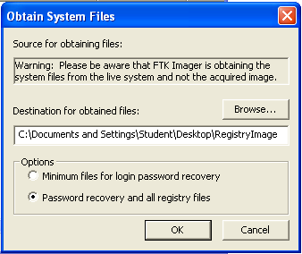
Acquiring the Registry
FTK Imager

Slide 18
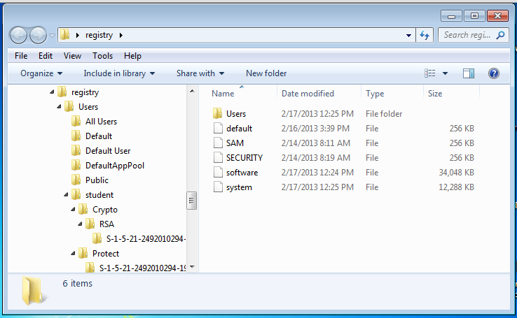
Acquired Files

Slide 19
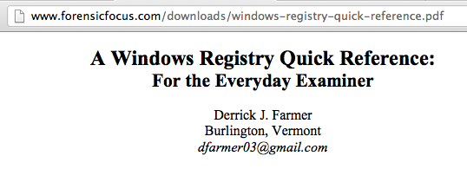
Reference
Link Ch 5c

Slide 20
Important Registry Data
Control Set
Time Zone
User Assist
USB Store

Slide 21
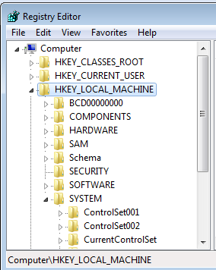
Control Set
A live Registry has an important key named HKLM\System\CurrentControlSet
Contains Time Zone, USBSTOR, and other information

Slide 22
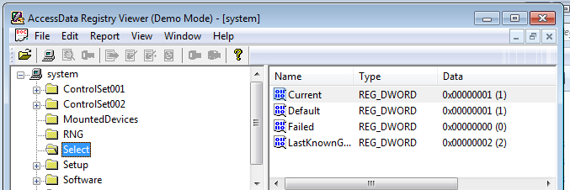
Control Set
Acquired image doesn't contain CurrentControlSet
It's ephemeral data—not stored in the hive files
To determine which ControlSet is current, look in
System\Select
In this case, ControlSet001 is Current
Link Ch 5a

Slide 23
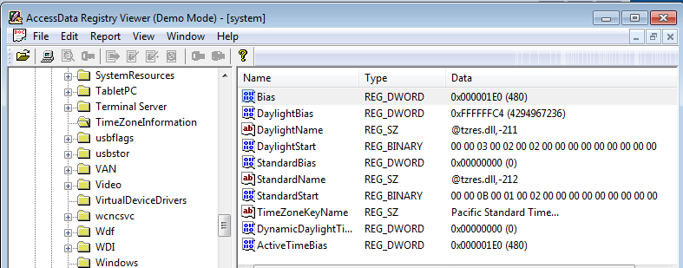
Time Zone
System\ControlSet001\Control\TimeZoneInformation
Assuming that ControlSet001 is Current

Slide 24
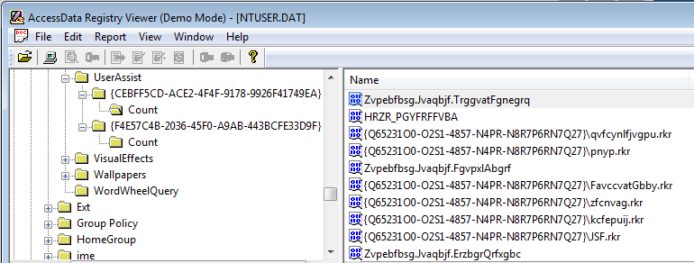
UserAssist
Shows objects the user has accessed
To see it, open Users\Username\NTUSER.DAT
Navigate to Software\Microsoft\Windows\CurrentVersion\Explorer\UserAssist

Slide 25
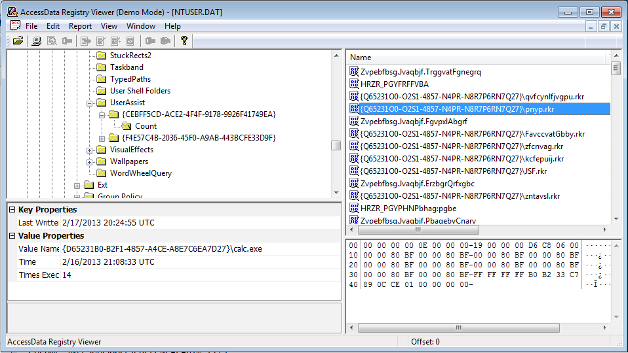
UserAssist Decoded in Lower Left Pane

Slide 26
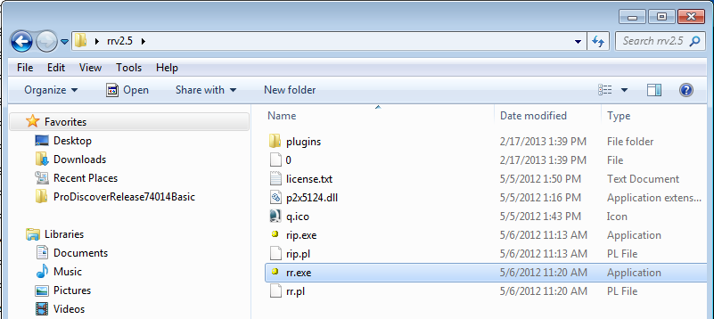
RegRipper
Link Ch 5k

Slide 27
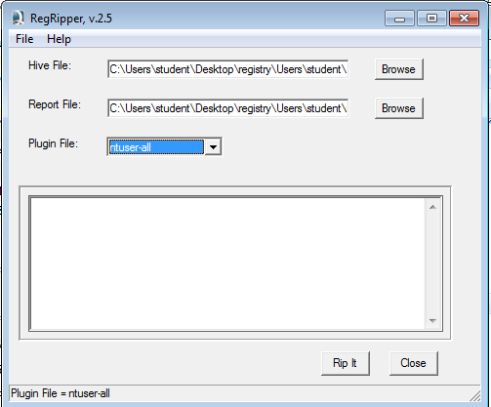

Slide 28
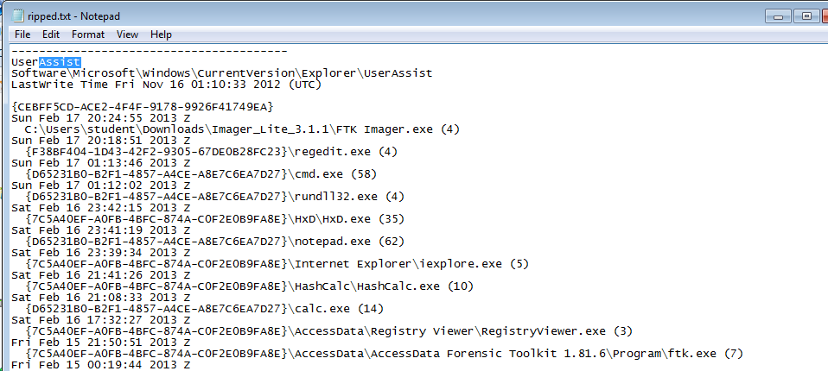
Ripped Registry

Slide 29
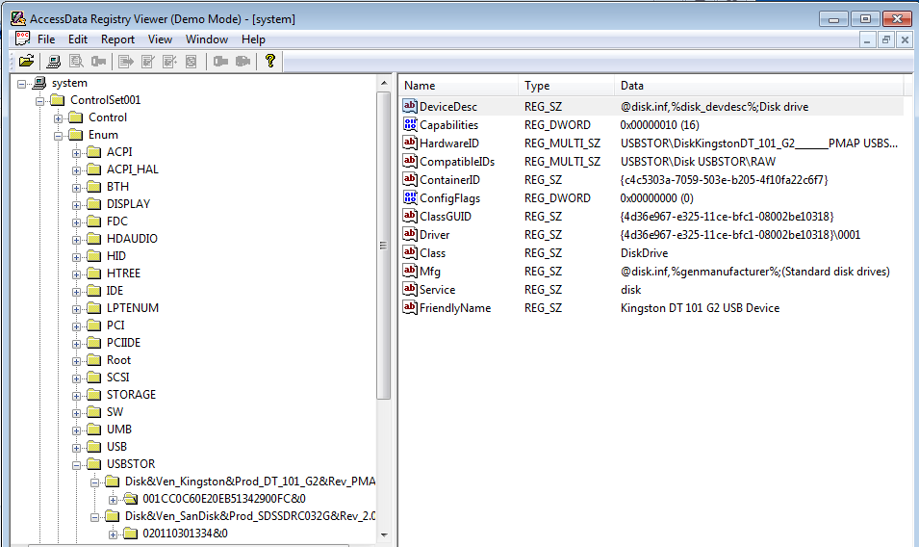
USBSTOR
System\ControlSet001\Enum\USBSTOR
Assuming Current Control Set is 1

