Slide 1

8. Windows System Artifacts Part 2

Slide 2
Topics
Attribution
Recycle Bin
Metadata
Thumbnail Images
Most Recently Used Lists
Restore Points and Shadow Copies
Prefetch and Link Files

Slide 3
Attribution
Evidence of an action is easy to find
Search terms
images
Web pages viewed
Attribution is more difficult
Who was using the computer when the action took place?
One machine may have multiple accounts
Win XP starts with Administrator and Guest
Both disabled by default in Windows 7

Slide 4
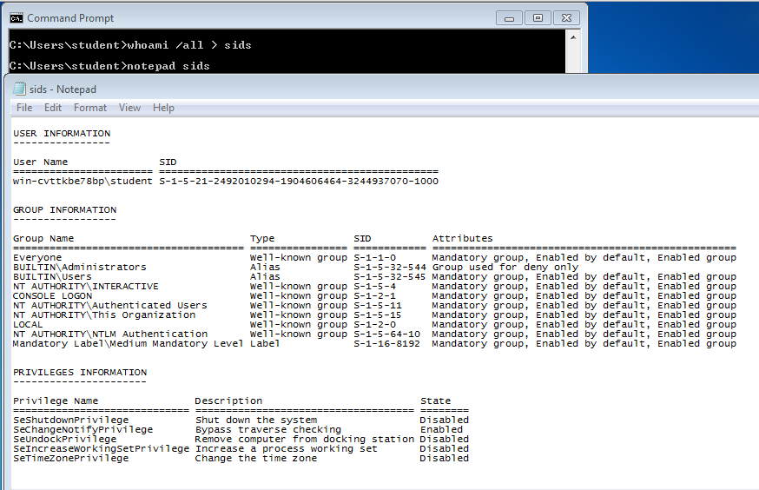
SID (Security Identifier)

Slide 5
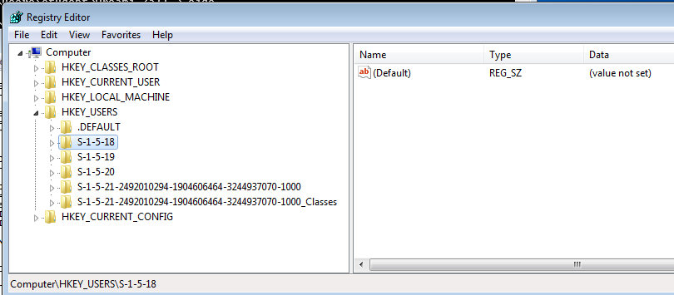
SIDs in the Registry

Slide 6
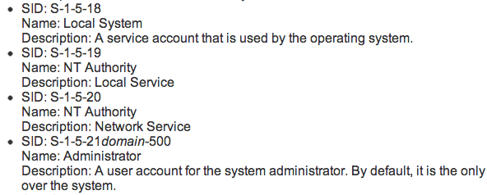
Well-Known SIDs
Link Ch 5o

Slide 7
External Drives
USBSTOR shows exactly which USB devices have been attached to a computer
Helpful in attributing evidence found on removable devices

Slide 8
Print Spooling
When a document is printed, two files are created
Enhanced Meta File (EMF) contains an image of the document to be printed
Spool File contains information about the print job
They are normally deleted after printing finishes, but may be retained on some systems

Slide 9
Recycle Bin

Slide 10
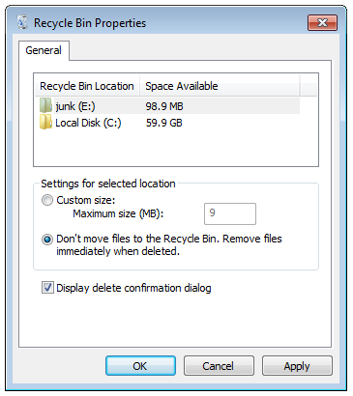
Recycle Bin Operation
Not everything deleted goes into the Recycle Bin
Shift+Delete will bypass the Recycle Bin, so will "Delete" from a command prompt
A user can disable the Recycle bin in Recycle Bin Properties

Slide 11
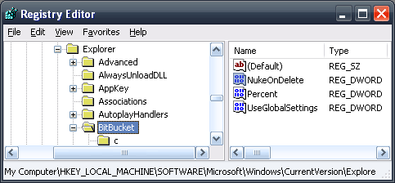
NukeOnDelete Registry Key
Win XP
(Link Ch 5p)
Win 7
(Link Ch 5q)

Slide 12
Metadata

Slide 13
Metadata
Data about data
File system metadata
Timestamps (Created, Modified, Accessed)
Permissions, owner
Application metadata
Author's name
GPS coordinates
Software owner's name

Slide 14
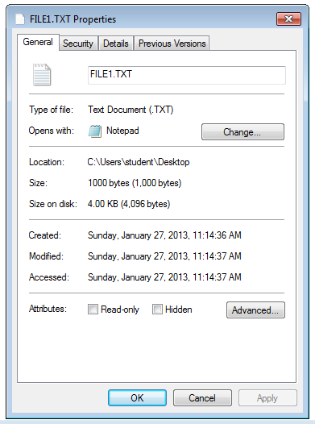
Timestamps
WARNING: These all depend on the system clock, which can be reset
Created
Modified
Accessed
Even if the file was not opened, but just scanned by antivirus

Slide 15

MACR Times
Sleuthkit will show these four timestamps
Link Ch 5r

Slide 16
Timestamp Principles
Be very careful
Perform experiments on similar systems to verify conclusions
Use multiple tools
Watch out for system clock changes

Slide 17

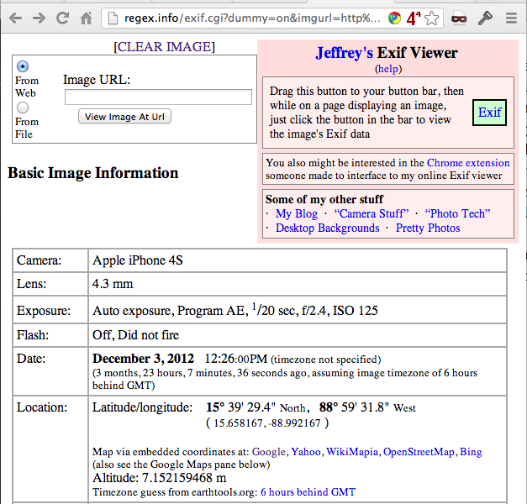
Demo: John McAfee's Photo
Exif Viewer
Link Ch 5t

Slide 18
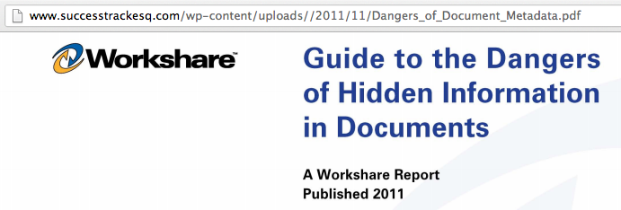
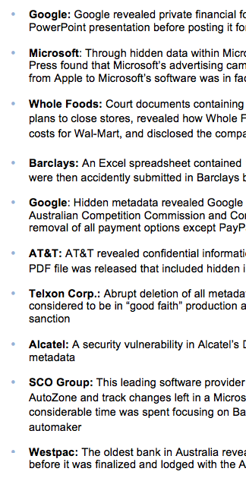
Link Ch 5u

Slide 19
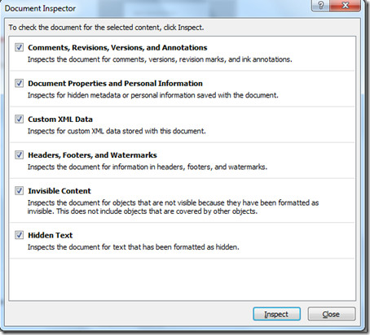
Removing Metadata
Microsoft Office Document Inspector
Link Ch 5v
Other tools
Link Ch 5w

Slide 20
Thumbnail Cache

Slide 21
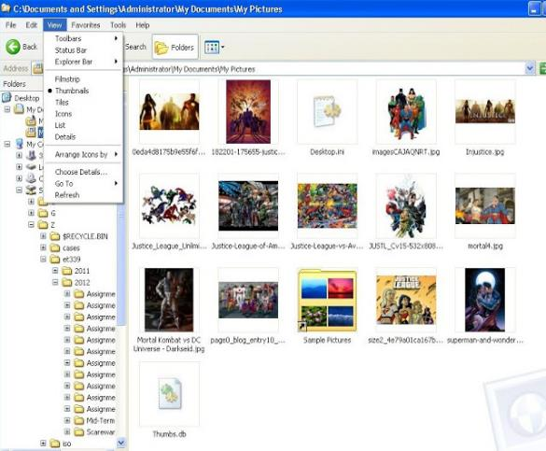
Windows XP Thumbnails
Thumbs.db
Hidden file in same folder as images
Image from link Ch 5x

Slide 22
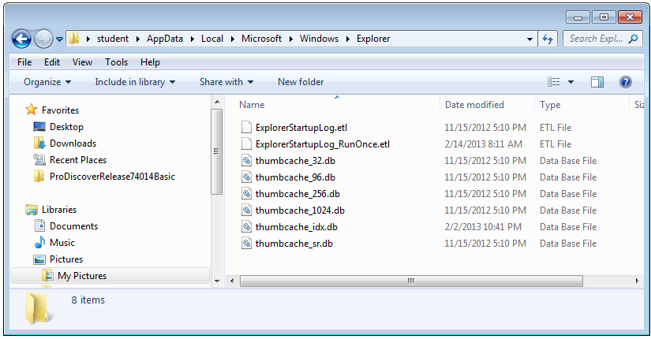
Windows 7 Thumbnails
To view these, see tool at link Ch 5x

Slide 23
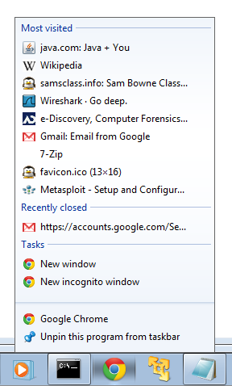
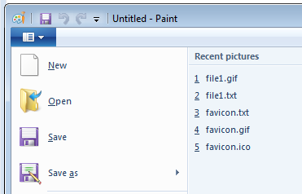
Most Recently Used
Right-click taskbar button in Windows 7
Click File icon In Paint
Many, many, other places

Slide 24
System Restore

Slide 25
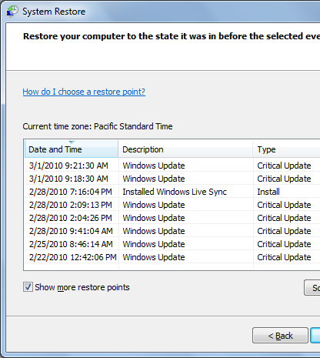
Restore Points
Win 7 creates a restore point every 7 days by default
XP and Vista did it every day
They are created by a Shadow Copy service, which can copy files even when they are in use

Slide 26
When Restore Points Are Created
An application is installed with a compatible Vista or Win 7 installer
Windows Updates
System Restore is performed
A Restore Point is made first so the System Restore can be reversed
Windows Backup
A Restore Point is created as part of the backup process

Slide 27
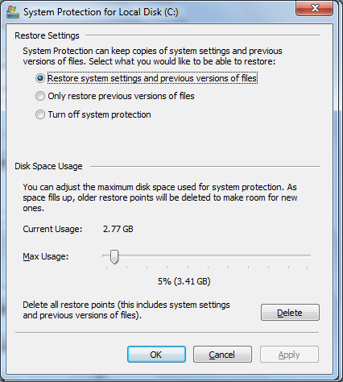
Restore Settings
Click Configure
Choose whether to monitor system settings or just files
"System Settings" includes the Registry and many other system file types

Slide 28
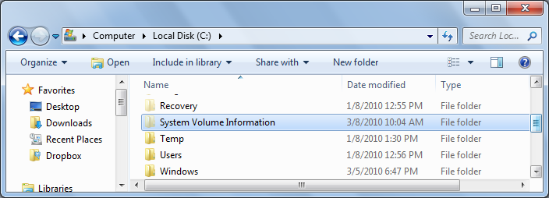
System Restore Files
In C:\System Volume Information
You can't open this folder, or even take ownership of it
It's only intended for System access

Slide 29
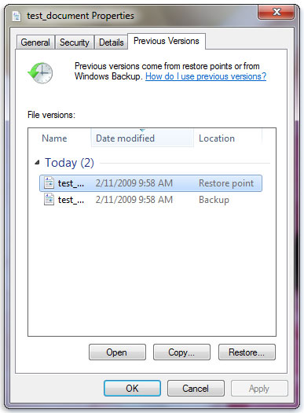
Previous Versions
Image from microsoft.com

Slide 30
PreFetch
To make a Windows machine run faster
A shortcut to programs you commonly open is saved in the Prefetch folder
There are Prefetch Viewers to help read the files
The format is different in Win XP and Win 7/Vista
Links Ch 5y, 5z
Notes:
For more details see Lect. 11 of IAR401

Slide 31
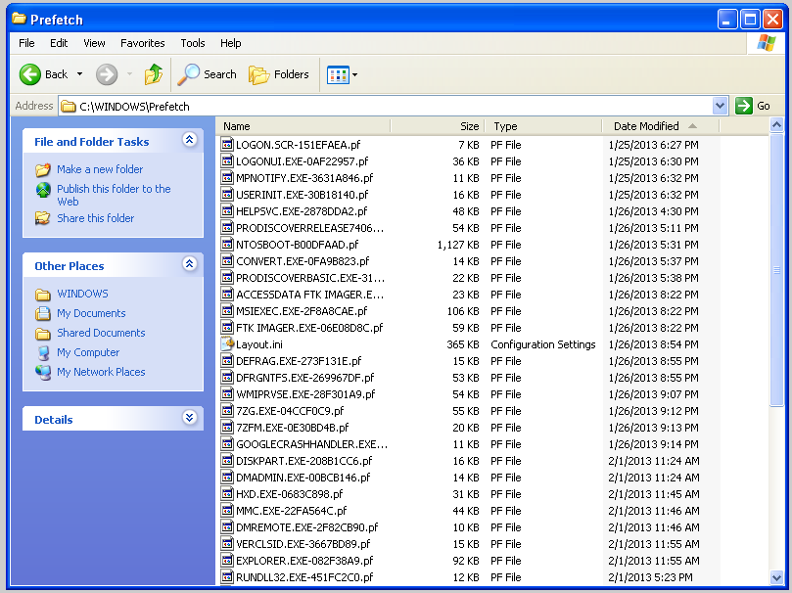
PreFetch in Win XP

Slide 32
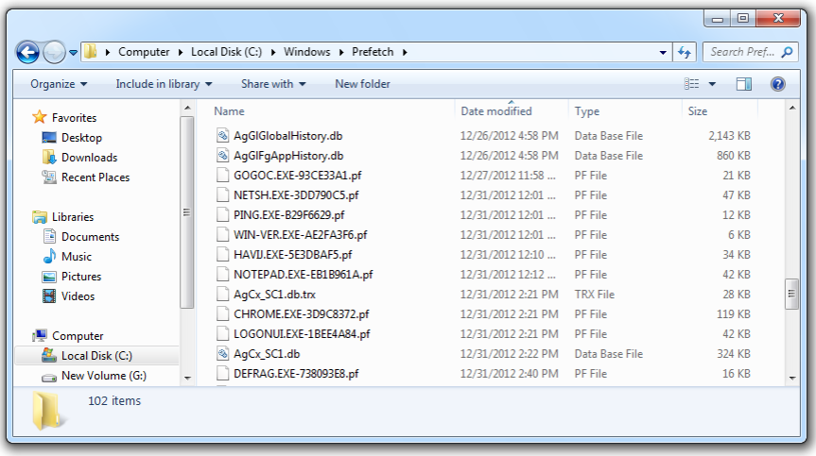
PreFetch in Win 7

Slide 33
Link Files
Shortcuts to programs and other files
They have time and date stamps
Links in the "Recent Files" folder to network shares even contain the MAC address of the server!

Slide 34
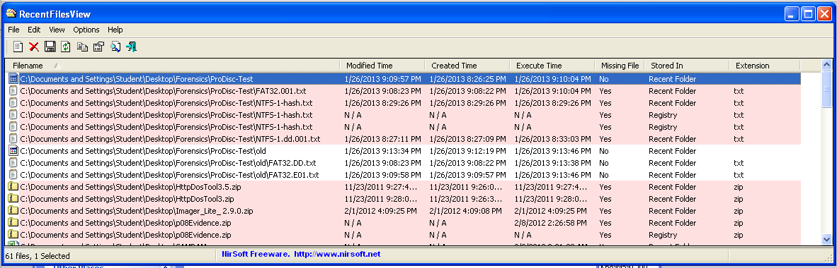
Recent Files Viewer
Works on Win XP & Win 7
Link Ch 5z1

Slide 35
Installed Programs
Give information about the user's activities
Recently uninstalled programs may also be important evidence of guilt
Traces of uninstalled programs may be found in
Programs folder
Links
Prefetch files

