Slide 1
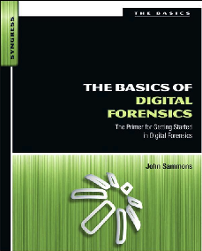
9. Antiforensics

Slide 2
Topics
Encryption
Breaking Encryption
Hiding and Destroying Data

Slide 3
Antiforensics
Techniques to manipulate, erase, or obfuscate digital data to make its examination difficult, time-consuming, or virtually impossible

Slide 4
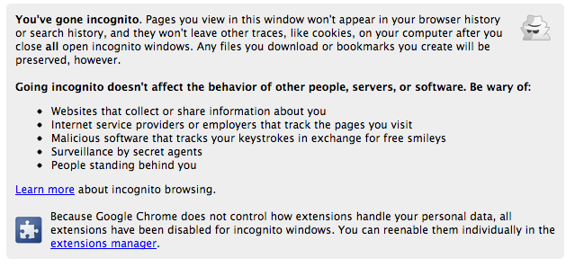
Private Browsing

Slide 5
Simple Privacy Methods
Weak, relatively ineffective
Delete cookies
Clear temporary internet files
Clear history
Changing filenames and extensions
Burying files in unrelated directories
Real obstacles to forensic examiners
Hiding files within other files (steganography)
Encryption

Slide 6
Encryption

Slide 7
Protecting Secrets
We all need encryption for
Credit card #s
Passwords
Medical data
Without encryption, the Web would be much less useful

Slide 8
Encryption Defined
Encryption converts data from plaintext (readable) to ciphertext (scrambled)
Algorithm is the mathematical process to encrypt and decrypt the message
Key is a value needed to encrypt and decrypt the data, usually a long random series of bits, sometimes derived from a password or passphrase

Slide 9
Caesar Cipher
Shift each letter forward one character
ABCDEFGHIJKLMNOPQRSTUVWXYZ
BCDEFGHIJKLMNOPQRSTUVWXYZA
CCSF --> DDTG

Slide 10
ROT13
Shift each letter forward 13 characters
ABCDEFGHIJKLMNOPQRSTUVWXYZ
NOPQRSTUVWXYZABCDEFGHIJKLM
CCSF --> PPFS → CCSF
Encrypting with ROT13 twice returns you to plaintext
Decryption algorithm = Encryption algorithm
Very weak - obfuscation, not encryption
Used in TypedURLS registry key, and for passwords in an early version of Netscape (Link Ch 6a)

Slide 11
Symmetric Cryptography
One key encrypts and decrypts data
Cleartext with Key makes Ciphertext
Ciphertext with Key makes Cleartext
Winning Lotto #s:
aWDHOP#@-w9
aWDHOP#@-w9
Winning Lotto #s:

Slide 12
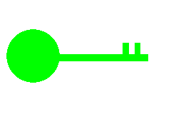

Asymmetric Cryptography Algorithms
Use two keys that are mathematically related
Data encrypted with one key can be decrypted only with the other key
Another name for asymmetric key cryptography is public key cryptography
Public key: known by the public
Private key: known only by owner

Slide 13
Asymmetric Cryptography
Cleartext with Public Key makes Ciphertext
Ciphertext with Private Key makes Cleartext
Winning Lotto #s:
aWDHOP#@-w9
aWDHOP#@-w9
Winning Lotto #s:

Slide 14
Popular Algorithms
Symmetric Encryption
DES, 3DES, AES, Blowfish
Asymmetric Encryption
RSA, ECC, ElGamal
The most secure algorithms are open-source
Proprietary, secret algorithms are almost always insecure

Slide 15
Keys
A sequence of random bits
The range of allowable values is called a keyspace
The larger the keyspace, the more secure the key
8-bit key has 2⁸ = 256 values in keyspace
24-bit key has 2²⁴ = 16 million values
56-bit key has 2⁵⁶ = 7 x 10¹⁶ values
128-bit key has 2¹²⁸ = 3 x 10³⁸ values

Slide 16
Brute Force Attack
In 1997 a 56-bit key was broken by brute force
Testing all possible 56-bit keys
Used 14,000 machines organized via the Internet
It took 3 months
See link Ch 6d

Slide 17
How Many Bits Do You Need?
How many keys could all the computers on Earth test in a year?
Pentium 4 processor: 10⁹ cycles per second
One year = 3 x 10⁷ seconds
There are less than 10¹⁰ computers on Earth
One per person
10⁹ x 3 x 10⁷ x 10¹⁰ ⁼ 3 x 10²⁶ calculations
128 bits should be enough (3 x 10³⁸ values)
Unless computers get much faster, or someone breaks the algorithm

Slide 18
Practical Key Lengths
Private keys of 128 bits or longer are practically unbreakable at the moment
Public keys must be much longer
2048 bits is the minimum recommended key size for RSA (length Ch 6b)

Slide 19
Common Encryption Products
Windows 7: BitLocker and EFS
Apple: FileVault
Linux: TrueCrypt
Full Disk Encryption
Much safer
Does not encrypt a "boot partition"
File and Folder encryption

Slide 20
Encrypting File System (EFS)
In File Properties in Windows
Easy to use
Uses password to make a key
Part of the NTFS file system

Slide 21
BitLocker
Encrypts entire system partition
BitLocker To Go encrypts USB sticks
Requires Windows 7 Ultimate
But it's available in all versions of Windows 8
Uses Trusted Platform Module chip
Best forensic method: seize the running, logged-in machine
BitLocker is decrypted at that point

Slide 22
Apple FileVault
128 bit AES
Can encrypt whole drive
Keys can be backed up with Apple

Slide 23
TrueCrypt
Free open-source software
Runs on Linux, Mac, or Windows
Can encrypt part or all of a disk
Can use AES, Serpent,or Twofish
256-bit keys

Slide 24
Breaking Encryption

Slide 25
Breaking Passwords
Ask the user for it
Brute force attack
Use every possible combination of characters
Dictionary attack
Use passwords from a dictionary of common passwords
Reset Passwords
Possible with administrator privileges or a hacking tool like UBCD
Won't get you into EFS-encrypted files

Slide 26
Custom Dictionary
Acquire the hard disk (and RAM, if possible) of the evidence machine
Extract all strings
Use that as the password dictionary

Slide 27
Password Cracking Tools
Password Recovery Toolkit (PRTK) from AccessData
John the Ripper
Cain
Ophcrack
Hashcat (in Backtrack)

Slide 28
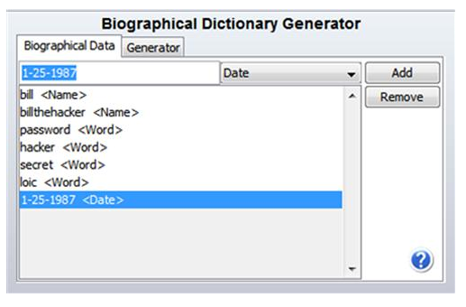
PRTK's Biographical Dictionary Generator

Slide 29
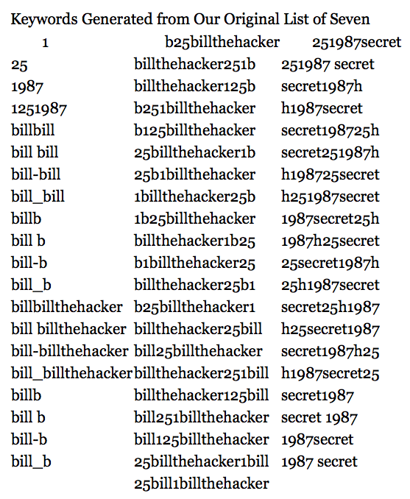

Slide 30
Breaking BitLocker
Cold Boot Attack
Freeze the RAM and recover the key
Dissolve the TPM chip and recover the key with a microelectrode
Both are exotic, impractical attacks
User may have backed up the key in a Microsoft account (Ch 7c)

Slide 31
Steganography

Slide 32
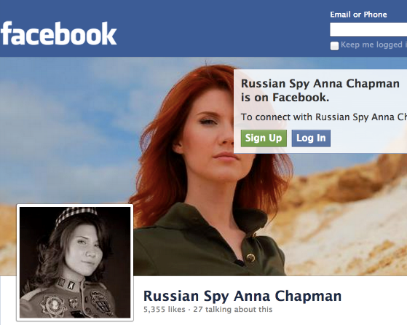
Steganography
Hiding a payload file inside another carrier file
Used by Osama Bin Laden and Russian spies (link Ch 6d)

Slide 33
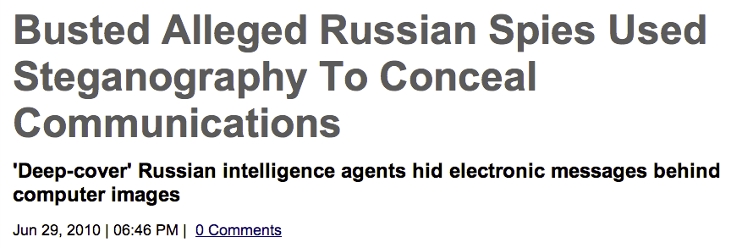
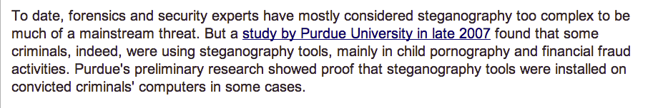

Slide 34
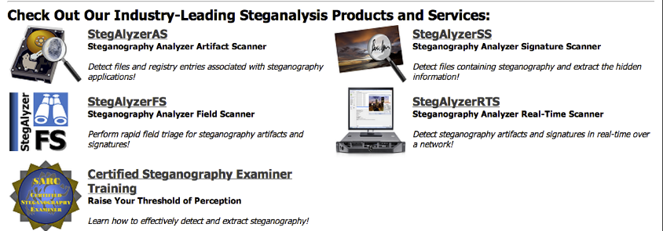
Steganography Detection Tools
Link Ch 6e

Slide 35
Hiding and Destroying Data

Slide 36
Data Destruction
Drive Wiping
Darik's Boot and Nuke (DBAN)
Window Washer
Evidence Eliminator
Mac OS X Secure Erase
Many others
Some erase whole disk, some only erase files or unused blocks, others erase only header & footer
Presence of these tools may be treated as evidence of guilt in court
Especially if they were used just before evidence seizure

Slide 37
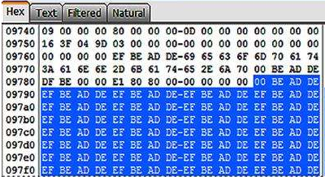
Some Wipers use Repeating Patterns
This is a sign of disk erasure

Slide 38
Defragmentation
Moves clusters to tidy up disk
Makes files open faster
Causes some sectors to be overwritten
Automatically performed weekly in Windows 7

