Slide 1

10. Legal

Slide 2
Topics
Fourth Amendment
E-Discovery
Duty to Preserve
Private Searches
ECPA
Searching With & Without a Warrant

Slide 3
Fourth Amendment

Slide 4
Fourth Amendment
The right of the people to be secure in their persons, houses, papers, and effects, against unreasonable searches and seizures, shall not be violated, and no Warrants shall issue, but upon probable cause, supported by Oath or affirmation, and particularly describing the place to be searched, and the persons or things to be seized.

Slide 5
Criminal Law - Searches Without a Warrant
1. Did the government act?
2. Did that action violate a person's reasonable expectation of privacy?
Only if both answers are "YES" does the Fourth Amendment apply
A person acting at the request of law enforcement becomes an agent of the government, and Q1=YES

Slide 6
Reasonable Expectation of Privacy
No simple answer
A computer can be treated as a closed container
If an officer lacks authority to open a desk drawer or box, there isn't authority to examine a computer either
If a reasonable expectation of privacy exists, the government must get a search warrant, or meet one of the documented exceptions
Are individual files closed containers?
Case law is unclear
Data a individual places on shared computers or drives is not protected by the fourth amendment

Slide 7
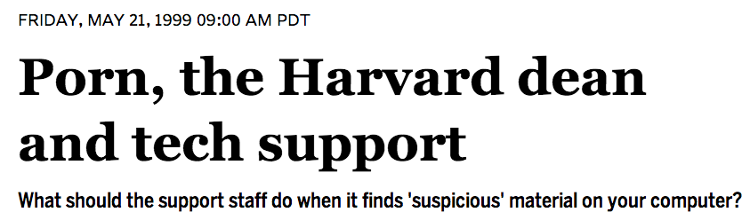
Private Searches
Fourth amendment does not apply if the examiner is not acting at the request of government
If a Geek Squad worker finds illegal files on a computer, that evidence is admissible
Link Ch 7a

Slide 8
Email
Treated like regular postal mail
Email has fourth amendment protection while it is being transmitted, but the protection stops when it is delivered to its destination.
Legal interception is regulated by the Wiretap Act of 1968
Prohibits unauthorized monitoring
Lists procedures needed to obtain a warrant for wiretapping

Slide 9
The Electronic Communications Privacy Act (ECPA)
Bans third parties from intercepting and/or disclosing electronic communications
An amendment to the the Wiretap Act, passed in 1968
Changed in 1994 by CALEA (Communications Assistance to Law Enforcement Act)
Changed again by the PATRIOT Act
Re-authorized in 2006

Slide 10
CALEA (Communications Assistance to Law Enforcement Act)
Requires telecommunications providers to assist law enforcement with wiretaps
In practice, this forces them to use special equipment
Expanded in 2006 to cover broadband Internet providers
From the FCC (Link Ch 7b)

Slide 11
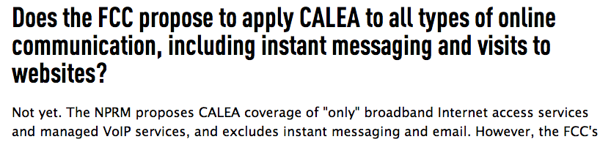
CALEA and the Internet
CALEA doesn't yet apply to instant messages and Email
From the EFF (Link Ch 7c)

Slide 12
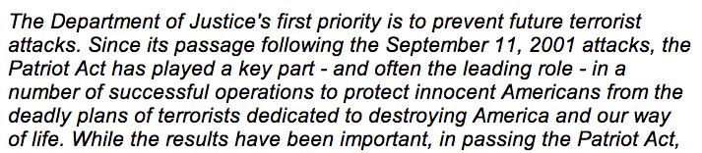
The USA PATRIOT Act
Uniting and Strengthening America by Providing Appropriate Tools Required to Intercept and Obstruct Terrorism
Here's what the DoJ says about it (Link Ch 8d)

Slide 13
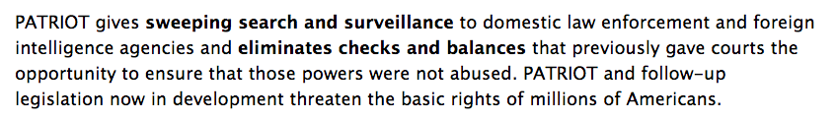
EFF on PATRIOT Act
Link Ch 7e

Slide 14
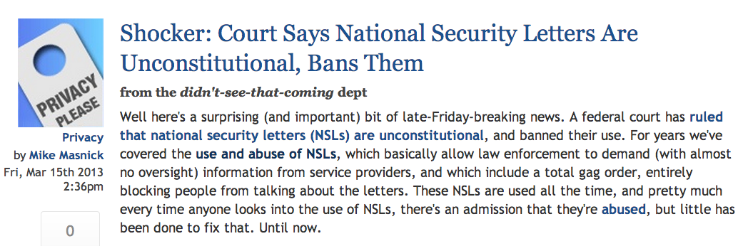
National Security Letters
National Security Letters are allowed by the PATRIOT Act, forcing Internet service providers to tap users and not tell them
The verdict below may stop them, but it may be appealed (Link Ch 7g)

Slide 15
Exceptions to the Search Warrant Requirement

Slide 16
Exceptions to the Search Warrant Requirement
An authorized person gives voluntary consent for the search
"Voluntary" will be judged on the totality of the circumstances
Consent can be revoked at any time
Search must stop at that time
BUT if you have already made a forensic clone, you only need to return the original and may continue to examine the clone
So make the clone promptly
Scope of consent
Consenting to search a house may not apply to closed containers and computers
Party may set forth restrictions on the search

Slide 17
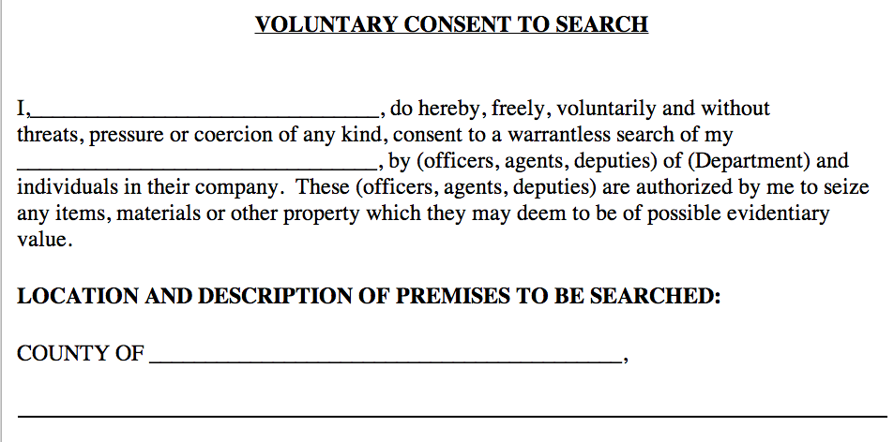
Consent Forms
Link Ch 7h

Slide 18
Consent Searches
Third parties can sometimes consent
Roommates, spouses, parents…
If a device is shared, all parties can consent to search its common areas
None of the users have a reasonable expectation of privacy in the common areas
Password-protected areas are not common areas
Unless the suspect shared the password with the third party

Slide 19
Consent Searches
Spouses can consent to the search of common areas
Parents can consent to a search of a minor child's property (age under 18)
Technicians often uncover evidence during their work
It's unclear whether technicians have the right to consent to a search

Slide 20
Exigent Circumstances
An immediate seizure and search of a digital device is required under one of three conditions:
Evidence is under imminent threat of destruction
A threat puts law enforcement or the public in danger
Suspect is expected to escape before a search warrant can be acquired
This may justify seizure only, not search

Slide 21
Plain View
If officers are legally allowed to be where they are and can see something immediately incriminating
They can use that evidence
A forensic examiner investigating one crime may find evidence of another
Stop the search until a separate search warrant is obtained

Slide 22
Border Searches
These searches are allowed more latitude
Border searches
Searches by probation or parole officers

Slide 23
Employees
Employees in the workplace may not have a reasonable expectation of privacy
Officers can search a computer if an employer or co-worker with shared authority gives permission
Government employees can only be searched if the search is "work-related, justified at their inception, and permissible in scope"

Slide 24
Searching with a Warrant

Slide 25
Searching with a Warrant
Search warrant is granted by a judge, based on probable cause that a crime was committed and evidence will be found at that location
Computer may have different roles
A computer containing child porn is contraband
Computer may contain incriminating documents
Computer may be the instrument of a crime such as hacking

Slide 26
Seize Hardware or Information?
Hardware must be seized if computer is:
Contraband
Evidence
Fruits
Instrumentality
Otherwise, all you need is the data

Slide 27
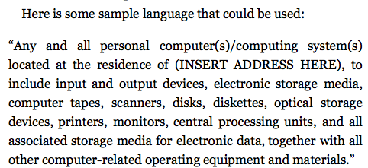
Particularity
You need to state clearly what can be seized and what cannot

Slide 28
Establishing Need for Off-Site Analysis
Examination is time-consuming and best performed in a forensics lab
This should be explained in the affidavit justifying removing and holding the devices

Slide 29
Stored Communications Act
Lays out process law enforcement must use to force disclosure of data from Internet Service Providers (ISPs)
Email
Subscriber and billing information
Enacted in 1986
Two types of service providers
Electronic Communication Service (ECS)
Including telephone and email services, like AOL
Remote Computing Service (RCS)
Provides storage or processing services

Slide 30
E-Discovery

Slide 31
Electronic Discovery (eDiscovery)
The process of collecting, preparing, reviewing, and producing electronically stored information (ESI) in the context of the legal process
ESI is
Easily modified
Volatile
Easily duplicated or dispersed
Large volume of data

Slide 32
Duty to Preserve
Rules of Civil Procedure were changed in 2006 to address digital evidence
Opposing attorneys must deal with ESI early in the process
Duty to preserve potentially relevant data begins with there is "reasonable expectation of litigation"
Failure to preserve is spoliation of evidence
Can lead to severe sanctions
Duty to preserve often starts long before a subpoena is served

Slide 33
eDiscovery
Data sampling is a way to test large volumes of ESI for the "existence or frequency of relevant information"
Costs of eDiscovery can be massive
Typically costs are borne by the producing party
Costs can be shifted to the requesting party if certain conditions are met

Slide 34
Private Searches in the Workplace
Employers have a lot of latitude to search an individual's company computer
Best practice: computer use policy stating that work computers, email, etc. are for work purposes only and may be searched at any time
Fourth amendment (if law enforcement is doing the search)
A work computer can be searched with consent of a supervisor or another employee who has common authority over the area to be searched
Consult with attorney for guidance

Slide 35
Expert Testimony
Expert witnesses can state opinions
Expert doesn't need a PhD or other credentials
An expert has "special knowledge, skill, training, or experience" which makes him or her qualified to "aid the fact-finder in matters that exceed the common knowledge of ordinary people"

Slide 36
Source of Images
Several images are from the textbook, I didn't cite sources for them

