Slide 1

11. Internet and E-Mail

Slide 2
Topics
Internet
Web browsers and evidence they create
E-mail function and forensics
Chat and social networking evidence

Slide 3
Internet Overview

Slide 4
Internet Concepts
URL (Uniform Resource Locator)
http://www.ccsf.edu/NEW/en/myccsf.html
Protocol: http
Host: www
Domain name: ccsf.edu
Top-level domain: .edu
Fully qualified domain name: www.ccsf.edu
Path to file: NEW/en/myccsf.html
Browser
IE, Chrome, Firefox, Safari, etc.

Slide 5
HTTP Process
HTTP (Hypertext Transfer Protocol)
Designed to deliver Web pages
First the domain name must be converted to an IP address with a query to a DNS Server (Domain Name Service)
Then the page is fetched by sending an HTTP GET request to the Web server
Pages are written in HTML (HyperText Markup Language)
May also contain images, video, sounds, etc.

Slide 6
Static and Dynamic Web Pages
Static pages are the same for every visitor
Dynamic pages are constructed to customize them for each viewer (Web 2.0)
Ex: Facebook, Gmail
Fetch items from databases
A Content Management System builds the page for each viewer
Viewers are identified by cookies
Some code runs on the server, (like SQL and CGI scripts), and other code runs on the client (like JavaScript)

Slide 7
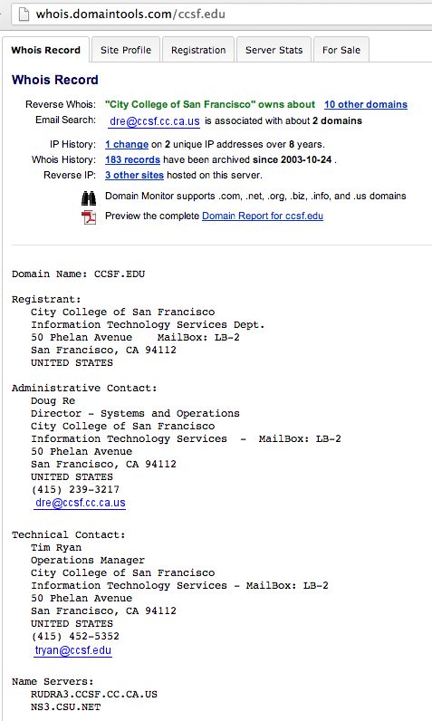
Whois
Identifies the registered owner of a domain name or IP address

Slide 8
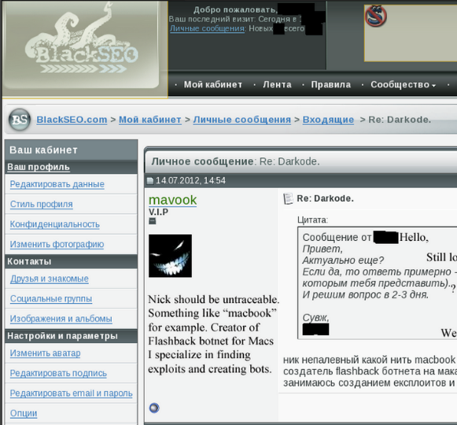
Who Wrote the FlashBack OS X Worm?
“mavook” took credit on the “BlackSEO” forum (in Russian)
His home page was mavook.com in 2005
Link Ch 8a

Slide 9
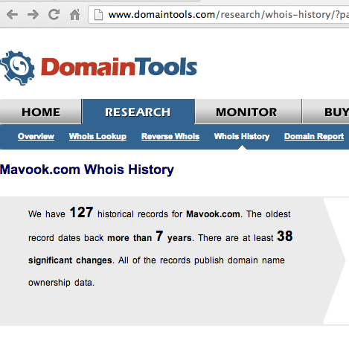
Whois History

Slide 10
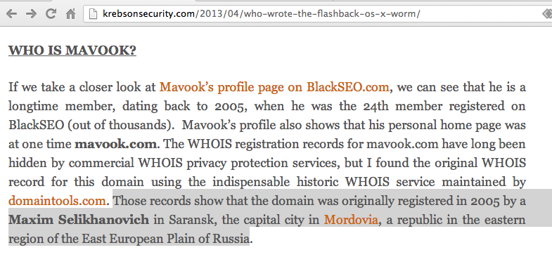
Who is Mavook?

Slide 11
Peer-to-Peer (P2P)
File-sharing
Uses Bittorrent protocol
Vast majority of P2P traffic is stolen music, videos, and software and other illegal content
Consumes vast amounts of bandwidth and ports
Examples: Gnutella, Limewire, uTorrent, Vuze, The Pirate Bay (Link Ch 8b)

Slide 12
Index.dat Files
Binary file used by Internet Explorer
Tracks URLs visited, number of visits, etc.
Link Ch 8c leads to “Index Dat Spy”
Best to find the files and list them
Link Ch 8d leads to “Index Dat Reader”
Shows all the results together

Slide 13
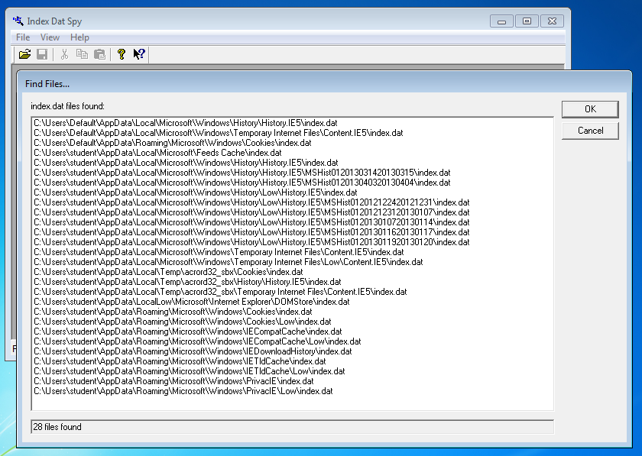

Slide 14
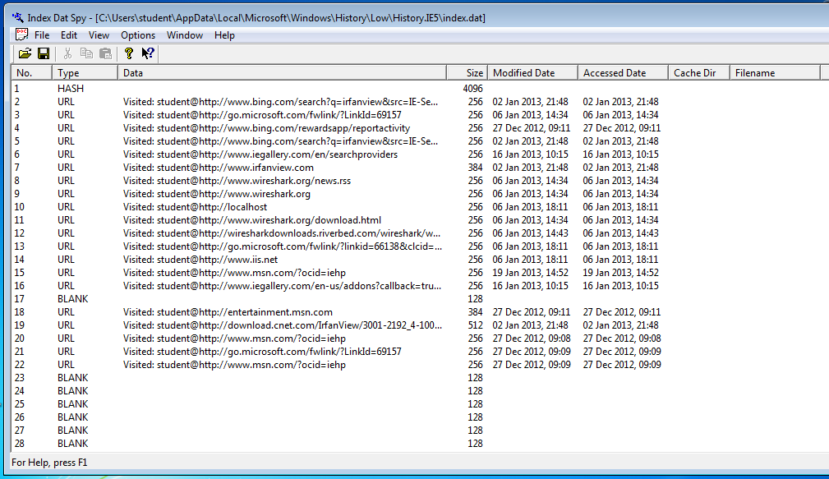
Files back to 2012!

Slide 15
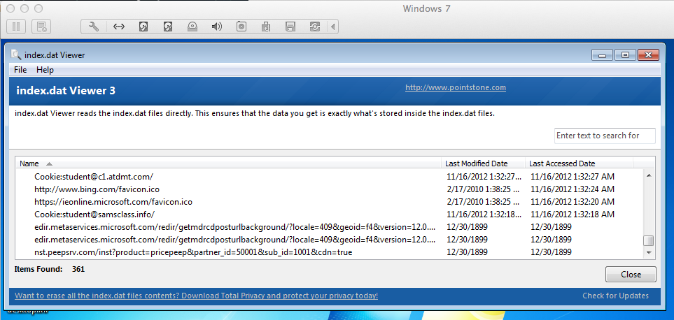
Index.dat Reader Shows All Entries
Back to 1899!
(Remember not to trust your tools!)

Slide 16
Web Browsers

Slide 17
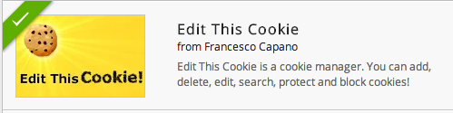
Cookies
“Edit This Cookie” Chrome Extension (Link Ch 8e)

Slide 18
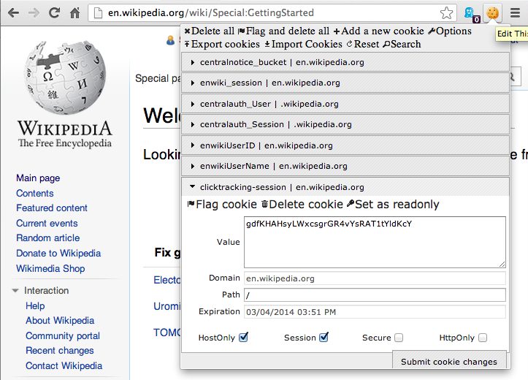

Slide 19
Cookies
Plain text files
Often dropped by third parties
A cookie from a site does NOT prove the user visited that site

Slide 20
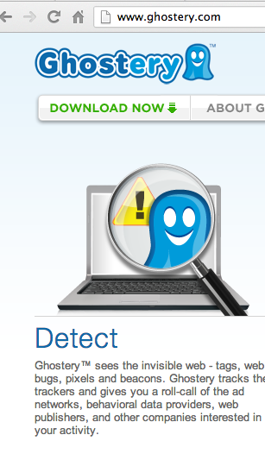
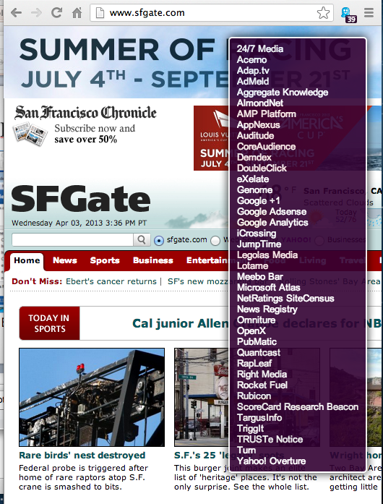

Slide 21
Temporary Internet Files
aka Web Cache
Makes pages reload faster
Internet Options, General tab, under Browsing history, click Settings. In the Settings dialog box, click View files.

Slide 22
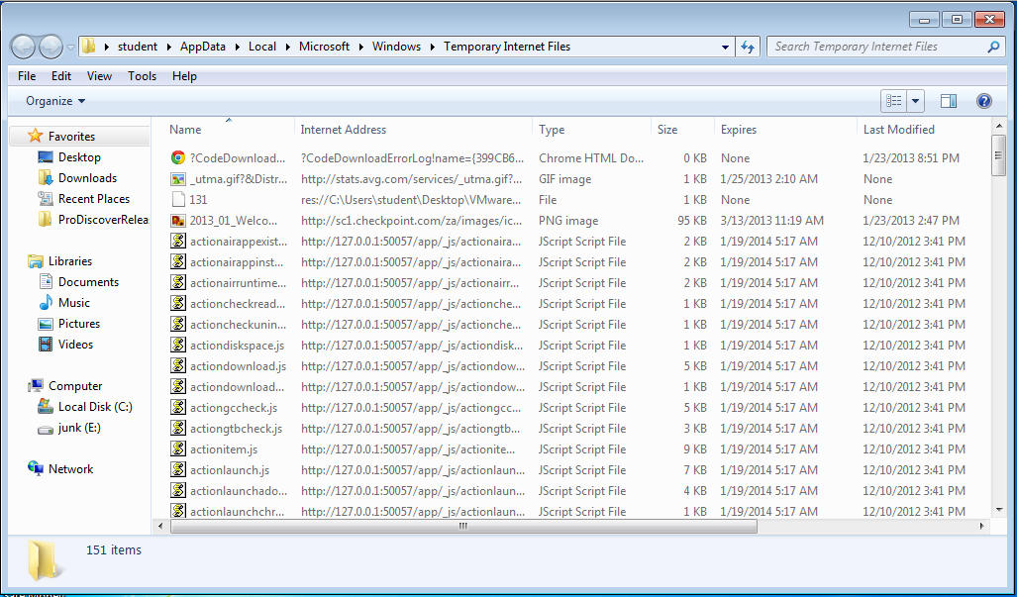

Slide 23
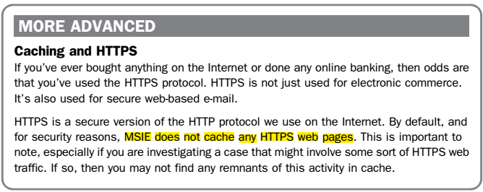
Error in Textbook, 1st Edition
In p.122 it was wrongly claimed that Internet Explorer does not cache HTTPS Web pages
Link: http://blogs.msdn.com/b/ieinternals/archive/2010/04/21/internet-explorer-may-bypass-cache-for-cross-domain-https-content.aspx

Slide 24
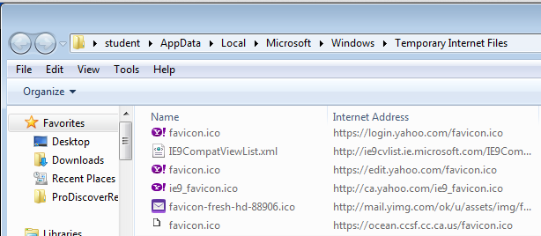
Error in Textbook, 1st Edition
HTTPS resources are cached by Internet Explorer the same as HTTP resources
By visiting some HTTPS pages in Internet Explorer and viewing the Temporary Internet Files: The items from HTTPS pages are easy to see:

Slide 25
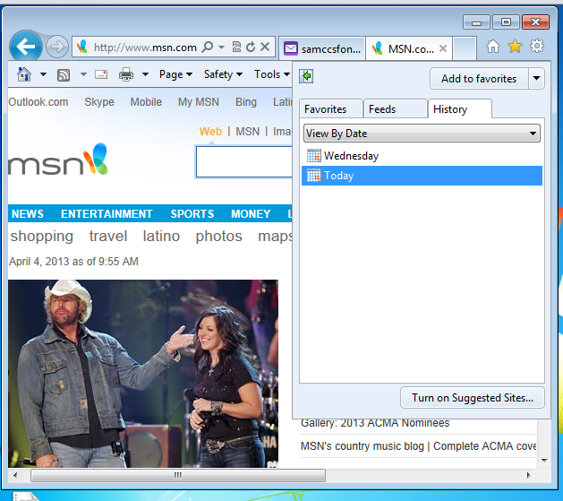
Internet History

Slide 26
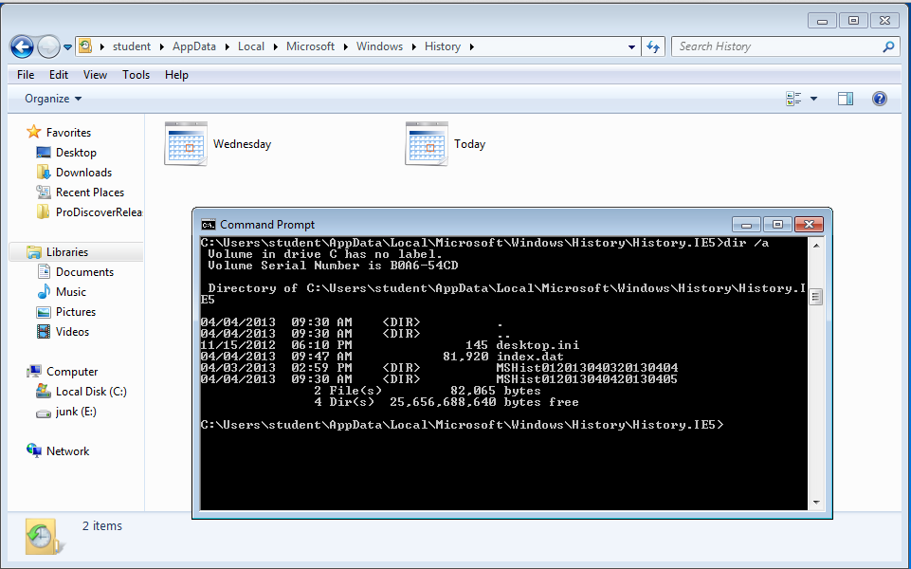
Internet History

Slide 27
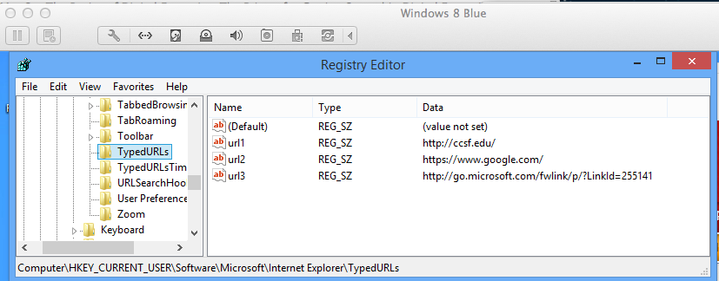
Typed URLs

Slide 28
Chat Clients

Slide 29
Popular Chat Clients
AOL Instant Messenger
Yahoo! Messenger
Windows Live Messenger
Trillian
ICQ
Many more
Popular among pedophiles

Slide 30


Link Ch 8h

Slide 31
Data from Chat Clients
Contact or “Buddy” list
Block list
List of recent chats
Logging of chats
Manually saved chat logs
Acceptance list for video chat, file transfers, personal messages
Cell phone associated with account

Slide 32

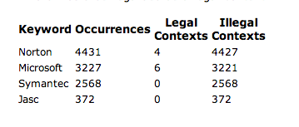
IRC (Internet Relay Chat)
No central authority
IRC Networks Undernet, IRCNet, Efnet, etc.
Link Ch 8i

Slide 33
ICQ
42 million active users
Average user connected more than 5 hours per day
47% female
80% of users between 13 and 29
High level of privacy - only invited users can chat with you

Slide 34
Email

Slide 35
Value of Email
One of the best sources of evidence
People forget that emails are not private

Slide 36
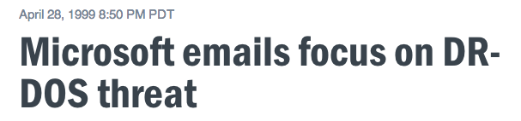
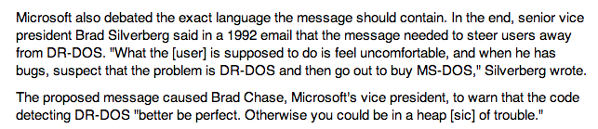

Link Ch 8j

Slide 37
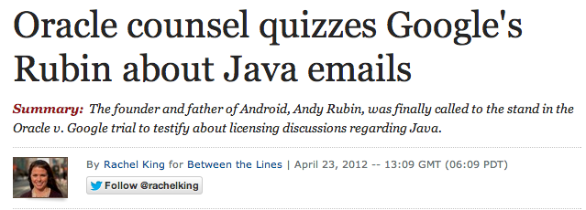
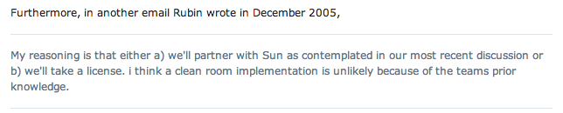
Link Ch 8k

Slide 38
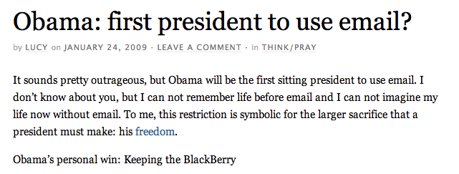
Link Ch 8l

Slide 39
How Email is Accessed
Web-based mail
Gmail or Hotmail
Accessed through a browser
Email client
Outlook
Stores data in .pst or .ost file
Proprietary database format (Link Ch 8m)
Windows Live Mail (formerly Outlook Express)
Outlook Express used .DBX files (databases)
Windows Live Mail uses .EML files (plain text files, one per message)

Slide 40
Email Protocols
SMTP (Simple Mail Transfer Protocol)
Used to send emails from one server to another
Post Office Protocol (POP)
Used by email clients to receive email messages
Internet Message Access Protocol (IMAP)
Used by email clients to receive email messages, more features than POP

Slide 41
Email as Evidence
Communications relevant to the case
Email addresses
IP addresses
Dates and times

Slide 42
Where Email can be Found
Suspect’s computer
Any recipient’s computer
Company SMTP server
Backup media
Smartphone
Service provider
Any server the email passed through

Slide 43
Components of an Email
Header
Shows the servers the email passed through
Body
Readable message
Attachments

Slide 44
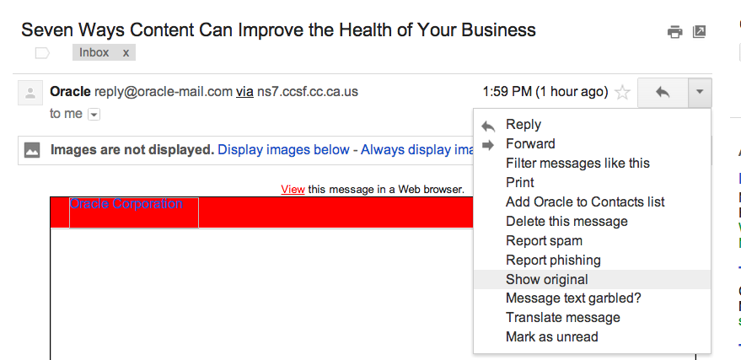
Gmail: “Show Original”

Slide 45
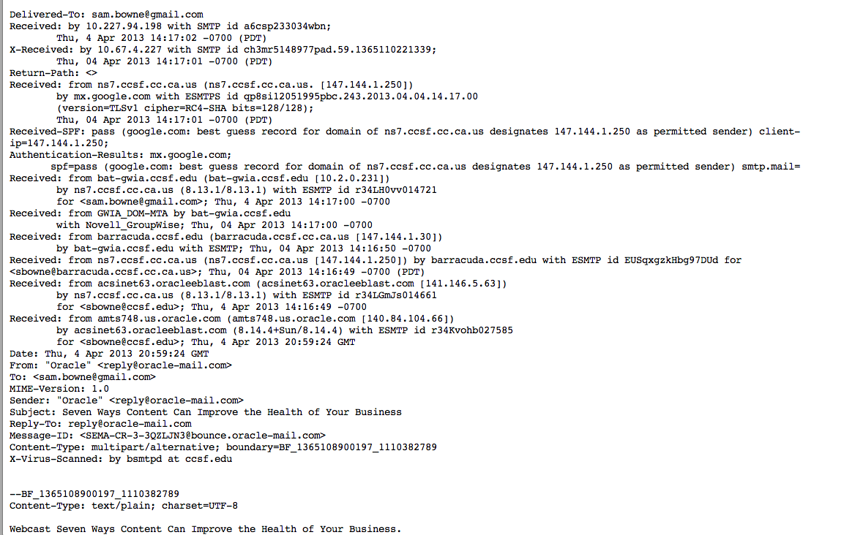
Header

Slide 46
Email - Covering the Trail
Spoofing
Falsifying the origin of an email
Anonymous Remailer
Strips the headers
Forwards email without them
Typically doesn’t keep logs
Protects the privacy of users

Slide 47
Shared Email Accounts
Create an account on a free Web service like Yahoo!
Share the username and password with recipients
Write an email and don’t send it
Save it in the “Drafts” folder
Recipient can log in and see it
Used by terrorists
Can be “One-Time Account”

Slide 48
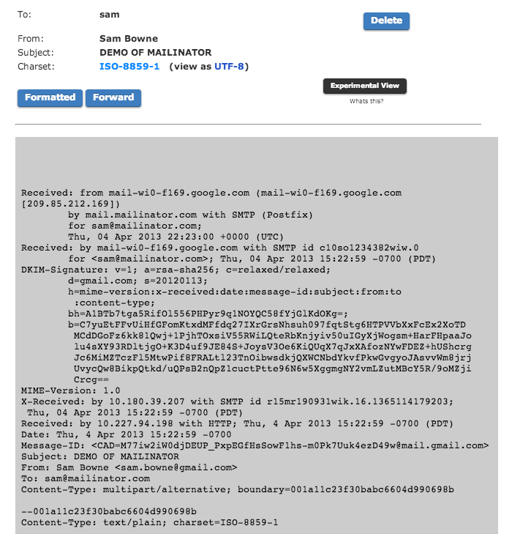
Mailinator
Cannot send, only receive
No passwords or privacy

Slide 49
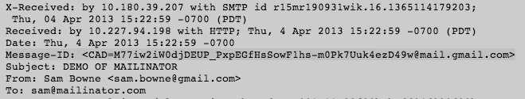
Tracing Email
Message ID is unique
Proves that the email has passed through that server
Detects falsified emails

Slide 50
Social Networking

Slide 51
Over-Sharing
People talk constantly and share everything
Facebook
Twitter
FourSquare
People check-in with their current location
Evidence may be on suspect’s computer, smartphone or provider’s network

Slide 52

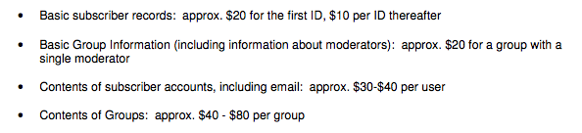
Link Ch 8n

Slide 53
