Slide 1
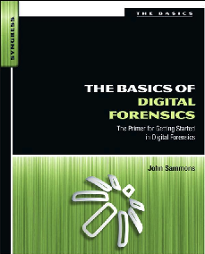
12. Digital Forensics and Networking

Slide 2
Topics
Networking Fundamentals
Types of Networks
Network Security Tools
Network Attacks
Incident Response
Network Evidence & Investigation

Slide 3
Networking Fundamentals

Slide 4
Network Concepts
TCP/IP (Transmission Control Protocol / Internet Protocol)
The common language for the Internet
Client/Server Network
Each computer has one of the roles: client or server
Modern computers mix the roles
Peer-to-peer Network
Every member has same role, as both client and server
Commonly used with bittorrent to share files illegally

Slide 5
Network Types
LAN (Local Area Network)
Within a single building or a few nearby buildings
WAN (Wide Area Network)
Larger area
Internet
Largest WAN, the whole world
MAN (Metropolitan Area Network)
PAN (Personal Area Network)
Bluetooth: max. range 10 meters
CAN (Campus Area Network)

Slide 6
IP Addresses
IPv4: 32 bits, in four octets
Each octet written as a decimal number 0-255
Ex: 192.168.1.101
Only four billion total addresses
They are running out
IPv6: 128 bit in eight 16-bit fields
Each field a 4-character hexadecimal valoe
Range 0000 – FFFF
Ex: 2001:0db8:0000:0000:1111:2222:3333:4444
Many addresses: 300 billion billion billon billion

Slide 7
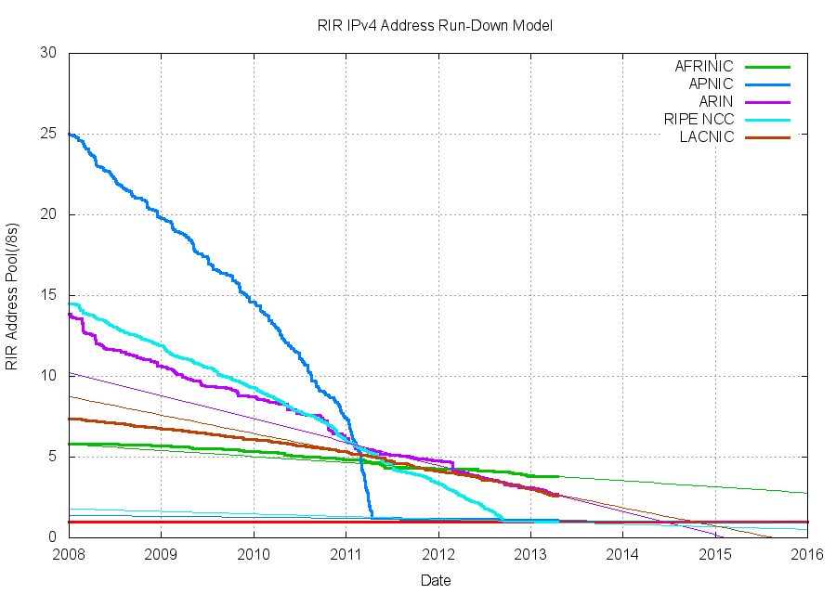

Slide 8
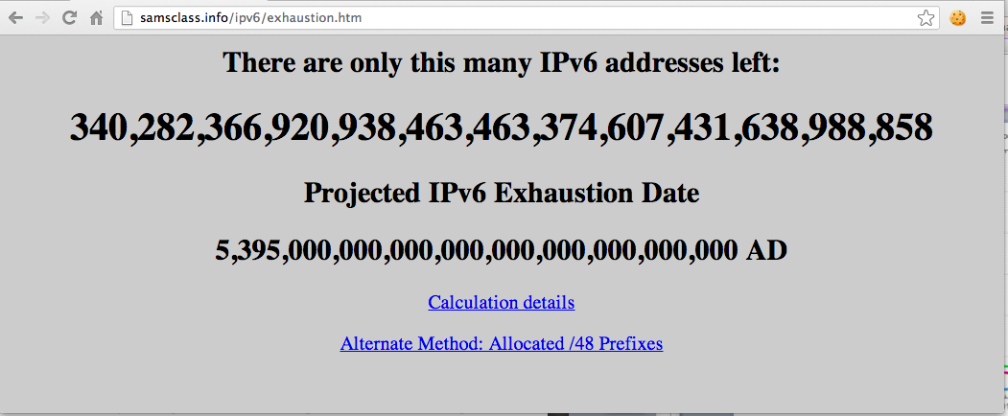

Slide 9
Network Security Tools

Slide 10
Firewalls, IDS, and Sniffers
Filters inbound and, optionally, outbound traffic
Simple firewalls filter based on packet headers
IP address, port number
Layer 7 firewall
Looks inside packet to discriminate more
Can detect Facebook, TeamViewer, BitTorrent
Intrusion Detection System
Blocks malicious traffic based on a set of definitions
Ex: Snort
Sniffer
Captures packets for analysis
Ex: Wireshark

Slide 11
Network Attacks

Slide 12
Network Attacks
DDoS (Distributed Denial of Service)
Many bots attack a server
IP Spoofing
False Source IP in packets
Can make attacks appear to come from trusted sources
Man-in-the-Middle
Intercept traffic
Attacker can examine or alter data
Can impersonate user
Defense is SSL

Slide 13

Social Engineering
Tricking people into security violations

Slide 14
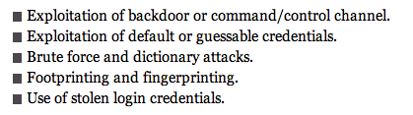
Most Common Hacking Methods
Backdoor
From a malware infection allowing remote control
Footprinting
Gathering public information about a target
Fingerprinting
Scanning a target for open ports and other information
Based on a 2011 Verizon study

Slide 15
Insider Threat
The biggest threat
Does more harm than external attacks
Difficult to detect or prevent

Slide 16
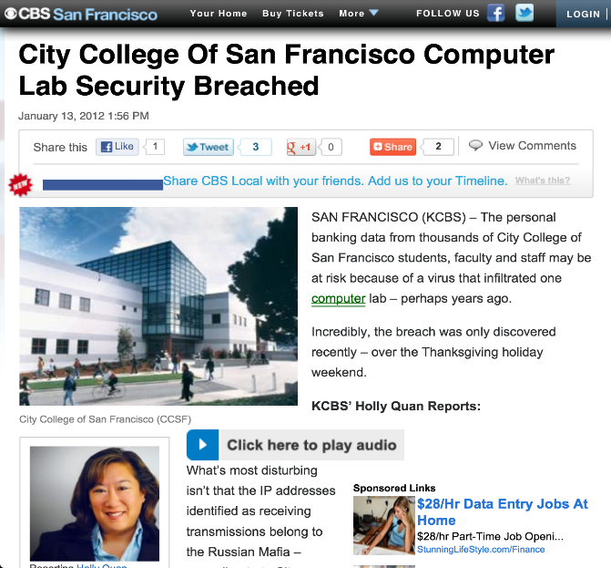

Slide 17


Link Ch 9a

Slide 18
Incident Response

Slide 19
NIST Process
Preparation
Planning for security incidents
Proactive defenses, such as
Hardening systems
Patching
Perimeter defense
User awareness training
Policies, procedures, and guidelines
Detection and Analysis
IDS produce false positives
Network traffic is erratic

Slide 20
NIST Process
Containment
Eradication
Recovery
Post-incident Review
Root-cause analysis
Plan how to prevent future incidence
Revise policies and procedures

Slide 21
Network Evidence & Investigation

Slide 22
Where is the Evidence?
All devices along the route may contain log files
Servers
Routers
Firewalls
Evidence may be volatile

Slide 23
Log Files
Authentication log
Account and IP address of users
Application log
Timestamps shown when application was used and by whom
Operating system log
Track reboots, file access, clients served, and much more
Device logs
On routers and firewalls

Slide 24
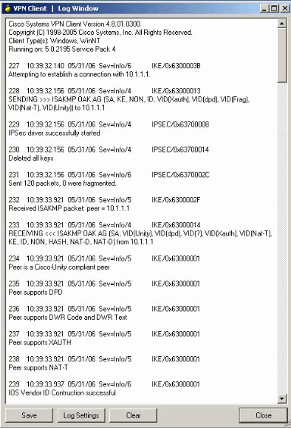

Slide 25
Network Investigative Tools
Wireshark
Sniffer
NetIntercept
Hardware applicance to record network traffic
NetWitness Investigator
Can gather and analyze network traffic
Snort
IDS

Slide 26
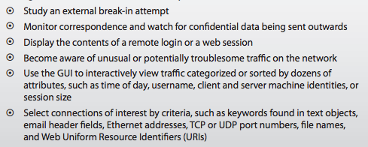
NetIntercept
Links Ch 9b, 9c

Slide 27
Network Investigation Challenges
IP addresses can be spoofed
Bounced through proxies
Or through compromised systems
Or through the Tor anonymity network
Logs are often incomplete or absent
Logs are erased after some time
Attackers can erase logs
Jurisdiction
Attacks can cross state or national boundaries

Slide 28
Binary

Slide 29
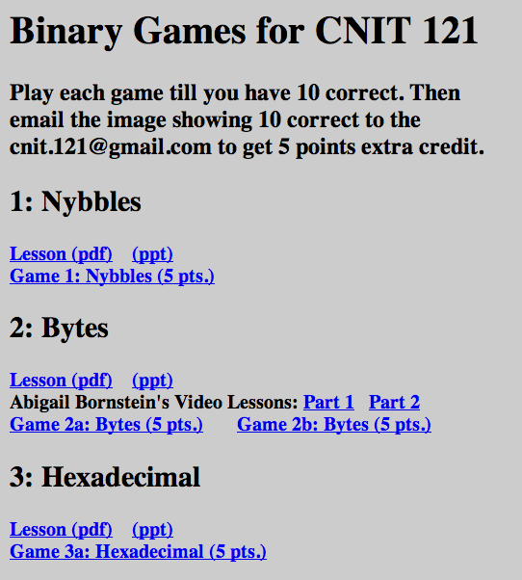
In Extra Credit Projects

