Slide 1
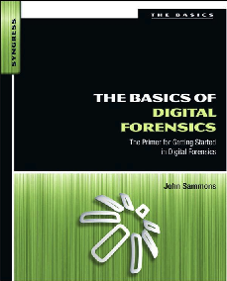
13. Mobile Device Forensics - Part 1

Slide 2
Topics
Cellular Networks
Cell Phone Operating Systems
Evidence on Cell Phones

Slide 3
Cellular Networks

Slide 4
Cell Phone Basics
Important evidence
Emails & SMS messages
Internet history
GPS (Global Positioning System)
Photos
Videos
Challenge: Diversity
Many makes, models, and operating systems
No standard hardware interface
More of them now have mini USB or micro USV

Slide 5
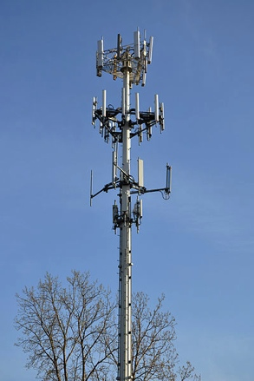
Cell Phone Tower
Also called “Base Transceiver Station” or “Cell Site”
Image from Wikipedia (Link 10a)

Slide 6
Cell Network Components
Base Station
Antennas and related equipment
Base Station Controller (BSC)
Regulates the signals between base stations
Critical as phones move from place to place
Mobile Switching Center (MSC)
Processes calls within the network
Holds a lot of evidence
Coordinates calls between different wireless networks and land lines
Handles SMS messages
Call detail records and logs are here

Slide 7
Cell Network Components
Visitor Location Register (VLR)
Database linked to a MSC
All mobile devices currently being controlled by that MSC are recorded in the VLR
Interworking functions are gateways to outside data networks such as the Internet
Home Location Register (HLR)
Information about individual subscribers
ID, billing, and services
Stores encryption keys
Supports Authentication Center (AuC) which controls access to the network

Slide 8
Cell Network Components
Short Message Service Center (SMSC)
Responsible for SMS messages
Messages may be recovered
No rule dictating how long providers must keep those messages

Slide 9
Handoff
Each cell phone is regularly communicating with nearest cell tower
Even if it’s not in use
It sends identification data to the tower
Cell phone number and service provider
Handoff is the transfer from tower to tower as you move

Slide 10
Handoff
Handled differently in GSM & CDMA networks
GSM (Global System for Mobile Communication)
Hard handoff: Phone can only attach to one tower at a time
CDMA (Code Division Multiple Access)
Soft handoff
Phone can connect to multiple towers at once
Records showing when a phone was connected to a tower can determine the approximate location of that phone

Slide 11
Mobile Switching Center (MSC)
Once your call hits the tower it’s transferred to the MSC
If you are calling a phone outside the network, call is passed to the PSTN (Public Switched Telephone Network)

Slide 12
Messaging Services
SMS (Short Message Service)
Text messages
Maximum of 160 characters
MMS (Multimedia Messaging Service)
Improved functionality
No 160 character limit

Slide 13
Types of Cellular Networks
CDMA (Code Division Multiple Access)
GSM (Global System for Mobile Communications)
iDEN (Integrated Digitally Enhanced Network)

Slide 14
CDMA (Code Division Multiple Access)
Originally military technology
Uses spread spectrum
Used by Sprint, Verizon, Alltel, and NEXTEL
Does not use SIM (Subscriber Identity Module) cards
Handsets identified by Electronic Serial Number (ESN)
ESNs have 32 bits and ran out in 2010, and the new system, MEID, has replaced it
MEID has 56 bits (Link Ch 10b)

Slide 15
GSM (Global System for Mobile Communications)
Used internationally
Uses Time Division Multiple Access (TDMA)
Uses SIM (Subscriber Identity Module) cards
Carriers include AT&T, Verizon, T-Mobile and Cellular One
Handsets identified by International Mobile Equipment Identity (IMEI) numbers (15 or 16 digits)

Slide 16
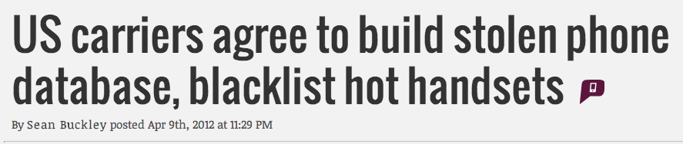
IMEI Blacklist
IMEI uniquely identifies phone, and is not changed by replacing the SIM card
IMEI can be used to blacklist stolen phones
Links Ch 10c & 10d

Slide 17
iDEN (Integrated Digitally Enhanced Network)
Two-way radio-like functionality
Supports normal phone users and “push-to-talk” dispatch users
Sprint will stop supporting iDEN in June, 2013
Link Ch 10e

Slide 18
Prepaid Cell Phones
Can be purchased with cash
No trail to the identity of the user
Cell phone will hold any subscriber information
Network provider will have call details
Location and calls sent and received

Slide 19
Cell Phone Operating Systems

Slide 20
Modern Cell Phone Operating Systems
Symbian
Apple iOS
Windows CE and Windows Mobile
Google’s Android
Blackberry OS

Slide 21
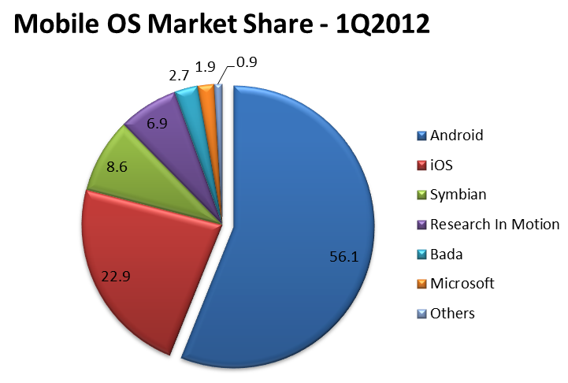
Link Ch 10f

Slide 22
Symbian
Started as EPOC in the 1980s
First used on phones in 2000 by Sony
Passed through many different companies
Nokia recently made it open-source
In 2011, Nokia switched to Windows Phone
Accenture continues to support Symbian

Slide 23
Blackberry
Introduced in 1999 by Research In Motion (RIM) from Canada
Common at workplaces
Synchronize with Novell’s GroupWise and Microsoft’s Exchange
Different OS versions for each carrier

Slide 24
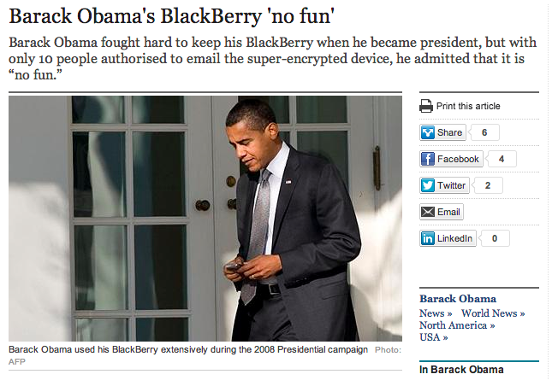
Link Ch 10h

Slide 25

Android
The most popular OS by far
Open Source
Used on Motorola, Sony Ericsson, and HTC phones
Also on tablets

Slide 26
Apple’s iOS
Used on iPhone, iPad, and iPod Touch
Based on OS X
Second most popular phone OS

Slide 27
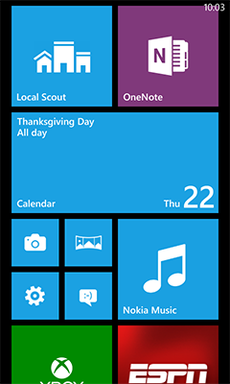
Windows Mobile (now Windows Phone)
Windows OS versions for smartphones and pocket PCs
Windows Phone 8 was released in Oct. 2012
Link Ch 10i

Slide 28
Evidence on Cell Phones

Slide 29
Potential Evidence Items
Call history
Text messages (active & deleted)
Email
Photos & video
Browser history
Contacts
GPS location information
Chat sessions
Calendar
Voice memos
Documents

Slide 30
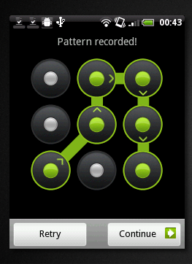
PIN (Personal Identification Number)
Can be used to secure the handset
Three failed attempts will lock the SIM
A Personal Unlock Key (PUK) is needed to unlock the SIM
PUK comes from the provider of the SIM card
Image from link Ch 10j

Slide 31
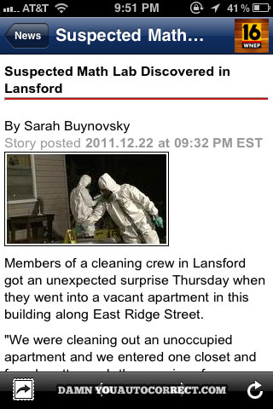
Predictive Text
Intended to make it easier to type on 10-digit keypads
Fills in text when the user types part of a word
System learns frequently used words
Database may contain words, slang, abbreviations, E-mail addresses or URLs
Also creates hilariously mangled messages
Link Ch 10k

Slide 32
Call Detail Records (CDR)
Used by the provider to troubleshoot and improve performance
May show:
Date/time call started and ended
Who called who
Whether call was incoming or outgoing
Originating and terminating towers
But you can’t tell who was holding the phone
Subscriber information is different from CDR
Name, address, acct. numbers, email address, credit card #

Slide 33
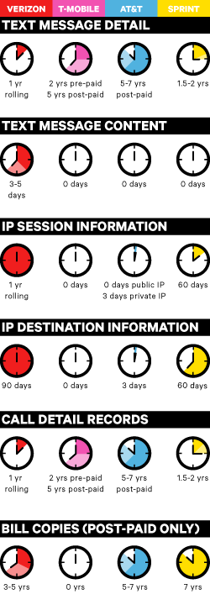
Retention Policies
Link Ch 10l

Slide 34
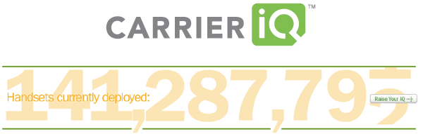
Software included in phones to send tracking data back to the carrier
Privacy controversy (Link Ch 10m)

Slide 35
Locating Cell Phones
Triangulation
Measure signal delay to three nearest towers
Can give approximate location of phone
Directional antenna
Enables location determination with only two towers from delay measurements
GPS
Locates cell phone with satellites
Wi-Fi Positioning System
Uses data on known Wi-Fi access points
Included on the iPad
Link Ch 10n

Slide 36
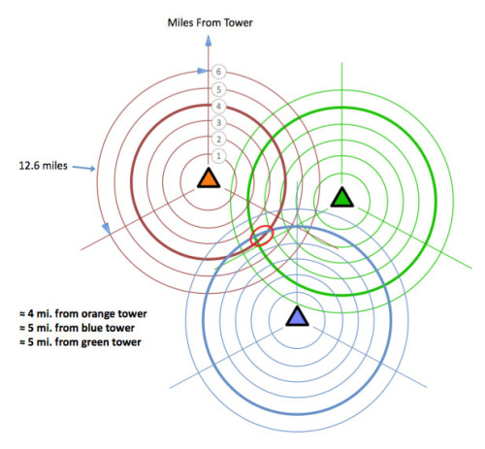

Slide 37
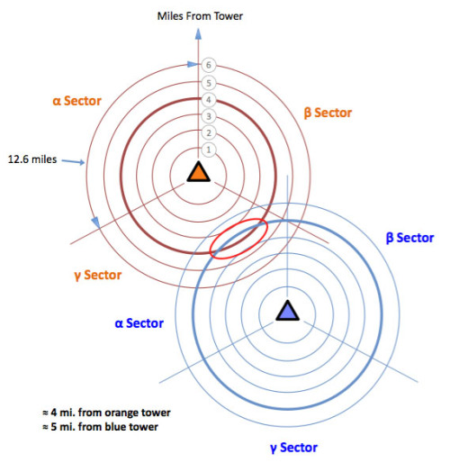

Slide 38
Triangulation images from link Ch 10o

