Slide 1
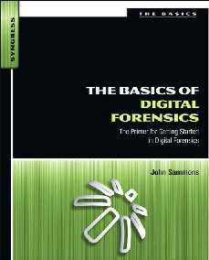
14. Mobile Device Forensics - Part 2

Slide 2
Topics
Collecting and Handling Cell Phones as Evidence
Cell Phone Forensic Tools
GPS (Global Positioning System)

Slide 3
Collecting and Handling Cell Phones as Evidence

Slide 4
Isolate the Phone
Use a Faraday bag or a paint can to block radio signals to the phone
This prevents
  Remote wiping
  inbound emails, texts, and calls, which could overwrite evidence
If phone is on, leave it on
  Turning off the phone will preserve the battery charge, but it might require a PIN when it’s turned back on
  A dead battery might trigger the security function, locking up the phone

Slide 5
If Phone is Off
Leave it off
Remove the battery and SIM card
Photograph the phone, front and back
Record identifying numbers under the battery
  IMEI/ESN/MEID
Isolate the phone from the network, just like a powered-on phone

Slide 6
Imaging the Phone
Best procedure
Identify make & model of phone
Create a forensic image
Examine the image

Slide 7
Manual Examination
If there’s no alternative, you can examine the live phone by hand
Take good notes
Explain why this was necessary
  Hostage situation or to prevent a violent act
Navigate through the phone, taking photographs

Slide 8
Voicemail
You will need the password-reset code from the carrier
Or, carrier may provide you with the data itself

Slide 9
Other Items
Look for
  Additional handsets
  SIM cards
  Power and data cables
A phone in isolation drains its battery rapidly, seeking a signal

Slide 10
SIM (Subscriber Identity Module)
Numbers on SIM card
IMSI (International Mobile Subscriber Identity)
  Identifies the subscriber’s account information
ICC-ID (Integrated Circuit Card Identifier)
  Serial number of the SIM card itself

Slide 11
Evidence on SIM Card
Subscriber identification (IMSI)
Service provider
Card identity (ICC-ID)
Language preferences
Phone location when powered off
User stored phone numbers
Numbers dialed by the user
SMS text messages (potentially)
Deleted SMS text messages (potentially)
  Only a small number of SMS messages are usually stored on the SIM card (link Ch 12e)

Slide 12
SIM Components
CPU
RAM
Flash memory
Crypto-chip

Slide 13
Cell Phone Acquisition
Physical and Logical
Physical
  Bit-for-bit copy
  Includes latent data
Logical
  Only files and folders, no deleted data
Can be performed with non-forensic tools like backup utilities
No write blocker is used

Slide 14
Cell Phone Forensic Tools

Slide 15
Limitations of Tools
A tool can’t support all phones
Two tools may not recover the same information from the same phone
Multiple tools will be required

Slide 16
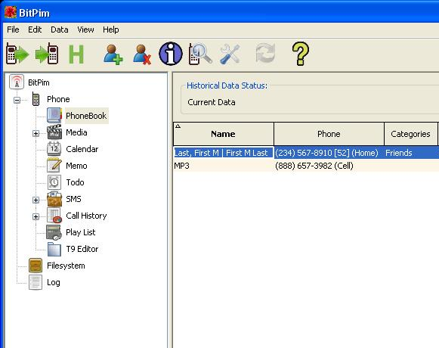
BitPim
Free, open-source software
Allows you to view and manipulate data from CDMA phones from Samsung and other manufacturers
Link Ch 10p

Slide 17
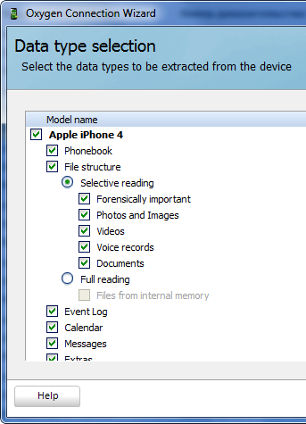
Oxygen Forensic Suite
Supports more than 6500 devices
$2500
Claims to extract more data than other tools
Link Ch 10q

Slide 18
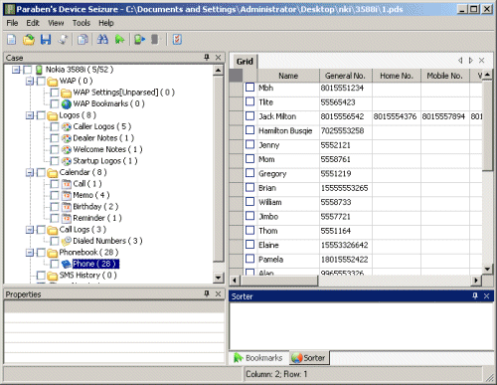
Paraben
Hardware and software products for mobile device forensics
Link Ch 10r

Slide 19
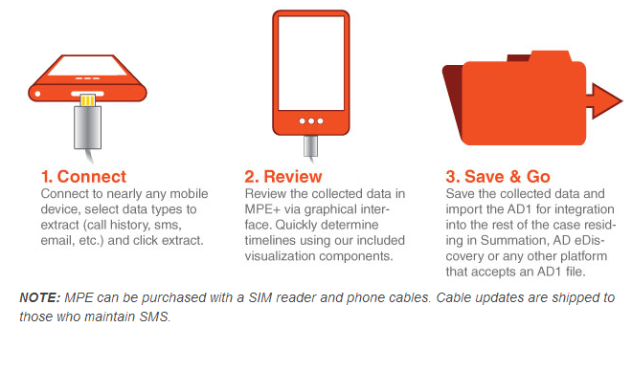
AccessData MPE+
Supports 6800 devices
May be a free version
Link Ch 10s

Slide 20
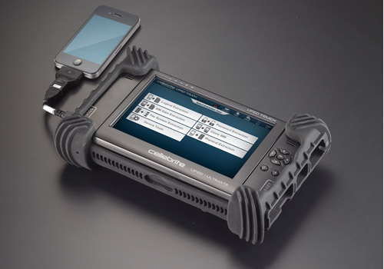
Cellebrite UFED
Hardware device that extracts data from mobile devices
They also make devices top copy data from one phone to another in phone stores
Link Ch 10u

Slide 21
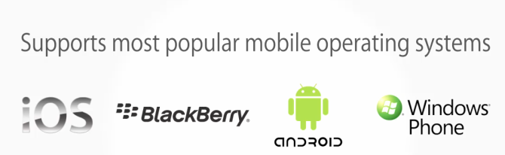
EnCase Forensic v7
Includes smartphone acquisition
Automatically detects device type—just plug it in
Link Ch 10t

Slide 22
GPS (Global Positioning System)

Slide 23
Evidence on GPSs
Physical location log
Some have
  Mobile phone logs
  SMS messages
  Images
Remembered places and routes
  Waypoints
  Tracks
  Routes
    Link Ch 10u

Slide 24
Four Categories of GPS
Simple
  Can store trackpoints & logs
Smart
  Automotive or USB storage devices
  2 GB or more storage
  Can play MP3s, store photos, & favorite places

Slide 25
Four Categories of GPS
Hybrid
  Feature-rich. Ike a smartphone
  Bluetooth connection to phone
  May have SMS messages, call logs, address book
Connected
  GSM radio; real-time Internet
  Google searches, traffic information
  Subscription-based service
  Information available from provider

Slide 26
Data on GPS Devices
System data
  Trackpoints are automatically generated and can’t be altered by the user
  The track log records where the unit has been
User data
  Waypoints are locations the user saved
  The user may not have gone there
  Points Of Interest are supplied by GPS manufacturer

Slide 27
GPS Handling
Like cell phones
May have volatile data
Are constantly interacting with satellites

