Slide 1
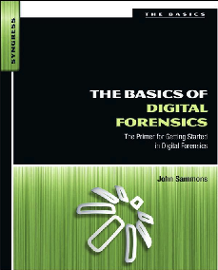
14. Reading: Looking Ahead

Slide 2
Topics
Standards and Controls
Cloud Forensics
Solid State Drives
Speed of Change

Slide 3
Standards and Controls
Standard
A prepared sample that has known properties that is used as a control during forensic analysis
Control
A test performed in parallel with experimental samples
A sample that provides a known result
Some forensic authorities want to use these concepts in computer forensics, others don’t

Slide 4
Cloud Forensics

Slide 5
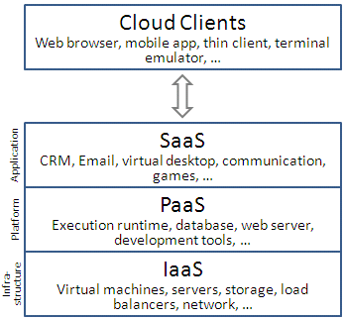
Cloud Computing
Infrastructure as a Service (IaaS)
Software as a Service (SaaS)
Platform as a Service (PaaS)
Image from Wikipedia, link 11a

Slide 6
Infrastructure as a Service (IaaS)
Most basic cloud service
Like renting a physical server at a colocation facility
Provides virtual machines and network service to the customer
Customer installs OS & apps
Responsible for maintaining and upgrading the them
Examples: Amazon EC2, Azure Services Platform, Google Compute Engine, Rackspace Open Cloud

Slide 7
Platform as a Service (PaaS)
Provides a computing platform that includes
Operating system
Programming language execution environment
Database
Web server
Application developers design apps without managing the lower hardware & software layers
Examples: AWS Elastic Beanstalk, Windows Azure Cloud Services, Google App Engine

Slide 8
Software as a Service (SaaS)
Provides an application for clients to use
Clients don’t control hardware, OS, or application
They just use the features the application provides
Examples: Google Apps, Microsoft Office 365

Slide 9
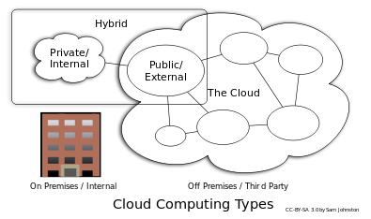
Private and Public Clouds
Private cloud
Company purchases and maintains servers
Restricted to company users
Eliminates many of the advantages of cloud computing
More secure (?)
Public Cloud
The most common type, provided by Amazon or Microsoft, etc.
Image from Wikipedia, link 11a

Slide 10
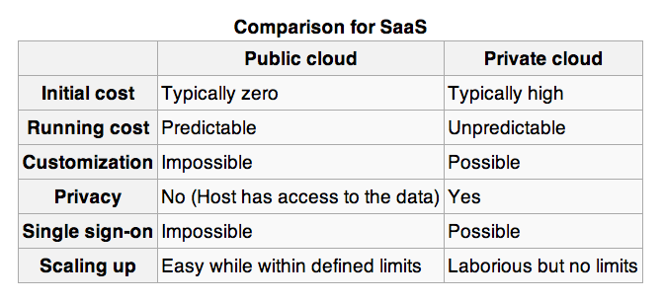
From Wikipedia, link 11a

Slide 11
Benefits of the Cloud
Startup cost is much lower
Flexibility
Scalability
Redundancy
Outsources server maintenance tasks so business can focus on their core competency

Slide 12
Legal Concerns
Usually no way to recover deleted data
Deleted data is on shared storage, and mapping is removed immediately when a file is deleted
Few forensic tools are available for cloud environments

Slide 13
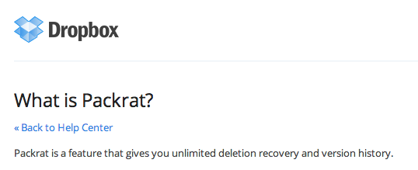
Cloud Persistence: Dropbox
Dropbox saves all deleted files
For 30 days by default for home users
Forever with the Packrat extension (default for business users)
Very handy for investigators!
Link Ch 11b

Slide 14
Jurisdiction
Cloud providers may be anywhere in the world
Regulations could help, if they required Cloud Service Providers to retain and provide data to investigators
Service Level Agreements may cover digital evidence collection and preservation
Wise precaution when litigation is expected

Slide 15
Solid State Drives

Slide 16
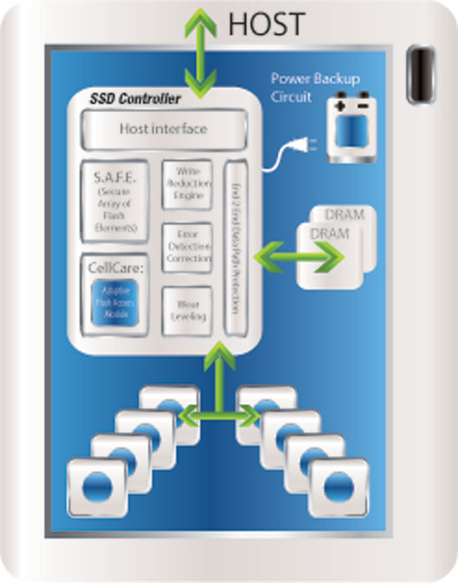
Internal Structure of an SSD
Link Ch 11d

Slide 17
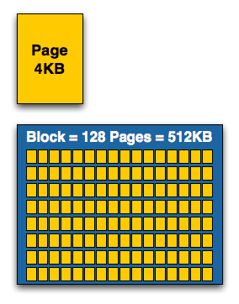
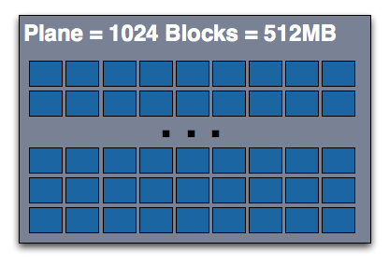
SSD Structure
Link Ch 11c

Slide 18
SSDs and TRIM
SSDs get slower as they fill up
SSD speed is only fast when it can do many writes in parallel
The smallest structure you can write is a page (4 KB)
But you cannot write to a page unless it is empty
The smallest structure you can erase is a block (512 KB)
Also, you can only erase a block 10,000 times before it fails (at least as of 2009)
SSDs are not all the same—they make different attempts to increase lifespan with “wear leveling”
Link Ch 11e

Slide 19
File Translation Layer
Computer thinks it knows where data is going on the drive
SSD uses a File Translation Layer to map apparent locations to real locations
The real location is adjusted by the SSD controller for wear leveling

Slide 20
Garbage Collection
SSD controller erases deleted files
When this happens varies across drive brands
Data on the drive may even be changing during forensic acquisition
This process may depend on the OS and drive format
TRIM command enables the OS to tell the SSD controller that a file has been deleted
Supported by Windows 7 and OS X but only active when conditions are right

Slide 21
Speed of Change
Case backlogs
Constant updates of software require new methods, retraining and research
Professional networking
HTCIA
Twitter
Conventions

