Slide 1
Programming 511
Chapter 1: Introduction
Nqubeko Mathenjwa

Slide 2
Let’s begin
Goal
  Teach you how to program effectively
Skills and information to be acquired
  What the heck all this means
  Problem solving
  Object-oriented design
  VB

Slide 3
So, what is a computer, anyway?

Slide 4
What is a computer?
Not a rhetorical question!
“A device that computes…
especially a programmable electronic machine that performs high-speed mathematical or logical operations or that assembles, stores, correlates, or otherwise processes information”
  From American Heritage® Dictionary of the English Language, 4th Edition

Slide 5
So what is a computation?
The act or process of computing
  Duh!
Definition of computing:
  To determine by the use of a computer
  To determine by mathematics, especially by numerical methods: computed the tax due
revised definition for computing:
  The act of taking a problem with specific inputs and determining a specific answer (output)

Slide 6
Axiom
By definition, a (properly functioning) computer will always produce the same output given the same input
So how do we compute random numbers?

Slide 7
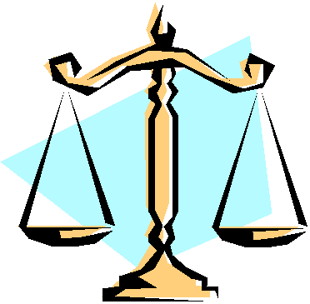
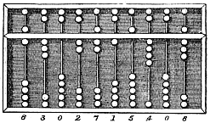
The first computers
Scales – computed relative weight of
two items
  Computed if the first item’s weight
  was less than, equal to, or greater
  than the second item’s weight
Abacus – performed mathematical computations
  Primarily thought of as Chinese, but also Japanese, Mayan, Russian, and Roman versions
  Can do square roots and cube roots

Slide 8
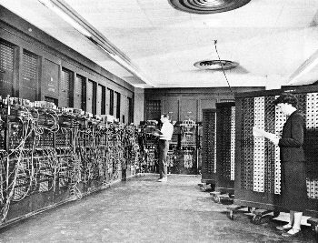
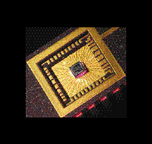
Computer Size
ENIAC then…
ENIAC today…

Slide 9
Algorithms

Slide 10
So what do we do with a computer…
… now that we have one?
We have to tell a computer what to do!
  Computers have no intelligence of their own
We tell a computer what to do by writing a computer program, or “algorithm”
  In this course, we’ll use VB

Slide 11
Algorithms
What is an algorithm?
“A step-by-step problem-solving procedure, especially an established, recursive computational procedure for solving a problem in a finite number of steps”
  From American Heritage® Dictionary of the English Language, 4th Edition
We’ve seen lots of algorithms before…

Slide 12
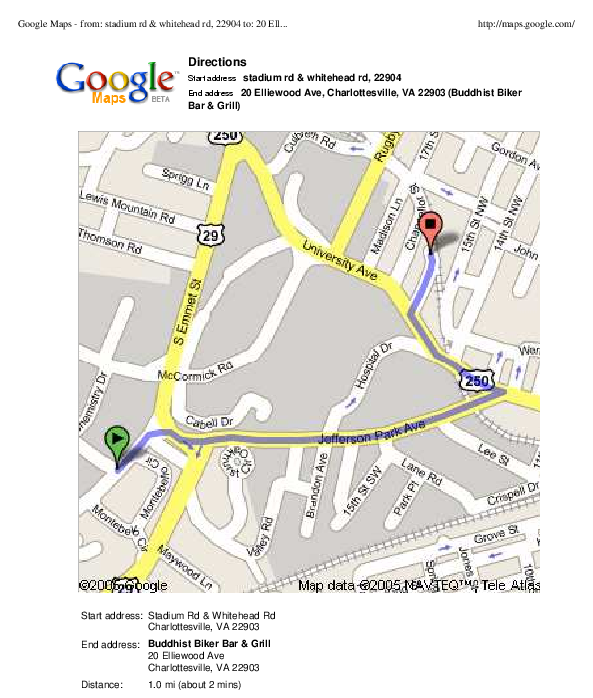
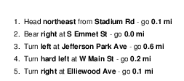
Example algorithm: map directions

Slide 13
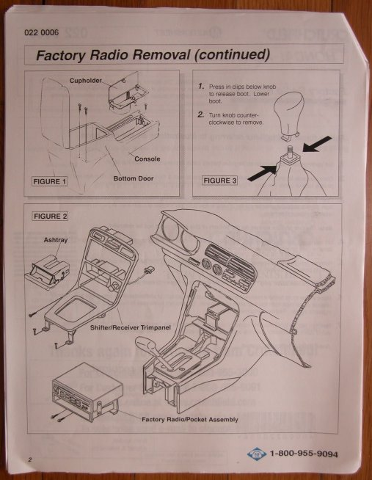
Example algorithm: car radio removal

Slide 14
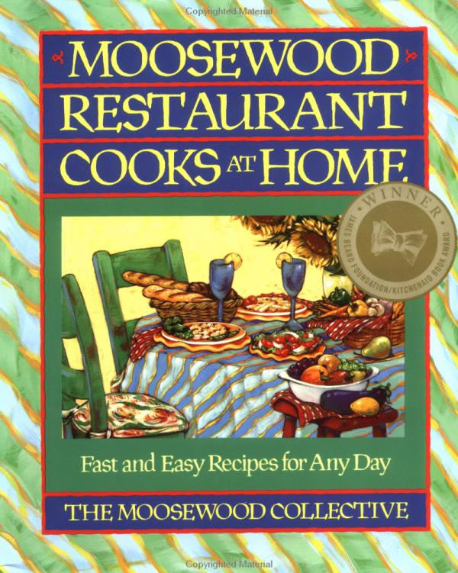
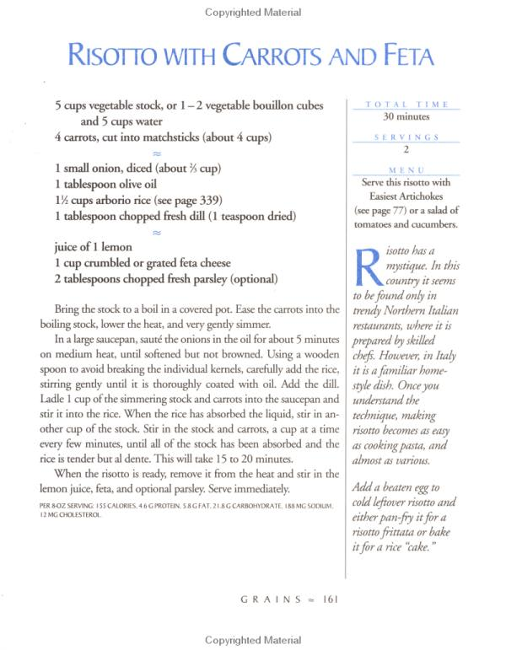
Example algorithm: Recipes

Slide 15
Algorithm correctness

Slide 16
Incorrect algorithms
Not all algorithms are “good”
So then what makes an algorithm “bad”?
  Can be wrong
  Can be inefficient
  Can never stop
  Can have other problems as well…

Slide 17
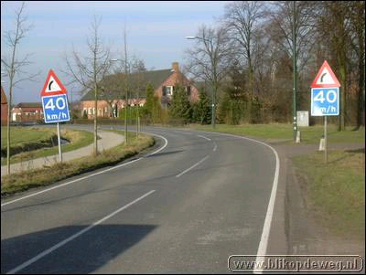
Incorrect algorithms: just plain wrong
From http://en.for-ua.com/blog/2005/12/09/102028.html

Slide 18
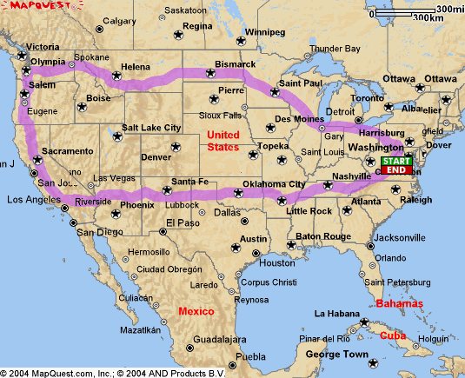
Note that this is not an incorrect algorithm!
  Just a very inefficient one

Slide 19

Incorrect algorithms: Shampoo directions

Slide 20
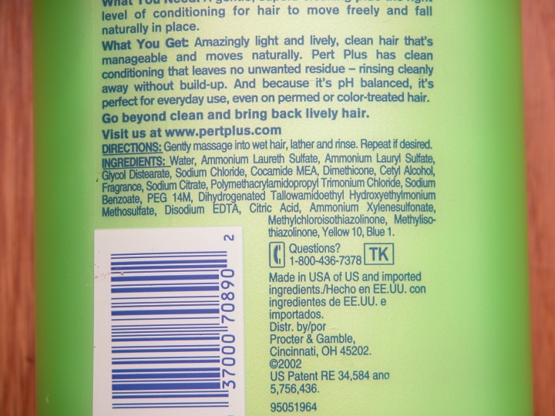
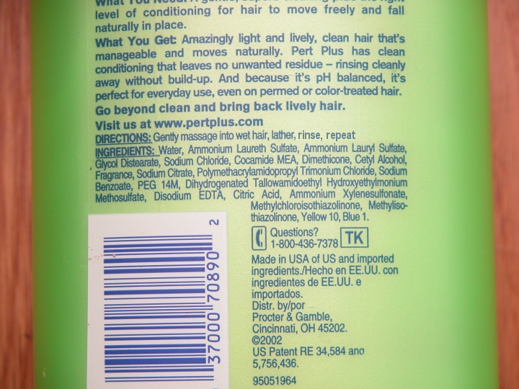

Slide 21
Incorrect algorithms: Shampoo directions
Lather, rinse, repeat
This algorithm repeats forever!
  It never halts
  Note that humans know to not to spend forever performing the algorithm
  But computers do not!
    Remember, they have zero intelligence
Hence the overplayed (and not very funny) computer joke:
  How did the computer scientist die in the shower?
  S/he read the directions: lather, rinse, repeat

Slide 22
Our goal
Is to write correct and efficient algorithms for a computer to follow
  Remember that computers are dumb!
We aren’t going to worry about the efficient part in this course
But what does “correct” mean?

Slide 23
“Correct” algorithms
Consider an algorithm to display the color blue
Is this blue?
Is this blue?
What about this?
And this one?
Definitely
Also, yes: two correct results!
Maybe (could be green)
Definitely not

Slide 24
Note that this is not an incorrect algorithm!
  Just a very inefficient one

Slide 25
So what does all this mean?
Humans specify algorithms without a lot of precision
  Display the color “blue”
  Get me from “here” to “there”
  When there isn’t much precision, there are often multiple answers
Computers need more precision
  Display the color 0x0000ff (royal blue):
    There is only one possible outcome
  Find the shortest route from “here” to “there”
We need to be very specific when we specify things to a computer
  Computers are dumb!

Slide 26
Programming a computer

Slide 27
First Programming Languages
Ada Lovelace (1833)
  Programmed of Babbage’s analytical engine
ENIAC (1945)
  Programmed by plugging wires
Binary
  100100010101001010101010
Assembly
FORTRAN (1954)

Slide 28
Programming Languages
Common programming languages:
  BASIC
  COBOL
  Pascal
  C (1972) by Dennis Ritchie
  C++ (1985) by Bjarne Stroustrup
  Java (1991) by James Gosling and others at Sun Microsystems
  Visual basic

Slide 29
Background

Slide 30
Computing units of measure
A bit is either a 1 or a 0
  On or off, true or false, etc.
A byte is 8 bits:
  01001010
  As there are 8 bits per byte, each byte can hold 2⁸=256 values
  01001010 = 74
All computing measurements are in terms of bytes

Slide 31
Computing units of measure
Kilo (K) = 1,000 (thousand)
Mega (M) = 1,000,000 (million)
Giga (G) = 1,000,000,000 (billion)
Tera (T) = 1,000,000,000,000 (trillion)
Kilo = 2¹⁰ = 1,024
Mega = (1024)² = 1,048,576
Giga = (1024)³ = 1,073,741,824
Tera = (1024)⁴ = 1,099,511,627,776
= Kibi (Ki)
= Mebi (Mi)
= Gibi (Gi)
= Tebi (Ti)

Slide 32
Computing units of measure
An unformatted text document (such as a vb program)
  3 pages per kilobyte (1,000 bytes)
A formatted document (such as a Word file)
  About 5k per page with formatting
A digital camera picture
  About 1 Mb each (1,000,000 bytes)
An MP3 music file
  5 Mb for a 5 minute song
A music file on a CD
  50 Mb for a 5 minute song
  10 times the size of an MP3!
A movie clip
  About 10 Mb per minute of (TV-sized) video

Slide 33
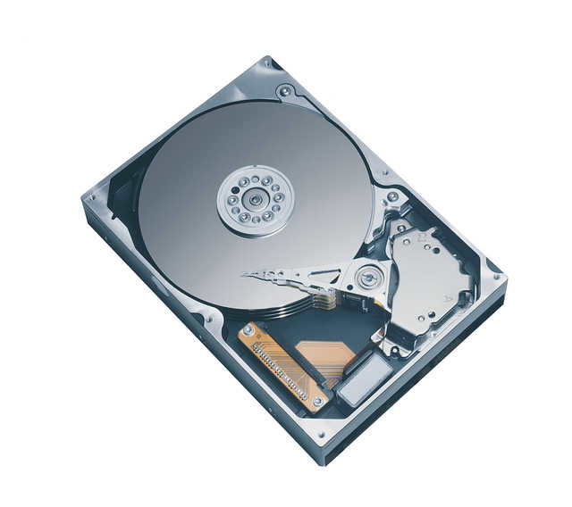
A marketing trick
This hard drive has 250,059,350,016 bytes
  = 250.06 Gigabytes
  = 232.89 Gibibytes
Guess which one they use when they are advertising the drive?

