Slide 1
Grammar
Author: Teacher troy
Version: may 10, 2020

Slide 2
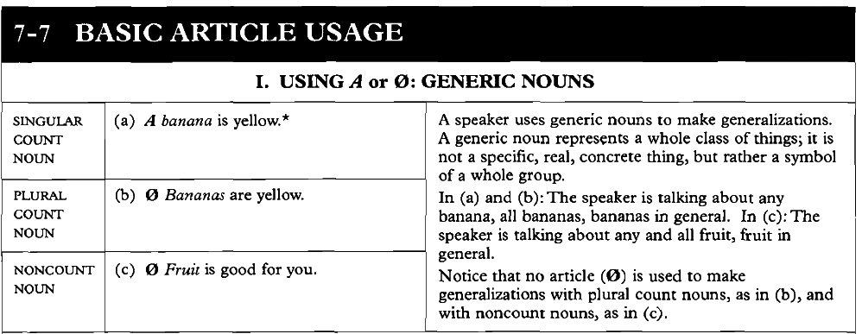
Lesson 25 – Basic article usage

Slide 3
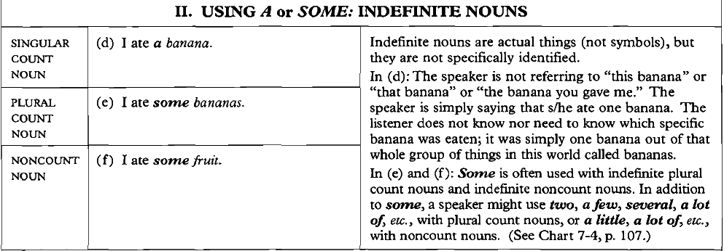

Slide 4
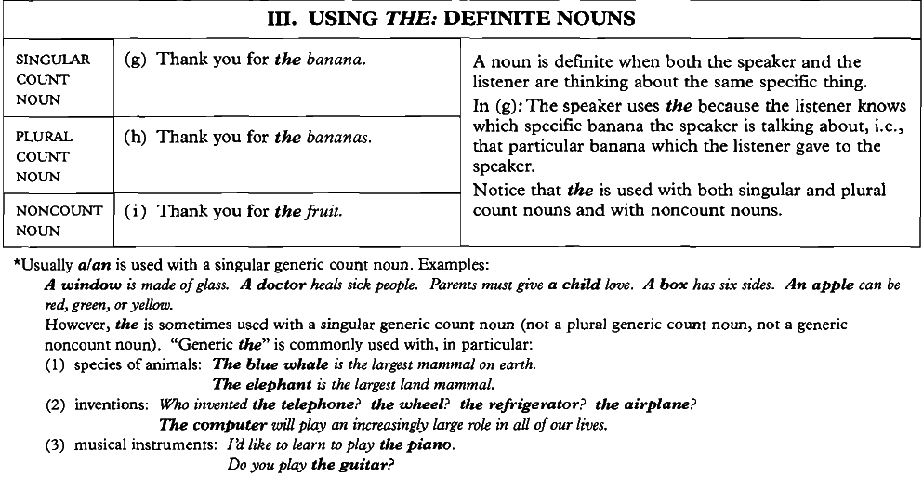

Slide 5


Slide 6
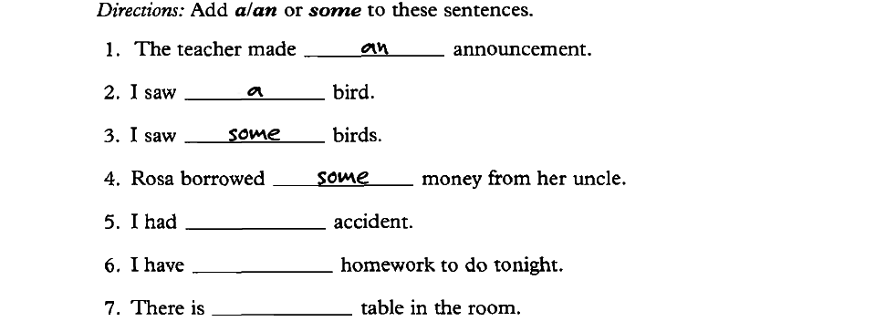
Exercise:

Slide 7
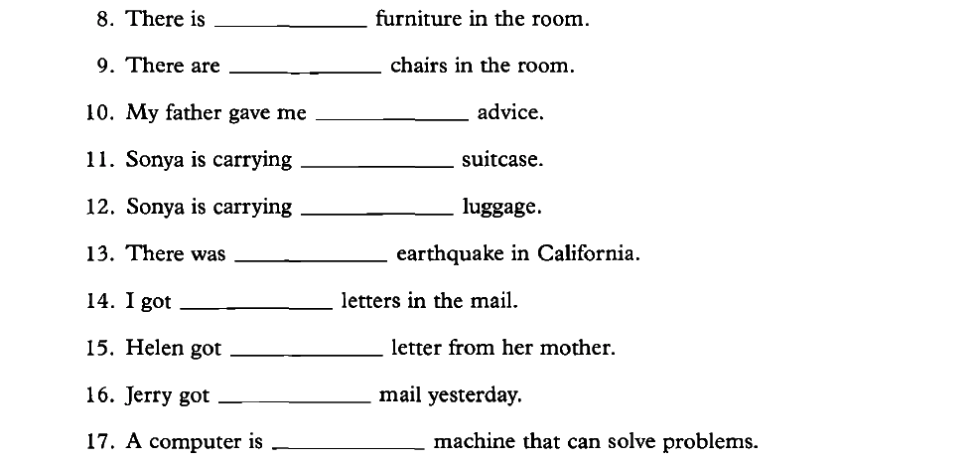

Slide 8
