Slide 1
Grammar
Author: Teacher troy
Version: may 12, 2020

Slide 2

Lesson 26 – General guidelines for article usage

Slide 3


Slide 4


Slide 5
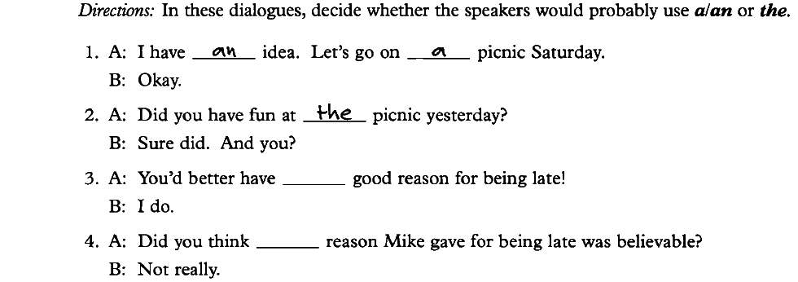
Exercise:

Slide 6
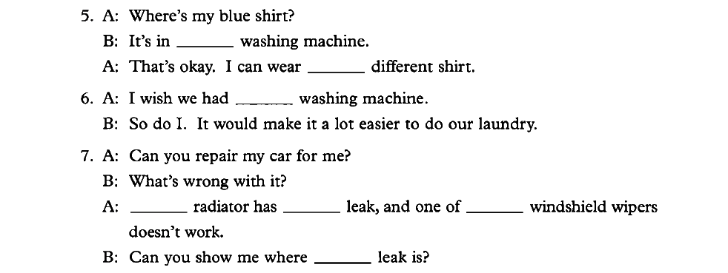

Slide 7
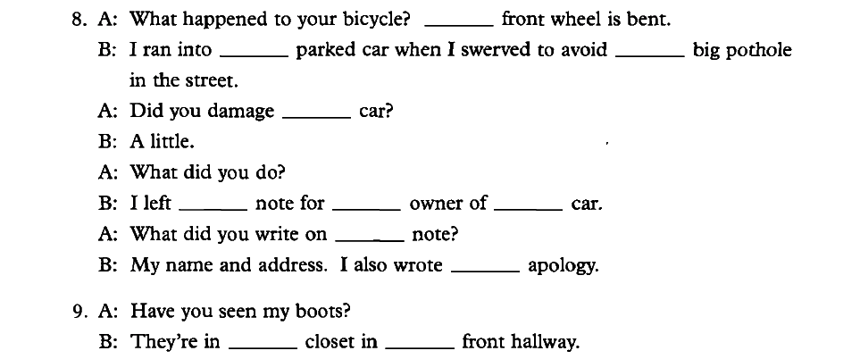

Slide 8
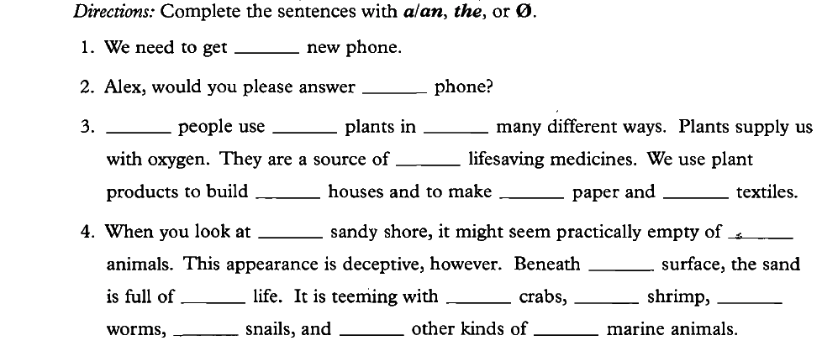
Exercise:

Slide 9
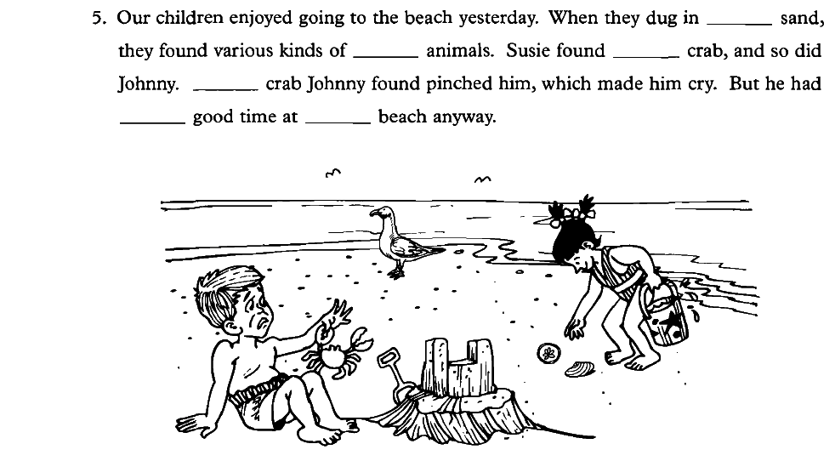

Slide 10


Slide 11
