Slide 1

LESSON LEARN
T40LP CPX4
LAYOUT FOR SIGNAL CELL
BE3 GROUP
Backend Design Dept.
Design Engineering Division
Renesas Design Vietnam Co.,Ltd.
Document number |  | D-IO-T40LP_CPX4-0009-01
Organization |  | BE3/IO
Revision No. |  | 1
Approver | Examiner |  | Creator
 | MinhVu Jan.20, 2018 |  | VinhLe Jan.17, 2018

Slide 2
Agenda
Overview
Power line
Floorplan
Connection
Conclusion and further work

Slide 3
Overview

Slide 4
Overview
Phenomenon/Background
Layout signal cell is the most difficult in layout IO cells. If we don’t consider properly in the design phase, maybe errors (DRC, EM, …) will occur in verification phase. Some case we must re-design again from beginning. It cause waste resource, shift schedule. It is not good.
The purpose of this LnL is to discuss about some points we need to consider when layout signal cell
Scope
This LnL focus on project T40LP MGA JADE and T40LP CPX4 (40nm).
It just mention about common points we need to consider and how can we consider them ?

Slide 5
Power line

Slide 6
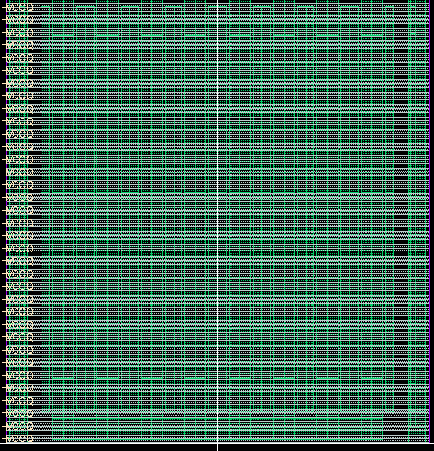
Power line design (1/2)
Horizontal power lines
Vertical power lines
We need to consider some points as following:
Metal structure of power line
Number of line
Number of metal for each line
Width of each metal layer
Spacing between each metal line
Purpose: Make sure the power line satisfy the spec (power resistance, DRC rule, EM-ESD, …)

Slide 7


Power line design (2/2)
How can we consider them?
Base on spec about cell size, process, position of each power supply, power line resistance, EM-ESD criteria, spacing for PAD terminal, drc rule, PDK we can consider as following:
PDK => Number of metal for each line
Power resistance, DRC rule => metal structure of powerline
Cell height, power line resistance, PAD terminal width, DRC rule => Number of line, width of each metal layer, spacing between each metal line
Example: Spec: cell height = 185um, cell width = 30, PAD terminal width = 4.5um, power resistance (mohm/um): VDD = 3.3, VSS = 2.5, VCCQ = 1.3, VSSQ = 1.6, PDK 1P7M_4X2Z. Don’t use M7 for power line
PDK 1P7M_4X2Z => can use M6->M4 for power line, M3->M1 for connection
Power resistance, DRC rule => metal structure
Cell height, PAD terminal width => total space for power line ≈ 185 – 4.5 = 181.5 um
Power resistance, cell width, number of metal for each line, DRC rule => 28 VDD lines, 37 VSS lines, 71 VCCQ lines, 58 VSSQ lines (M4 = 0.58um, M5 = 0.56um, M6 = 0.5um for each line)
EM-ESD criteria and floorplan of ESD device (next part) => number and width of vertical power line
Vertical metal connection
M6
M6
M6
V5
V5
More line
Small resistance
Not need vertical connection
V5
V5
Less line
Large resistance
Need vertical connection
M5
M5
M5
M5
V4
V4
V4
V4
M4
M4
M4
M4

Slide 8
Floor plan

Slide 9
Floorplan (1/7)
We need to consider some points as following:
Function, type and power supply voltage of each device/block => good power supply, prevent LUP error, easy and make strong connection, EM
Position of ESD device => better in ESD protection
Spacing rule for layer which require large space (NW, DNW, …) => enough spacing for wiring
Clean DRC (spacing, density) for lower layer => make sure the floorplan is fixed
Purpose: Make sure the floorplan is fixed, achievable, reduce error in verification phase as much as possible

Slide 10
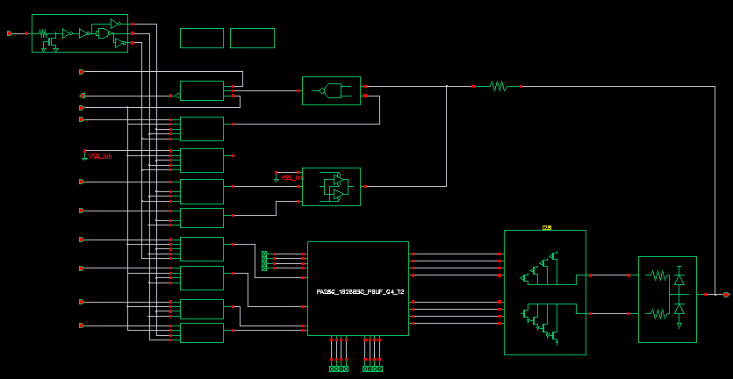
Floorplan (2/7)
Function, type and power supply voltage of each device/block
Position of ESD device
Project: T40LP MGA JADE
Lib name: TC40APA25G_4X2Z
Cell name: PA25GC33BA0EWAZ
How can we consider them ?
Level shifter part:
Function: change voltage level of signal from core domain to IO domain and vice verse
Have pin connect direct to core domain
Power supply: core (low) and IO (high)
=> Suggestion floorplan
+ Place in the top cell: easy for connecting to core side
+ Near core voltage power: better power supply
+ Separate P-type and N-type
Internal logic part
ESD devices
Output buffer part
PAD
Level shifter part

Slide 11
Floorplan (3/7)
How can we consider them ?
Internal logic part:
Function: Control to transfer signal from core domain to IO domain and vice versa
Power supply: IO voltage (VCCQ)
=> Suggestion floorplan
+ Place in middle of cell (below level shifter): easy for connecting to level shifter output buffer and ESD devices
+ Put near IO voltage power: better power supply
+ Separate P-type and N-type
Project: T40LP MGA JADE
Lib name: TC40APA25G_4X2Z
Cell name: PA25GC33BA0EWAZ
Internal logic part
ESD devices
Output buffer part
PAD
Level shifter part

Slide 12
Floorplan (4/7)
How can we consider them ?
Output buffer part:
Function: Main buffer for output path (I -> PAD) in signal cell.
Power supply: IO voltage (VCCQ)
Connect directly to PAD (need to consider latch-up)
=> Suggestion floorplan:
+ Place in bottom of cell:
- Make the distance between level shifter part (core voltage) and buffer part (IO voltage) largest to prevent LUP error
+ Put near IO voltage power: better power supply
+ Distance between PMOS and NMOS as large as possible: prevent LUP error
Project: T40LP MGA JADE
Lib name: TC40APA25G_4X2Z
Cell name: PA25GC33BA0EWAZ
Internal logic part
ESD devices
Output buffer part
PAD
Level shifter part

Slide 13
Floorplan (5/7)
How can we consider them ?
ESD devices:
Function: ESD protection
+ Resistance: prevent ESD current (from PAD) flow into output buffer and logic circuit
+ Diode: dis-charge ESD current (from PAD)
Power supply: IO voltage (VCCQ)
Connect directly to PAD (need to consider latch-up)
=> Suggestion floorplan:
+ Should place so that the ESD current must flow through ESD devices before flow into devices be protected
+ Diode => Place between PMOS and NMOS of output buffer: Make the distance between PMOS and NMOS larger
Project: T40LP MGA JADE
Lib name: TC40APA25G_4X2Z
Cell name: PA25GC33BA0EWAZ
Internal logic part
ESD devices
Output buffer part
PAD
Level shifter part

Slide 14
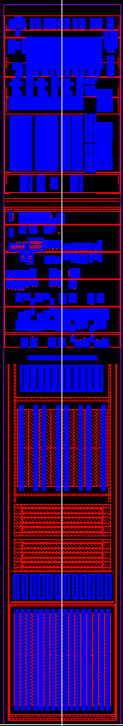
Floorplan (6/7)
Combine all of above factor we have following floorplan (T40LP MGA JADE):
Project: T40LP MGA JADE
Lib name: TC40APA25G_4X2Z
Cell name: PA25GC33BA0EWAZ
Level shifter part
VDD
Internal logic part
VSS
Internal logic part
VCCQ
ESD devices
VSSQ
Output buffer part
PAD
Resistor
Output buffer (NMOS)
VSSQ
ESD devices
(Diode)
Resistor
PAD
VCCQ
Output buffer (PMOS)
Level shifter part

Slide 15
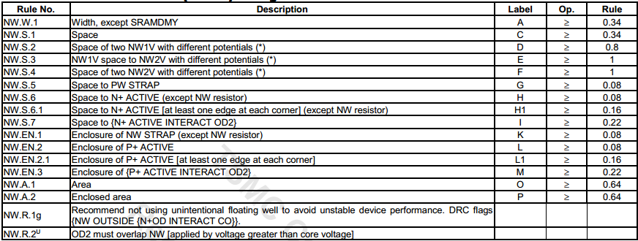
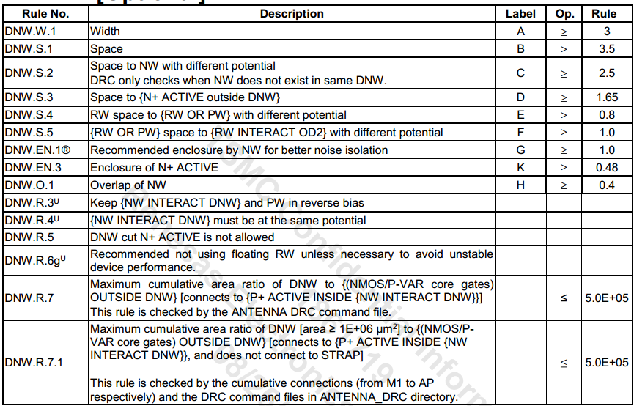
Floorplan (7/7)
Spacing rule for layer which require large space (NW, DNW, …)
Clean DRC (spacing, density) for lower layer
NW, DNW rules
(Document No. : TN45CLDR001_2_4
Version: 2.4)
How can we consider them?
Check devices structure => to know the layers of each device
Check design manual => to know the spacing rule, density rule
Run DRC => to make sure all lower layer have clean DRC

Slide 16
Connection

Slide 17
Connection (1/4)
We need to consider some points as following:
EM-ESD calculation
ESD net and high voltage net must be as large as possible
Purpose: Better in prevent ESD, improve current driving ability, reduce EM-SIGRA violation as much as possible

Slide 18
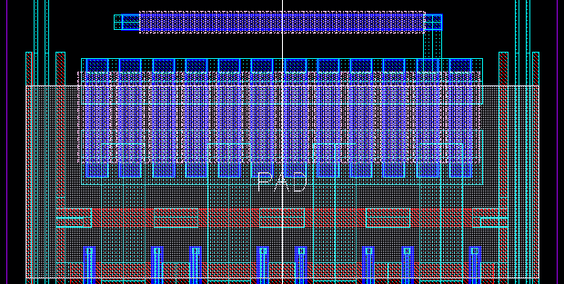
Connection (2/4)
How can we consider them ?
Connection from PAD to ESD devices:
Function:
+ Normal operation: transfer signal
+ ESD occur: flow ESD current from PAD to ESD devices
=> Suggestion connection:
+ Width: as large as possible
+ Via, contact: as much as possible
+ Resistance: as small as possible
+ EM-ESD: should have margin compare with Spec
Project: T40LP MGA JADE
Lib name: TC40APA25G_4X2Z
Cell name: PA25GC33BA0EWAZ
Connection from PAD to ESD devices
Logic connection
Output buffer connection
POWER
PAD
GND

Slide 19
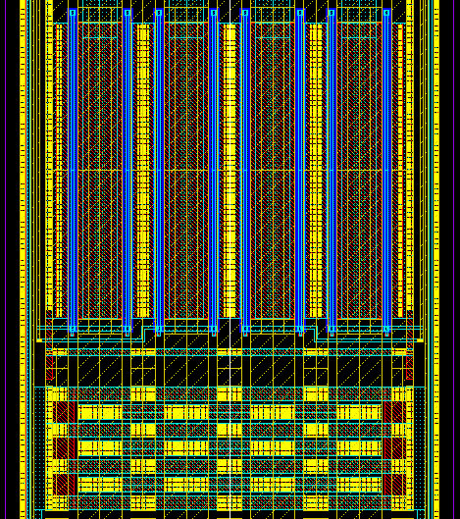
Connection (3/4)
GND connection
DRAIN connection
How can we consider them ?
Output buffer connection
Function:
+ Normal operation: current buffer
+ ESD occur: flow ESD current (smaller than ESD net due to have resistor in front of buffer)
=> Suggestion connection:
+ Width: as large as possible
+ Resistance: as small as possible
+ Via, contact: as much as possible
+ EM-ESD: should have margin compare with Spec
Output buffer/NMOS
Project: T40LP MGA JADE
Lib name: TC40APA25G_4X2Z
Cell name: PA25GC33BA0EWAZ
Net connected to ESD devices
Logic connection
Output buffer connection
GND Diode
POWER
PAD
GND

Slide 20
Connection (4/4)
How can we consider them ?
Logic connection
Function: logic control and transfer signal
=> Suggestion connection:
+ Width: based on voltage of each net. High voltage net need large width
+ Via, contact: as much as possible
+ Uniform in wiring (Ex: odd metal is vertical, even is horizontal)
Project: T40LP MGA JADE
Lib name: TC40APA25G_4X2Z
Cell name: PA25GC33BA0EWAZ
Connection from PAD to ESD devices
Logic connection
Output buffer connection
POWER
PAD
GND

Slide 21
Conclusion and further work

Slide 22
Conclusion (1/2)
This LnL just show common point we need to consider while layout signal cells. It is not total properly for all project. Some project, we can get good result for this part but the other is not so good and vice versa. In that case, we must trade off between them based on the priority and spec. If there is issue occur due to trade off, we must find the countermeasure to solve the issue.
Example about trade off in project T40LP CPX4 (next page)
 | Considering points | Suggestion
Power line | Metal structure Number of line, number of metal per line Width and spacing | PDK => Number of metal for each line Power resistance, DRC rule => metal structure of powerline Cell height, power line resistance, PAD terminal width, DRC rule => Number of line, width of each metal layer, spacing between each metal line
Floorplan | Level shifter part Internal logic part Output buffer part ESD devices | Place in the top cell; Put near core voltage power; Separate P-type and N-type Place in middle of cell (below level shifter); Put near IO voltage power; Separate P-type and N-type Place in bottom of cell; Make the distance between level shifter part (core voltage) and buffer part (IO voltage) largest; Put near IO voltage power; Distance between PMOS and NMOS as large as possible Should place so that the ESD current must flow through ESD devices before flow into devices be protected; Place diode between PMOS and NMOS of output buffer
Connection | from PAD to ESD devices; Output buffer connection Logic connection | Width: as large as possible; Via, contact: as much as possible; Resistance: as small as possible; EM-ESD: should have margin compare with Spec Width: based on voltage of each net. High voltage net need large width; Via, contact: as much as possible; Uniform in wiring (Ex: odd metal is vertical, even is horizontal)

Slide 23
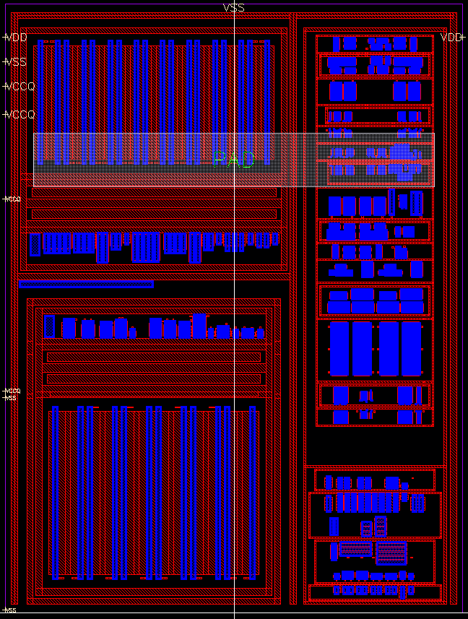
Conclusion (2/2)
Output buffer/ PMOS
Level shifter part
In this project, spec of cell height is 80um => do not have enough space to floorplan as above recommendation => must trade off to meet spec (80 um)
ESD devices + Output buffer + driver control: left side
Level shifter: right side (top)
Internal logic: right side (bottom)
Issue: ESD devices and output buffer near level shifter => Latch-up occur
Countermeasure => using double guard-ring and investigate LUP rules in design manual to have a properly spacing
PMOS diode
Driver control
NMOS diode
Output buffer/ NMOS
Internal logic part

Slide 24
Further work
This LnL just show common point we need to consider while layout signal cells. There are some point we need to make more detail in the future (by LnL or sharing document):
Power line resistance calculation
Latch-up prevention => What? When? Where? Why? How to prevent ?

Slide 25
Renesas System Design Co., Ltd.

