Slide 1
Negative bias temperature instability effect
Thao Tran
2014/05/23
© 2012 Renesas Electronics Corporation. All rights reserved.

Slide 2
OUTLINE
Introduction
Mechanism
Modeling
Effect
Countermeasure

Slide 3
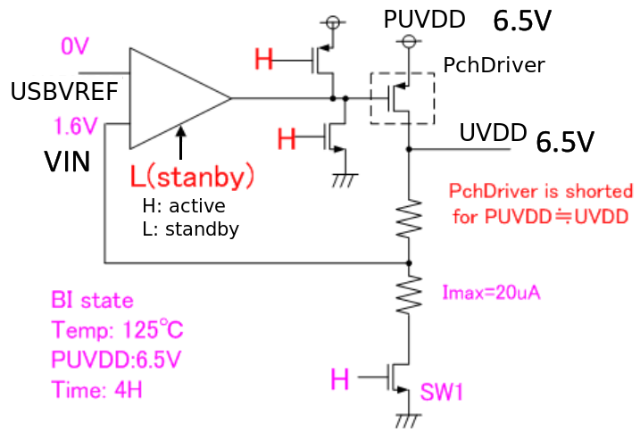
Introduction (1/3)
NBTI issue in USBVDC circuit
Burn In mode:
For NBTI, VIN is needed same as USBVREF. But, we do not have same voltage. So, VIN is as low as possible. The problem here is if SW1 is OFF, VIN is 6.5V while USBVREF = 0.
Different NBTI stress cause the mismatch in Vth of PMOS differential pair in amplifier. Then the circuit performance get worse.

Slide 4
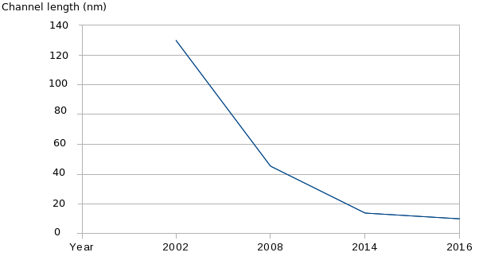
Introduction (2/3)
Challenge of scaling down process
Reliability issue
like NBTI
become severe
Scaling down CMOS process into 100nm regimes has brought about new reliability challenges in MOSFET device such as hot carrier injection, Negative Bias Temperature Instability (NBTI), Time Dependent Dielectric Breakdown TDDB...
NBTI in PMOS gets worse due to higher operation temperature and ultra thin oxide 10Å (higher oxide field).

Slide 5
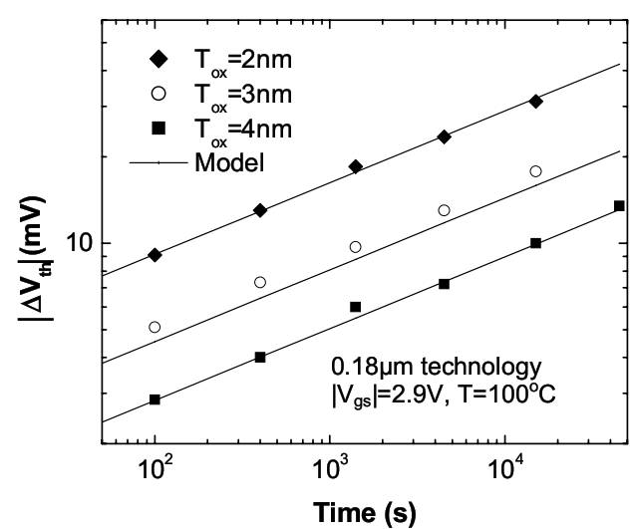
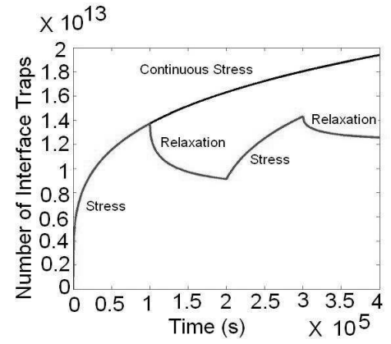
Introduction (3/3)
NBTI reliability issue
Negative-bias temperature instability (NBTI) is a key reliability issue in MOSFETs. NBTI manifests as an increase in the threshold voltage and consequent decrease in drain current and transconductance of a MOSFET.
Concern in p-channel MOS devices which always operate with negative gate-to-source voltage.
However, same mechanism also affects nMOS transistors when biased in the accumulation regime (w/i negative bias applied to the gate).
NBTI ~ stress time, temperature (100^{O}C – 250^{O}C), negative bias...

Slide 6


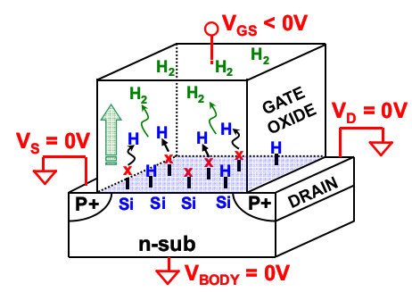
Mechanism (1/2)
Sub
Gate oxide
Gate
+
+
+
+
Si - H
Si
H
Stress
H, H₂
Recovery
Si - H
H, H₂
Sub
inv
Gate oxide
Gate
+
+
+
+
Si⁺
H⁺
Si⁺
H⁺
Si⁺
H⁺
H⁺
H, H₂
- +
Interface trap
Δv_{th} ~ N_{IT}

Slide 7
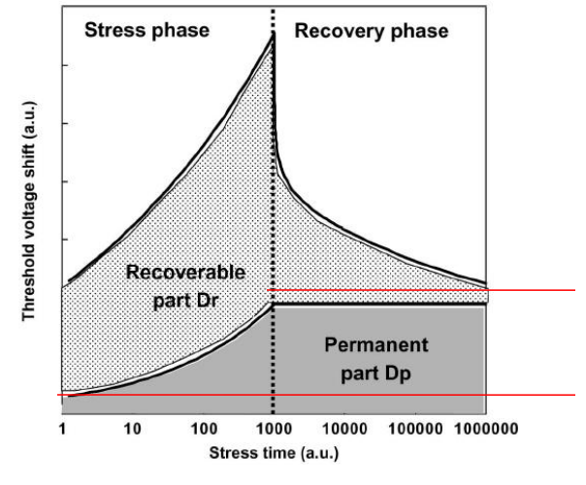

Mechanism (2/2)
NBTI has 2 phases:
Phase 1: Vg = 0 (Vgs = -VDD), positive interface traps are accumulation over the stress time with H diffusing towards the gate
-> “stress” or “static NBTI”.
Phase 2: Vg = VDD (Vgs = 0), hole are not present in the channel
-> no new interface traps are generated, H diffuse back and anneals the broken Si-H
-> number of interface taps is reduced & NBTI degradation is recovered
-> “recovery”.
V_{th} increased
Sub
Gate oxide
Gate
+
+
+
+
Si - H
Si
H
Stress
H, H₂
Recovery
Si - H
H, H₂

Slide 8
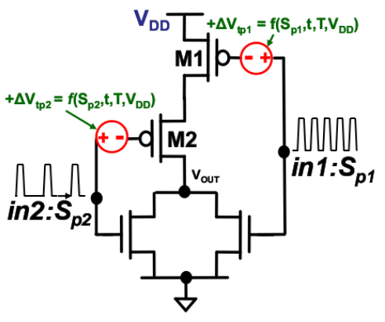
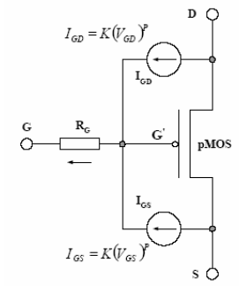
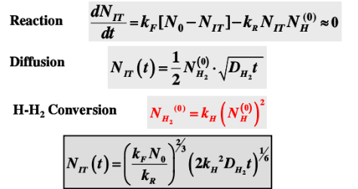
Modeling
Circuit simulation model:
NBTI represented as voltage source.
Reaction diffusion based model
MaCRO NBTI circuit model.

Slide 9
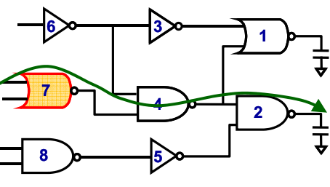
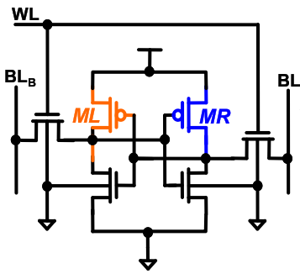
Effect
Threshold voltage increase
-> Drive current decrease
-> Delay increase.
-> Failure/error in Memory, CPU operation.
Threshold voltage change differently
-> Effect matching property (pair MOS).

Slide 10
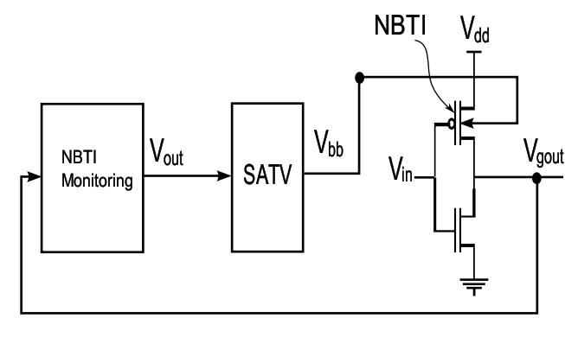

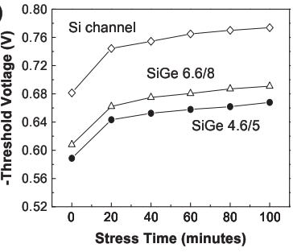
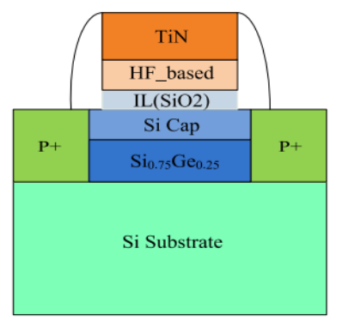
Countermeasure
  Self Adjusting Threshold Voltage
Power:
Power gating, Input vector control (duty cycle)...
Circuit design:
Sense & Correction, Gate/TR sizing...
Others:
Improve MOSFET structure...
Schematic of HfO₂ metal gate SiGe pMOSFET.

Slide 11
NBTI consideration for analog circuit
VCC
+ Normal operation : V_{IP} = V_{IN}
S1: L
S2: H
→ switches have influence ON circuit operation.
+ Standby operation:
S1: H
S2: L
→ Gate of M1 & M2 = VCC.
→ Vgs_{M1} = Vgs_{M2} = 0
→ can avoid mismatch degradation due to NBTI.
VCC
VCC
S2
S2
V_{IP}
S1
S1
M1
M2
V_{IN}

Slide 12
Thank you
© 2012 Renesas Electronics Corporation. All rights reserved.

Slide 13
Burn In
Burn-in is the process by which components of a system are exercised prior to being placed in service (and often, prior to the system being completely assembled from those components).
The intention is to detect those particular components that would fail as a result of the initial, high-failure rate portion of the bathtub curve of component reliability.
For electronic components, burn-in is frequently conducted at elevated temperature and perhaps elevated voltage.

Slide 14
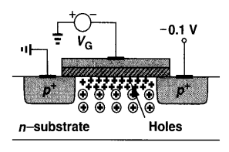
Threshold voltage
  The threshold voltage Vth is the value of the gate–source voltage when the conducting channel just begins to connect the source and drain contacts of the transistor, allowing significant current.

