Slide 1
Greenroom
A live-show director that learns from rehearsal
Jayesh Suyal + Omkar
Notes:
60-second pitch, slide 1
Greenroom turns an approved stage sequence into a reusable procedure, while checking what is true right now.
Sources and evidence
Source: docs/greenroom-architecture.md. Team: Jayesh Suyal and Omkar (oasb16).

Slide 2
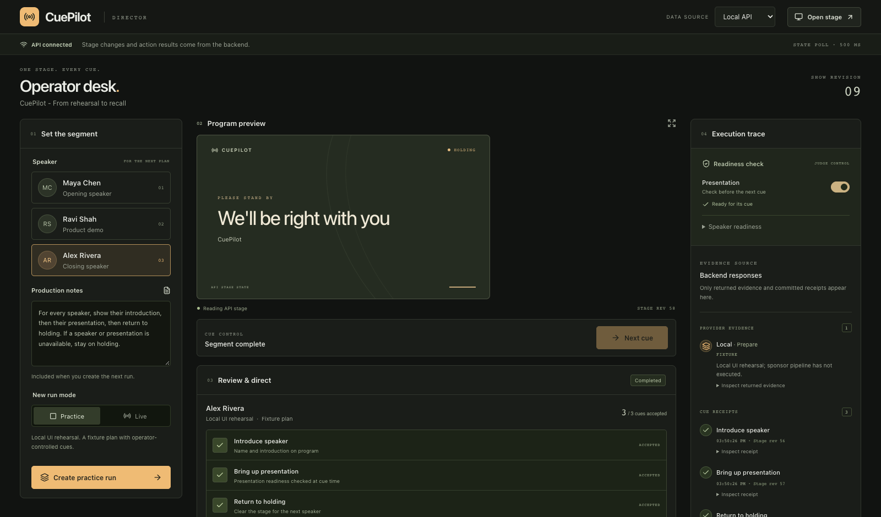
The plan is ready. Is the stage?
Slides can disappear
after the introduction.
The next cue must stop.
Operator desk (practice view)
Notes:
60-second pitch, slide 2
Live shows change between planning and execution. A missing presentation should stop the next cue, even after the introduction.
Sources and evidence
Source: docs/greenroom-architecture.md, interruption behavior. Screenshot, if present, comes from the actual Greenroom local app.

Slide 3
Greenroom system
Cognee
HydraDB (local)
Extracts rules
Stores graph + outcomes
RocketRide
Greenroom API
Modiqo / Rote
Orchestrates
Checks every cue
Records + replays
hotdata.dev
Queries fresh readiness
Operator approves the exact plan before execution
Notes:
60-second pitch, slide 3
Cognee extracts rules. Local HydraDB stores the graph. Hotdata checks fresh readiness. RocketRide orchestrates. Rote records and replays. Our API checks every cue.
Sources and evidence
Sources: docs/greenroom-architecture.md and docs/sponsor-readiness.md. Cognee hosted graph: 11 nodes and 16 edges. The graph is persisted and read back through local Hydra. All five live service paths passed at 22:35 UTC on 11 September 2026. Snyk is development security, not runtime cue authorization.

Slide 4
One procedure. Three live cases.
Maya
Learned the sequence
3 receipts
Ravi
Replayed the same package
3 new receipts
Alex
Lost slides after introduction
1 receipt
Presentation stopped. Stage held.
Live acceptance passed 11 September 2026, 22:35 UTC
Notes:
60-second pitch, slide 4
Maya learned three cues. Ravi replayed the same package with three new receipts. Alex lost slides after introduction: presentation stopped, and the stage held.
Sources and evidence
Source: docs/sponsor-readiness.md and greenroom/.runtime/acceptance/20260911T223543.936639Z_fb0d972f96f14eb996f96ffb7669e690.json. Maya and Ravi each had three matched canonical receipts. Alex retained one intro receipt and held the stage. This proves procedure reuse and interruption behavior. It does not establish latency, cost or quality improvement.

Slide 5
Approval stays in control
Exact plan approval
Current readiness
Verified receipts
212
backend tests passed
Snyk: 0 first-party source findings
6 dependency advisories open
1 critical, 3 high, 2 medium
Notes:
60-second pitch, slide 5
Operators approve the exact plan. We passed 212 backend tests. Snyk found no first-party source issues. Six dependency advisories remain open.
Sources and evidence
Sources: docs/greenroom-architecture.md, docs/sponsor-readiness.md and final backend test run evidence. 187 Python plus 25 Node tests equals 212 tests. Snyk source scan at 22:36 UTC, 11 September 2026: zero findings in first-party source scan scope. Six dependency advisories remain: one critical, three high, two medium. This does not establish an absence of vulnerabilities.

Slide 6
Learn the sequence.
Check the moment.
Reusable execution for changing shows.
Greenroom live demo
Jayesh Suyal + Omkar
Notes:
60-second pitch, slide 6
Greenroom reuses the procedure and checks the moment. That is the demo: learned execution with current-state control.
Sources and evidence
Source: docs/greenroom-architecture.md. Demo scope: one introduction, presentation and holding segment. Private repository: jayeshsuyal/greenroom. Local services and the authenticated bridge must remain running for this demo.

