Slide 1

IT8811- Project work
Future Navigation Demand Trends: Accurate Ride Request Forecasting Optimization Via Machine Learning
Final Review
Project Team
Naveen Raj S ( 312820205028)
Arun Kumar B ( 312820205006)
Guided By
Dr. G. A.SENTHIL
Associate Professor
Dept of IT
Agni College of Technology

Slide 2
Outline
Abstract and Scope
Introduction
Literature Review
Existing System
Proposed System
Hardware and Software Requirements
Methodology
References

Slide 3
Abstract
Transport Network Companies are represented by platforms such as Uber, Rapido, and Ola. In order to satisfy passenger requests, evaluate system efficiency, and improve service dependability, it is becoming more and more necessary to analyze large volumes of accessible information using big data technologies and sophisticated algorithms. there are number of issues facing the ride-hailing sector that affect the precision and effectiveness of the current systems. The demand for rides can be influenced by dynamic and non-linear elements including the weather, special events, and unforeseen catastrophes. Forecasting models get more difficult due to seasonality, trends, and the dynamic character of metropolitan surroundings. Moreover, privacy issues, the influence of legal changes, and data availability and quality all add to the difficulty of maximizing ride-hailing services. This study uses a trip request dataset to construct a model that uses data to predict the gap between passenger needs and driver supply in a specific time period and location. Important details in the dataset include the time of the trip booking, the pickup location, and the latitude and longitude of the drop point. Columns such as client ID, booking timestamp, pickup latitude, pickup longitude, drop latitude, and drop longitude are linked to each data point. Using a phone application, the traveler selects the origin and destination before touching the "Request Pickup" button to start a ride request In response to the inquiry, the driver grants the command. Even though the training is small in comparison to the ride-hailing sector as a whole, it is considered enough for pattern recognition. By utilizing data-driven insights to more fully comprehend and tackle current issues, close the gap between rider demand and driver supply, and ultimately raise the general effectiveness and dependability of these transportation services, the study seeks to improve ride-hailing systems.

Slide 4
Objective and Scope of the Project
Objective:
Improve the efficiency and reliability of ride-hailing services by predicting unmet demand (gap between rider requests and driver availability) in specific locations and timeframes.
Scope :
Develop a machine learning model using a trip request dataset.
The model will predict the demand gap based on features like:
Booking time
Pickup and drop-off locations
Utilize K-means clustering to identify patterns in demand based on these features.
Train an XGBoost model to predict the demand gap for specific locations and timeframes.
Evaluate model performance using Root Mean Squared Error (RMSE).

Slide 5
Introduction
The rise of Transportation Network Companies (TNCs) like Uber, Rapido, and Ola has significantly transformed urban mobility. However, a key challenge remains: unmet demand, the gap between passenger requests and available drivers. This unmet demand is often influenced by unpredictable factors like weather changes, special events, and unforeseen circumstances. Further complicating prediction are seasonal trends, evolving traffic patterns, and the dynamic nature of city environments. This project aims to leverage big data technologies and sophisticated algorithms to address this challenge. By analyzing large volumes of trip request data, we aim to build a model that predicts unmet demand for specific locations and timeframes. The model will consider factors like booking time, pickup and drop-off locations, and potentially leverage techniques like K-means clustering to identify demand patterns within the data. Ultimately, this project seeks to improve the overall efficiency and reliability of ride-hailing services by utilizing data-driven insights to bridge the gap between rider needs and driver supply.

Slide 6
Literature Review
Title: Ride-Hailing Demand Prediction
Ride-hailing services rely on demand prediction models, but these models often lack transparency on interpretability. Complex models might achieve high accuracy, but they can be "black boxes" that don't reveal the "why" behind predictions on deep learning models. This hinders efforts to improve resource allocation (e.g., driver positioning) based on demand insights. Additionally, real-time integration of existing models with ride-hailing platforms might be limited to integration challenges. This project focuses on a short-term approach to address these limitations. We aim to build a transparent and explainable model using techniques like K-means clustering. This initial phase lays the groundwork for future integration with platforms, ultimately aiming to improve service efficiency and reliability.
References:
G. Cantelmo, R. Kucharski and C. Antoniou: Focus on interpretability in demand prediction models
C. Guido, K. Rafal, and A. Constantinos: Deep learning for ride-hailing demand prediction
Z. Ara and M. Hashemi, : Challenges of integrating demand prediction models with platforms

Slide 7
Existing System
INACCURATE WAIT TIMES FOR RIDERS:
Traditional forecasting methods often rely on historical averages, which can be misleading. Unforeseen events, seasonal fluctuations, or even localized trends can cause sudden surges or dips in demand that the system fails to capture.
As a result, riders may be presented with inaccurate wait times. This can lead to frustration and a negative user experience. Riders might cancel rides if the wait time seems too long, impacting both rider satisfaction and driver earnings.
DRIVER INEFFICIENCY AND LOST REVENUE:
Inaccurate demand forecasting can lead to inefficient driver allocation. In areas with unexpectedly high demand, there might not be enough drivers available, resulting in longer wait times for riders and potential frustration.
Conversely, areas with predicted high demand that turn out to be lower might have an excess of drivers waiting for rides, leading to wasted driver time and lost potential income.

Slide 8
Existing System
IMPACT OF THE PROBLEM:
Decreased rider satisfaction: Riders frustrated with inaccurate wait times or long waits might switch to alternative transportation options.
Reduced driver earnings: Inefficient driver allocation can lead to lost potential income for drivers, impacting their overall satisfaction with the platform.
Negative impact on platform reputation: A reputation for inaccurate wait times and inefficient service can damage the ride-hailing platform's brand image and user base.

Slide 9
Proposed System
The current state of ride-hailing is plagued by inaccurate wait times and inefficient driver allocation, leading to frustration for both riders and drivers. These issues stem from limitations in traditional forecasting methods that rely on historical averages and fail to capture the dynamic nature of ride demand. Here, we propose a revolutionary solution – a machine learning-based demand forecasting system.
Imagine a sophisticated algorithm trained on a vast treasure trove of historical ride request data. This data goes beyond just pick-up and drop-off locations; it encompasses timestamps, potentially even anonymized passenger information, and could even integrate external data sources like weather forecasts or public event schedules. By feeding this rich data pool into a machine learning model, we unlock the power of pattern recognition and predictive analytics.
Think of the model as a highly skilled detective, meticulously analyzing historical data to identify patterns and trends. Did ride requests surge during a snowstorm last year? The model will remember. Do weekend mornings in a specific area consistently see a spike in airport rides? The model will learn this too. Over time, the model becomes adept at recognizing these patterns and relationships within the data, allowing it to not only predict future demand with greater accuracy but also adapt to new trends and changing circumstances.

Slide 10
Proposed System
This approach offers several advantages over traditional methods. Machine learning models can handle complex, non-linear relationships within the data. They can account for the impact of dynamic factors like weather or special events, leading to more realistic wait time estimates for riders. Furthermore, the model's ability to learn and adapt ensures that it can keep pace with seasonal trends and urban environment changes.
For instance, the model might learn that "early morning commutes" on weekdays have a consistently higher demand compared to weekends. It could also identify areas with limited public transportation options, where demand is likely to be higher during rush hour. This level of granularity allows for highly accurate predictions of future ride demand for specific times and locations, ensuring a smoother experience for riders.
Additionally, with a clearer picture of future demand, the platform can optimize driver allocation. In areas with predicted high demand, the model can trigger incentives or prioritize driver notifications, ensuring enough drivers are available to meet rider needs. Conversely, in areas with lower predicted demand, driver allocation can be adjusted to avoid an excess of waiting drivers. This not only improves rider wait times but also maximizes earning potential for drivers, creating a win-win situation for all stakeholders.
In essence, this proposed system represents a paradigm shift in ride demand forecasting. By leveraging the power of machine learning, we can move away from static predictions and towards a dynamic, data-driven approach that unlocks the potential for a smoother, more efficient, and ultimately more satisfying ride-hailing experience for both riders and drivers.

Slide 11
Hardware and Software Requirements
Developing Kit
 | Processor | RAM | Disk Space
VISUAL-STUDIO CODE & GOOGLE COLAB | Computer with a 2.6GHz processor or higher | 2GB | Minimum 20 GB
Database
MySQL 5.0 AWS CLOUD SERVICE | Intel Pentium processor at 2.6GHz or faster | Minimum 512 MB Physical Memory; 1 GB Recommended | Minimum 20 GB

Slide 12
Hardware and Software Requirements
Software Requirements
Programming Language : Python, Scikit, Pandas, Pycharm, Google Colab.
Development Environment : Google Co-Lab, IDE, Jupyter NB
Additional Consideration : OS (Windows, MacOS, Linux)
Database : MySQL5.6.12-log, AWS

Slide 13
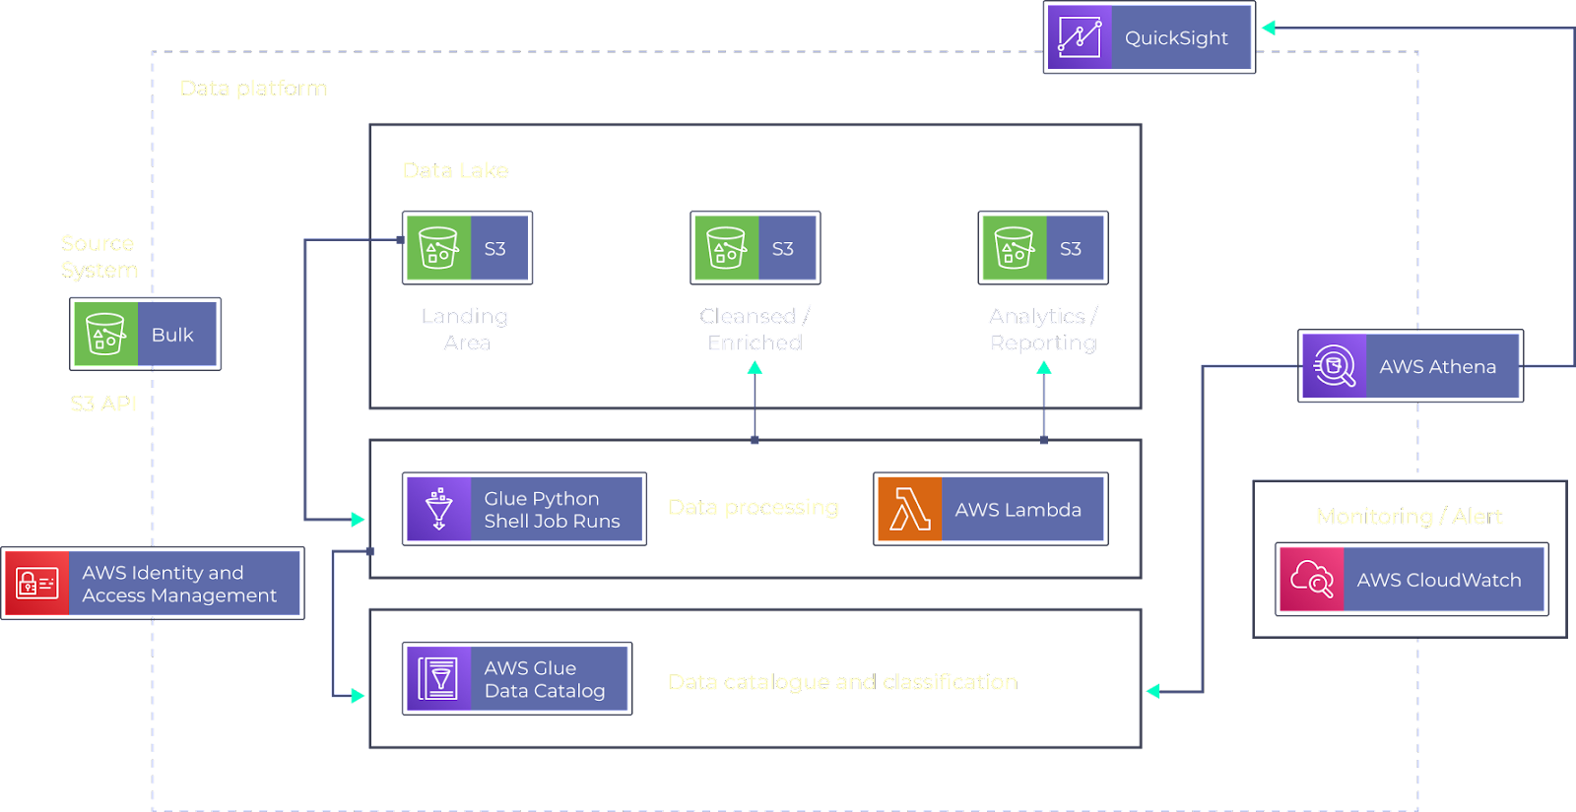
ARCHITECTURE DIAGRAM

Slide 14
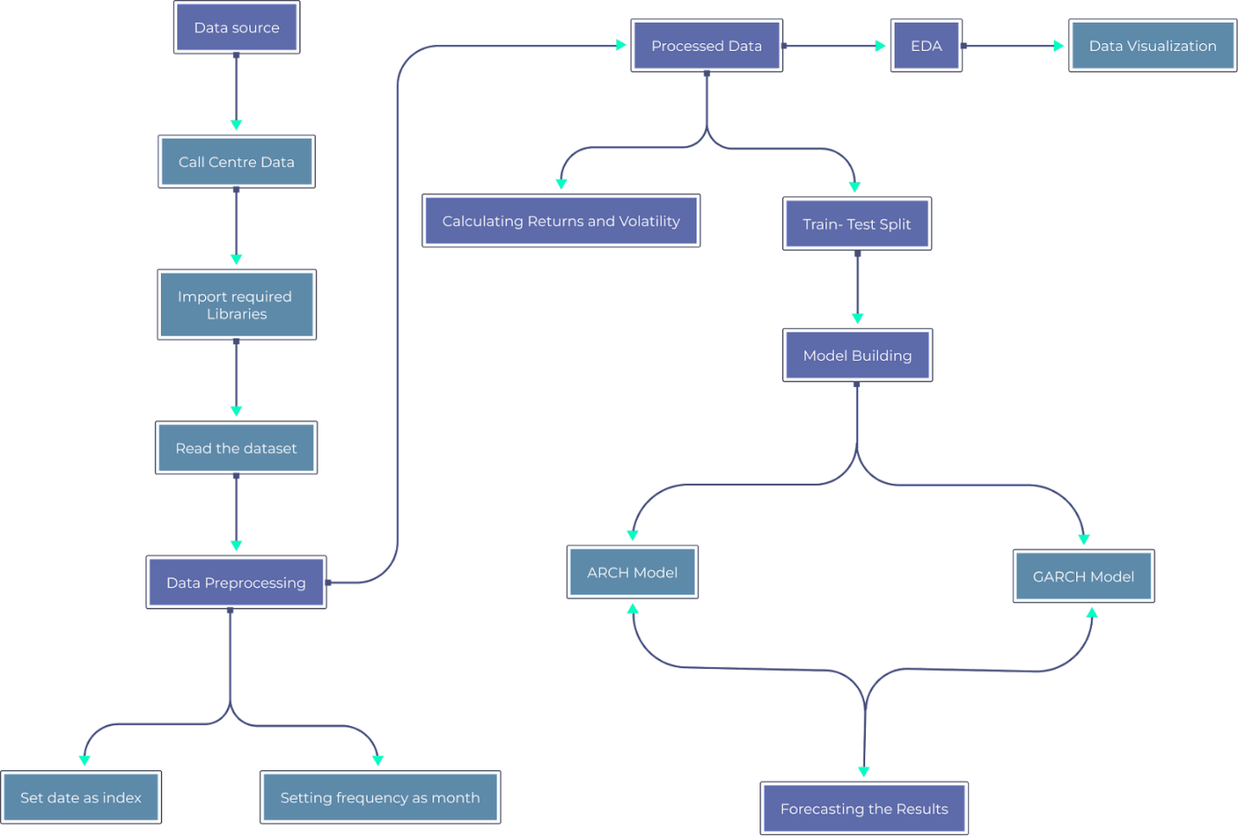
DATA FLOW DIAGRAM

Slide 15
Methodology
Ride-hailing services are losing money and market share to rivals as a result of their inability to meet the needs of numerous customers about their trips. A unique methodology is proposed to estimate.
Dataset: A dataset was employed in this investigation. The booking trip time, start point location, and end point latitude/longitude would all be included in this information. There are several data points pertaining to ride requests. The customer's ID, the booking time stamp, the starting point latitude, the starting point longitude, the ending point latitude, and the ending point longitude are the multiple columns of the dataset.
Data Assumption: The data must first be preprocessed to ascertain the real estimated demand by consumers in order to build a prediction model for the demand for rides in a certain location at a given time. In order to assess the true demand, I removed ride requests that were highly likely to cause issues. geospatial engineering was required since geographical data cannot be used for demand forecasting operations. It would take hours of CPU time to cluster 4 million data points using ordinary K-means. Thus, using a method called "Mini Batch K-means Clustering," we have separated Bangalore into 50 different zones.

Slide 16
Methodology
Train Set Test Split: The multiple data and test sets using the train test split technique. The data must first be separated into features (X) and labels (y). The data frame is split up into four sections: y_train, y_test, X_train, and X_test. The models are fitted and trained using the X_train and y_train sets. To determine if the models are correctly predicting the outputs and labels, utilize the X_test and y_test sets. We are capable to execute the train and test sets’ size explicit. Sample set: To provide an accurate assessment of the final model fit, a subset of the providing practices dataset is used as the test dataset.
Validation set: When adjusting the model's hyper-parameters, a validation dataset is a sample of data taken from the practice set of your model that is used to measure model performance.

Slide 17
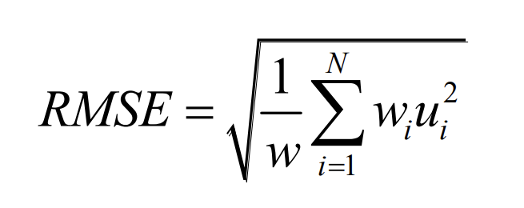
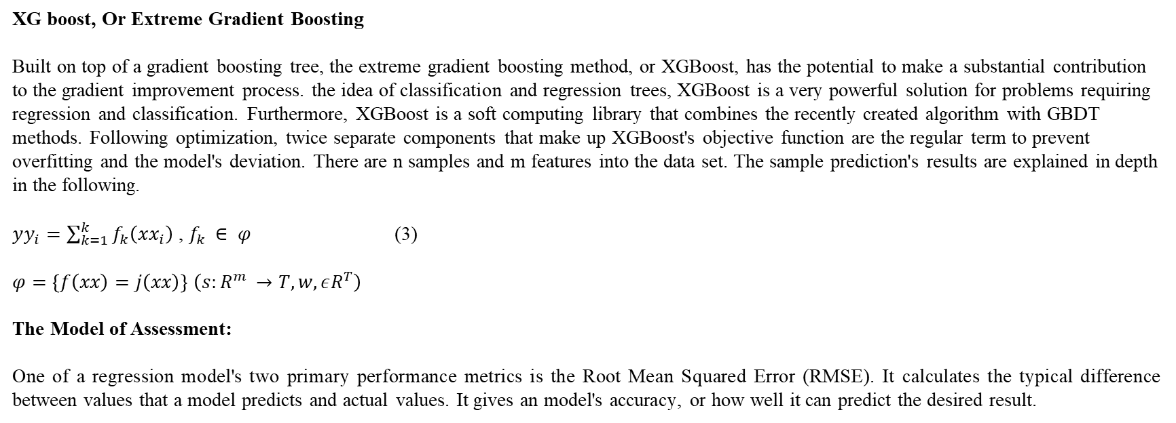
Methodology
XG boost, Or Extreme Gradient Boosting Built on top of a gradient boosting tree, the extreme gradient boosting method, or XGBoost, has the potential to make a substantial contribution to the gradient improvement process. the idea of classification and regression trees, XGBoost is a very powerful solution for problems requiring regression and classification. Furthermore, XGBoost is a soft computing library that combines the recently created algorithm with GBDT methods. Following optimization, twice separate components that make up XGBoost's objective function are the regular term to prevent overfitting and the model's deviation. There are n samples and m features into the data set. The sample prediction's results are explained in depth in the following.
$yy_{i}=\sum_{k=1}^{k}{f_{k}\left(xx_{i}\right)}$ , $f_{k }∈ φ$ (3)
$φ=\left\{f\left(xx\right)=j\left(xx\right)\right\}$ $\left(s:R^{m }→T,w,εR^{T}\right)$
The Model of Assessment:
One of a regression model's two primary performance metrics is the Root Mean Squared Error (RMSE). It calculates the typical difference between values that a model predicts and actual values. It gives an model's accuracy, or how well it can predict the desired result.

Slide 18
References

Slide 19
Thank You

