Slide 1
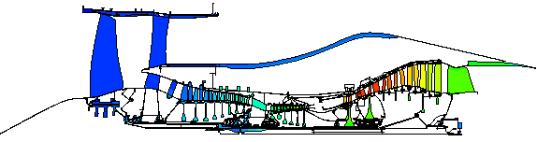
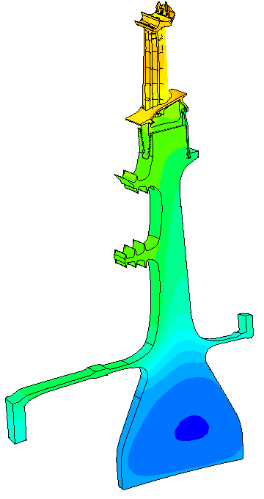
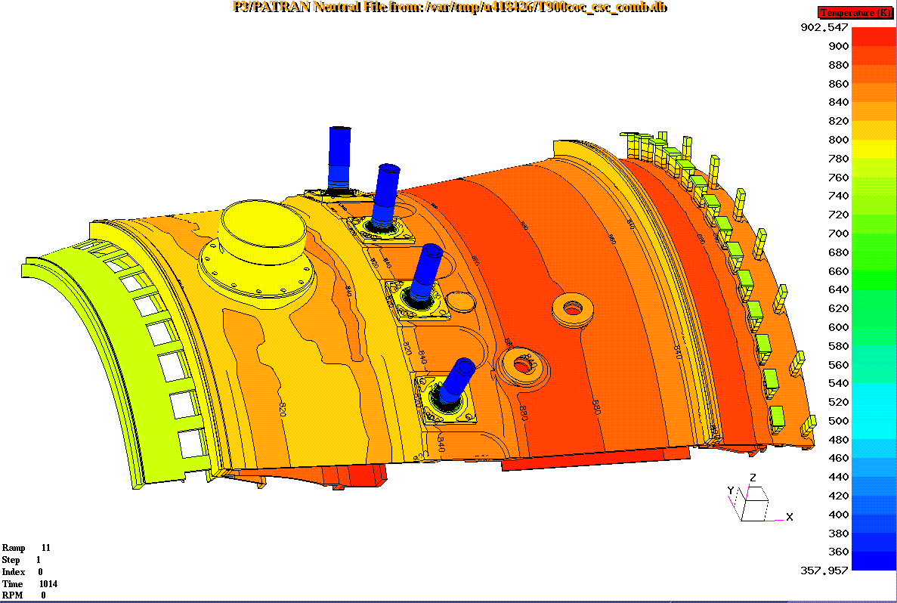
Heat Transfer Course
Heat transfer fundamentals and Thermo-mechanical analysis using SC03
SAP Number 50069218

Slide 2
Course Aim
The aim of this course is to provide an understanding of the fundamentals of heat transfer and to apply this to calculate component temperatures

Slide 3
Course Objectives
By the end of the training you will be confident with :
  Conduction, convection and radiation
    description and hand calculations
  Approximate temperature analysis and scaling
    methodology and hand calculations
  Thermal boundary conditions in SC03
    what, when and how to use them

Slide 4
Course Content
PART 1 (Fundamentals)
Introduction
Conduction
Convection
Radiation
Approximate analysis
Temperature scaling
Intro to finite elements
PART 2 (Application)
Thermal boundary conditions
Advection & mixing
Absolute & relative temperatures
Entrainment & windage
Examples of models
Validation
Displacement analysis

Slide 5
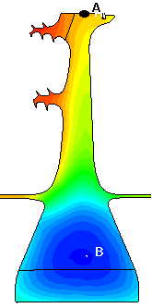
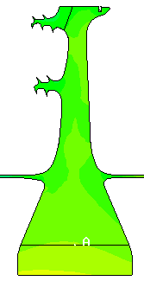
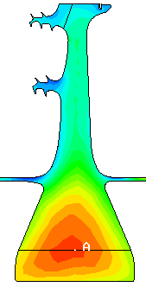
What is Thermo-mechanical Analysis ?
Prediction of component temperatures
Analysis of component stresses
Analysis of engine movements
Clearance optimisation
Without thermal stresses
With thermal stresses

Slide 6
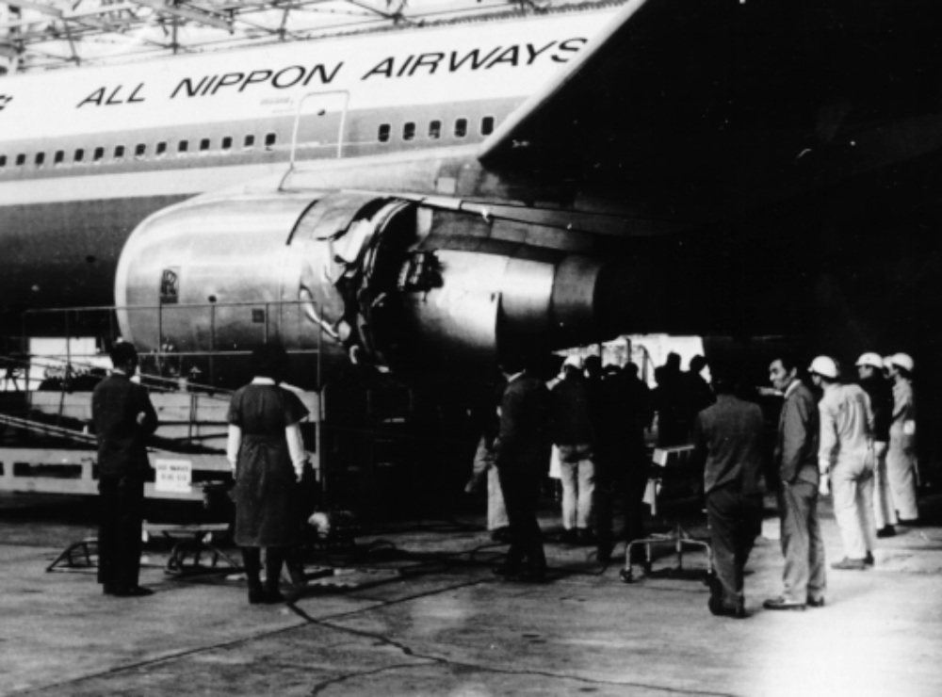
Why is Thermo-mechanical Analysis Performed ?
Thermo-mechanical analysis supports many issues :
  Integrity
  Lifing
  Cost
  Weight
  Performance

