Slide 1
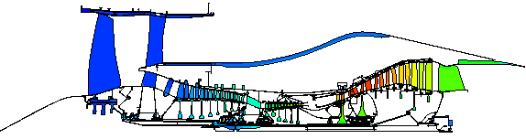
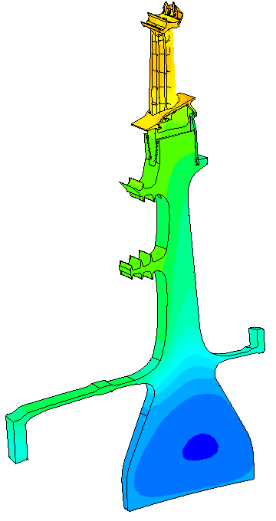
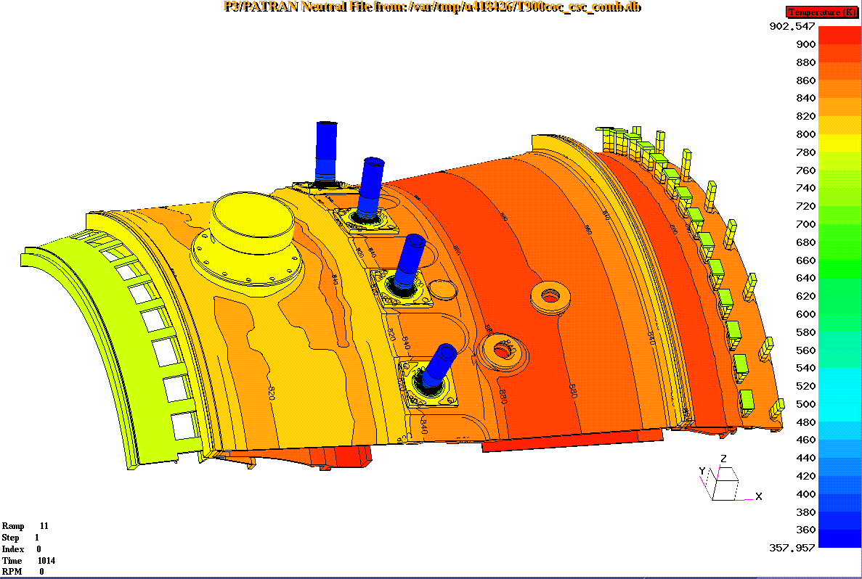
Heat Transfer Course - Part 2
Thermo-mechanical Analysis
Using SC03

Slide 2
Course Content
What is thermo-mechanical analysis
Fundamentals of heat transfer
Approximate temperature analysis & scaling
Introduction to finite element analysis
Thermal boundary condition types
Defining the cycle
Absolute & relative temperatures
Windage & entrainment
Practical examples
Validation (matching)
Displacement analysis

Slide 3
Units
QUANTITY
UNIT
Geometry
mm
Rotational Speed
rads/sec
Temperature
K
Conductivity
mW/mm/K
Specific Heat
mJ/Mg/K
Mass Flow
Mg/sec
Heat Transfer Coef
mW/mm²/K
Power Input
mW
Heat Pick-up
mW/mm²
Time
sec

Slide 4
Thermal Boundary Conditions
Convecting Zones
Thermal Voids
Thermal Streams
Thermal Ducts
External Radiation
Internal Radiation
Thermal Contact

Slide 5
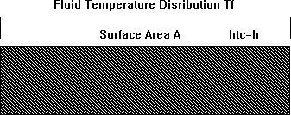
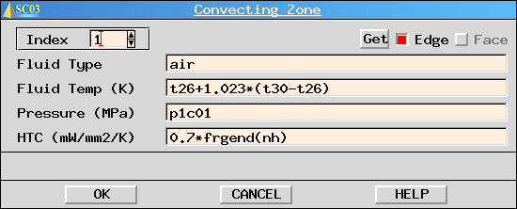

Convecting Zones
Used where fluid temperature is known
Region of infinite heat capacity

Slide 6
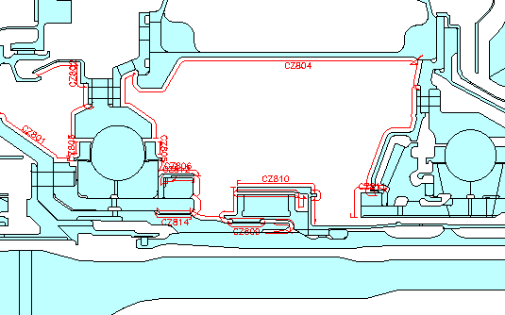
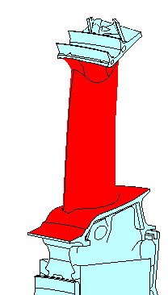
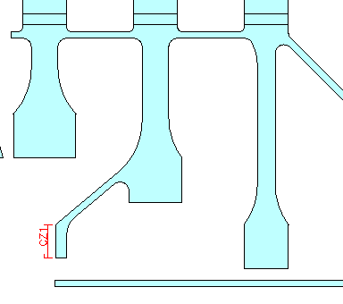
Convecting Zones (examples)

Slide 7
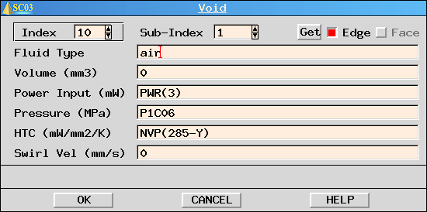
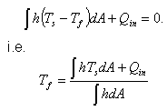
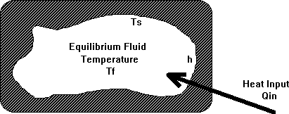
Thermal Voids
Region at uniform temperature
Region of negligible heat capacity
Influenced completely by surroundings

Slide 8
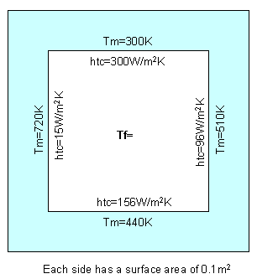
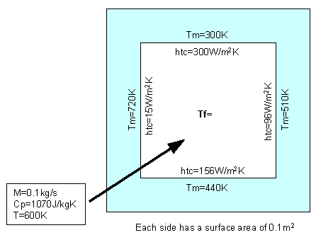
Thermal Voids (exercise)
Calculate the void temperature for the two cases below:

Slide 9
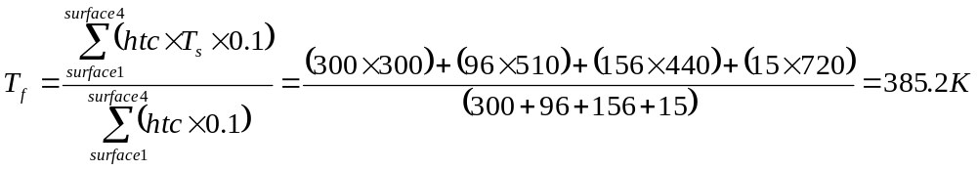
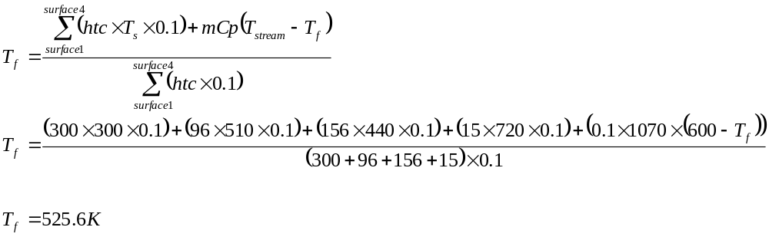
Thermal Voids (exercise - answers)
No external heat source
With external heat source

Slide 10
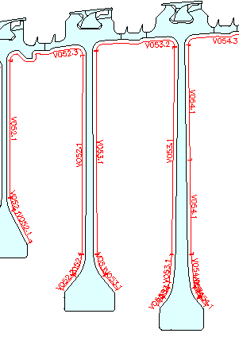
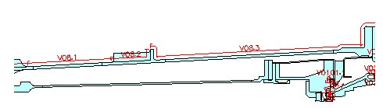
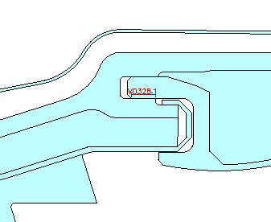
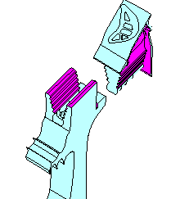
Thermal Voids (examples)

Slide 11
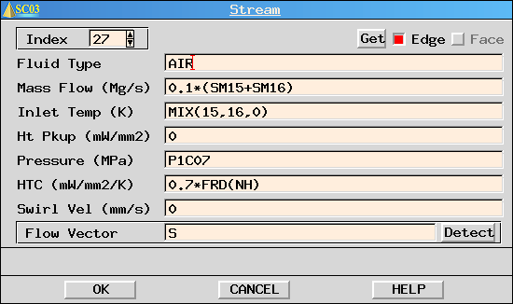
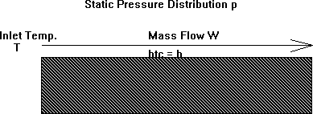
Thermal Streams
Used to model a finite flow of fluid
Stream has a finite heat capacity
Temperature rise = f(heat capacity,convection,HPU)

Slide 12
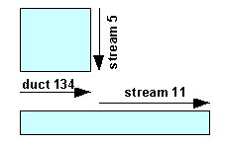
Thermal Streams (mixing)
Mixing of streams using an enthalpy balance
(mCpT)₁ + (mCpT)₂ + (mCpT)₃ … = (mCpT)_{mix}
Stream 11
T = mix(5,-134,0)

Slide 13
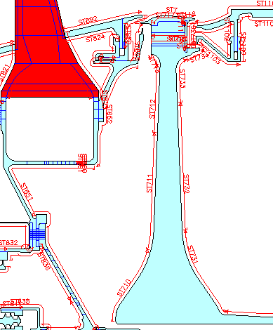
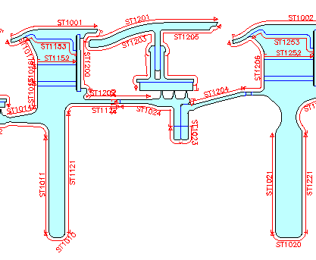
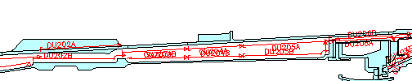
Thermal Streams (examples)

Slide 14
Thermal Streams (exercise)
For the stream SC03 model
  Vary the stream mass flow
    1E-5, 5E-5, 1E-4, 4E-4, 1E-3, 1E-2 Mg/s
  Vary the stream heat transfer coefficient
    0.01, 0.1, 0.3, 0.7, 1.0, 3.0 mW/mm²K
For each of the above, look at the effect on the stream temperature rise

Slide 15
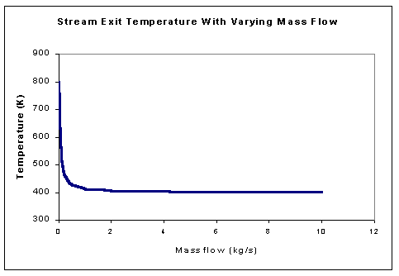
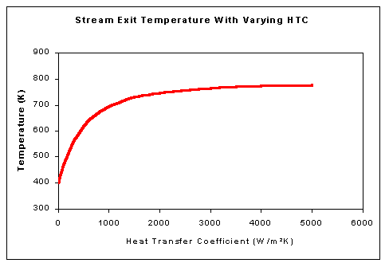
Thermal Streams (exercise - answers)

Slide 16
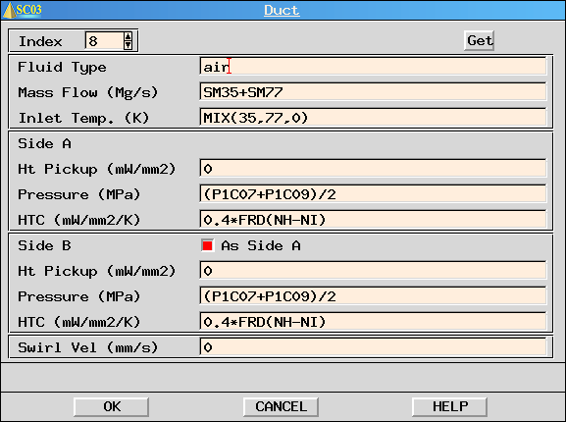
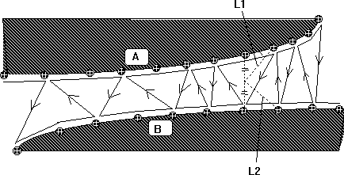
Thermal Ducts (2D only)
Similar to a stream except that energy can be exchanged between surfaces

Slide 17
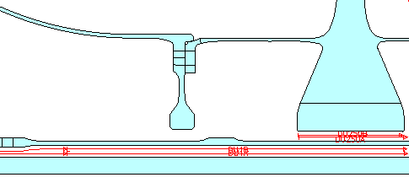
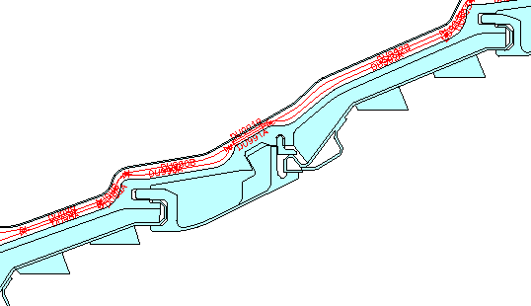
Thermal Ducts (examples)

Slide 18
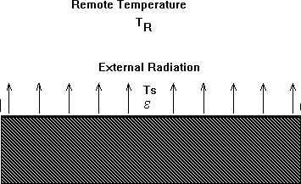
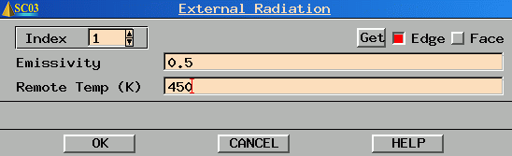
External Radiation
Used to account for radiation from a remote source

Slide 19
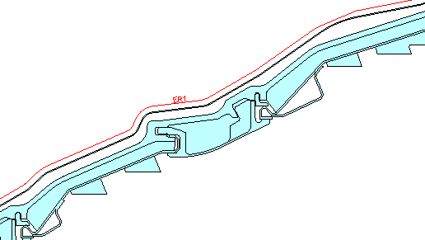
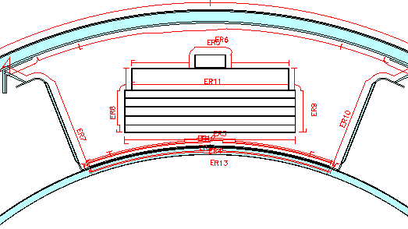
External Radiation (examples)

Slide 20

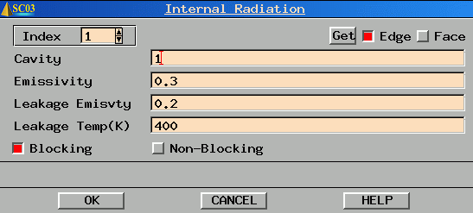
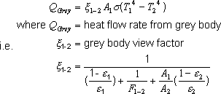
Internal Radiation
Regions that can transmit and receive radiation from themselves and each other

Slide 21
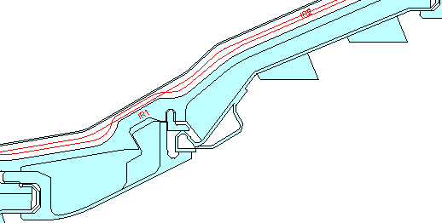
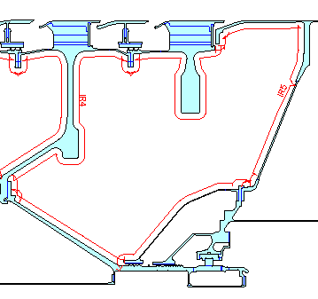
Internal Radiation (examples)

Slide 22
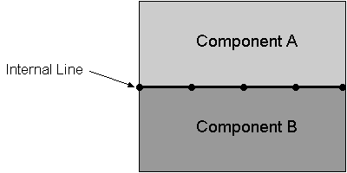
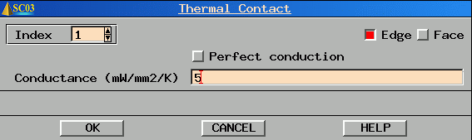
Thermal Contact
Used to restore full or partial conduction across an interface
Partial conduction caused by small scale irregularities at the interface

Slide 23
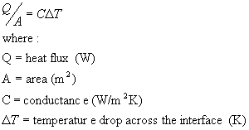
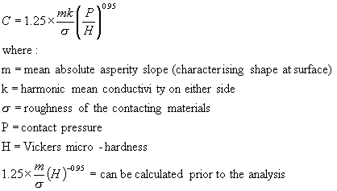
Thermal Contact
Equation
Conductance

Slide 24
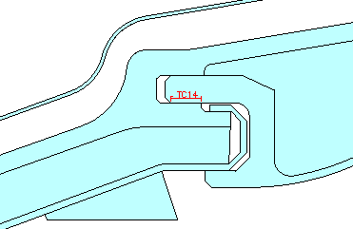
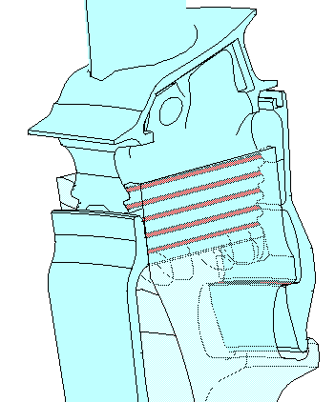
Thermal Contact (examples)

Slide 25
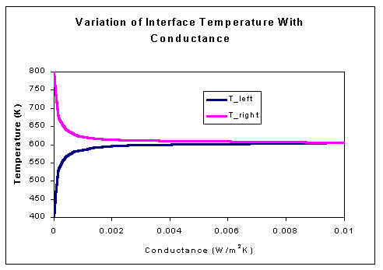
Thermal Contact (exercise)
Using the Thermal Contact SC03 model, vary the conductance and look at the effects on interface temperature.

Slide 26
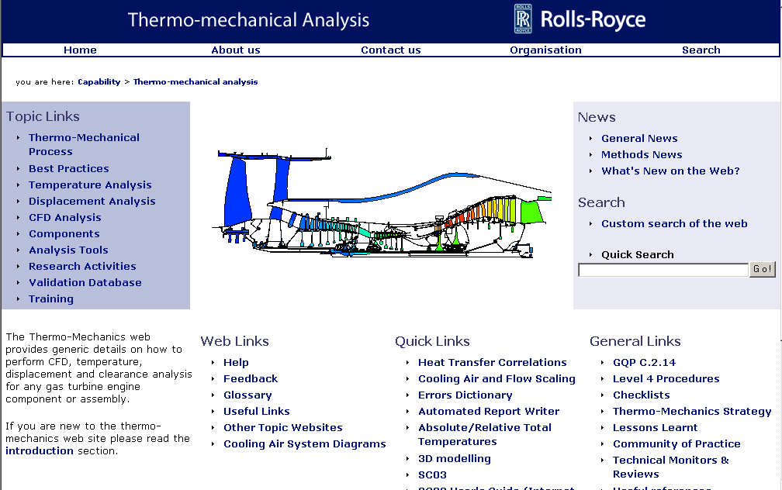
Thermo-mechanics Web

Slide 27
What to put in the Panels ?
Fluid Temperatures
Mass Flows and Pressures
Heat Transfer Coefficients
Interdependencies
Defining the Cycle
Absolute/Relative Temperatures
Entrainment and Windage

Slide 28
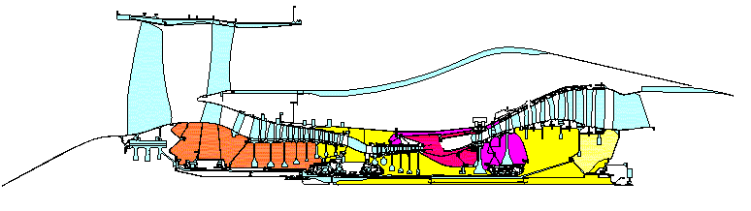
Fluid Temperatures
Main gas path
  from external source (Q263, CFD etc)
Secondary air system
  temperature only specified at the source
  subsequent temperatures calculated automatically

Slide 29
Mass Flows and Pressures
Main gas path
  Pressures
    from external source (Q263, CFD etc)
  Mass flows
    generally from performance analysis
Secondary air system
  Mass flows and pressures from a flow program (e.g. SPAN)

Slide 30
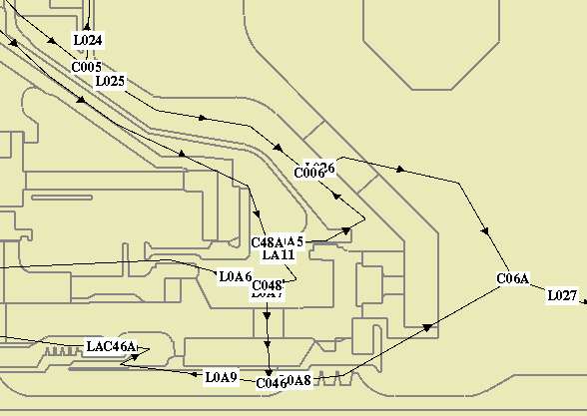
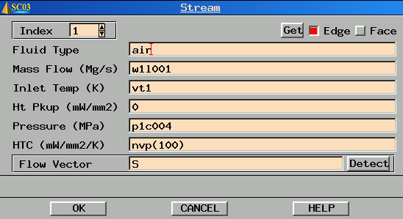
Mass Flows and Pressures

Slide 31
Heat Transfer Correlations
Standard correlations built into SC03
  Natural convection - plates and cylinders
  Forced convection - ducts and plates
  Forced convection - rotating flow
  Forced convection - impingement
  Forced convection - labyrinth seals
Based on air as the fluid

Slide 32

Natural Convection - Plates & Cylinders
Natural Convection driven by Buoyancy Forces
For rotating components, g is replaced with rω²
Nu = f(Gr,Pr)

Slide 33

Natural Convection (examples)
nus(1000)

Slide 34

Forced Convection - Ducts & Plates
Characteristics of the boundary layer dictate the heat transfer
Nu = f(Re,Pr)

Slide 35


Ducts & Plates HTC - entry lengths
The forced convection in a duct correlation includes an entry length effect
Exercise
  using the example from Part 1, vary the entry length in the forced duct
  correlation from 1 to 1000mm
  Use both FCD and NUN
  correlations.

Slide 36

Entry Length Exercise - Answers
Nunner correlation (NUN) is recommended for forced convection in a duct
FCD
NUN

Slide 37

Ducts & Plates HTC (examples)
nun(45100,32,400)
nun(78.5,10,5.5)
nun(1082000,55,78)

Slide 38

Forced Convection - Rotating Flow
Rotating System similar to ducts and plates in many ways.
Nusselt number a function of ROTATIONAL Reynolds Number
Nu = f(Re,Pr)

Slide 39

Rotating Flow HTC (examples)

Slide 40

Thickness Properties and HTC Factoring
Consider 'n' holes on a pitch circle diameter:
  Diameter of holes:
    D = r_{o}- r_{I}
  Pitch circle radius:
  r_{m} = (r_{o}+ r_{i})/2
  Calculate the actual volume of ‘n’ holes
    V_{act} = (π.D²/4).t.n
  Calculate the swept volume between
  r_{o} and r_{i}
    V_{swept} = π.(r_{o}²-r_{i}²).t
  Calculate the fraction of air
    X_{air} = V_{act}/V_{swept}
  Hence, calculate the fraction of material
    X_{mat} = 1- X_{air}
Thickness property = X_{mat}.2.pi.r_{m}

Slide 41
Thickness Properties and HTC Factoring (2)
Since Q=hAΔT, altering the ‘h’ value has the same effect as altering the area:
  HTC Factor, f = A_{act} / A_{SC03}
  Q =h. (A_{act} / A_{SC03}). A_{SC03.}ΔT
Surface area at r_{o}:
  (2π.r_{o}+TP).t
Total wetted area calculated by SC03 is :
  A_{SC03}=(2π.r_{o}+TP).t+(2π.r_{i}+TP).t
The actual wetted area for ‘n’ holes on the pitch circle is:
  A_{act}=π.D.n.t
HTC Factor, f = A_{act} / A_{SC03}

Slide 42

Thickness Properties and HTC Factoring (exercise)
Calculate the Thickness Property and ‘geometric’ factor to be applied to the heat transfer coefficient.
Number of holes = 30
r_{o} = 340mm
r_{i} = 320mm

Slide 43


Thickness Properties and HTC Factoring (exercise answers)
Thickness property calculation
Geometry factor calculation

Slide 44

Interdependencies
SC03 allows for interdependencies of mass flows, temperatures and pressures

Slide 45

Interdependencies (example)
Fill in the gaps in the diagram below:

Slide 46
Thermal Streams (mixing)
Mixing of streams using an enthalpy balance
(mCpT)₁ + (mCpT)₂ + (mCpT)₃ … = (mCpT)_{mix}
m=sm2/2
T=st2
HTC, HPU,P=0
stream 1
stream 3
stream 4
Stream 3
T = mix(1,4)
stream 2

Slide 47



Defining the Cycle
In most cases, transient temperatures are required for a number of cycles
The model must be made independent of cycle

Slide 48

Defining the Cycle
The model can be made independent of cycle by relating the boundary conditions to main gas path parameters

Slide 49




Defining the Cycle

Slide 50

Defining the Cycle – Global Control
Defines the type of analysis
  thermal, thermo-mechanical, structural
Additional thermal
control
  time stepping accuracy
  refinement accuracy
  base parameters

Slide 51


Defining the Cycle – Thermal Control
Time stepping accuracy
  controls the automatic
  time stepping

Slide 52

Defining the Cycle – Thermal Control
Refinement accuracy
  controls the mesh refinement (adaption)

Slide 53

Defining the Cycle – Thermal Control
Base parameters
  modification of parameters at low
  engine speeds (usually at start)
  avoids mathematical instabilities

Slide 54



Absolute & Relative Temperatures
Static Components
Rotating Components
where:
T_{abs}=absolute Total temperature
t = static temperature
v_{abs} = absolute velocity
c_{p} = specific heat capacity
where:
T_{rel}=relative Total temperature
t = static temperature
v_{rel} = relative velocity
c_{p} = specific heat capacity
Defining the swirl fraction,β=v/rω gives

Slide 55

Absolute & Relative Temperatures
Problems occur when there is interaction between rotating and static components

Slide 56
Absolute & Relative Temperatures (exercise)
Calculate T_{rel} (i.e. the temperature that the rotor ‘sees’).
Assume:
  Disc speed is 700 rad/s
  Bulk air in the cavity is rotating at 0.3xdisc speed
  Temperature reading on the stationary thermocouple is 600K
  Radius of the thermocouple is 400mm
  Cp=1000 J/kg/K

Slide 57

Absolute & Relative Temperatures (exercise answers)

Slide 58

Use of CFD
Used as an aid to a
conventional FE analysis
Fully Coupled
FE/CFD analysis

Slide 59

CFD to Support Conventional FE Analysis
Stand-alone CFD analysis performed
Used to choose type and position of b.c’s in the FE model
Used to choose htc correlations and factors
& windage

Slide 60




CFD to Support Conventional FE Analysis
0.31
0.19
758K
788K
stator
rotor
0.03
700K
705K
Stream Functions
(shows flow pattern)
Swirl Ratio
Absolute Total
Temperature
Relative Total
Temperature

Slide 61
Conventional boundary conditions removed and replaced with input from CFD
T_{m1}-T_{m2}

Slide 62


Fully Coupled FE/CFD Analysis
Conventional boundary conditions removed and replaced with input from CFD

Slide 63

Windage
Velocity profile in boundary layer
Disc surface
  air rotating at disc speed
Outside the boundary layer
  main body of air rotating at a different speed
Shearing of the air causes a temperature rise – windage (or frictional) heating

Slide 64





Windage
Conservation of angular momentum:
Multiply by disc speed to give work:
also:
recalling that:
with a knowledge of absolute total temperature and swirl, relative total temperature can be calculated

Slide 65
Windage (exercise)
For the windage SC03 model, determine the temperature rise due to windage in each of the two streams.
  Which stream has the largest temperature rise and why?
Vary the stream mass flows and then the disc rotational speed.
  Which has the greatest effect?

Slide 66


Windage (exercise answers)

Slide 67


Entrainment
When a disc or cone is rotated, the CF forces induced in the fluid cause it to move radially outwards, which in turn entrains more air to replace it.

Slide 68
The Final Straight
Practical Examples of Modelling
Thermal Model Validation (matching)
Displacements Analysis

Slide 69
Practical Examples of Modelling
For each of the following cases, choose what type of boundary condition should be applied and what type of heat transfer correlation:
  LP Turbine Assembly
  HP Turbine Disc
  IP Compressor Assembly
  HP Compressor Assembly

Slide 70

LP Turbine Assembly

Slide 71


LP Turbine Assembly (answers)

Slide 72

HP Turbine Disc

Slide 73

HP Turbine Disc (answers)

Slide 74

IP Compressor Assembly

Slide 75

IP Compressor Assembly (answers)

Slide 76

HP Compressor Assembly

Slide 77

HP Compressor Assembly (answers)

Slide 78
Thermal Model Validation
The true test of the quality of a model is when it is compared to real, measured data
Only when the model has been validated can temperature predictions for any cycle be relied upon.
The validation process has 4 main steps :
  Production of a test specification
  Test data reduction
  Initial model production
  Model matching

Slide 79

Test Specification
Defines measurements
  what
  where
  what accuracy
Defines Test Cycles
  square cycle
  performance curve

Slide 80
Temperature Measurements
Thermocouples
  Advantages
    accurate
    transient capability
    record for any cycle
  Disadvantages
    intrusive
    discrete
    prone to failure
    expensive
    time consuming to build
    available later in dev prog
Thermal Paint
  Advantages
    large area coverage
    visual temp patterns
    cheap
    available early in dev prog
  Disadvantages
    inaccurate
    error caused by paint presence
    limited to thermal paint test
    requires human judgement
    problems at high temps

Slide 81
Test Data Reduction
Engine/Rig test is run
Raw test data is captured
Rogue test data challenged
Test data stored securely
Test data reported

Slide 82


Initial Model Production
Thermal model set up to reflect ACTUAL test
Predicted temperatures compared with data

Slide 83

Matching Exercise
Appropriate and justifiable modifications to type of boundary condition, htc correlations and factors
Matching Order
s-s air temps
s-s metal temps
transient metal temps
Accuracy
5K steady state
15K transient
HTC factors in range
0.5 to 2

Slide 84

Displacement Analysis
Starting point is a thermal model
Add loads and restraints (including joints)

Slide 85

Displacement Analysis - Hazards
Pressures
  scaling
  double accounting
  on non-axisymmetric features
Joints
  break conduction path
Restraints
  don’t over-restrain

