Slide 1
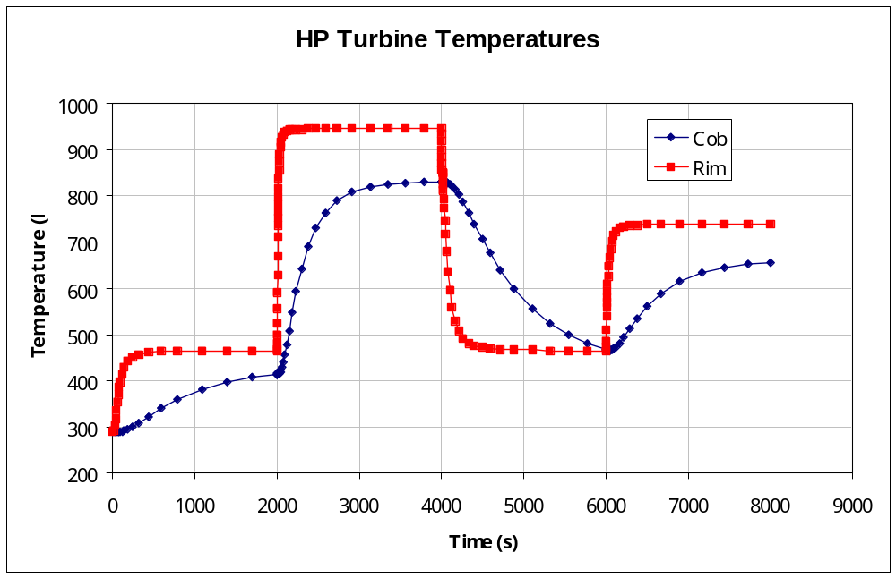
Temperature Scaling
What temperatures are required ?
  Steady state
    Components reached thermal equilibrium
  Transient
    Component
    temperatures
    vary with time

Slide 2
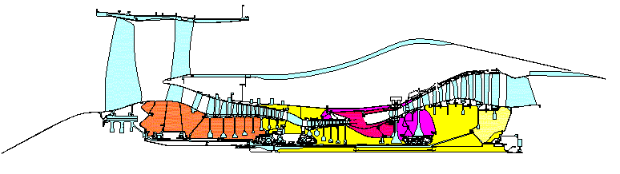
Steady State Scaling
Direct scaling from
  Rig/engine measurements
  Previous finite element model
Temperatures generally scaled on 2 engine performance parameters
  HP compressor inlet and exit etc.

Slide 3
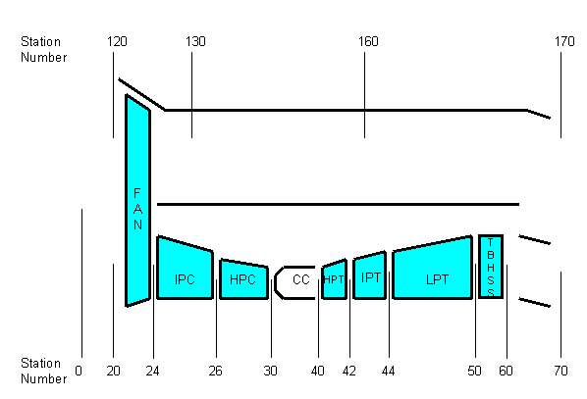
Station Numbering

Slide 4
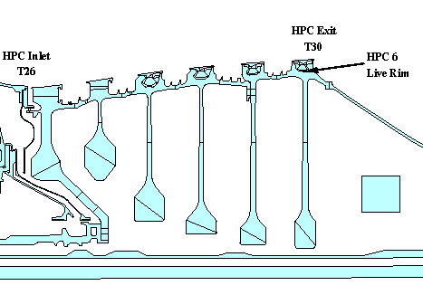
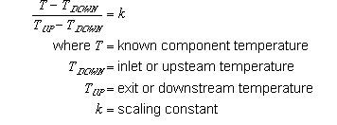
Steady State Scaling – k-factor

Slide 5
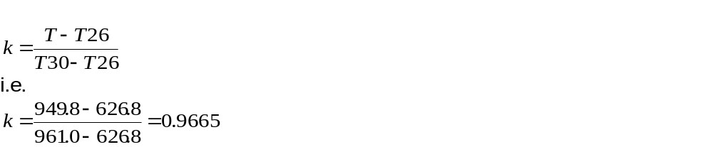
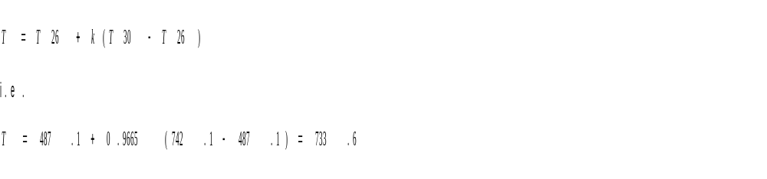
Steady State Scaling – example
Live rim metal temperature = 949.8K
T26 = 626.8K, T30 = 961.0K
Thus at a different condition:
  T26 = 487.1K, T30 = 742.1K

Slide 6
Steady State Scaling Exercise
Exercise 1 in notes
Calculate k-factors for positions shown
Calculate steady state temperatures at the cruise condition

Slide 7
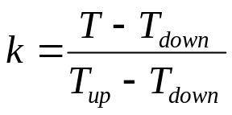
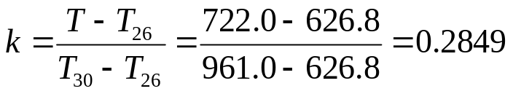

Steady State Scaling Exercise - Answers
K-factors
  For HP Compressor Cob:
Cruise Temperatures
  For HP Compressor Cob:

Slide 8
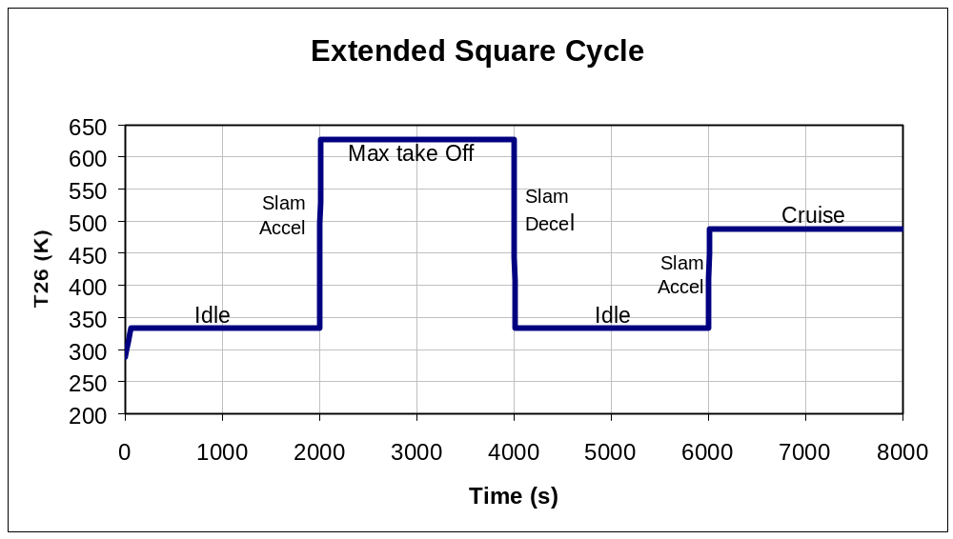
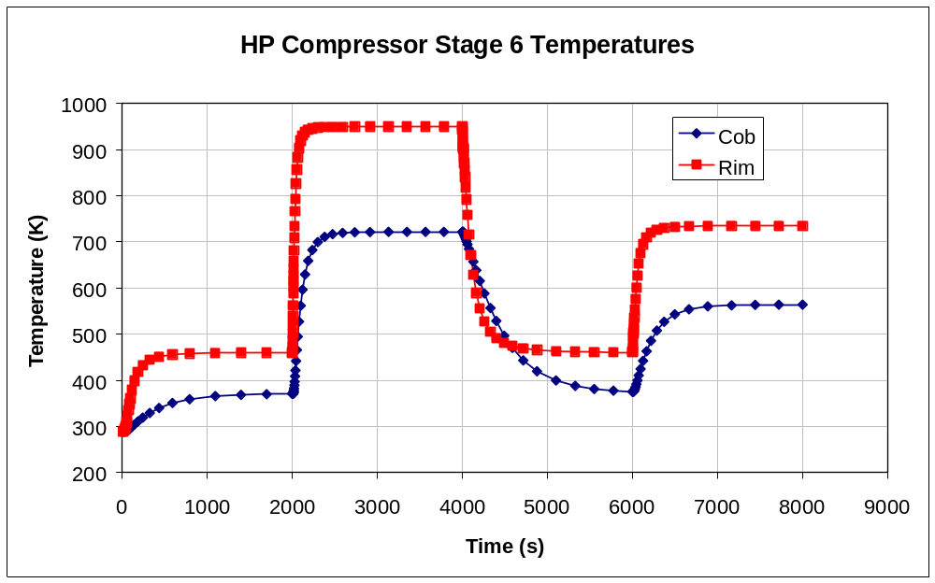
Transient Temperature Scaling

Slide 9
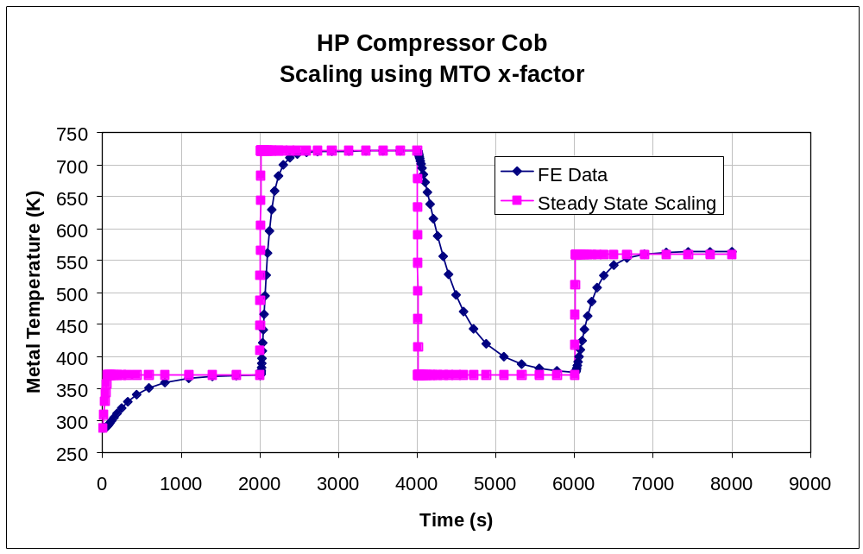
Transient Temperature Scaling
Steady State scaling should NOT be used for transient temperatures

Slide 10
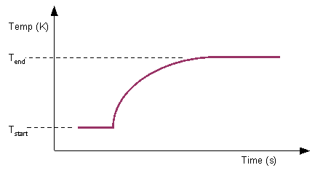
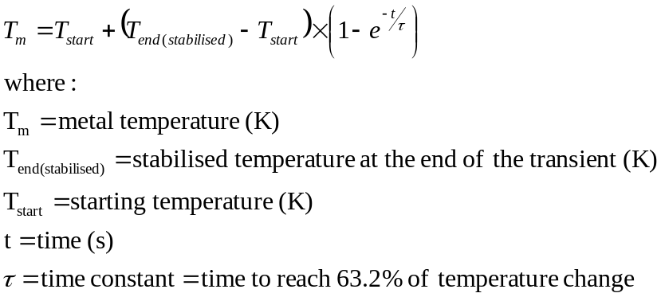
Time Constants
Similar to lumped capacitance

Slide 11
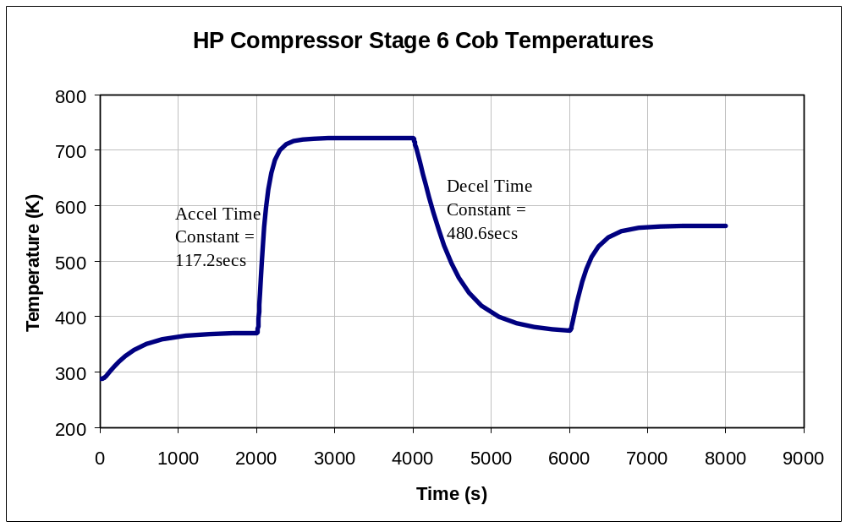
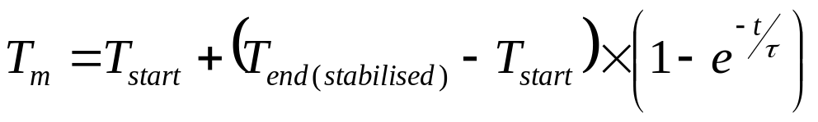
Time Constants (2)
HP Compressor Cob

Slide 12
Transient Scaling Exercise
Complete Exercise 2 from the notes
  Calculate time constants for slam accel
  Calculate steady state temperatures at max take-off condition
  Calculate the transient temperatures at the times requested

Slide 13
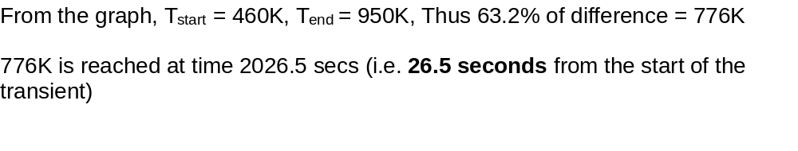
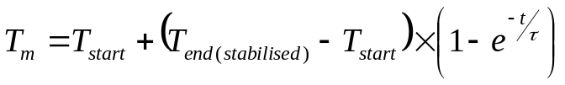

Exercise 2 Answers
Time Constant Calc (HPC Rim)
Steady State Calc
Transient

Slide 14
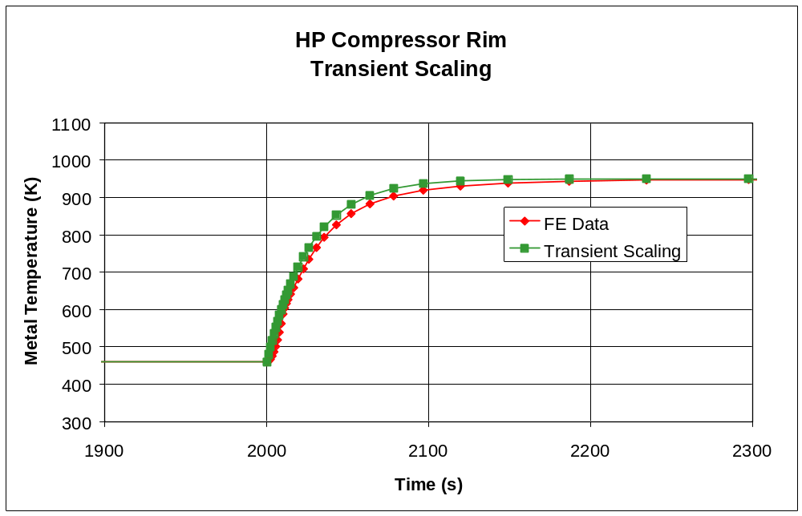
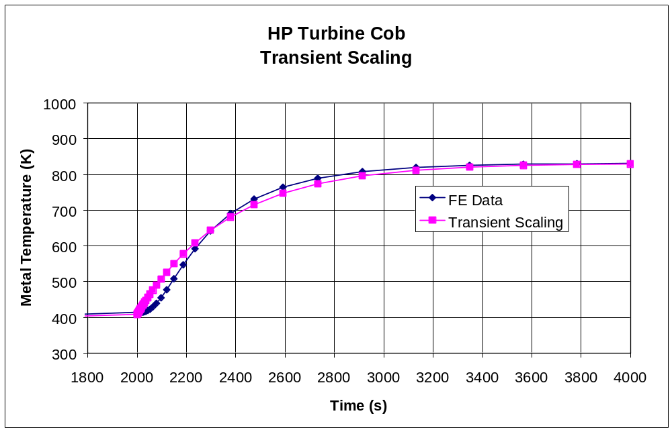
Exercise 2 Answers (2)

Slide 15
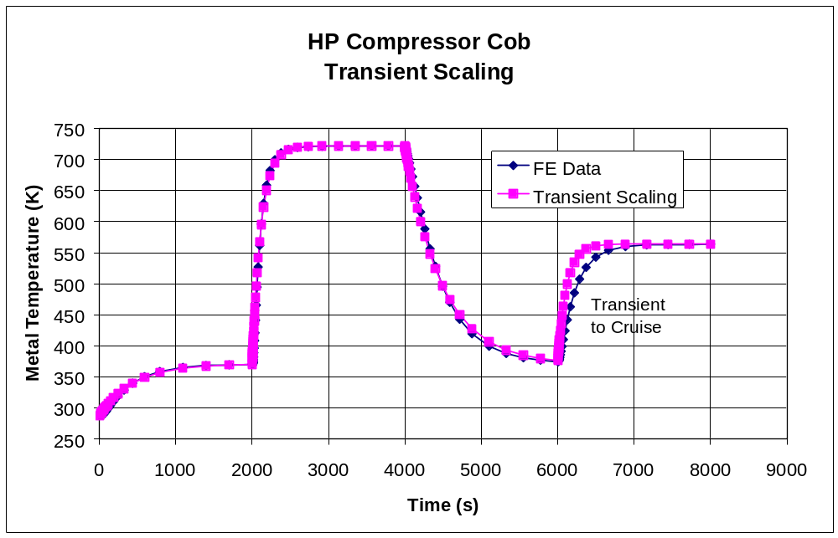
Exercise 2 Answers (3)

