Slide 1
Thermal Modelling for HP and IP Turbines
Part 1: Heat Transfer Fundamentals
Rory Clarkson
March 2006

Slide 2
Introduction
The intention of the notes presented here is to act as an introduction to thermal modelling of HP and IP turbines. The recipient need have no background in thermofluid analysis. For those that do, the notes will only act as revision. The purpose of this first part is to provide the background principles that form the basis of thermal analysis. (I have focused on the principles that I have personally relied upon during my time as a Thermals Analyst – i.e. thermal analysis of components outside the main annulus, as opposed to the analysis of blades, vanes and seal segments.) The second part (coming soon) describes the mechanics of setting up models in SC03.
Contents
Part 1 - Heat Transfer Fundamentals
Some background thermodynamics
  Heat and Temperature, Static and Total Temperature, Steady Flow Energy Equation
Heat transfer mechanisms
  Conduction
  Convective Heat Transfer (Solid-Fluid Heat Transfer)
  Radiation
Heat Transfer Modelling

Slide 3

Heat and Temperature
According to the Physicists heat is energy transferred from one body to another body at a lower temperature,
  i.e. an isothermal body does not contain/possess heat, but hopefully Physicists would concede that the body contains thermal energy. They would probably also say that ‘heat transfer’ is tautology.
Engineers tend to think of thermal energy and heat as the same thing. The amount of heat/thermal energy (E) contained in a body is proportional to its temperature (T), and to the amount of mass (m) the body has.
The relationship between a change in E, the associated change in temperature and the mass of the body is given by:
The constant of proportionality, c, is called the specific heat capacity, which has the units of J/kg K.
  NB There are many ways in which heat can be introduced into a gas, the two most useful ways w.r.t. analysis being at constant pressure and at constant volume. For these two situations the definitions and names of E and c in the above equation change. For a perfect gas:
    at constant volume c is the specific heat at constant volume, c_{v}, and E is the internal energy, U.
    at constant pressure c is the specific heat at constant pressure, c_{p}, and E is the enthalpy, H.

Slide 4
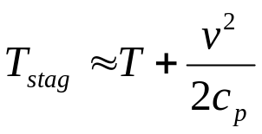
Static and Total Temperature
Static temperature (T) is a fundamental thermodynamic property of a substance; it indicates the level of energy possessed by the substance at the molecular/atomic level (effectively the internal energy)
When a fluid is moving it possesses additional kinetic energy, associated with that movement
  For unit mass of fluid the kinetic energy is v²/2.
  Ignoring any potential energy, the total energy of a unit mass of fluid is c_{p}T + v²/2.
To measure the temperature of a moving fluid with a (stationary) thermocouple or thermometer, the fluid needs to be brought to rest; as the fluid comes to rest the kinetic energy is converted to internal energy
  A process driven by viscosity
As a result of the local increase in the internal energy, the local static temperature rises to what is called the stagnation temperature, T_{stag}
The stagnation temperature is essentially equal to the (total energy of the free stream)/c_{p} , i.e.
Free Stream
Thermocouple
T
Velocity, v

Slide 5
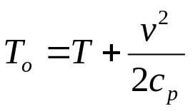
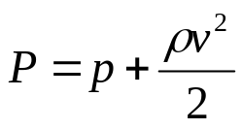
Static and Total Temperature
Note that the conversion of kinetic energy to internal energy occurs wherever the fluid is brought to rest (or for that matter has its speed changed)
  e.g. at a stationary solid boundary (from the no slip condition)
Because of this general effect, and its influence on local static temperature, the (total energy of the free stream)/c_{p} term is called the total temperature, T_{o} ,i.e.
  Note that usually T_{o} can be considered equal to T_{stag} ; if it is not it will be pretty close to being equal.
There is an analogous situation with pressure; as a body of fluid changes its velocity its static pressure, p, changes
  Static pressure, like static temperature, is a fundamental thermodynamic property of the fluid.
Similarly it is convenient to define the total pressure, P, given by:
Free Stream
Thermocouple
p
Velocity, v

Slide 6
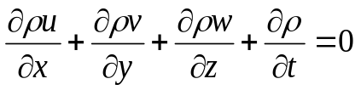

Conservation Equations
There are two conservation principles that the thermal analyst needs to be particularly aware of, and which they should avoid violating
Conservation of mass – Continuity Equation
  Expressed simply, for a steady state system, the mass flow entering the system must equal the mass flow leaving the system.
  If the system is not at steady state, there may be an imbalance between mass entering and leaving, but as a consequence the fluid density will change, or the system boundaries must change.
  Fortunately it can always be assumed that the flow networks associated with gas turbine thermal analysis are at a steady state.
  Just to get people in the mood for differential equations, the continuity equation can be expressed as:
  Or for a more simple situation:
A₁, ρ₁, v₁
A₃, ρ₃, v₃
A₂, ρ₂, v₂
Conservation of energy – i.e. the 1st Law of Thermodynamics
  Expressed simply, for a steady state system, energy entering the system must equal the energy leaving the system.
  If the system is not at steady state, there can be an imbalance between the energy entering and leaving, but as a consequence the total energy within the system will change.
  A change in the total energy of the system can manifest itself in a number of ways – e.g. a change in the mean temperature and/or a change in the kinetic energy within the system.

Slide 7
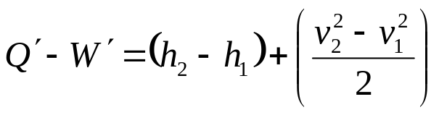
Steady Flow Energy Equation
1
W´ – work out
2
v – fluid velocity
h – enthalpy
Q´ – heat in
v₁ , h₁
v₂ , h₂
The energy entering and leaving a moving fluid (i.e. work W´ and heat Q´ ), as well as the energy already contained within the fluid is described by the steady flow energy equation:
  The above equation is for 1 kg/s of fluid, and each term has dimensions of energy per unit mass, e.g. J/kg, hence the use of W´ and Q´ , to distinguish them from similar terms (e.g. Q) with dimensions of power, e.g. W.
  Note that potential energy terms have been neglected.
  Work occurs when a force is moved.
  Enthalpy, h, is a derived fluid property given by u+p/ρ , i.e. combining the internal energy and the work done by the fluid at stations 1 and 2.
  The v²/2 terms represent the flow’s kinetic energy.

Slide 8



Steady Flow Energy Equation
Another way of arranging the steady flow energy equation is to combine the enthalpy and kinetic energy terms into what we call total enthalpy, H (analogous to total temperature):
If there is no work done by (or on) the fluid, W disappears
For a perfect gas H is given by c_{p}T_{o}, where T_{o} is the total temperature
  The temperatures and pressures under which the gases in a gas turbine exist are such that, most of the time, they can be approximated to being perfect gases.
Thus for the two above conditions, and for a given mass flow of gas,
  Note the dimensions of this equation are power, i.e. W or J/s.
  This is a commonly used, and very useful, little equation.
  A similar equation exists for liquids.

Slide 9
Conduction
Let’s consider a flat sheet of metal of thickness l, where the temperature only varies through the thickness of the sheet, i.e in one direction (x), and the temperatures have reached a steady state condition
T
Q
T
Q
T₁
Side 2
Side 2
T₁
Side 1
Side 1
T₂
T₂
l
l
x
x
Because T₁ is greater than T₂ heat (Q) will travel from side 1 to side 2, in the +ve x direction
However, the thermal gradient, (T₂ – T₁)/l or dT/dx, is -ve in the x direction
Q is proportional to the magnitude of the thermal gradient, the constant of proportionality being the thermal conductivity, k
Q is also proportional to the area, A, over which the thermal gradient is applied

Slide 10
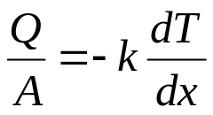
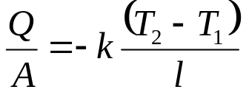
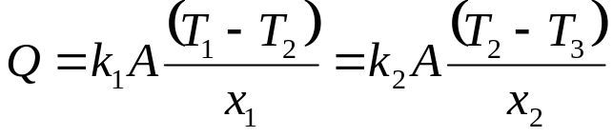
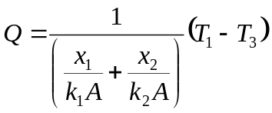
Conduction
Side 1
To make life easier, let’s consider the heat transferred per unit of area, Q/A
  Q/A is known as the heat flux (q), in W/m^{2.}
Then the relationships between thermal gradient and the heat transferred per unit area can be expressed mathematically as:
Area A
Q
or
Side 2
l
Lets consider 1D steady state conduction through a composite sheet of two different metals
The Q through both sheets must be equal, thus:
  If all but Q and T₂ are known, Q and T₂ can be calculated, e.g. Q from:
T
Q
Q
T₁
k₁
k₂
T₂
x₁
x₂
T₃
x

Slide 11

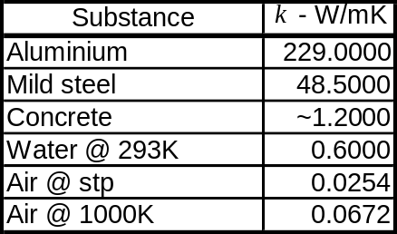
Conduction
The processes that drive conduction occur at a molecular/atomic level -
  In a solid this is either by increased atomic vibrations causing the passage of energy to their neighbours, or by free electrons passing between atoms (which is usually restricted to metals).
  In a fluid it is by the random oscillations/migration of molecules, that pass on energy to their neighbours via collisions.
In a fluid the process is essentially a diffusion process, i.e. the diffusion of heat/thermal energy
  Not to be confused with the ‘diffusion’ that describes the slowing of a fluid and its associated pressure rise, as in a diffuser.
  Other properties than can be transported by diffusion include momentum and chemical species concentration.
The thermal conductivity that results from these processes will vary with temperature, and pressure
  In a solid these variations are small.
  In a fluid they can be significant, particularly the variation with temperature.
  When k cannot be taken as constant, the equation needs to be solved.
  Note that in solids k can vary with direction.
Typical magnitudes of k :

Slide 12
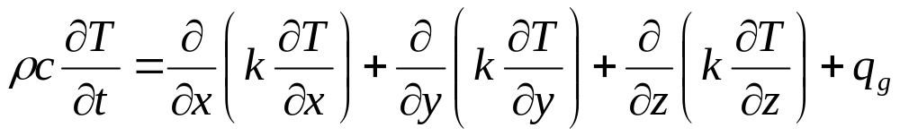
Conduction
Now let’s consider general 3D conduction; take a small volume of a solid, allow for heat generation within the volume, q_{g} (e.g. electrical heating), and that the heat entering may be different from that leaving
Equating the heat fluxes in and out (q) to q_{g} , and noting that an imbalance will cause the temperature of the block to change with time, the following equation can be derived:
  Refer to textbooks for details.
  Each term has dimensions of power per unit volume (e.g. W/m³).
q_{yo}
q_{xi}
q_{g}
y
q_{xo}
q_{yi}
x
Mass - m
Spec heat - c
Conduct - k
z
Other than a limited number of situations, the general 3D conduction equation can only be solved using a numerical approach
  Finite difference or finite volume approach, such as most CFD codes (e.g Fluent, CFX, etc)
  Finite element approach, such as ANSYS or SC03 (of which more later)
  Is a brief description of numerical methods needed?

Slide 13

Thermal Contacts
Returning to composite materials, and other examples where heat is being transferred between two different solid bodies in contact with each other
Frequently the contact between the two materials is not perfect – uneven surface, thin oxide layer, etc. – such that there is a resistance to thermal conduction
This resistance is conveniently represented via a contact conductance, C (in W/m²K)
  The treatment is similar to that used for 1-D conduction, but across an infinitesimally small distance.
The heat flux across the interface, q , is then given by (see diagram for details):
  Note that for perfect conduction, or zero resistance, C approaches infinity
T
q
q
T₁
k₁
T₂
k₂
T₃
x₁
x₂
T₄
x
General guidance on typical values for C, based on experience, would be between 1 to 5 W/m²K
  Selecting a suitable value for C is a bit of a black art.
  The Thermo-Mechanics intranet site offers a correlation, by Yavanovich, that can be used for a rough, conforming contact.

Slide 14
Convection
Convection is derived from the Latin word veho (vect-) meaning to carry
  There is some disagreement about the most appropriate use of the term, but the following does avoid confusion, particularly when discussed in conjunction with CFD or mass transfer.
Like diffusion, it is a general transport mechanism; it results from the bulk movement of a fluid
  Also like diffusion it is not just heat than can be transported by convection; momentum and chemical species can be convected.
Convection is present if the fluid exhibits a velocity field
  Can a moving solid (e.g. conveyor belt) ‘convect’ heat?
Convection can take place without the close proximity of a solid
Convection can exist in an isothermal fluid, e.g. a jet of air being squirted into a room
t₄
t₁
t₂
t₃

Slide 15
Convective Heat Transfer
Heat transfer between a solid and a moving fluid is commonly referred to as Convective Heat Transfer
  Being pedantic, it could be said that squirting a jet of hot gas into a cold room also involves convective heat transfer.
The transfer of heat between a solid and a fluid results from a complex mix of diffusion and convection
  However it is the presence of convection (the moving fluid) that makes the heat transfer significantly greater than through pure diffusion (conduction).
It is both the structure of the flow field and the material properties of the fluid that dictate the quantity of heat transferred
Laminar Region
Transition Region
Turbulent Region
Typical Boundary Layer (cartoon)
Impingement Jet

Slide 16
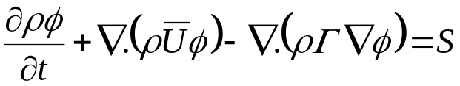
Convective Heat Transfer
The thermofluid processes taking place in the fluid can be described using the Navier-Stokes Equations and the Energy Equation
  Transport of chemical species also affects heat transfer, but we can usually ignore such effects.
  The equations take the general form (in vector notation) of:
The only (known) way of solving these equations is using a numerical approach
  i.e. finite volume or finite element CFD.
Conjugate heat transfer calculations – the thermofluid equations and the conduction equation are solved simultaneously
  Because the conduction equation is a simplification of the above equation, most CFD codes can be set up to perform conjugate heat transfer calculations.
  But CFD isn’t quick or cheap, modelling turbulence is a problem, and what do you do if it gives inaccurate solutions?
There is a simpler way to represent the heat transferred between the solid and the fluid
transient
term
source
terms
convection
term
diffusion
term

Slide 17

Convective Heat Transfer
Let us consider a typical temperature profile through a solid and an adjacent fluid
Making use of the general rule that the heat transferred, Q, is proportional to the difference between the solid surface temperature, T_{w}, and the fluid temperature, T_{f} , the following expression can be set up:
Temperature Profile
x
T_{f}
Fluid
Q
T_{w}
Solid
T_{s}
T
The constant of proportionality, h, is called the heat transfer coefficient (HTC)
  h has dimensions of power per unit area, per unit of temperature change (e.g. W/m²K).
It is found that h is a function of the flow structure and the fluid properties
  Thus h is a function of (T_{f} – T_{w})
However a big question is, which fluid temperature (T_{f}) to use?

Slide 18

Convective Heat Transfer
Which fluid temperature to use:
  Free stream temperature ?
  Bulk (averaged) temperature ?
  A representative ‘film’ temperature ?
Note that Q is actually driven by the static temperature gradient very close to the wall
Temperature Profile
Fluid
T_{f}
Distance
from Wall
T_{w}
T_{s}
Solid
When the value of Q is (relatively) small, but the fluid is moving with a significant velocity, the free stream or bulk static temperature can be quite different from the fluid static temperature at the wall
Consider the adiabatic scenario:
  As the fluid comes to rest kinetic energy gets converted to internal (i.e. thermal) energy, via viscosity – known as kinetic heating.
Combining kinetic heating with heat transfer – the question becomes static or total temperature?
Temperature
T
T_{o}
Pr = 1
= c_{p}μ/k
Distance
from Wall
Recovery Temperature
‘Diabatic’
Adiabatic
Temperature

Slide 19

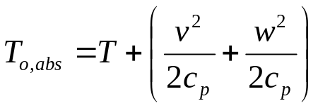
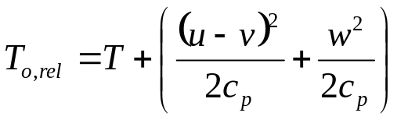
Convective Heat Transfer
Kinetic heating exists because of the no slip condition – the fluid must be travelling at the same velocity as the solid, when they are in direct contact
The velocity of the solid affects the degree of kinetic heating
  If the free stream fluid and the solid are at the same velocity, there is no kinetic heating.
  Thus the recovery temperature of the fluid depends on the velocity of the solid, relative to the velocity of the fluid.
  Similarly the total temperature of the fluid depends on your point of reference – whether you are moving or standing still; it is the influence of a vector (velocity) on total temperature that leads to this effect.
Consider the total temperature as seen by a static component, T_{o,abs} , and then relative to a rotating component, T_{o,rel}
The Stationary Frame
i.e. sat on stator
Static Thermocouple
The Rotating Frame
i.e. sat on rotor
absolute air velocity
w
r
w
relative air velocity
v
u - v
rotor
ω
.
rotor
Rotating Disc

Slide 20


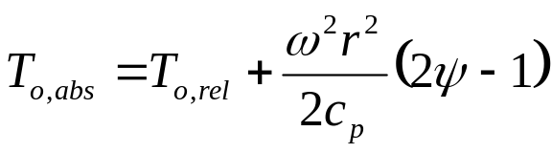
Convective Heat Transfer
Relative Total Temperature:
Consider the relationship between T_{o,rel} and T_{o,abs}
The Stationary Frame
The Rotating Frame
absolute air velocity
w
w
relative air velocity
v
u - v
rotor
.
rotor
- Equ (1)
- Equ (2)
Ignoring the term, or combine with T, and combining Equ (1) and (2)
And defining the swirl ratio (i.e. swirl fraction), ψ, as:
Gives:

Slide 21
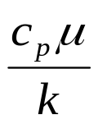
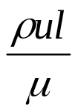
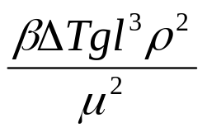

Convective Heat Transfer
Returning to the heat transfer coefficient, h :
Remember that h = f(flow structure, fluid properties)
Non-dimensional parameters are a good way of numerically describing flow structure and fluid properties
  For more information refer to Dimensional Analysis and Buckingham’s Π Theorem in an appropriate text book.
Fluid properties – Prandtl number, Pr
  Pr is the ratio between the molecular transport (i.e. diffusion) of momentum to the molecular transport (i.e. diffusion) of heat.
Flow structure – Reynolds number, Re
  Re is the ratio of the inertia forces to the viscous forces.
Flow structure – Grashof number, Gr
  Gr is the ratio of the buoyancy forces to the viscous forces.
  β is the volumetric coefficient of thermal expansion.
Heat transfer coefficient – Nusselt number, Nu
  Ratio of heat transferred through convection to what would be transferred through pure diffusion
inertia
viscous
pressure

Slide 22

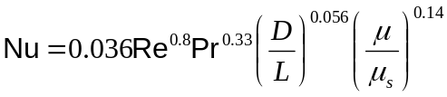
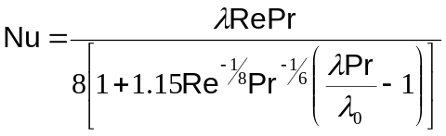
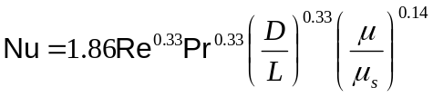
Convective Heat Transfer
Forced Convection (fluid movement is driven by some mechanical means):
Experimental evidence indicates that in these circumstances Nu = f(Re,Pr)
  For very high speed flow Nu becomes influenced by another non-dimensional parameter, the Brinkman number, Br
  Where (quasi-)analytical solutions are possible, they confirm the Re, Pr dependence.
Relevant Forced Convection Situations:
1) Where the bulk flow is travelling parallel to the solid surface, i.e. there is a well defined, 2D, attached boundary layer
Turbulent flow in a circular pipe, some examples:
  Dittus-Boelter (1930)
  Sieder and Tate (1936)
  Nunner
Laminar flow in a circular pipe
  Sieder and Tate
  The D/L term in the Sieder and Tate covers entry effects – the developing temperature and/or velocity profiles at the pipe entrance. All the other expressions are for fully developed flow (usually where L > 10D to 20D).

Slide 23
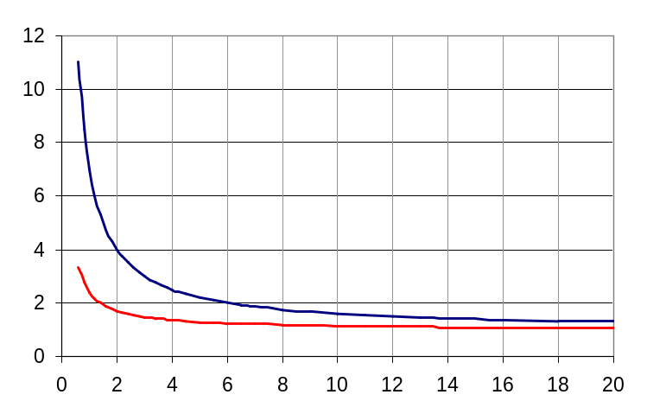



Convective Heat Transfer
Entry effects – flat temperature and/or velocity profiles at pipe entrance
  The combination of a developing hydrodynamic and thermal boundary layer causes the HTC to be more than 10 times that of the fully developed flow.
  Effect is reduced if only the thermal boundary layer is developing (i.e the inlet temperature starts off flat) and the velocity profile is fully developed.
x/D
Flow parallel to a flat plate; Reynolds-Colburn
  Turbulent flow
  Laminar flow
  Note that because the length scale in both Nu and Re is the distance along the plate, entry effects are covered by the above expressions.
Note that for turbulent flow in a pipe and over a flat plate the generally rule is that Nu ∝ Re^{0.8}
  I’m investigating why, for laminar flow, the Re power is respectively 0.33 and 0.5.
The boundary layers in many flows can be approximated to a 2D boundary layer
  Further study of heat transfer in 2D boundary layers is appropriate once we get into using CFD.

Slide 24




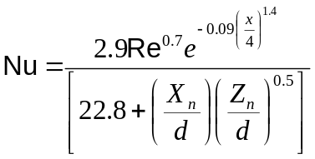
Convective Heat Transfer
2) Flow field generated by a rotating disc
  As the disc rotates it drags the fluid along, because of the no slip condition and viscosity. This rotating fluid also gets centrifuged outwards. To replace the fluid that is flung outwards additional fluid is entrained close to the disc, which in turn gets flung outwards. This flinging out of fluid effect gets stronger with increasing radius.
Correlation for a free disc; Dorfman (1963)
  Appropriate Re is:
  Turbulent flow
  Laminar flow
r
ω
3) Impingement
  At the point where the jet hits the surface very steep thermal and velocity gradients occur.
  This environment results in high HTC values, typically 2.5 – 3 times what the same flow would generate if it was directed parallel to the surface.
Arrays of impingement jets; single row of circular holes
  Appropriate Re is:
  Goldstein and Seol
  There are correlations for other
arrangements of jets

Slide 25






Convective Heat Transfer
Natural (Free) Convection:
Flow is driven by density variations within a potential field, i.e. buoyancy
  Note that the potential field can result from gravity, or rotation. In the rotating situation ω²r replaces g in Gr.
Experimental evidence indicates that in these circumstances Nu = f(Gr,Pr)
  Gr and Pr are usually combined to form the Rayleigh number, Ra (= Gr.Pr).
e.g. Vertical plate or cylinder
  The length scale is the length of of the plate.
For
g (or r)
For
For
  Note that in the turbulent regime, Ra > 10⁹, the length scales on either side of the Nu expression cancel, so the HTC is independent of the length of the plate.
The Ra^{0.25} and Ra^{1/3} relationships are found with other natural convection situations
  Upper and lower surfaces of horizontal plates
  Horizontal cylinders
  Note that the length scales and Ra defining the various regimes are different for these situations.

Slide 26

Convective Heat Transfer
Mixed Convection:
Mixed convection occurs when buoyancy forces augment or retard the heat transfer resulting from forced convection
  Whether augmenting or retarding, the heat transfer depends on the temperature of the fluid relative to the solid, and the direction of the flow.
  Its onset depends on the relative magnitude of Re and Gr
  Mixed convection primarily occurs with laminar and transitional flows and moderate to large Gr
If in the mixed convection region the Nu becomes f(Re,Pr,Gr)
  i.e standard forced convection correlations should not be used, the correct mixed convection correlation should be – refer to appropriate literature
10⁵
Forced convection, turbulent
Horizontal tubes with uniform wall temperature
10⁴
Re
Mixed convection, turbulent
Transition
10³
Forced convection, laminar
Transition
Mixed convection, laminar
10²
10⁴
10⁵
10⁶
Ra
10⁷
10⁸
10⁹
10¹⁰

Slide 27
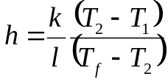
Convective Heat Transfer
HTC correlations are also available in SC03 that cover labyrinth seals and pedestals and pin fins
  In the open literature there are many other HTC correlations, covering well defined flow/geometric situations.
HTC correlations cover ideal, relatively simple, laboratory situations
  What do we do if a particular flow situation isn’t covered by an established HTC correlation, which is usually the case in jet engines?
Adjustment (i.e. fiddle) factors
  Using engineering judgement/experience select a simple situation, that is covered by an HTC correlation, which has the main characteristics of the flow/heat transfer environment of interest.
  Use the HTC correlation of this simple situation, but with an adjustment factor applied.
  But how to decide on an appropriate adjustment factor value?
T_{f}
1) Engine/rig temperature measurements
  ‘Back analysis’ : h can be derived from the measured metal and fluid temperatures.
  ‘Matching’: in complex geometries a best guess computational model is produced, which is then tuned to obtain an acceptable match to the measured data.
  Matching is a complex activity, where parameters other than h are usually adjusted (it deserves a lecture of its own).
  Why apply a factor to a relevant HTC correlation, why not just use h?
  To allow the calculation of temperatures at different flow/engine conditions – i.e. to have scalable computational models.
x
T₂
l
T₁
T

Slide 28
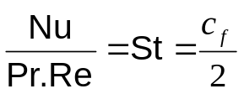
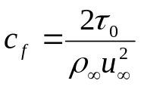

Convective Heat Transfer
2) Reynolds’ Analogy
Reynolds postulated that the mechanism driving momentum transfer is the same as (or similar to) that driving heat transfer – if true a knowledge of the flow field would allow an h to be derived
If Reynolds’ analogy holds it can be shown that
For laminar flow the postulate is true if Pr = 1 (by the definition of Pr)
For turbulent flow the postulate is true if the turbulent Pr (Pr_{t}) = 1
What is the turbulent (or turbulence) Pr?
  It comes from a method of modelling turbulence; the transport effects of turbulence are analogous to molecular diffusion, i.e. they can be represented by gradients in the mean velocity and temperature, and an associated turbulent (or eddy) diffusivity.
  Hence for momentum transfer the concept of a turbulent (or eddy) viscosity (μ_{t}) is derived.
  Similarly for heat transfer the concept of a turbulent (or eddy) conductivity (k_{t}) is derived.
  Therefore
Unfortunately Pr_{t} does not equal 1; the mechanism driving turbulent transfer of momentum is subtly different from that driving turbulent transfer of heat
  For a 2D boundary layer, at y⁺ values greater than 30-40 Pr_{t} settles down to a value of about 0.86.
where

Slide 29
Convective Heat Transfer
Although not a panacea Reynolds’ Analogy shows that a knowledge of the flow field can be used to guide engineering judgement
Make judgements on the relative HTCs in the situations below
(a)
(b)
(a) relative to (b) ?
Moving surface (e.g. disc)
Moving surface (e.g. disc)
Indicate the regions with a relatively high and low HTC
Diffuser
Backward facing step

Slide 30
Convective Heat Transfer
3) From CFD
CFD calculations can be set up to solve the heat transfer and fluid flow, as a pure flow field calculation or a conjugate (solid and fluid) calculation
As with the real world there are a number of ways of defining the HTC from CFD by using different fluid temperatures
  Reynolds’ analogy can also be used to extract an HTC, but caution is advisable.
  Having extracted an HTC from the CFD, there are also a number of ways of incorporating the the data within the heat transfer computational model, e.g. simply derive an adjustment factor and apply in a conventional manner, the influence coefficient method, a coupled CFD/heat transfer model.
A conjugate heat transfer CFD calculation actually obviates the need to derive an HTC, but there are drawbacks:
Calculations are expensive and take time (i.e. weeks)
Transient calculations, or calculations at varying (engine) conditions, take even longer
CFD isn’t 100% accurate (it is doing well at 80-90%), and it is very difficult to apply post validation adjustment factors

Slide 31
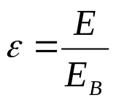
Radiation
Transfer of energy between matter via electro-magnetic waves
No medium is needed through which to transmit the energy, i.e. electro-magnetic waves can pass through a vacuum
  Gases absorb negligible amounts of radiation.
The amount of radiation absorbed and emitted by a body dictates its temperature change
Absorption of radiation by a Black body
  A body that absorbs all the radiation that falls on it. To achieve this it doesn’t need to be black in colour.
Absorption of radiation by real bodies
  Most solids transmit or reflect a portion of the radiation that falls on them.
  Thus they only absorb some of the radiation that falls on them.
Absorptivity (α): the proportion of the radiative energy falling on a body that is actually absorbed by the body
  α = 1 for a black body, α < 1 for a real body
Emission of radiation – Emissive Power, E (W/m²)
  It can be shown that black bodies are the best possible emitters of radiation (with emissivity denoted as E_{B}).
  E is a function of the body’s temperature.
Emissivity (ε): ratio of the emissive power of a body to the emissive power of a black body at the same temperature
i.e.

Slide 32
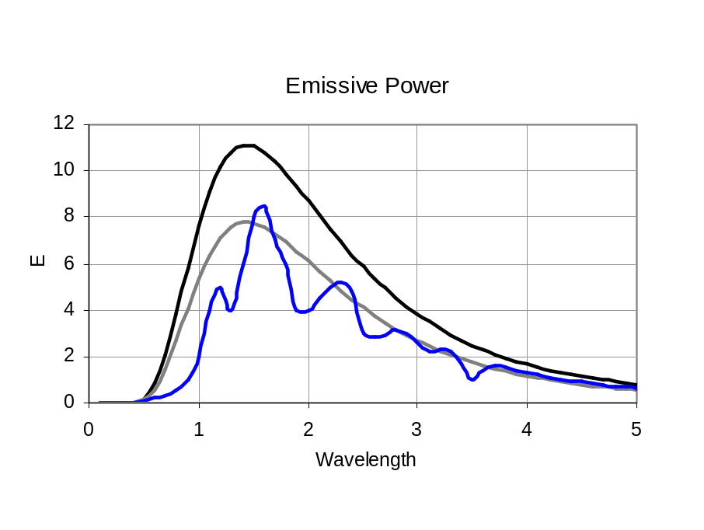


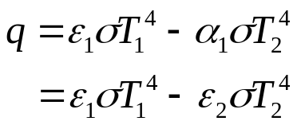

Radiation
Kirchhoff’s Law: The emissivity of a body at a temperature T is equal to the absorptivity of the body when receiving radiation from a source at temperature T.
Spectral distribution of emitted radiation
  Planck Distribution for a black body.
Grey bodies
  An ideal body (i.e. not real).
  ε = a/b = constant for all wavelengths, and all temperatures
  Thus from Kirchhoff’s Law, ε = α = constant
Emissive power at a given temperature
black body
a
grey body
b
E = f(T), Stefan-Boltzmann Law
  σ = 5.67x10⁻⁸ W/m² K⁴ (Note that T must be in K)
real body
and
Consider a body totally surrounded by a black body, and the net energy (heat) flux entering the body, q
  If it is a real body:
  If it is a grey body:
  The grey body assumption works if one, or both, temperatures are low.
black body at
T₂
T₁

Slide 33



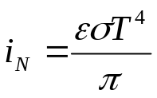
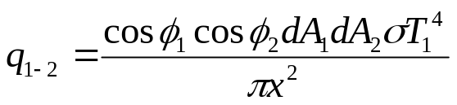
Radiation
Bodies that only see part of the radiation emitted from other bodies
  The previous example of a body surrounded by a black bodies is a rather specialised case.
  To study the more general case requires the concept of the intensity of radiation.
Intensity of normal radiation, i_{N}
  Rate of energy emission from unit surface area through unit solid angle, along a normal to the surface
  The solid angle is given by:
  The intensity at an angle φ to the normal is denoted by i_{φ}
Lambert’s Cosine Law:
Total energy emitted by dA:
It can be shown that:
i_{N}
A₂
i_{φ}
x
φ
dA
Consider two black surfaces, dA₁ and dA₂, at an angle to each other
The energy received by dA₂ is given by:
dA₂cosφ₂
φ₂
φ₁
dA₂
T₂
dA₁
T₁
x
i_{N}cosφ₁dw₁dA₁

Slide 34

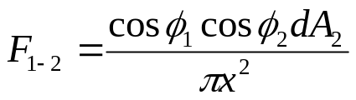




Radiation
The total energy emitted by dA₁ is given by:
φ₂
dA₂cosφ₂
φ₁
dA₂
T₂
dA₁
T₁
x
i_{N}cosφ₁dw₁dA₁
View Factor, F₁₋₂: the ratio of the energy received by dA₂ from dA₁ to the total energy emitted from dA₁, i.e.
In a similar way to the above analysis, the energy received by dA₁ from dA₂ is given by:
and similarly
Calculating view factors is a long and complicated activity (involves double integrations) – either let a computer code do it, or use published data
Examples of view factors:
  A body completely enclosed by another
  A small disc opposite a parallel circular plate of radius R at a perpendicular distance L
  Small sphere at the centre of axis of a cylinder of radius R and length 2L
1

Slide 35
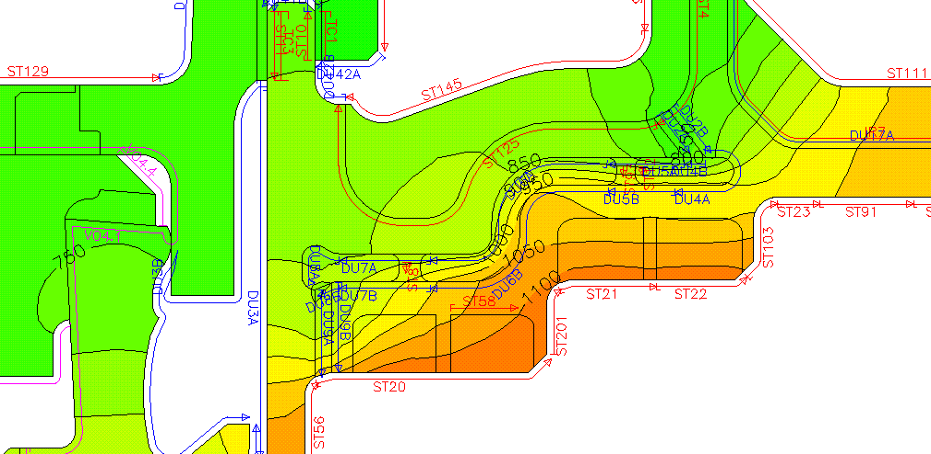
Heat Transfer - Putting It All Together
What type of calculation?
Simple hand calculations
  Backs of envelopes, spreadsheets – usually restricted to 1D
2D/3D conduction in the solid with simple 1D boundary conditions applied
  e.g. Codes like SC03, which uses a finite element (FE) approach to solve for the solid conduction, with simple 1D boundary conditions.
  Commercial codes like ANSYS and PATRAN are very similar to SC03.
2D/3D conjugate heat transfer calculation
  Via a conjugate heat transfer CFD model, or a coupled CFD/SC03 (via SC89) type calculation.

Slide 36
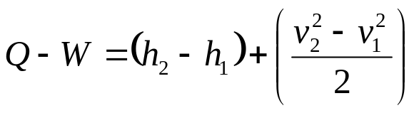

1D Boundary Conditions
Some additional modelling considerations:
To calculate q from the HTC requires that the fluid temperature be known – consequently there is a need to know what affects T_{f}
Return to the steady flow energy equation
  Note that the primes have been dropped from Q and W
T_{f} is affected by Q to and from the solid
  Note that Q from chemical energy release – as with combustion – is being neglected.
But T_{f} is also affected by work (W) being put into, or extracted from, the fluid
  In turbines work only comes from the rotating components.
CFD takes care of these effects itself
  Provided the correct terms are present and active.
1D boundary conditions (BCs) need to be able to capture these effects
  SC03 BCs like streams, ducts and voids can take account of the effect Q has on the fluid temperature.
  They also need to be able to take account of W.
  Note that convection zones have their fluid temperature prescribed, but a knowledge of W may be needed to correctly prescribe T_{f}.
or

Slide 37




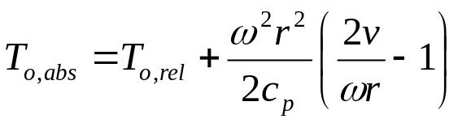
Work on the Fluid
Consider the rotor-stator cavity shown, with rotor torque, T_{q}, and stator drag D
Treating the cavity as an integral whole
stator
rotor
r₂
The steady flow energy equation, as observed from the stator, i.e. in the absolute frame, is:
W is often referred to as the Windage
  However windage is a term that appears to mean different things to different people.
  Author’s opinion: windage is a bad term because of this ambiguity. Work done by the rotor, in the absolute frame, is a better, unambiguous, phrase.
- Equ (1)
D
T_{q}
r₁
ω
The torque balance on the flow gives:
  The rate of change of angular momentum equals the net applied torque.
Multiplying by ω gives the rotor work, W:
Combining (1) and (2), and replacing T_{o,abs} with the appropriate expression for T_{o,rel} :
- Equ (2)
gives….

Slide 38
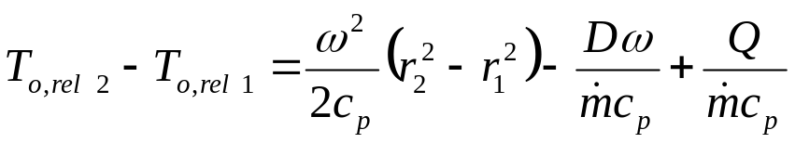

Work on the Fluid
stator
rotor
r₂
The equation above is effectively the steady flow energy equation as seen by the rotor, i.e. in the relative frame
The Dω/ term is referred to as the stator drag, and is the work done by the stator in the relative frame
  Remember, work out of the system is positive.
D
T
r₁
ω
The first term on the r.h.s. results from changing position in a (rotational) potential field – it is independent of the flow velocity field
  In SC03 parlance it is referred to as the ‘vorx’ term, in the blade cooling world it is called ‘radial pumping’.
Thus:
When calculating an absolute total temperature the work done by the rotor has to be taken into consideration
When calculating a relative total temperature the work done by the stator and the change in the potential field term have to be taken into consideration

Slide 39
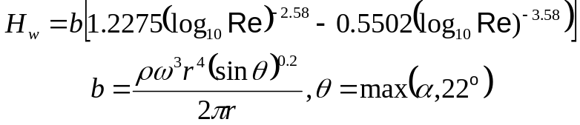

Work Done on the Fluid
Work done by a rotor:
The universal ‘windage’ formula – applicable to discs, cones and shafts rotating in free space
It is used to give the work done in the absolute (stationary) frame, as a rise in total enthalpy term, H_{w}
  For nomenclature and details refer to intranet.
  Strictly applicable for radial out flow, it has been used for radial in flow.
As with HTC correlations, the windage formula is derived for an ideal situation, so it has to be adjusted via factors appropriate for real situations
  e.g. having a stator close by
Guidance on a suitable factor can be obtained by consideration of the nature of the flow
  i.e. how close it is to a free vortex (no work done: vr = const) to a forced fortex (maximum work done: v = ω r)
  Forced vortex work:

Slide 40
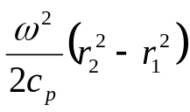
Work Done on the Fluid
Work done by a stator in the relative frame (stator drag):
Little information is available in the open literature on correlations for stator drag
The present best practice is to use the universal ‘windage’ formula for rotor work with a factor
  This approach is reasonable, as a stator behaves like a rotor in the relative frame.
An alternative approach is to model the change in the T_{o,abs} and work out the T_{o,rel} from a knowledge of the swirl velocity (or ratio)
  Swirl velocities can be derived from (adiabatic) CFD calculations, previous matching exercises or engineering judgement.
  This approach obviates the need to account for the ‘vorx’/’radial pumping’ term
Change in T_{o,rel} purely due to the change in radius:
If solving the steady flow energy equation in the relative frame, the term is very straight forward to calculate
  In SC03 using the ‘vorx’ term from the SC77 plug-in,
  or a hand built expression in the heat pick-up option of a stream or duct BC.

Slide 41
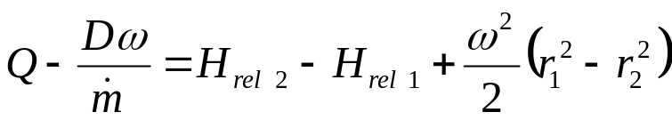

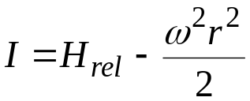

Rothalpy and How Not To Worry About It
The steady flow energy equation in the relative frame can be re-arranged into the following form:
When the H_{rel} and the terms are grouped together they are called rothalpy, I:
i.e. If there is no work in the relative frame (i.e. there are no stators near by), and the system is adiabatic, rothalpy is conserved as r changes
However real engine situations are rarely adiabatic, and there is frequently a stator near by, thus it is the information on slide 38 that is important, not rothalpy
  Some CFD codes solve the energy equation in its rothalpy form, because some terms discretised in a more reliable way.
Note – if there is no stator, i.e. drum inter-disc cavity, the term is zero

Slide 42
Transient/Temporal Analysis
Variation in metal temperatures with time
  Can have a big impact on the stress field and tip/seal clearances.
  Strictly transient relates to things that occur over a short time period, however it is commonly used (including the author) to cover situations where things vary over long time periods.
  The more general, and probably correct, term is temporal.
Rate solid heats/cools – time constant
  Time taken for the solid to reach 63.2% of its final value.
Modelling time dependence – Fluid temperatures:
Full transport equations contain transient terms
Most of the temporal effects in the flow field are short term (relative to solid temporal effects), but they can affect mean HTCs
Relevant temporal effects are driven by the thermal inertia in the metal
SPAN calculations are steady state
Modelling time dependence – Solid temperatures:
3D conduction equation contains a transient term
Simple 1D calculations
  Analytical solutions are available using separation of variables method (see text book for details).
Lumped capacity approach
  Example of a simple hand calculation approach.

Slide 43
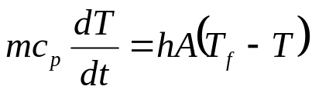
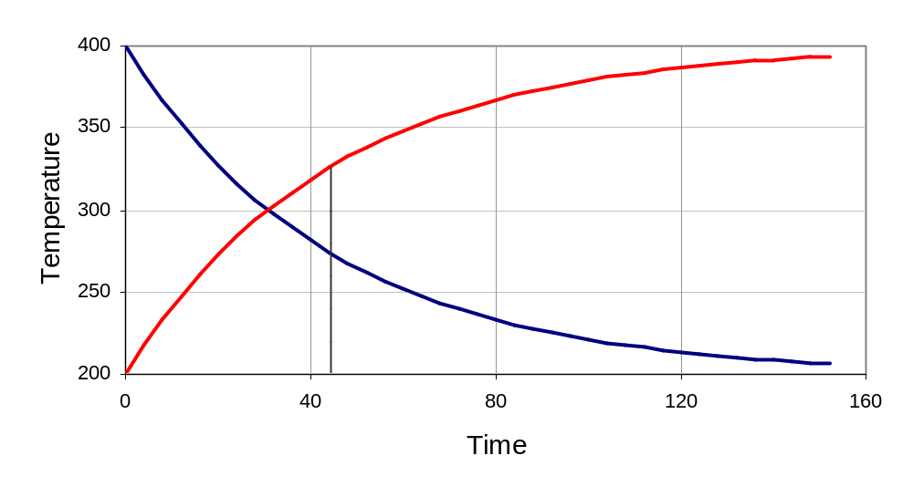
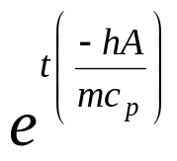
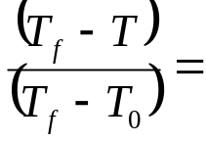
Transient/Temporal Analysis
Lumped capacity approach:
Consider a body (mass m, surface area A) immersed in a large amount of fluid, at a temperature T_{f}
A
T_{f}
T
m, c_{p}
h
Initial temp = T₀
If the temperature of the solid can always be taken as uniform, then the variation in this temperature with time is given by:
  A uniform temperature requires a reasonable high k, but how high?
Assuming that the thermal capacity (mc_{p_fluid}) of the fluid is large enough that any heat added or removed from it does not affect its temperature, i.e. T_{f} = const, and integrating gives:
Heating
63.2%
Cooling
Note that the time constant, τ, is mc_{p}/hA
Time Constant

Slide 44
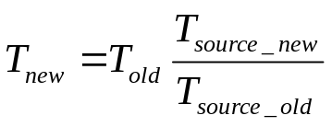
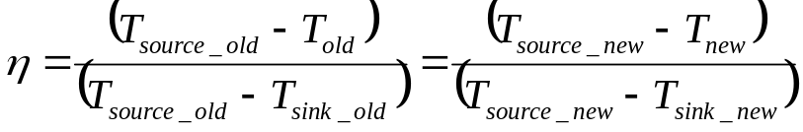
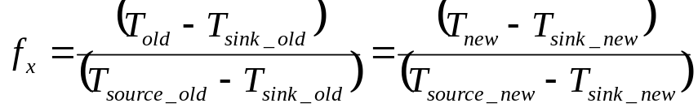
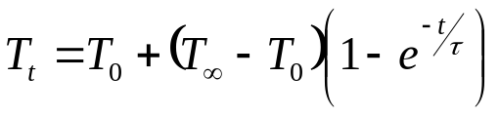
Temperature Scaling
Taking a calculated (or measured) temperature at one engine condition and estimating the equivalent temperature at a different engine condition
  A distinction should be drawn between this and the transient analysis of fluid or solid temperatures.
  Scaling of fluid temperatures is useful for setting up boundary conditions, e.g. in SC03 convection zones.
  Scaling of solid temperatures is useful as a quick way of providing data for preliminary design/lifing.
Influence of a single source temperature:
  e.g. the OGV bowl or CRIC, which is surrounded with HP6 air, thus should scale on T30.
Influence of two temperatures, a sink and a source:
Effectiveness
  e.g. turbine blades and NGVs. The source of heat would be the annulus gas, the sink HP6 air.
.
X-Factor
  Often used for casings and discs.
Transient scaling of solid temperatures using time constant approach
  Similar to lumped capacity approach.

Slide 45
Closure
There is much more to heat transfer, but hopefully all the main concepts that are relevant to thermal analysis of components outside the main annulus, in the core turbines (and compressors) have been covered
If not let me know
  Heat transfer associated with high speed flows
  Film/transpiration cooling would be covered in a similar lecture on aerofoil/annulus component cooling.
  Ingestion of annulus gas will be addressed in Part 2.
And Part 2 is being prepared – provisional contents
Part 2 - SC03 Modelling
Geometry and Domains
Types of Boundary Condition
Air System Representation
Which Boundary Condition When

