Slide 1
Thermal Systems
Hand Calculations

Slide 2
Contents
Temperatures
  Conduction
  Convection
  Radiation
  Thermal contact
  Steady-state scaling
  Transient scaling
Displacements
  Thermal effects
  CF effects
  Pressure effects
  Tensile/compressive effects

Slide 3
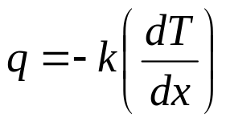
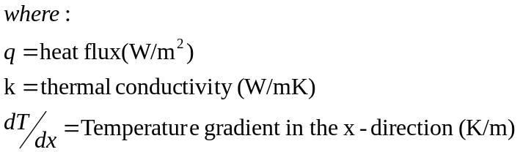
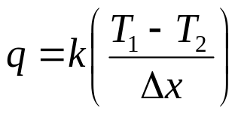
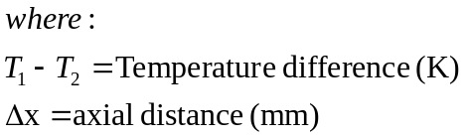
Conduction
Fourier’s Equation for 1-D
k₁
k₂
T₁
T₂
T₃
  The -ve sign results from the convention of defining a positive heat flow in the direction of a negative temperature gradient
Δx₁₂
Δx₂₃
  Assuming constant conductivity and changing the sign convention, this can be integrated to give:

Slide 4
Conduction (2)
1D steady-state
hand calculation
Calculate T₂
Note that q₁₂=q₂₃ =q₁₃
Key equation is:
k₁=10W/mK
k₂=5W/mK
T₁ =700K
T₂
T₃ =300K
q₁₂
q₂₃
Δx₁₂ =10mm
Δx₂₃ =20mm

Slide 5
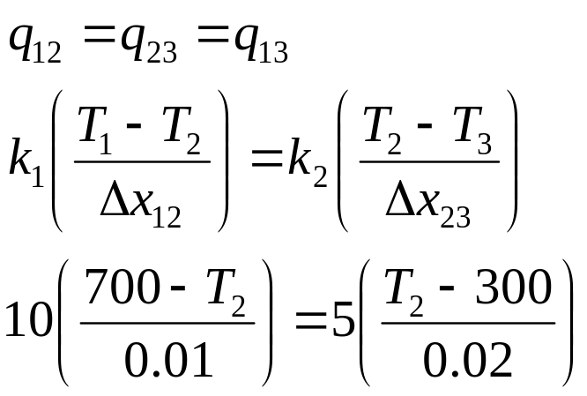
Conduction (3)
Method 1
Note that q₁₂=q₂₃=q₁₃
k₁=10W/mK
k₂=5W/mK
T₁ =700K
T₂
T₃ =300K
q₁₂
q₂₃
Δx₁₂ =10mm
Δx₂₃ =20mm
Solving this gives:
  T2=620K

Slide 6
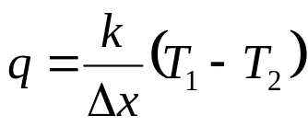
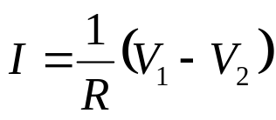
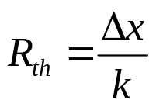
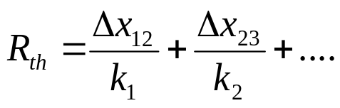
Conduction (4)
Method 2 – Electrical Analogy
Compare the following:
A thermal resistance can be defined as
Thus for multiple walls, these resistances to heat transfer can be added in series:
Thermal Electrical

Slide 7
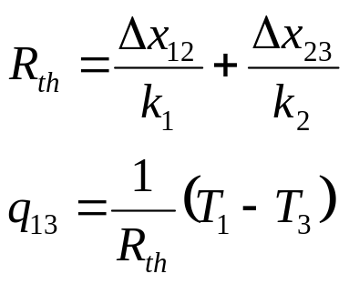
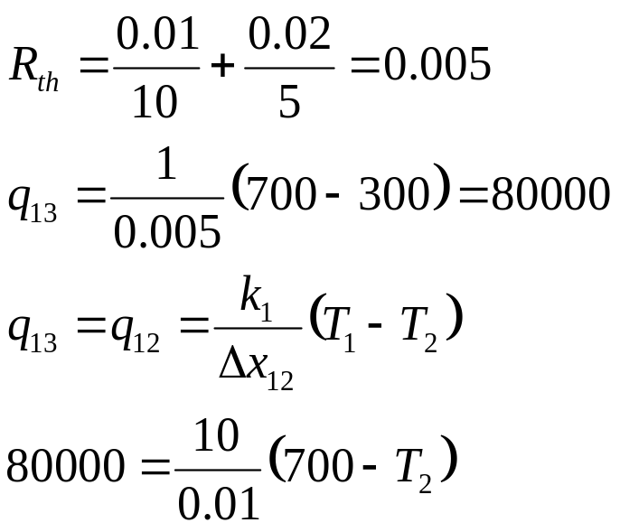
Conduction (5)
Method 2 – Electrical Analogy (cont)
Thus
k₁=10W/mK
k₂=5W/mK
T₁ =700K
T₂
T₃ =300K
q₁₂ =q₂₃ =q₁₃
q₁₂
q₂₃
Δx₁₂ =10mm
Δx₂₃ =20mm
Solving this gives:
  T2=620K

Slide 8
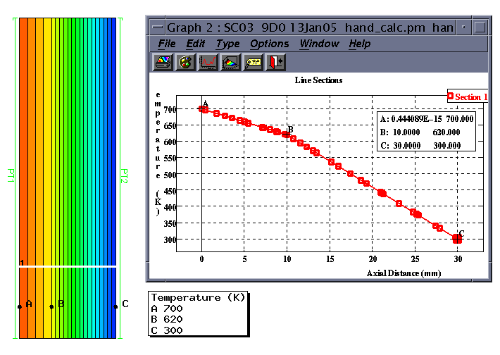
Conduction (6)
SC03 modelling of the simple case
  hand_calc.pm

Slide 9

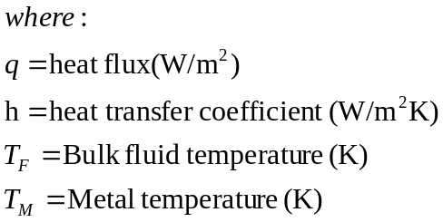
Convection
Newton’s Equation for 1-D
k₂
k₃
T₂
T₃
T₄
T_{F5}
h₅
T_{F1}
h₁
Δx₂₃
Δx₃₄

Slide 10
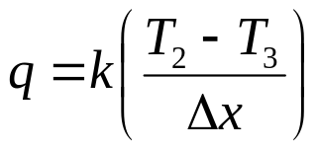
Convection (2)
1D steady-state hand calculation
  combined conduction & convection
Calculate T₂ ,T₃ & T₄
Note that
q₁₂=q₂₃ =q₃₄ =q₄₅ =q₁₅
Key equations
are:
k₂=10W/mK
k₃=5W/mK
T₂
T₃
T_{F5}=300K
h₅ =100W/m²K
T_{F1}=700K
h₁ =200W/m²K
T₄
q₁₂
q₂₃
q₃₄
q₄₅
Δx₂₃ =10mm
Δx₃₄ =20mm

Slide 11

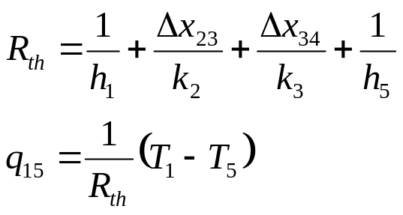
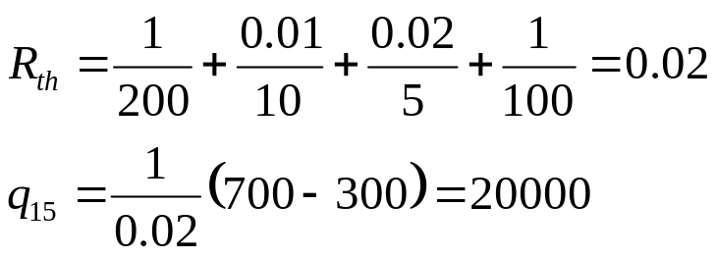
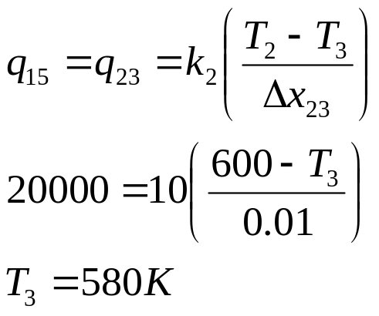
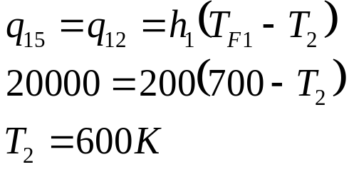
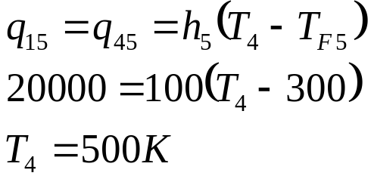
Convection (3)
k₂=10W/mK
k₃=5W/mK
T₂
T₃
T_{F5}=300K
h₅ =100W/m²K
T_{F1}=700K
h₁ =200W/m²K
T₄
q₁₂
q₂₃
q₃₄
q₄₅
Δx₂₃ =10mm
Δx₃₄ =20mm
Thus

Slide 12
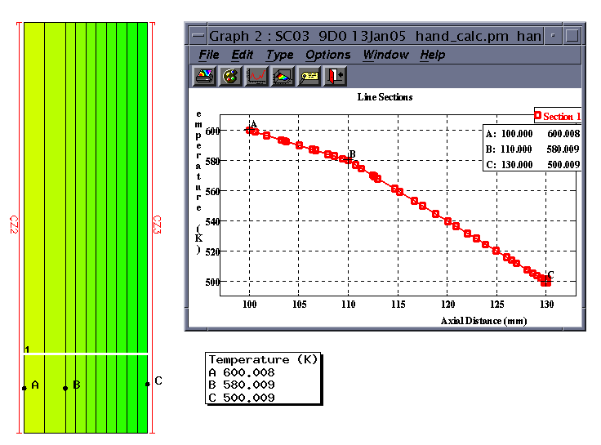
Convection (4)
SC03 modelling of the simple case
  hand_calc.pm

Slide 13

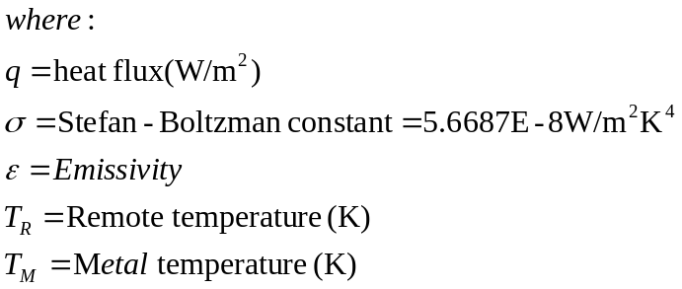
Radiation
Stefan-Boltzman Equation:
T_{R}
T_{M}
ε

Slide 14
Radiation (2)
1D steady-state
hand calculation
Calculate T₂ & T₃
Note that q₁₂=q₂₃=q₃₄
T₁ =700K
T₂
ε=0.5
Δx=10mm
k=5W/m²K
T₃
T₄=300K, h=200W/m²K

Slide 15
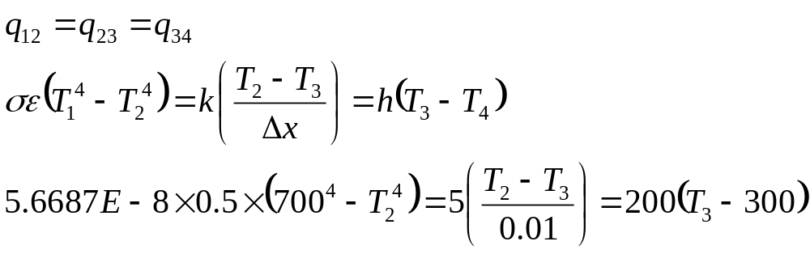
Radiation (3)
Note that q₁₂=q₂₃=q₃₄
T₁ =700K
T₂
ε=0.5
Δx=10mm
k=5W/m²K
T₃
T₄=300K, h=200W/m²K
Solving this gives:
  T2=344.836K, T3=332.027K

Slide 16
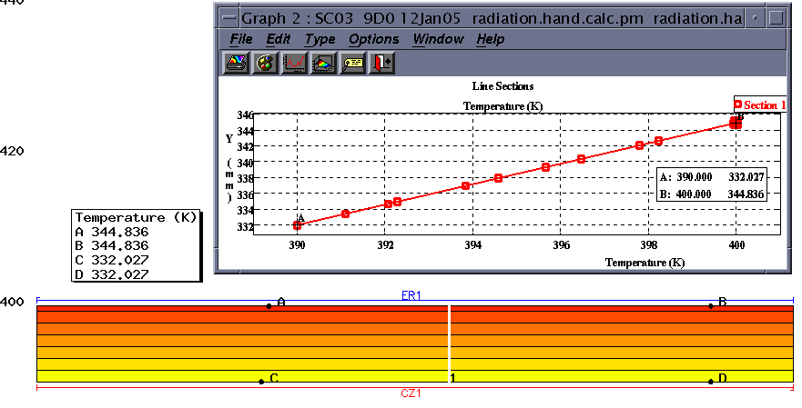
Radiation (4)
SC03 modelling of the simple case
  hand_calc.pm

Slide 17
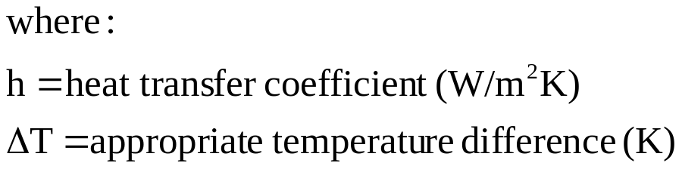
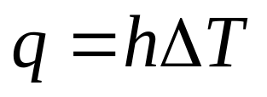
Radiation-in SC03 (1)
Stefan-Boltzman Equation:
T_{R}
T_{M}
In SC03 this is solved by re-arranging the equation into the same form as the convection equation, i.e.

Slide 18
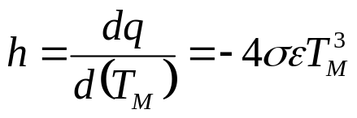
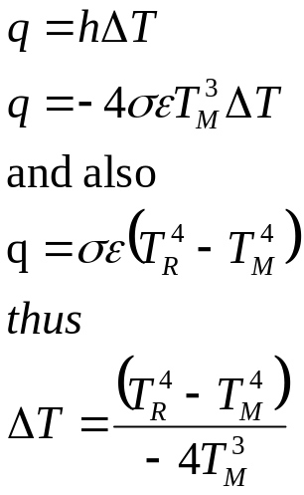
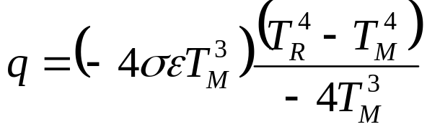
Radiation-in SC03 (2)
Manipulation of the equation:
  define htc as dq/d(T_{M})
  compare against standard convection equation
  thus, rearranged in ‘convection’ form, the radiation equation is:

Slide 19
Radiation-in SC03 (3)
1D steady-state
hand calculation
Calculate T₂ & T₃
Note that q₁₂=q₂₃=q₃₄
T₁ =700K
T₂
ε=0.5
Δx=10mm
k=5W/m²K
T₃
T₄=300K, h=200W/m²K

Slide 20
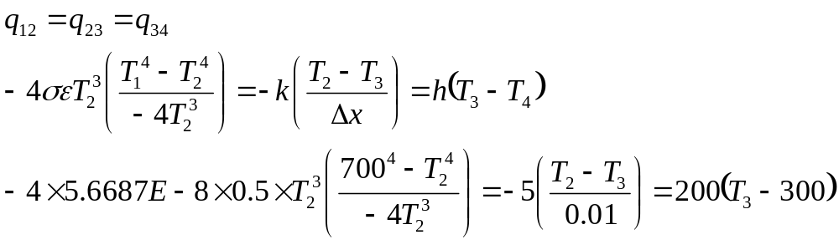
Radiation-in SC03 (4)
Note that q₁₂=q₂₃=q₃₄
T₁ =700K
T₂
ε=0.5
Δx=10mm
k=5W/m²K
T₃
T₄=300K, h=200W/m²K
Solving this gives:
  T2=344.836K, T3=332.027K

Slide 21

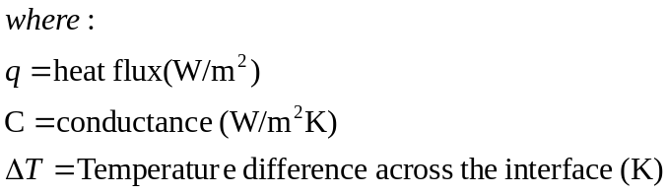
Thermal Contact
Additional thermal resistance at an interface
k₁
k₃
C
T₁
T₂
T₃
T₄
  Note that this is the same form as the convection equation:
Δx₁₂
Δx₃₄
  Thus in the same way that 1/h is a measure of the thermal resistance, 1/C is the equivalent for contact resistance

Slide 22
Thermal Contact (2)
1D steady-state
hand calculation
Calculate T₂ & T₂
Note that q₁₂=q₂₃ =q₃₄ =q₁₄
Key equations are:
k₁=10W/mK
k₃=5W/mK
C=500W/m²K
T₁ =700K
T₂
T₃
T₄ =300K
q₁₂
q₃₄
q₂₃
Δx₁₂ =10mm
Δx₃₄ =20mm

Slide 23
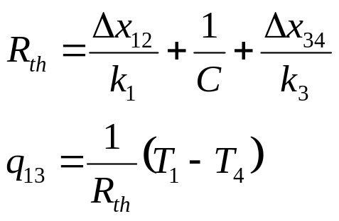
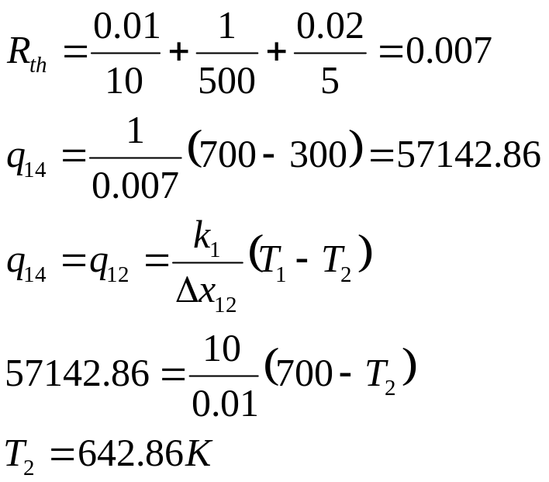
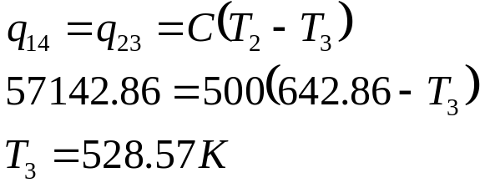
Thermal Contact (3)
Electrical Analogy
Thus
k₁=10W/mK
k₃=5W/mK
q₁₂ =q₂₃ =q₃₄ =q₁₄
C=500W/m₂K
T₁ =700K
T₂
T₃
T₄ =300K
q₁₂
q₃₄
q₂₃
Δx₁₂ =10mm
Δx₃₄ =20mm

Slide 24
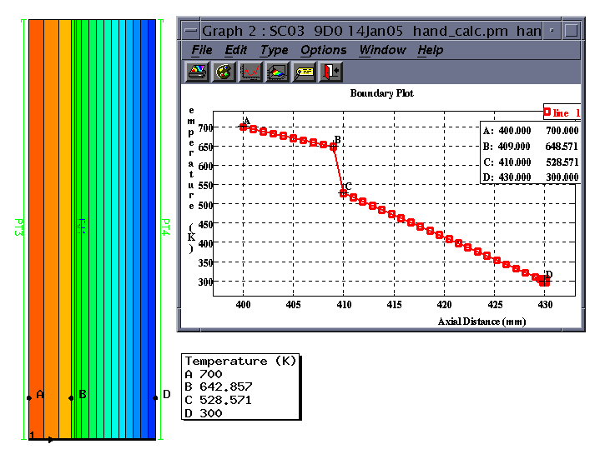
Thermal Contact (4)
SC03 modelling of the simple case
  hand_calc.pm

Slide 25
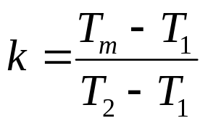
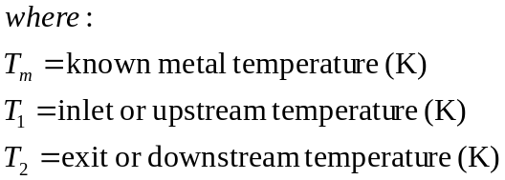

Steady-State Scaling (1)
Scale based on 2 appropriate performance parameters
  e.g. for HP Compressor drum scale on T26 & T30
  Metal temperature is known for particular condition
  ‘k-factor’ can then be calculated relating metal temperature to performance parameters
  Using this k-factor, metal temperatures can be calculated at another performance condition
K-factor calculation
Metal temperature at new condition

Slide 26
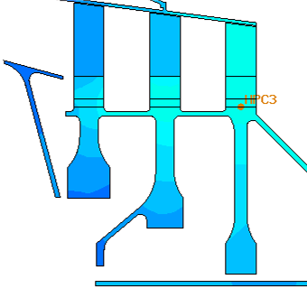
Steady-State Scaling (2)
Calculate the temperature of the HP compressor stage 3 disc rim at idle
  Rim temperature at max take off = 730.304K, where T26 = 462.705, T30 = 752.309
  At idle, T26 = 301.983K, T30 = 407.761K
Key equations are:

Slide 27
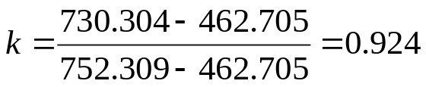
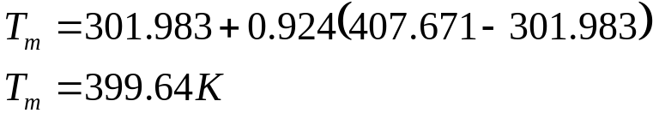
Steady-State Scaling (3)
Key equations are:
At max take off:
Thus assuming that the k-factor is valid at idle:

Slide 28
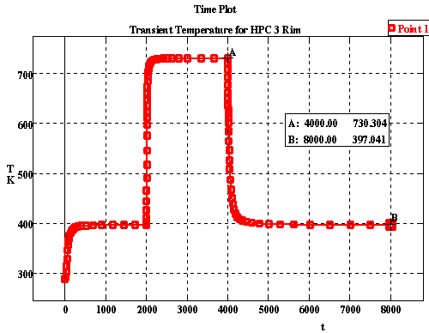
Steady-State Scaling (4)
SC03 modelling of the simple case
  transient_scaling.pm
Note the discrepancy between the scaled result and the FE result (2K)

Slide 29
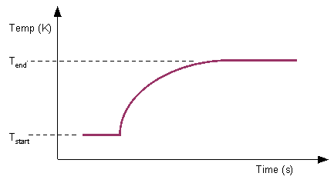
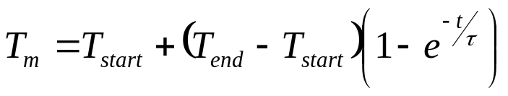
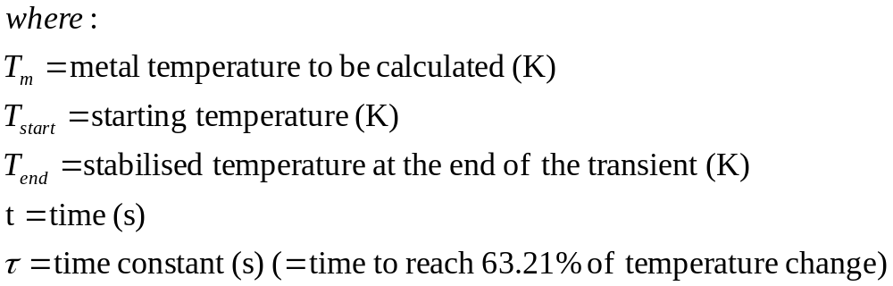
Transient Scaling (1)
Scale based on an assumed exponential heating or cooling curve:
τ can be determined by inspection of transient temperature plots from engine/rig tests or from previous finite element analyses
63.21% diff
Time Constant, τ

Slide 30
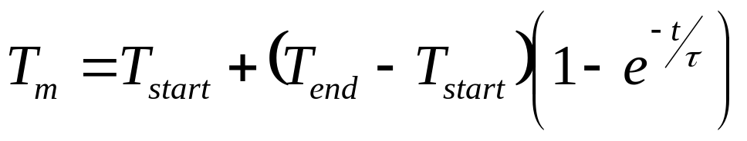
Transient Scaling (2)
Calculate the temperature of the HP compressor stage 3 disc rim 100.21 seconds after the start of the acceleration from idle to max take-off
  Stabilised rim temperature at max = 730.304K
  Stabilised rim temperature at idle = 397.041K
  Time constant = 44.7426s
Key equation is:

Slide 31
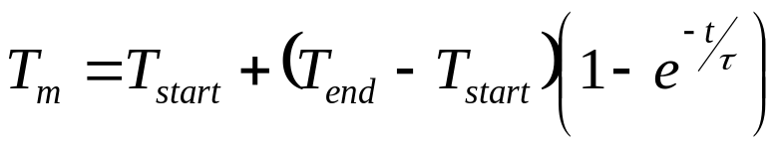
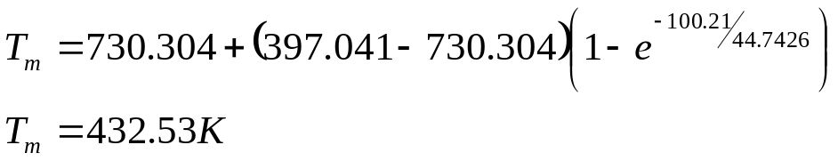
Transient Scaling (3)
Key equation is:

Slide 32
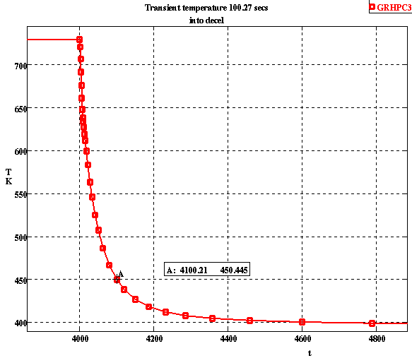
Transient Scaling (4)
SC03 modelling of the simple case
  transient_scaling.pm
Note the discrepancy between the scaled result and the FE result (18K)!

Slide 33
Displacements
Thermal effects
CF effects
Pressure effects
Tensile/Compressive Effects

Slide 34


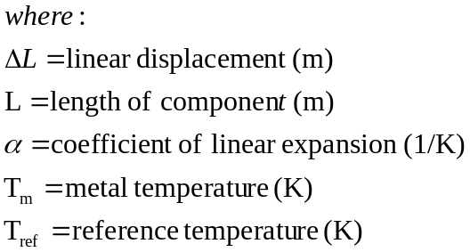
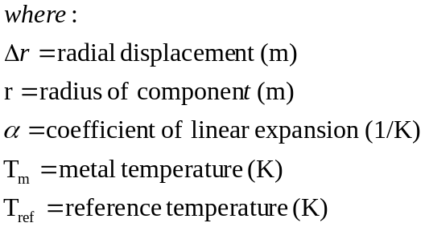
Displacements – Thermal Effects (1)
Thermal expansion is governed by the equation:
For a bar
For a cylinder
T_{m} α
r
L
T_{m}

Slide 35
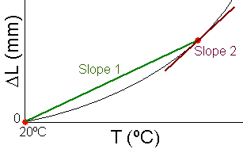
Displacements – Thermal Effects (2)
Definition of α used within SC03
  COMMIT (and hence SC03) use a definition of α referenced to 20ºC. i.e. a 'mean' value of alpha corresponding to slope 1 on the graph below for a particular temperature.
  Some data sources may quote α as a local value (corresponding to slope 2 on the graph below).

Slide 36
Displacements – Thermal Effects (3)
Calculate the thermal growth of the bar as it is heated from 400K to 800K
Key equation is:
Calculate the thermal growth from 20ºC to 800K - growth1
Calculate the thermal growth from 20ºC to 400K – growth2
Calculate growth1-growth2
α= 0.8E-5 /K@400K
α= 1.6E-5 /K@800K
L=400mm

Slide 37



Displacements – Thermal Effects (4)
Key equation is:
Thermal growth due to temperature increase from 400K to 800K
α=0.8E-5 /K@400K
α=1.6E-5 /K@800K
L=400mm

Slide 38


Displacements – Thermal Effects (5)
SC03 modelling of the simple case
  hand_calc.pm
  At ramp 1 step 1 (Tm=400K), dx= 0.34192mm
  At ramp 3 step 1 (Tm=800K), dx= 3.24384mm
  Thermal growth from 400 to 800K = 2.902mm

Slide 39
Displacements – Thermal Effects (6)
Calculate the thermal growth of the cylinder as it is heated from 400K to 800K
Key equation is:
Calculate the thermal growth from 20ºC to 800K - growth1
Calculate the thermal growth from 20ºC to 400K – growth2
Calculate growth1-growth2
r=500mm
T_{m}
α=0.8E-5 /K@400K
α=1.6E-5 /K@800K

Slide 40



Displacements – Thermal Effects (7)
Key equation is:
Radial growth due to temperature increase from 400K to 800K
T_{m}
r=500mm
α=0.8E-5 /K@400K
α=1.6E-5 /K@800K

Slide 41


Displacements – Thermal Effects (8)
SC03 modelling of the simple case
  hand_calc.pm
  At ramp 1 step 1 (Tm=400K), drad= 0.4274mm
  At ramp 3 step 1 (Tm=800K), drad= 4.0548mm
  Thermal growth from 400 to 800K = 3.6724mm

Slide 42


Displacements – CF Effects (1)
There is no simple equation for the displacement due to CF effects
Instead, values for CF growth are scaled on speed-squared from a known displacement at a known rotational speed
Δr known at N₁
Scale to find Δr at N₂

Slide 43
Displacements – CF Effects (2)
Calculate the radial growth of the disc at a rotational speed of 1500rad/s
Note that at 1000rad/s the radial growth due to CF is 2mm
Key equation is:
At N₁=1000rad/s, Δr=0.242787mm
Scale to find Δr at 1500rad/s

Slide 44

Displacements – CF Effects (3)
Key equation is:
At N₁=1000rad/s, Δr=0.242787mm
Scale to find Δr at 1500rad/s

Slide 45


Displacements – CF Effects (4)
SC03 modelling of the simple case
  hand_calc.pm

Slide 46


Displacements – Pressure Effects (1)
If the wall thickness of a cylinder is small compared to the other dimensions (diameter, length) then a thin wall approximation can be made
p
r
T

Slide 47
Displacements – Pressure Effects (2)
Calculate the radial growth of the cylinder due to:
  internal pressure load of 2MPa
  external pressure load of 0.4MPa
Key equation is:
E=221750MPa
p=0.4E6Pa
r=300mm
p=2E6Pa
T=1mm

Slide 48

Displacements – Pressure Effects (3)
Key equation is:
E=221750MPa
p=0.4E6Pa
r=300mm
p=2E6Pa
T=1mm

Slide 49

Displacements – Pressure Effects (4)
SC03 modelling of the simple case
  hand_calc.pm

Slide 50


Displacements – Tensile Effects (1)
Tensile/compressive effects are governed by the equation:
Area, A
Ε
F
L

Slide 51

Displacements – Tensile Effects (2)
Calculate the axial growth of the cylinder due to the load of 10E6N
Key equation:
Inner radius =295mm
Outer radius =300mm
Ε=221750MPa
F=10E6N
L=50mm

Slide 52


Displacements – Tensile Effects (3)
Key equation:
Inner radius =295mm
Outer radius =300mm
Ε=221750MPa
F=10E6N
L=50mm

Slide 53

Displacements – Tensile Effects (4)
SC03 modelling of the simple case
  hand_calc.pm

Slide 54

Model Details - Conduction
Open SC03 with hand_calc_base.pm
Locate the geometry for the conduction example
Apply Prescribed temperatures using Thermal/Prescribed Temps
Run the model (Analysis/Run)
Use Results/Get Values to determine the temperature at the T₂
Extension Activity
  Increase the width of the blocks
    double just the left block width
    double just the right block width
    double both block widths
T₂
PRESCRIBED TEMPERATURES
-----------------------
| INDEX | 1
| TEMPERATURE | t30
| INDEX | 2
| TEMPERATURE | t26

Slide 55
Model Details – Thermal Contact
Open SC03 with hand_calc_base.pm
Locate the geometry for the thermal contact example
Apply Prescribed temperatures using Thermal/Prescribed Temps
Apply Thermal Contact at the interface
Apply a Fixed Joint (Structural/Joints) at the interface
Run the model (Analysis/Run)
Use Results/Get Values to determine the temperatures T₂ and T₃ either side of the interface
T₂
T₃
THERMAL CONTACT
---------------
| PERFECT CONDUCTION TOGGLE | OFF
| CONDUCTANCE | 0.5
PRESCRIBED TEMPERATURES
-----------------------
| INDEX | 3 | INDEX | 4
| TEMPERATURE | t30 | TEMPERATURE | t26
Extension Activity
  Modify values of conductance from 0.1 to 10

Slide 56
Model Details - Convection
Open SC03 with hand_calc_base.pm
Locate the geometry for the convection example
Apply Convecting Zones using Thermal/Convecting Zones
Run the model (Analysis/Run)
Use Results/Get Values to determine the temperature at T₂, T₃ and T₄
Extension Activity
  Increase the temperature of convecting zone 2
    by 100K
    by 200K
    by 300K
  See the effects on T₃
T₂
T₃
T₄
CONVECTING ZONES
----------------
| INDEX | 2
| FLUID TYPE | air
| TEMPERATURE | t30
| PRESSURE | 0
| HTC | 0.2
| INDEX | 3
| FLUID TYPE | air
| TEMPERATURE | t26
| PRESSURE | 0
| HTC | 0.1

Slide 57
Model Details - Radiation
Open SC03 with hand_calc_base.pm
Locate the geometry for the radiation example
Apply Convecting Zone using Thermal/Convecting Zones
Apply External Radiation using Thermal/External Radiation
Run the model (Analysis/Run)
Use Results/Get Values to determine the temperature at T₂ and T₃
Extension Acivity
  Change the emissivity in the range 0 to 1
  See the effect on T₂ and T₃
T₂
T₃
CONVECTING ZONES
----------------
| INDEX | 1
| FLUID TYPE | air
| TEMPERATURE | t26
| PRESSURE | 0
| HTC | 0.2
EXTERNAL RADIATION
------------------
| INDEX | 1
| EMISSIVITY | 0.5
| REMOTE TEMP. | t30

Slide 58

Model Details – Transient Analyses
Open SC03 with transient_scaling.pm
Run the model (Analysis/Run)
Plot graphs (Graphs/Plot graphical item) for:
  grhptcob
  grhpc1cob
  grcoc
  grhpip
Toggle ON the ‘steady-state’ option from Model/Global Control/Thermal Control
Run the model (Analysis/Run)
Re-plot graphs defined above
Copy and paste graphs to compare
Extension Activity
  modify boundary conditions to speed up the response at the COC

Slide 59

Model Details – Transient Analyses

