Slide 1
Indy Academy
Heat Transfer
Course No. E00410
Dave Fox, Instructor

Slide 2
Presentation Overview – Heat Transfer
Introduction
  Organizational structure
  Motivation for thermal analysis
Basic heat transfer theory
  Conduction, convection, radiation
  Thermal material properties
Thermal analysis overview
  Inputs, analysis tools, outputs
  Examples of thermal analyses
  Thermal testing / Model validation
Conclusion
  Closing comments, web site location

Slide 3
Organization Structure – Heat Transfer
Propulsion Systems, System Analysis (Paul Owen)
  RRC non-turbine thermal analysis
Fans, Compressors & Turbines OBU, Turbines Aerothermal Design (Steve Gegg)
  RRC turbine thermal analysis
Design Methods and Technology, Mechanical Methods and Acoustics (Bill Dalton)
  RRC thermal methods
AADC Heat Transfer (Jim Forry)
  AADC thermal analysis and methods

Slide 4
Propulsion Systems Organization Structure for Thermal Analysis
Susan Watkin, Director, Propulsion Systems Engineering
  Steve Murray, Chief, Propulsion Systems Design
    Paul Owen, Manager, System Analysis, Thermal and Flow
      Dave Fox, Technical Specialist
      Ashok Chandoke
      Ron Hall
      Bob Koth
      Matt Miller
      Dick Trippett
      Michael Zhivov

Slide 5
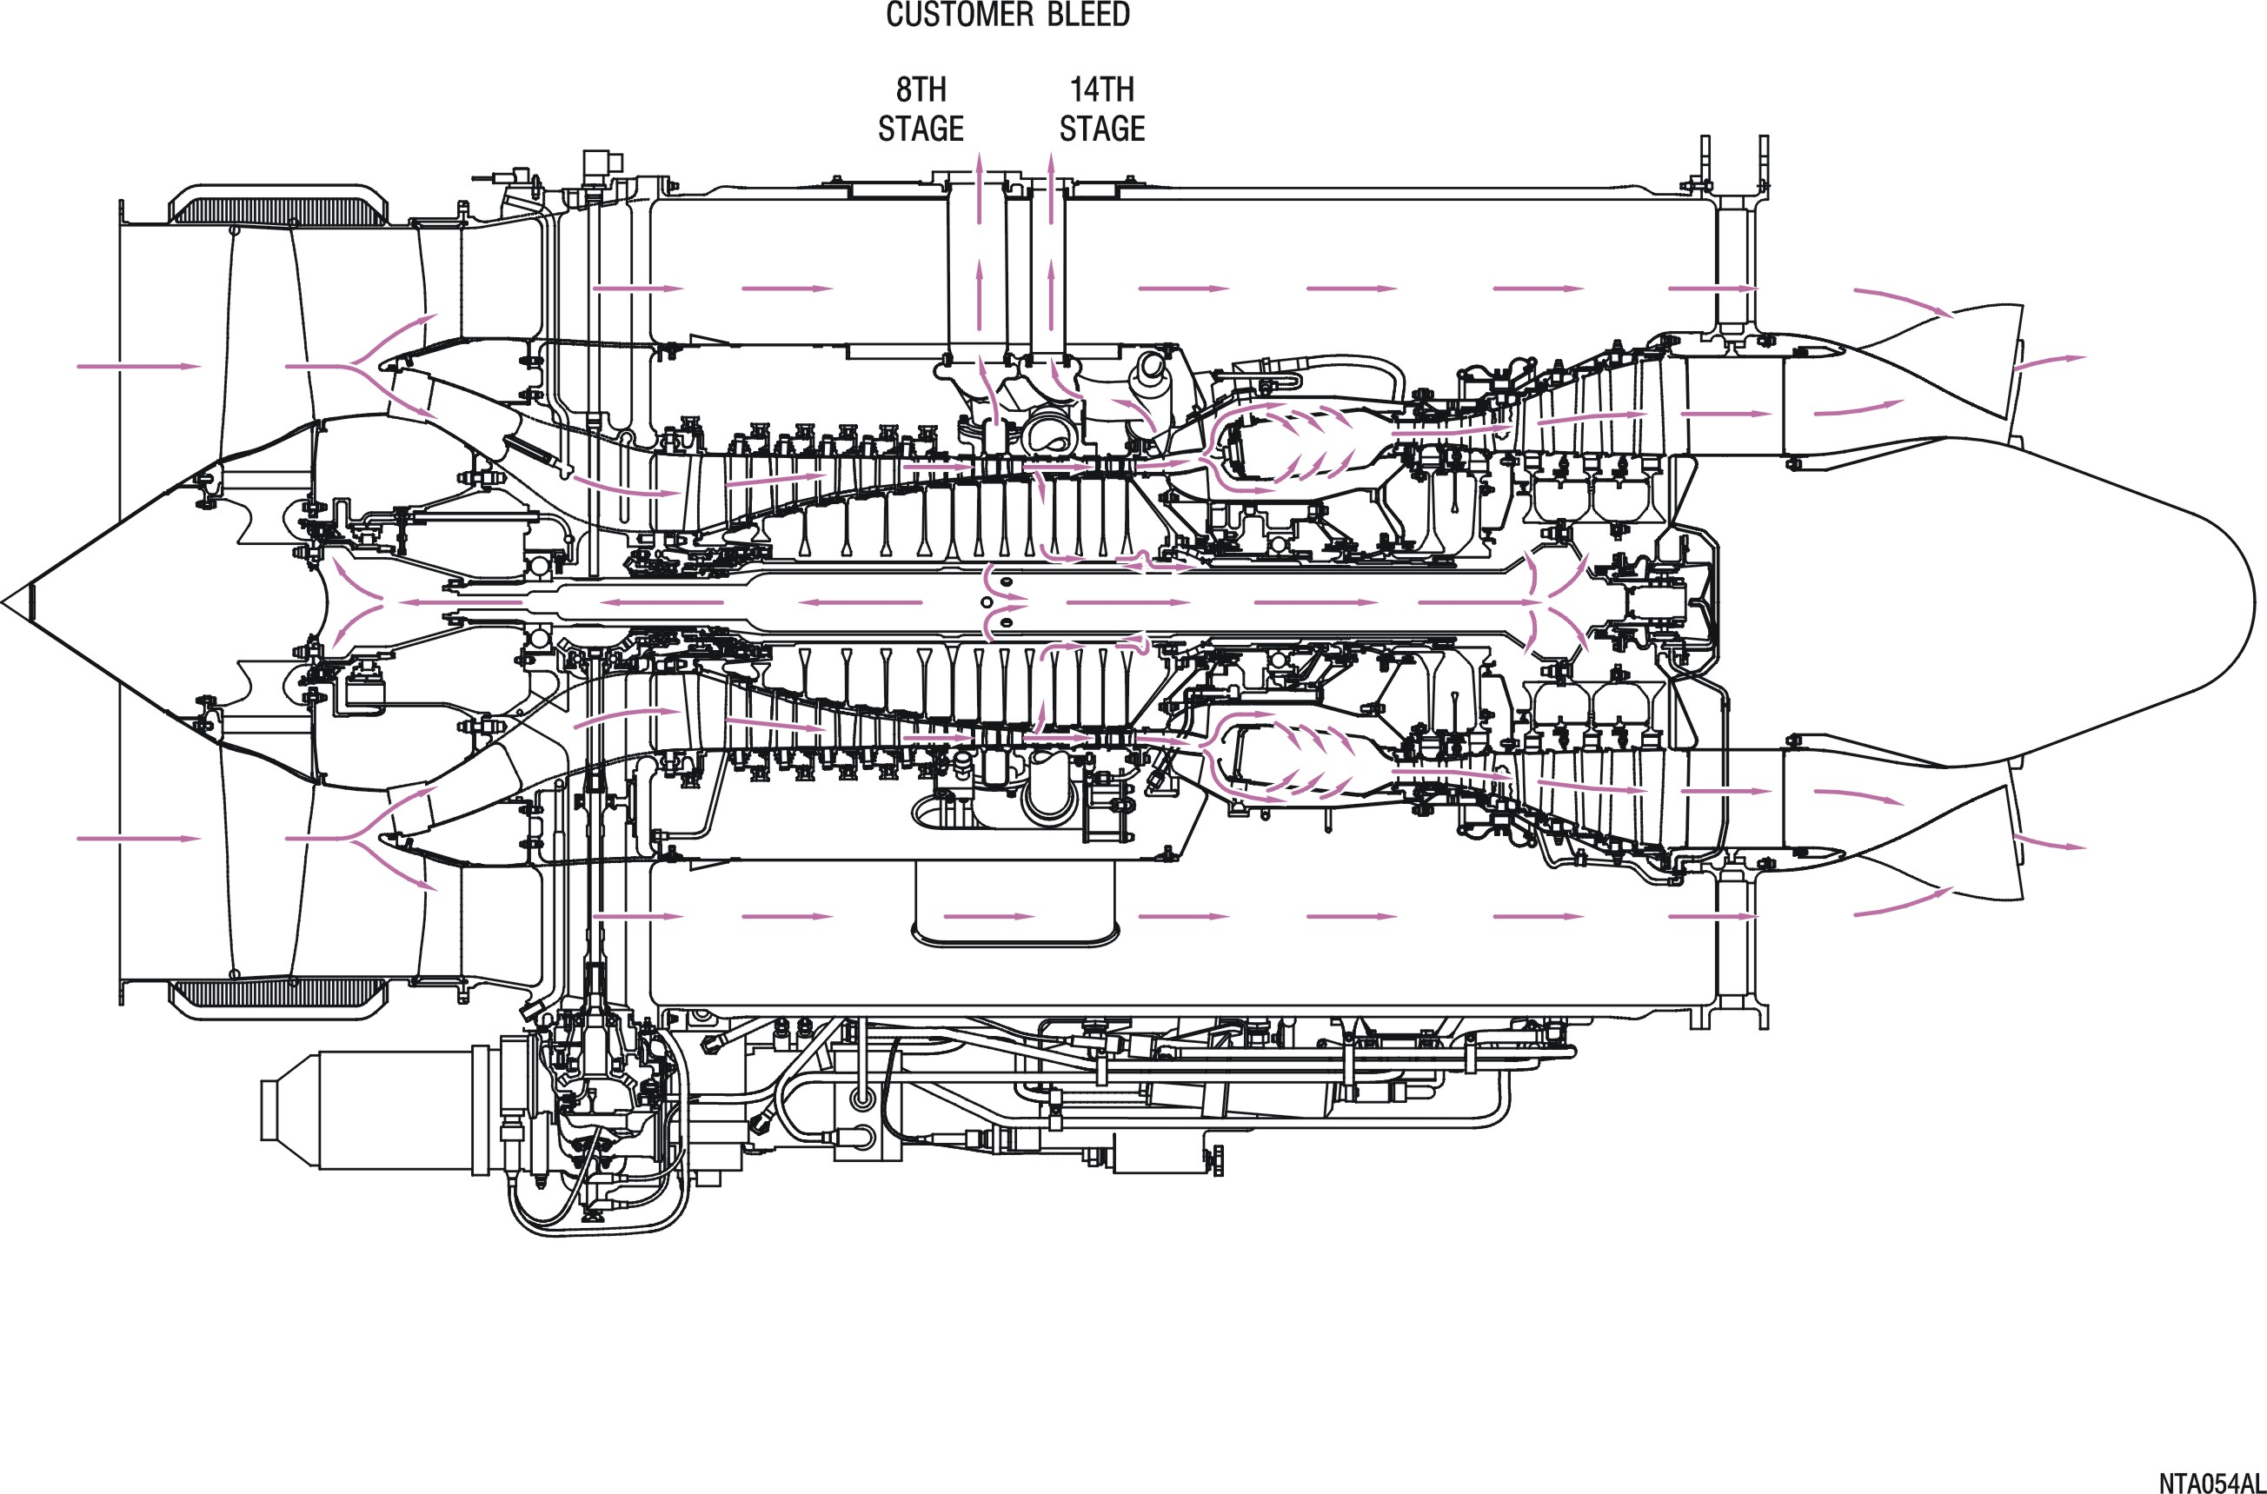
Motivation for Thermal Analysis
“Everything is thermally-related.”
- Susan Watkin

Slide 6
Why perform thermal analyses?
Selection of appropriate materials
Calculation of thermally-induced stresses
Evaluation of blade tip and seal clearances
Support evaluation of integrity, lifing, cost, weight, and performance

Slide 7
Typical Thermal Analysis Applications
IBD Temps
(material selection
for soakback)
Bleed Tube Mounts
(cost reduction)
Fan Blade
Tip Clearance
(performance)
Front Frame
(structural)
Compressor
Blade Tip
Clearance
(performance)
Anti-icing?
(safety)
Pilot Loads
(structural,
α-mismatch)
Carbon Seal
Temperatures
(oil smell)
Wheel
Thermo-mechanical
Stresses
(LCF lifing)
Thermal
Loads at
Bearing
(lifing)
Sump Temperatures
(material selection)
Tiebolt Clamp
(structural,
performance)

Slide 8
Typical Thermal Analysis Applications
Effusion-cooled
Combustor Liner
(crack initiation?)
Turbine Airfoil
Internal Cooling
(structural integrity)
Turbine Blade
Tip Clearance
(performance)
Wheel Cavity
Purge Air
(prevent ingress)
Sump Temperatures
(oil coking?)
Preswirler
(turbine cooling)
Turbine Wheel
Thermo-mechanical
Stresses
(LCF lifing)
Axial Limit Stack
(rotor-stator gaps)

Slide 9
Heat Flow and Temperature
Heat flow is the transfer of thermal energy (energy/time) between two systems.
  English units: BTU/hr
  SI units: watts
  Conversion: 1 BTU/hr = 0.293 watts
Temperature is a measure of the ability of a system to absorb or give up heat.
  English units: °F (Fahrenheit)
  SI units: °C (Celsius)
  Conversion: °F = (1.8 * °C) + 32

Slide 10
Heat Transfer Mechanisms
Conduction – heat carried through a stationary medium (solid or fluid)
Convection – heat carried by a moving fluid
Radiation – heat carried by electromagnetic waves (photons)

Slide 11
Heat Transfer by Thermal Conduction
T₁
T₂
k
Δx
q = k A (ΔT / Δx)
  q = heat flow (BTU/hr)
  k = thermal conductivity (BTU/hr-ft-°F)
  A = surface area (ft²)
  ΔT = T₂ - T₁ = delta temperature (°F)
  Δx = delta distance (ft)

Slide 12
Thermal Conductivity – Typical Values
MATERIAL (at 70°F)
k
(BTU/hr-ft-°F)
Aluminum | 89
410 Stainless Steel | 14
IN-718 | 6.6
Titanium | 4.0
Min-K Insulation | 0.04
Air | 0.015

Slide 13
Heat Transfer by Convection
T_{f}
T_{s}
q = h A (T_{s} – T_{f})
  q = heat flow (BTU/hr)
  h = convection coefficient (BTU/hr-ft²-°F)
  A = surface area (ft²)
  T_{s} = surface temperature (°F)
  T_{f} = fluid temperature (°F)

Slide 14
Evaluation of Convection Coefficients
Example -- Empirically-derived correlation for turbulent flow over a flat plate:
h = 0.036 (k / L) (ρ V L / μ)^{0.8} (Pr)^{0.33}
h = convection coefficient (BTU/hr-ft²-°F)
k = thermal conductivity of air (BTU/hr-ft-°F)
L = length of plate (ft)
ρ = density of air (lb/ft³)
V = velocity of air (ft/hr)
μ = viscosity of air (lb/ft-hr)
Pr = Prandtl Number of air (dimensionless)

Slide 15
Convection Coefficients – Typical Values
CONVECTION COEFFICIENT
(BTU/hr-ft²-°F)
CONDITION
15 MPH air at atmospheric pressure (Low velocity, low pressure) | 5
Gaspath at compressor inlet (High velocity, low pressure) | 75
Gaspath at compressor exit (High velocity, high pressure) | 1000
Convection coefficient increases as velocity and pressure increase.

Slide 16
Evaluation of Coolant Air Temperature Rise
W
T_{s}
Tin
T_{ex}
W cp (T_{ex} – T_{in}) = h A [ T_{s} – (T_{ex} + T_{in})/2 ]
  W = air flow rate (lb/sec)
  cp = specific heat of air (BTU/lb-°F)
  T_{ex} = air exit temperature (°F)
  T_{in} = air inlet temperature (°F)
  h = convection coefficient (BTU/hr-ft²-°F)
  A = surface area (ft²)
  T_{s} = surface temperature (°F)

Slide 17
Specific Heat – Typical Values
MATERIAL
(at 70°F)
Cp
(BTU/lb-°F)
Water | 1.0
Oil, Mil-L 23699 | 0.46
Air | 0.24
410 Stainless Steel | 0.11

Slide 18
Heat Transfer by Radiation
T_{env}
T_{s}
q = ε σ A ( T_{s}⁴ – T_{env}⁴)
  q = heat flow (BTU/hr)
  ε = surface emissivity (dimensionless)
  σ = Stefan-Boltzman constant (0.1714 x 10⁻⁸ BTU/hr-ft²-°R⁴)
  A = surface area (ft²)
  T_{s} = surface temperature (°R) (°R = °F + 459.6)
  T_{env} = black-body environment temperature (°R)

Slide 19
Emissivities – Typical Values
EMISSIVITY
0 ≤ ε ≤ 1
SURFACE
Silver: Polished | 0.02
Steel: Polished | 0.07
Steel: Oxidized | 0.7
Black Paint | 0.95

Slide 20
Transient Heat Transfer (Time Dependent)
Lumped-Mass Thermal Capacitance Model
T_{f}
Temperature
T_{i}
τ
Time
T(t) = T_{i} + (T_{f} – T_{i})(1 – e^{(-t/τ)})
  T(t) = Temperature of lumped-mass as a function of time
  T_{i} = Initial temperature (°F)
  T_{f} = Final temperature (°F)
  τ = Time Constant = ρVcp/hA =
  time for 63% stabilization

Slide 21
Inputs to Thermal Analysis Model
Design – geometric definition, material selection
Performance – engine cycles and flight missions
Aerodynamics – gaspath temperatures, pressures, and velocities
Secondary flow – internal pressures and flows

Slide 22
Thermal Analysis Capabilities
Current thermal analysis tool: SC03
  Axisymmetric and 3-D models
  Automatic mesh generation
  Built-in material properties library
  Built-in convection coefficient correlations
  Surface-to-surface radiation
  Menu-driven entry of boundary conditions
  User-defined expressions
  “Plug-ins” for automated input
  Modeling of internal “streams” and “voids”
  Time-dependent boundary conditions
  Automated time-stepping
  Coupled thermo-mechanical analysis capability
Legacy thermal analysis tool: STRATAHT

Slide 23
Outputs from SC03 Thermal Analysis Model
Metal temperatures for structural analysis
  Temperature contour plots
  Temperature-versus-time plots
  Animated temperature contour plots
Air temperature rise for streams and voids
Thermo-mechanical analysis results
  Deflected shape plots
  Clearance/deflection-versus-time plots
  Animated deflected shape plots

Slide 24
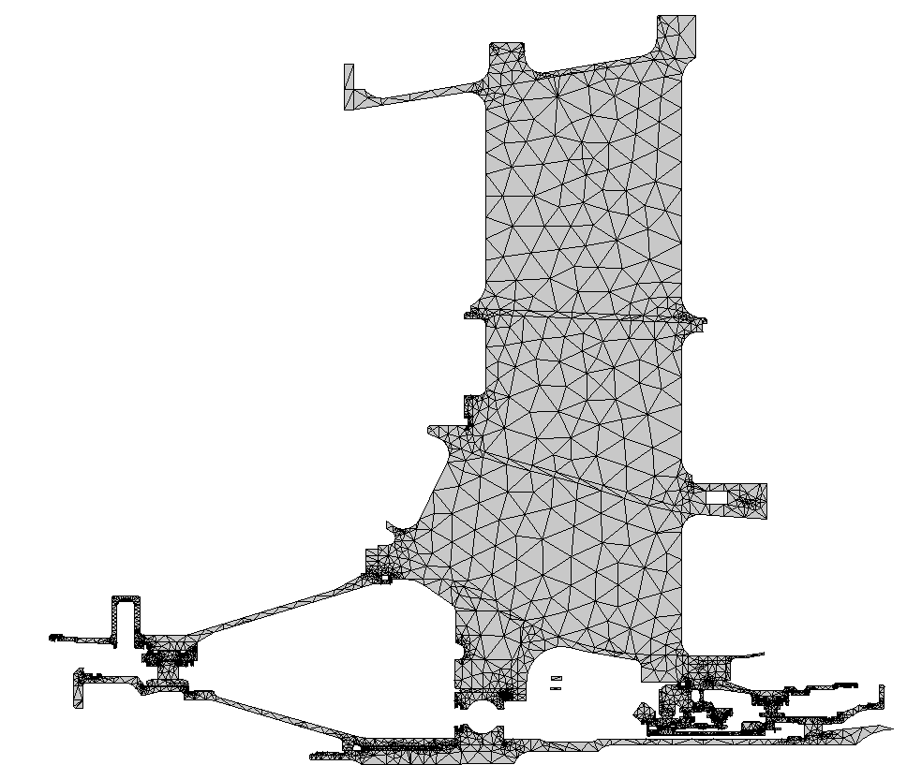
Example #1: Front Frame Thermal Analysis
INPUTS
Axisymmetric finite element geometry definition
Strut thicknesses
Thermal material properties
Bypass air temperatures, pressures, and velocities
Core air temperatures, pressures, and velocities
Oil inlet temperature, flow rate
Bearing heat generation
Carbon seal heat generation
Buffer air inlet temperature, pressure, and flow rate
LP shaft speed
Bypass air
Core air
#1 Ball Bearing

Slide 25
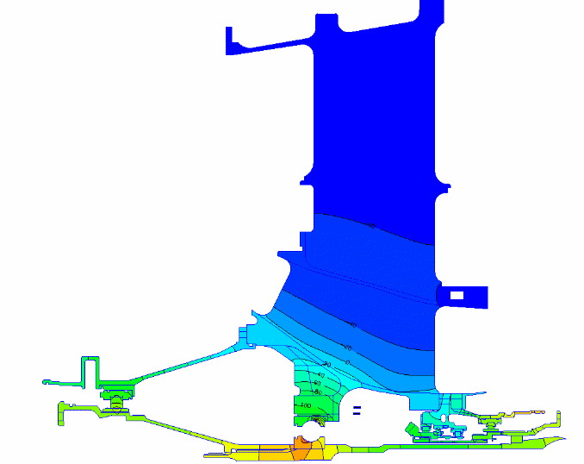
Example #1: Front Frame Thermal Analysis
RESULTS
At high-altitude flight idle, front frame structure at gaspath much cooler than near the #1 ball bearing
Thermal field generates significant compressive load at #1 ball bearing (magnesium has high α)
Calculated loads used to evaluate and improve bearing life

Slide 26
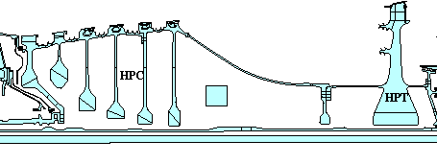
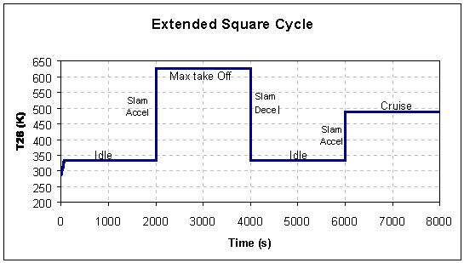
Example #2: HP Compressor Stage 6
Transient Thermal Analysis
Rim
HPC Stage 6
Bore

Slide 27
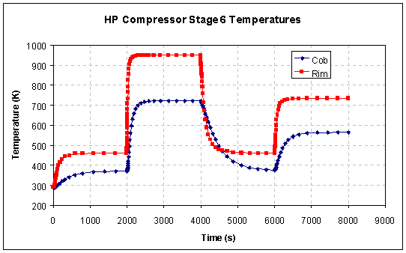
Example #2: HP Compressor Stage 6
Transient Thermal Analysis
Startup
Idle
Takeoff
Idle
Cruise
Maximum
Rim-Bore
Δ Temperature
Minimum
Rim-Bore
Δ Temperature
Note: “Bore” (US) = “Cob” (UK)

Slide 28
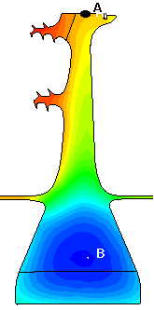
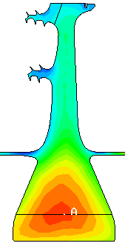
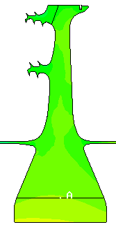
Example #3: Importance of Thermals for Evaluation of Turbine Disk Stress/Life
TEMPERATURE
TANGENTIAL STRESS
Temperature @ Time = 60 sec after accel to maximum power
(Hot rim, cool bore)
Bore stress, including thermal stress = 1170 Mpa
Bore stress, excluding thermal stress = 607 Mpa
RIM
RIM
BORE
BORE

Slide 29
Validation of Thermal Models
Thermal models are no more accurate than the applied boundary conditions.
Thermocouples and/or thermal paint strongly recommended to validate thermal models
Models calibrated to test data by adjusting thermal boundary conditions as needed:
  Thermal contact assumptions
  Convection coefficient multipliers
  Emissivity values
  Leakage/ingress flow adjustments
Calibrated models then used to analyze other operating cycles or other engine configurations with high degree of confidence

Slide 30
Thermocouples and Thermal Paint
THERMOCOUPLES
THERMAL PAINT
Advantages:
  Accurate (±1%)
  Provides transient data
  Data for multiple test cycles on same build
Disadvantages:
  Intrusive, discreet
  Possibility of failure
  More expensive
  Slip-ring or telemetry required for rotating structures
Advantages:
  Large areas surveyed
  Temperature patterns easily visualized
  Less expensive
Disadvantages:
  Less accurate (±40°F)
  Interpretation required
  Dedicated test required
  No transient data – only indicates highest tested temperatures

Slide 31
Solutions to Thermally-Related Problems
Change materials
Restrict/eliminate conduction paths
Add insulation (ineffective without heat “sink”)
Add/increase cooling air flow or oil flow
Increase surface area of cooled surfaces
Improve seal capability
Add radiation/convection heat shields
Add/remove mass (for transient response)
Redesign interference-fits
Break hoop-integrity of static structures
Change operating conditions/cycles

Slide 32
Closing Comments – Key Points to Remember
“Everything is thermally-related.”
Theory of conduction, convection, and radiation
Who to contact for thermal analysis work
Excellent thermal analysis capabilities at RRC
Thermal stresses can exceed mechanical stresses
Test data is vital to calibrate thermal analyses
More information on the Thermo-mechanics web:
http://www.capability.rolls-royce.com/genthermal/default.htm

