Slide 1

N RACHANA
Final Project
3/21/2024 Annual Review

Slide 2

KEYLOGGER AND SECURITY
KEYLOGGER : A keylogger is a type of software or hardware that is designed to record every
Keystroke made on a computer or mobile device.
It takes the information and sends it to a hacker using a command-and-control (C&C) server.
3/21/2024 Annual Review

Slide 3


AGENDA
1 Introduction to Keylogger.
2.Types of keyloggers
3.Implimentation
4.Advantages of keyloggers
5.Disadvantages of keyloggers
6.Different end users
3/21/2024 Annual Review

Slide 4

PROBLEM STATEMENT
"Investigate the impact of keyloggers on cybersecurity measures and explore the effectiveness of security protocols in detecting and preventing keylogger attacks. Develop strategies to enhance protection against keyloggers while considering the ethical implications of using such technology. Analyze the legal frameworks surrounding keylogger usage and propose recommendations for individuals and organizations to safeguard their sensitive information from potential keylogging threats."
3/21/2024 Annual Review

Slide 5

keyloggers
Keyloggers can be used for both legitimate and malicious purposes. Legitimate uses include monitoring children's online activities or tracking employee productivity. However, they can also be used by cybercriminals to steal personal information or financial details. To prevent falling victim to keyloggers, it's essential to keep your devices updated with the latest security patches, use reputable antivirus software, be cautious of clicking on suspicious links or downloading unknown files, and consider using virtual keyboards for entering sensitive information. If you suspect your device may be infected with a keylogger, it's crucial to run a full antivirus scan, change your passwords from a clean device, and consider seeking help from a cybersecurity professional to remove the keylogger and secure your system.
3/21/2024 Annual Review

Slide 6
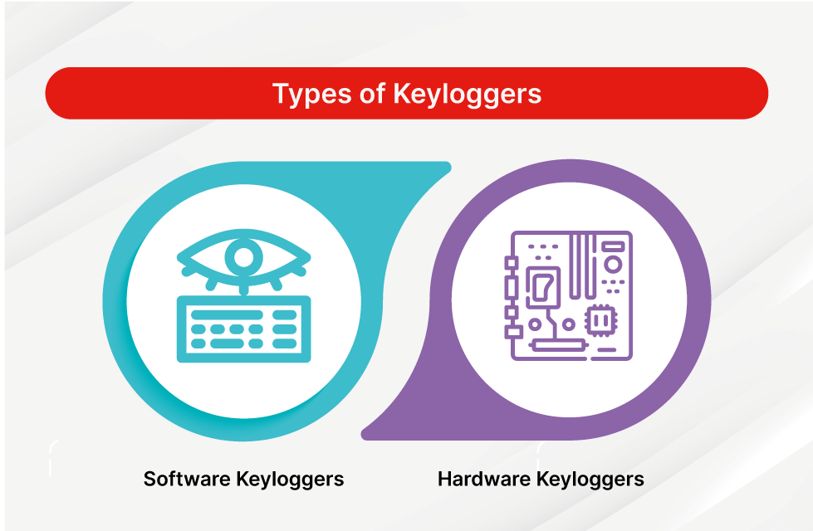

Types of Keyloggers
3/21/2024 Annual Review

Slide 7

Software keyloggers:
Software keyloggers are programs that can be installed on a computer or device to record all keystrokes made by the user. They can capture sensitive information like passwords, credit card details, and personal messages.
Hardware keyloggers:
Hardware keyloggers are physical devices that can be plugged into a computer or keyboard to record keystrokes. They are discreet and can capture all information entered on the keyboard, including passwords and sensitive data.
3/21/2024 Annual Review

Slide 8



Implementation:
3/21/2024 Annual Review
8

Slide 9


Output:
Teams cam add wireframes
3/21/2024 Annual Review
9

Slide 10
Advantages of Keyloggers
Keyloggers can have some advantages in certain situations.
They can be used by parents to monitor their children's online activities and ensure their safety.
Employers may use keyloggers to track employee productivity and prevent data breaches.
Additionally, individuals can use keyloggers to recover lost data or passwords.
However, it's crucial to use keyloggers ethically and legally, respecting privacy rights and obtaining consent when monitoring others' activities.
3/21/2024 Annual Review
10

Slide 11

Disadvantages of keyloggers
Keyloggers can also have significant disadvantages.
They pose a serious threat to privacy as they can capture sensitive information like passwords and personal messages without the user's consent.
Malicious keyloggers used by cybercriminals can lead to identity theft, financial loss, and other forms of cyberattacks
. Additionally, the presence of keyloggers can erode trust in personal and professional relationships if used inappropriately.
It's essential to be cautious and take steps to protect against the negative impacts of keyloggers.

Slide 12
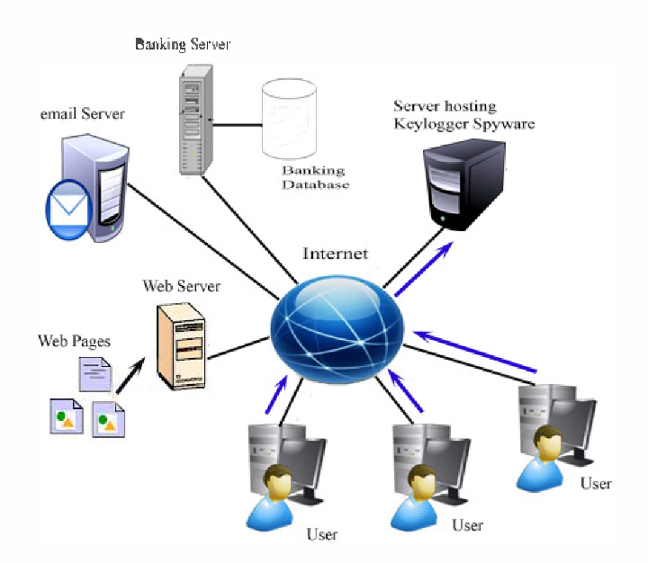
End Users of Keyloggers
1.Parents might use a keylogger to monitor a child's screen time.
2.Companies often use keylogger software as part of employee monitoring software to help track employee productivity.
3.Information technology departments can use keylogger software to troubleshoot issues on a device.

Slide 13
Results:
In results, keyloggers can serve various purposes, such as monitoring children's online activities, tracking employee productivity, or recovering lost data. However, it's crucial to use them ethically and responsibly to protect privacy and prevent potential risks associated with unauthorized data capture. By understanding the advantages and disadvantages of keyloggers, individuals can make informed decisions about their use while prioritizing security and privacy.

Slide 14
My Project GitHub link is here:
https://github.com/nrachana512/cybersecurityproject.git

