Slide 1




STRATEGIC BUSINESS REVIEW
Customer Shopping Behavior Analysis
Executive Brief — Comprehensive Data Insight
& Strategic Recommendations
DATE
DATA SCOPE
December 2025
3,900 Transactions
Confidential & Proprietary • Internal Distribution Only
GENSPARK
AI

Slide 2





EXECUTIVE SUMMARY
What Leaders Need to Know
A high-level synthesis of 3,900 customer transactions, identifying key revenue drivers and strategic opportunities.
Data Scope
Key Analyses
Strategic Imperatives
3,900
Revenue by Demographics
Boost Subscriptions
Gender and age group spending patterns.
TOTAL TRANSACTIONS ANALYZED
Strengthen Loyalty Programs
Subscription Impact
18
37
Financial lift of subscribers vs. non-subscribers.
Refine Discount Policy
DATA ATTRIBUTES
IMPUTED RATINGS
Customer Segmentation
Elevate Top Products
Classified into New, Returning, and Loyal.
"Robust dataset processed via Python & SQL pipelines to ensure high-confidence insights."
Target High-Value Segments
Discount Behavior
Identified high-spending discount users.
See Recommendations (Slide 8)
Customer Shopping Behavior Analysis
Page 2

Slide 3









METHODOLOGY
Business Context & Framework
A structured analytical approach transforming raw transactional data into actionable strategic intelligence.
ANALYTICAL PIPELINE
Data Engineering
Business Logic
Visualization
Data cleaning, null imputation, column standardization, and feature engineering (e.g., age binning) using Pandas.
Structured SQL queries in PostgreSQL to calculate revenue metrics, segmentation rules, and performance indicators.
Interactive dashboard creation to visualize trends across demographics, products, and subscription models.
CORE DATA DIMENSIONS
Customer Demographics
Purchase Details
Subscription Status
Age, Gender, Location
Category, Item, Amount, Size
Subscriber vs. Non-Subscriber
Shopping Behavior
Shipping Preferences
Quality Feedback
Discounts, Frequency, History
Standard vs. Express
Review Ratings (Imputed)
PRIMARY OBJECTIVE
"To decode complex spending patterns and translate behavioral data into targeted revenue growth and customer retention strategies."
Customer Shopping Behavior Analysis
Page 3

Slide 4

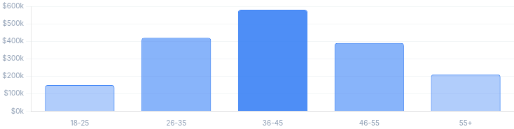




STRATEGIC INSIGHT
Revenue & Customer Segments
Analyzing purchase power across demographics to identify high-value cohorts and growth pockets.
Revenue Contribution by Age Group
USD (Thousands)
Customer Segments
Loyal (High Value)
Customers with 5+ purchases. Highest recurring revenue potential.
Returning
2-4 purchases. Critical target for loyalty conversion.
New
First-time buyers. Focus on onboarding incentives.
Revenue Share by Gender
% Split
EXECUTIVE TAKEAWAY
"The 26-45 age demographic generates the majority of revenue. Marketing spend should prioritize this cohort with 'Returning' segment incentives."
PRIMARY DRIVER
Female 12%
Higher Avg. Transaction Value
SECONDARY DRIVER
Male
Consistent Frequency
Action: Tailor lifecycle messaging
Customer Shopping Behavior Analysis
Page 4

Slide 5

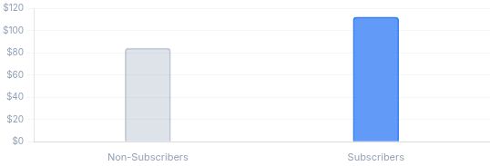

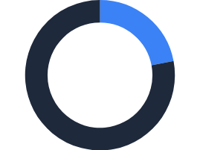
STRATEGIC INSIGHT
Subscription Model Impact
Quantifying the financial leverage of the subscription base and identifying conversion pathways.
Average Spend per Transaction
+28% Lift
REPEAT CORRELATION
CLV IMPACT
Comparing basket value efficiency
3.5x
$450+
Customers with >5 purchases are 3.5x more likely to subscribe.
Projected additional annual value per converted subscriber.
The "Loyalty Gap" Opportunity
Analysis reveals a critical threshold at 5 purchases. Users crossing this mark transition from "transactional" to "relational" behavior. Currently, only 15% of eligible repeat buyers are being targeted.
Revenue Contribution Density
Subscribers not only spend more per order ($112 vs $84) but show significantly lower churn rates, stabilizing monthly revenue predictability.
Subscriber Base
22% of Users
STRATEGIC RECOMMENDATION
Revenue Share
"Implement an automated 'Loyalty Bridge' campaign: Trigger exclusive subscription offers immediately after a customer's 4th purchase to capture high-intent users."
38% of Total Rev
Customer Shopping Behavior Analysis
Page 5

Slide 6



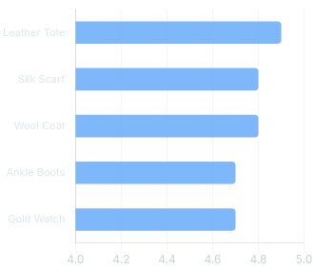
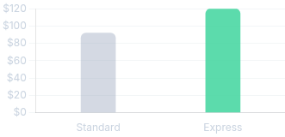


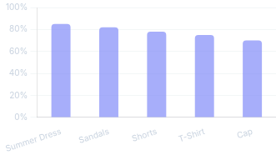


STRATEGIC INSIGHT
Product & Discount Intelligence
Optimizing inventory and pricing strategies by analyzing top performers and discount sensitivity.
Top 5 Rated Products
SEGMENT SPOTLIGHT
Shipping Impact
High-Spending Discount Users
A unique cohort (18% of users) actively seeks discounts but maintains an AOV 22% higher than the average shopper.
Action: Target with bundle offers
Discount Dependency
Insight
Express users spend $28 more per order.
Products with highest % of sales on promo
Category Mix
Category Best Sellers
Footwear
Boots, Sneakers, Sandals
Outerwear
Coat, Jacket, Parka
CLOTHING
ACCESSORIES
Winter Coat, Jeans
Leather Bag, Scarf
Accessories
Belt, Hat, Gloves
Customer Shopping Behavior Analysis
Page 6

Slide 7




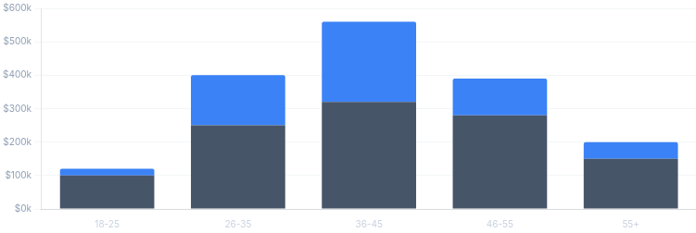



FINANCIAL OVERVIEW
Analyzing revenue quality, margin drivers, and basket economics to optimize the bottom line.
Financial Implications
RECURRING REVENUE
KEY COHORT CONC.
EXPRESS PREMIUM
38%
62%
+$28
Total revenue from subscribers
Revenue from Age 26-45 group
Higher AOV on express orders
Revenue Composition by Cohort
Subscription
One-Time
Margin Risk Analysis
High-Spending Discount Users
$108 AOV
High volume offsets margin % loss
Standard Discount Users
$75 AOV
Margin dilutive without volume
Basket Economics
STANDARD
EXPRESS
Insight: The 26-35 and 36-45 age groups not only drive volume but have the highest subscription penetration density, representing the most stable revenue streams.
$92
$120
Express users buy 1.5x more items per order.
Customer Shopping Behavior Analysis
Page 7

Slide 8




ACTION PLAN
Five prioritized initiatives to drive revenue quality, customer retention, and operational efficiency.
Strategic Recommendations
PRIMARY IMPACT
01
Boost Subscriptions
Recurring Revenue
Promote exclusive benefits (e.g., early access, free express shipping) to convert high-frequency buyers into recurring revenue streams.
PRIMARY IMPACT
02
Customer Loyalty Programs
Retention & CLV
Implement a tiered rewards system targeting "Returning" customers (2-4 purchases) to transition them into the "Loyal" segment.
03
Review Discount Policy
PRIMARY IMPACT
Reduce blanket discounts on low-margin items. Shift strategy to bundle offers to balance sales lift with strict margin control.
Profit Margin
PRIMARY IMPACT
04
Product Positioning
Conversion Rate
Spotlight top-rated items (4.5+ stars) and best-sellers in homepage inventory to reduce friction and boost conversion rates.
05
Targeted Marketing
PRIMARY IMPACT
Focus ad spend on high-revenue age groups (26-45) and Express Shipping users to maximize Return on Ad Spend (ROAS).
Marketing ROI
Customer Shopping Behavior Analysis
Page 8

Slide 9






STRATEGIC EXECUTION
90-Day Implementation Roadmap
A phased approach to operationalize insights, launch pilots, and scale revenue-generating initiatives.
1
2
3
PHASE ONE
PHASE TWO
PHASE THREE
Foundation & Setup
Days 0–30
Launch & Activation
Days 30–60
Scale & Optimize
Days 60–90
Establish baselines and infrastructure.
Execute pilots and market-facing tests.
Refine strategy based on initial data.
Define KPIs: Confirm success metrics (Sub conversion rate, Repeat purchase velocity).
Launch Campaigns: Deploy targeted email/SMS flows to high-value age cohorts.
Evaluate Performance: Review cohort retention and subscription uptake rates.
Build Segments: Tag 'New', 'Returning', and 'Loyal' users in CRM based on SQL logic.
Loyalty Pilots: Activate subscription triggers for 4th-purchase customers.
Scale Winning Plays: Roll out successful loyalty triggers to broader audience.
Finalize Offers: Structure 'Loyalty Bridge' incentives and A/B test groups.
Merchandising: Highlight top-rated items and adjust discount rules for dependent products.
Operationalize: Finalize automated Power BI dashboards for executive monitoring.
KEY DELIVERABLE
KEY DELIVERABLE
KEY DELIVERABLE
Segmented User Database
Live Pilot Campaigns
Automated Dashboard
Customer Shopping Behavior Analysis
Page 9

