Slide 1





PROJECT DOCUMENTATION
December 2025
HR Analytics Dashboard
CONFIDENTIAL
EXECUTIVE BRIEFING
Workforce Intelligence & Attrition Analysis
A comprehensive review of retention levers, value-at-stake, and strategic planning for the next 12 months.
AUDIENCE
SCOPE & SCALE
KEY OUTCOME
CEO, CHRO, CFO
591
14.7%
Align on targets, initiatives, and governance for attrition reduction.
Records
Attrition

Slide 2








HR ANALYTICS DASHBOARD
Business Challenge & Context
EXECUTIVE BRIEFING
Project Objectives
WHY NOW?
Transitioning from reactive management to proactive analytics.
Workforce stability is under pressure.
Human capital is our key differentiator, yet we face increasing complexity in managing retention.
Reduce Attrition
Improve Satisfaction
Identify and mitigate risk factors for specific segments (Age 26-35) before departures occur.
Correlate job satisfaction with retention to address role-specific burnout and engagement issues.
14.7%
CURRENT ATTRITION RATE
High turnover drives direct replacement costs, disrupts productivity, and erodes institutional knowledge.
Strengthen Planning
Enable Decisions
THE PROBLEM
Ensure diverse succession pipelines and balanced demographics for long-term health.
Provide leadership with actionable, data-backed recommendations for policy adjustments.
Reactive Approach: Current management relies on intuition rather than evidence.
Blind Spots: Lack of clarity on who leaves, when, and why.
FROM
TO
Gut-Feel Decisions
Evidence-Based Strategy

Slide 3









HR ANALYTICS DASHBOARD
Key Metrics Snapshot
CURRENT STATE ASSESSMENT
Analysis of 591 employee records reveals critical workforce health indicators. A 14.7% attrition rate signals a need for immediate intervention.
TOTAL EMPLOYEES
ATTRITION COUNT
ATTRITION RATE
591
87
14.7%
Baseline workforce sample size
Total departures in period
Critical metric requiring review
AVG TENURE
AVG AGE
AVG SALARY
7 Yrs
37.3 Yrs
6.68K
Proxy for organizational stability
Mean compensation benchmark
Reflects a mature workforce
Note: Gender distribution totals in dashboard filters may exceed sample size shown here; pending validation for enterprise-wide rollout.

Slide 4

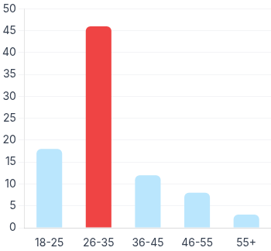
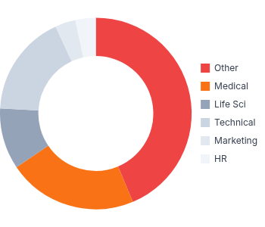
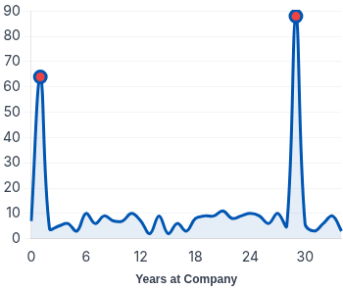
HR ANALYTICS DASHBOARD
Critical Insights: Attrition Patterns
DEEP DIVE ANALYSIS
Segmentation analysis identifies distinct high-risk cohorts. The 26-35 age group and employees with "Other" educational backgrounds are primary drivers of turnover.
BY AGE GROUP
Highest Risk
BY EDUCATION
Skill Misalignment?
BY TENURE (YEARS)
Critical Milestones
Observation
Observation
"Other" (38) and "Medical" (19) fields account for 65% of departures, suggesting potential role misalignment.
Observation
46 employees (53% of attrition) left from the 26-35 bracket, indicating volatility in early-mid career stages.
Distinct spikes at Year 1 (early churn) and Year 29 (retirement) reveal bimodal risk.

Slide 5


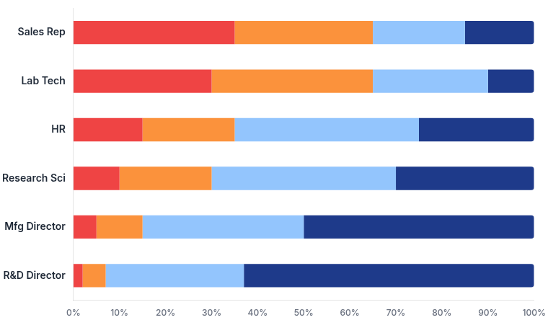


HR ANALYTICS DASHBOARD
Job Satisfaction by Role
SIGNALS & HOTSPOTS
Analysis reveals a polarization of sentiment. While leadership roles report high engagement, Sales Representatives and Lab Technicians show alarming dissatisfaction rates.
Critical Hotspots
Sales Reps and Lab Technicians display the highest concentration of "1" and "2" ratings.
Low (1)
Med-Low (2)
Med-High (3)
High (4)
Sales: Likely driven by commission structure volatility.
Lab Techs: Potential issues with repetitive workload.
Immediate Actions
1
Deep-Dive Pulse Survey
Deploy specific questionnaires to Sales & Lab teams to isolate root causes.
2
Manager Enablement
Equip frontline managers with retention toolkits and intervention budgets.

Slide 6



HR ANALYTICS DASHBOARD
Strategic Recommendations & ROI
ACTION PLAN
5 Priority Initiatives
Execution: Q1-Q2
Value at Stake
1
Targeted "Stay Interviews" (Age 26-35)
Deploy proactive retention discussions for the highest risk group (46 exits). Identify individual career aspirations before resignation letters land.
ANNUAL SAVINGS PROJECTION
Career Architecture for "Other" & Medical
Target Attrition Reduction
Retained Talent
2
14.7%
12.0%
~16 Emp.
Address the 65% attrition share in these fields by creating clear internal mobility maps and skill utilization reviews.
Avg. Replacement Cost
$40.1k
3
Onboarding & Early Career Support
(0.5x Annual Salary of $80.2k)
Counter the Year 1 attrition spike with a structured 12-month onboarding program, including mentorship and 90-day check-ins.
Total Estimated Savings
$0.64M
4
Role-Specific Engagement (Sales/Lab)
Address low satisfaction scores through comp structure review for Sales and workload balancing for Lab Technicians.
+ Productivity Gains & Morale
5
Succession Planning (Senior Tenure)
Mitigate knowledge loss from the Year 29 spike by formalizing knowledge transfer processes and identifying successors.
*Assumptions: Replacement cost includes recruitment, training, and ramp-up time.

Slide 7



HR ANALYTICS DASHBOARD
Implementation Roadmap
0-90 DAYS & BEYOND
A phased approach to transition from insights to action, prioritizing immediate retention risks while building long-term institutional capabilities.
1
2
3
PHASE 1
PHASE 2
PHASE 3
LONG TERM
0–30 Days
31–60 Days
61–90 Days
Q2 – Q4
Mobilize & Diagnose
Pilot Interventions
Scale & Optimize
Sustain & Embed
Validate Data: Confirm "Year 29" anomaly & KPI definitions.
Internal Mobility: Pilot pathways for "Medical" & "Other" backgrounds.
Scale Pilots: Expand mobility programs to all depts.
Enterprise Rollout: Full adoption of data-driven retention policies.
Launch Stay Interviews: Target Age 26-35 cohort immediately.
Succession Planning: Map successors for senior tenure exits.
Quick Wins: Adjust comp/workload for critical hotspots.
Governance: Quarterly HR analytics reviews with C-Suite.
Pulse Survey Design: Create targeted pulses for Sales & Lab Techs.
Knowledge Transfer: Formalize handover protocols.
Integration: Link attrition models to annual workforce planning.
Onboarding Fix: Standardize 90-day check-in process.
Timeline assumes immediate approval of pilot resources.
Critical Path
Operational
Scaling

Slide 8









HR ANALYTICS DASHBOARD
Targets, Governance & Decisions
THE PATH FORWARD
Proposed 12-Month Targets (OKRs)
FY 2026 Goals
Decisions Required
Immediate approval needed to launch Phase 1 initiatives.
ORGANIZATION ATTRITION
EARLY TENURE CHURN
≤12.0%
-25%
14.7%
Year 1 Exits
Primary KPI. Reduction stabilizes core workforce.
Driven by new onboarding & mentorship programs.
Approve Target Ranges
Formalize the 12% attrition goal and associated departmental sub-targets.
ROLE SATISFACTION
SUCCESSION READINESS
Endorse Pilot Resources
+15%
+20%
Sales & Lab
Allocate budget for "Stay Interview" training and internal mobility platform pilot.
Critical Roles
Improvement in engagement scores (1-4 scale).
Coverage for Year 29+ retirement wave.
GOVERNANCE FRAMEWORK
Monthly Review
Quarterly Deep Dive
CHRO
CFO
VPs
STATUS
PENDING APPROVAL
Audience: CEO, CHRO
Audience: Function Leads
Program
ROI/Value
Execution

